Slide 1
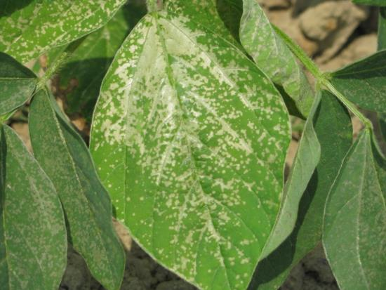

Trouble Shooting Tips and Common Field Problems
Eric P. Prostko, Ph.D.
Professor and Extension Weed Specialist
Department of Crop & Soil Sciences

Slide 2
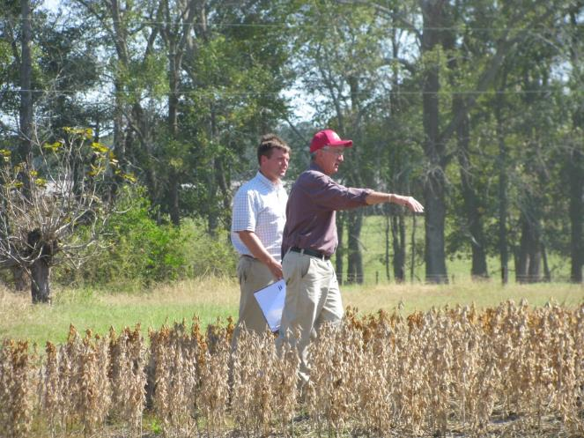
My Approach
Obvious or not?
Patterns
Crop history
Things you can easily prove or rule out
pH
fertility
nematodes

Slide 3
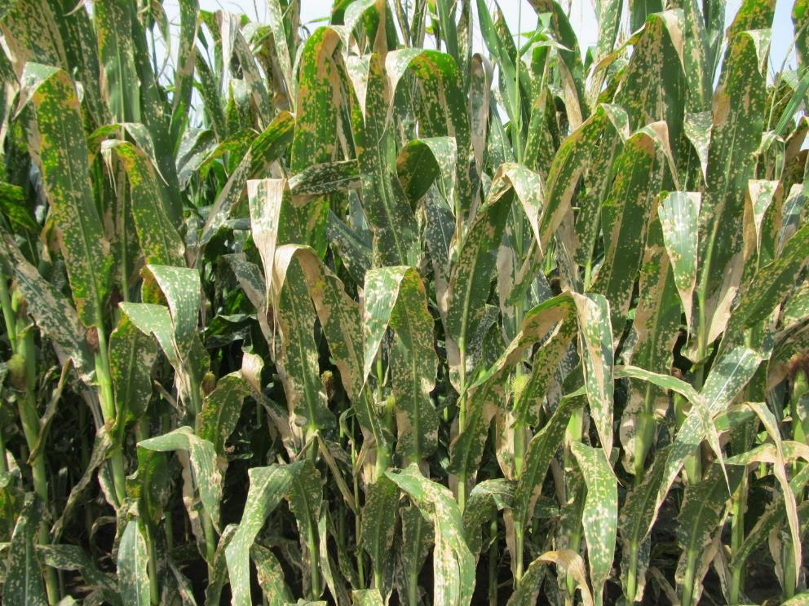
This is obvious (paraquat drift)!

Slide 4
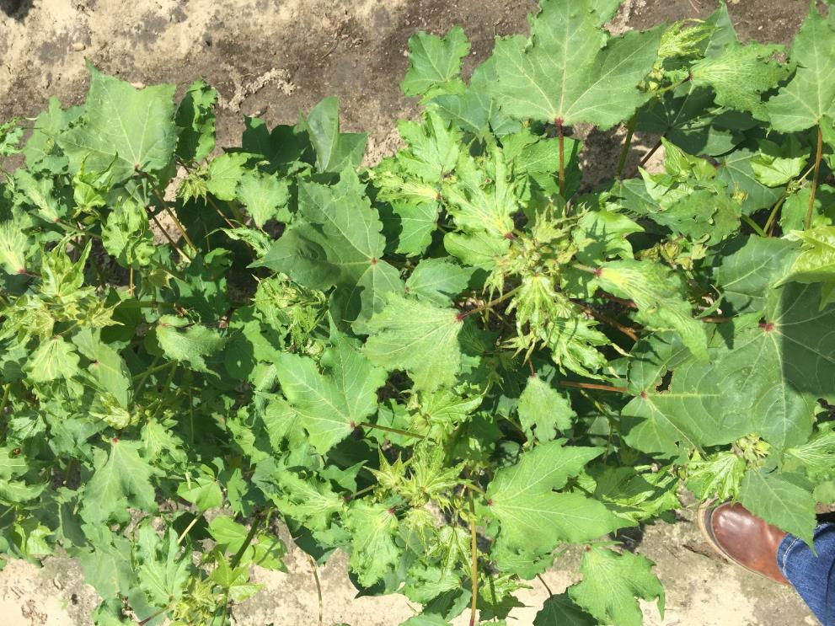
This is obvious (auxin injury)!

Slide 5
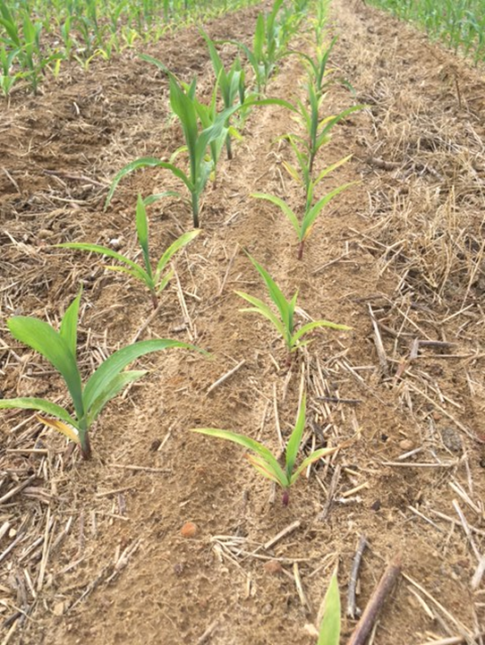
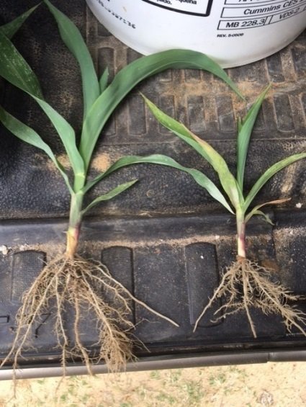
This is not obvious! (stubby root nematode)

Slide 6
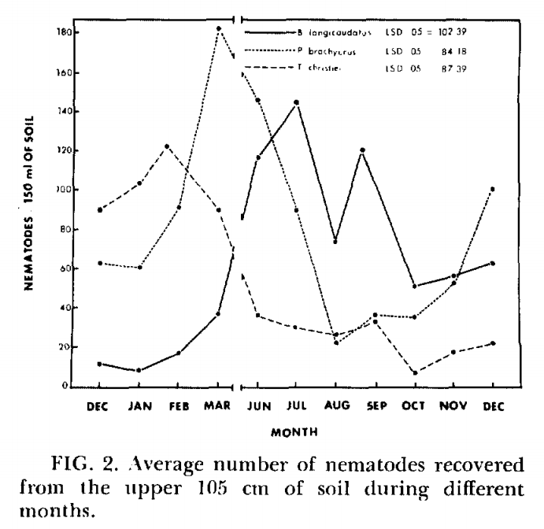
Nematode Distribution in Georgia
Sting - July Lesion - March
Stubby - February
Source: B.B. Brodie. 1976. Journal of Nematology 8:243-247.

Slide 7
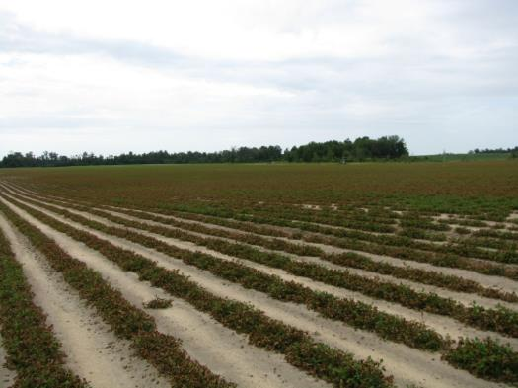
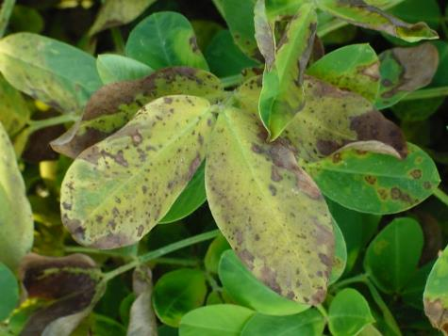
Why pick on herbicides?
Herbicides applied on all crops
Companies have money
Could not be anything I did or didn’t do!
I grid sampled and results were fine!

Slide 8
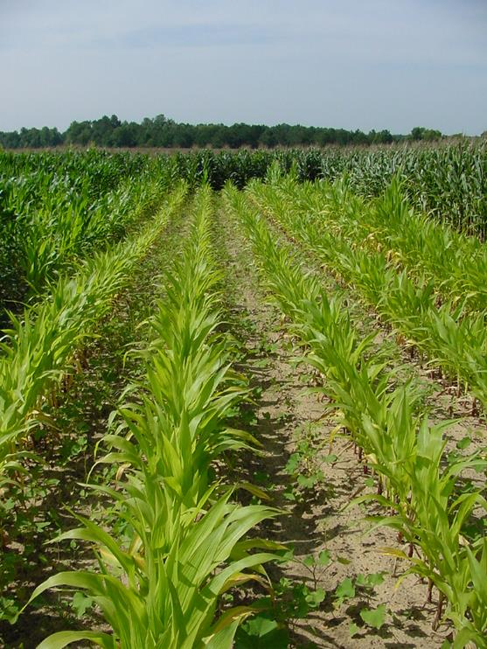
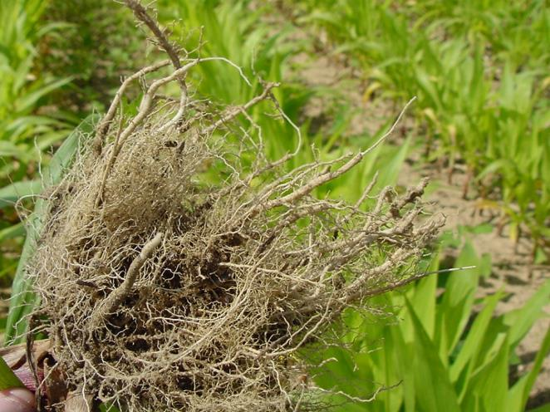
Herbicide Injury???

Slide 9
Herbicide Injury or Nematodes???
796-Rootknot nematodes/sample
50+ is a problem

Slide 10
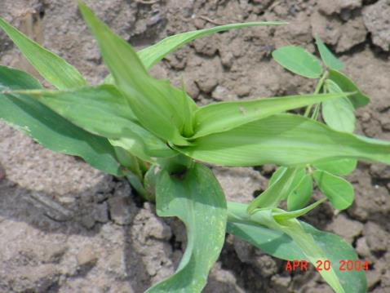
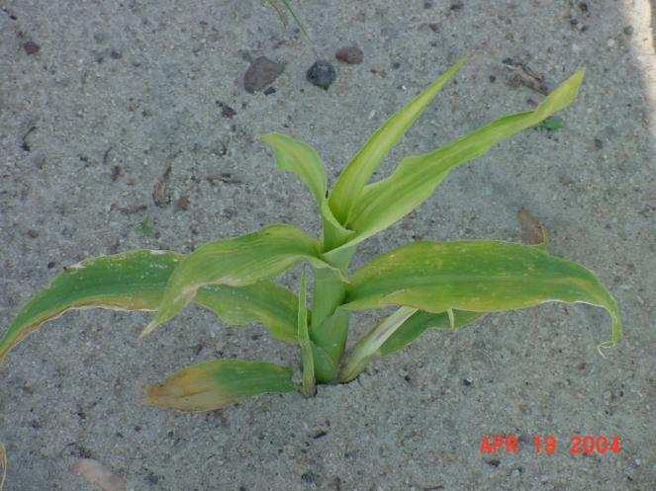
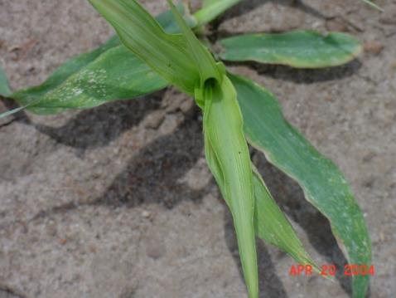
Herbicide Injury??

Slide 11
Herbicide Injury or Fertilizer Injury?
Phosphite Fertilizer

Slide 12
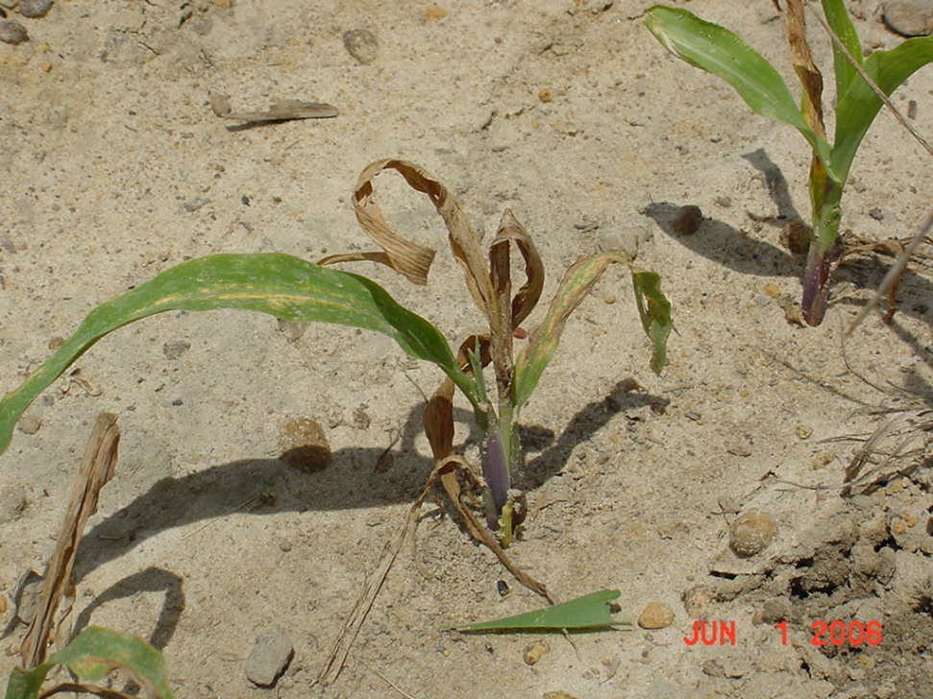
Roundup Drift?

Slide 13

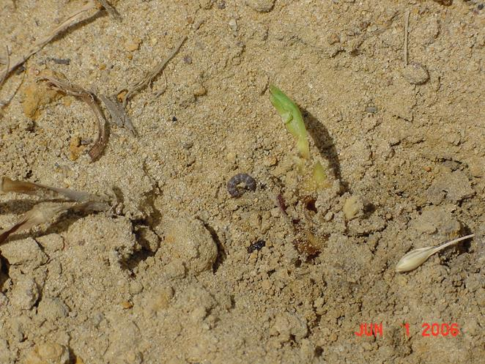
Roundup Drift or LCB??

Slide 14
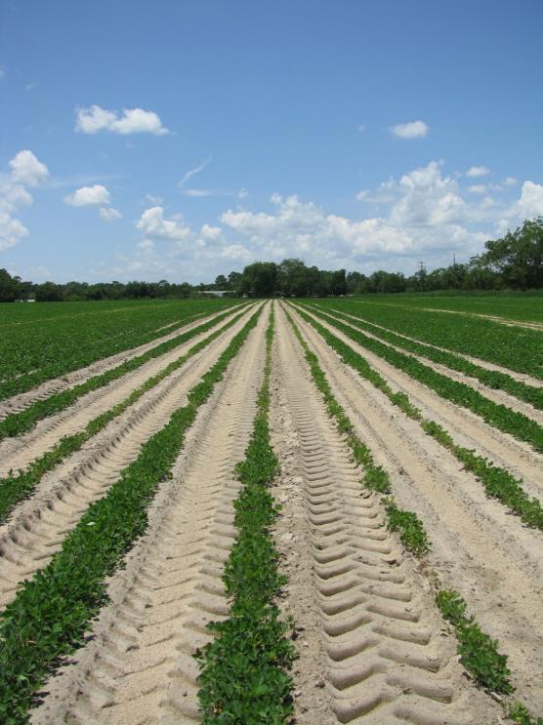
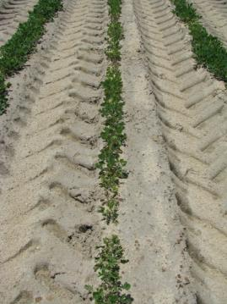
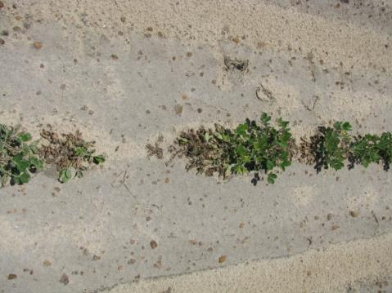
Valor Injury?

Slide 15
Valor Injury or Soil pH/Zn?
July 2007
pH = 5.04
Zn = 14-17 lbs/a

Slide 16
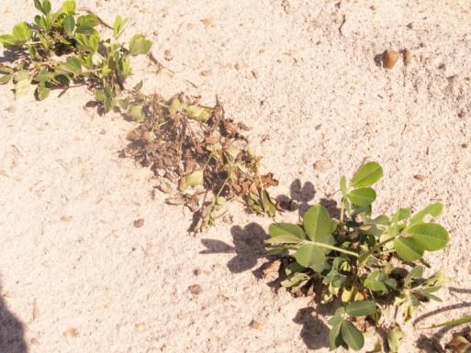
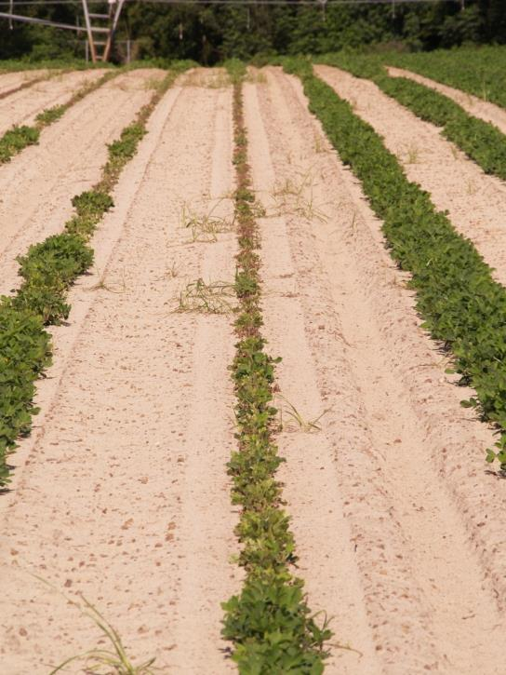
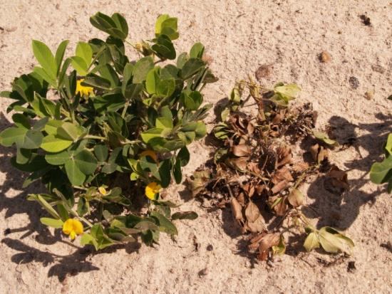
Valor Injury?

Slide 17


Herbicide Injury or Soil pH/Zn?
June 2010
pH = 4.8
Zn = 14 lbs/A

Slide 18
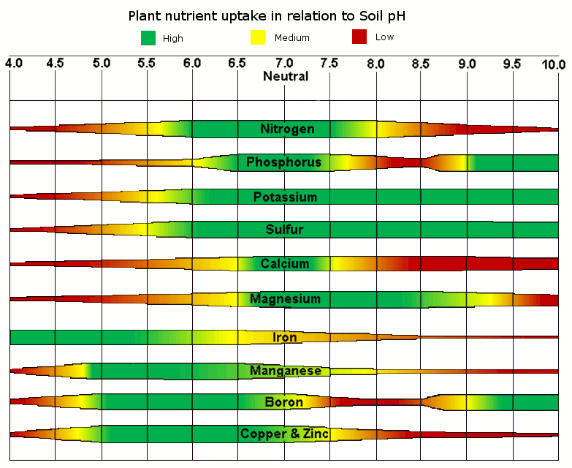
Soil pH is the key!

Slide 19
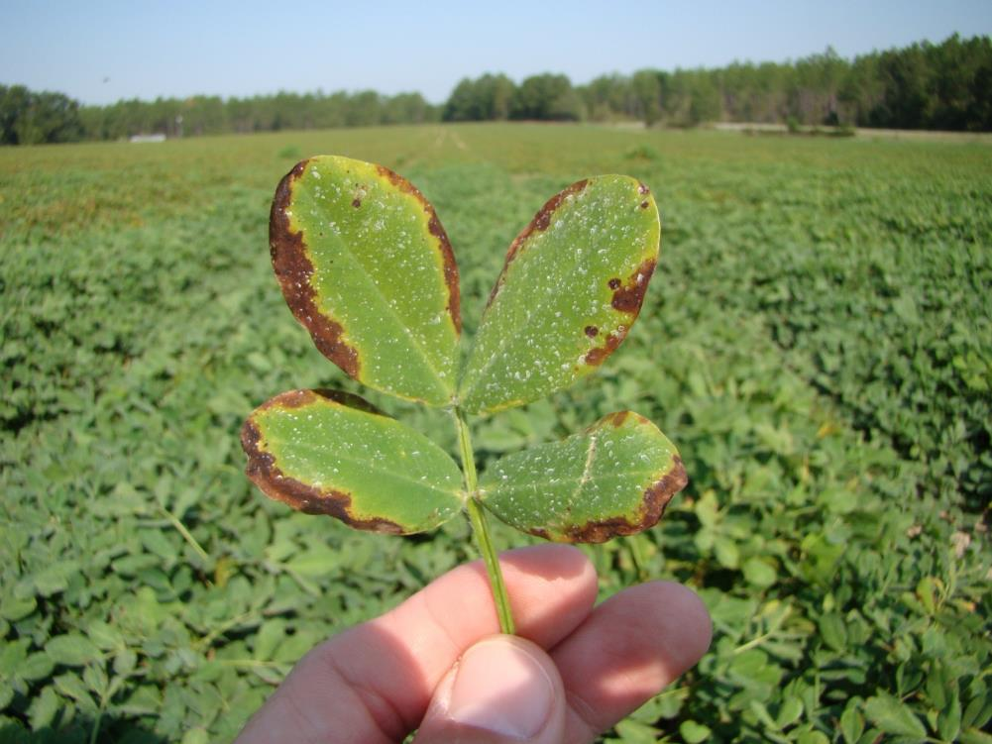
Herbicide Injury?

Slide 20
Herbicide Injury or Soil Fertility
Old Pasture, no fertilizer was applied, medium soil test K (40 lbs/A)
but K deficient (was 0.34% should be 1.7-3.0%) leaf sample

Slide 21
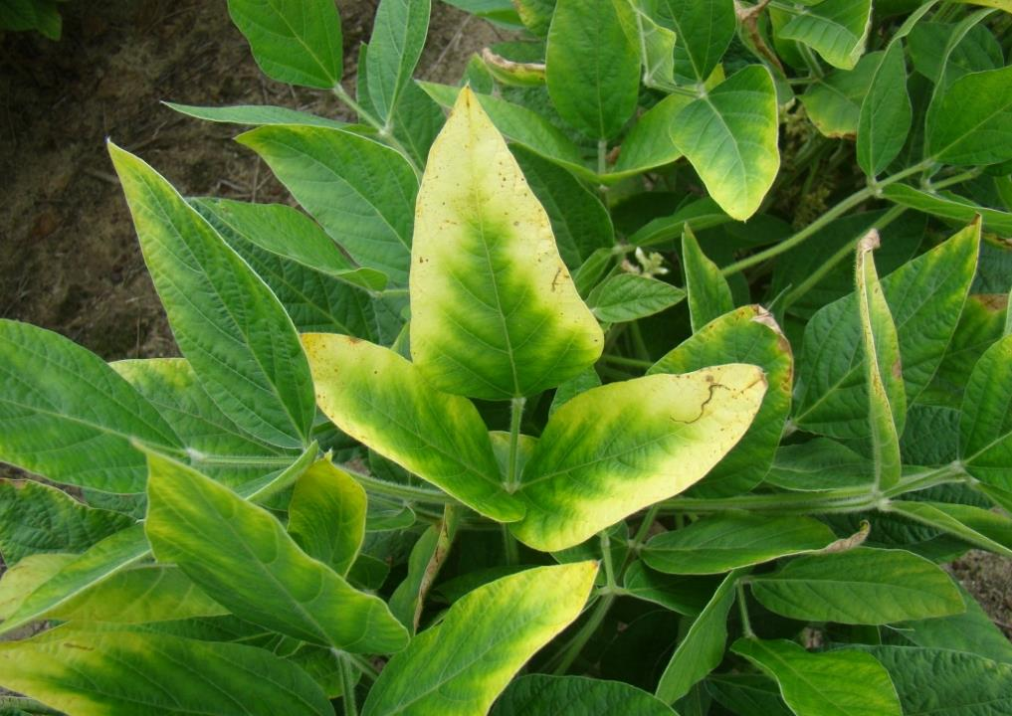
Herbicide Drift?

Slide 22
Herbicide Drift or Potassium?
Soybeans are a BIG user of potash (1.14 lbs K₂0 removed/bushel)

Slide 23
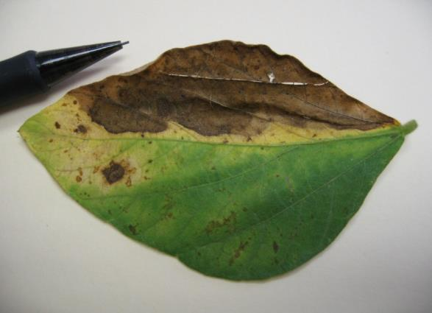
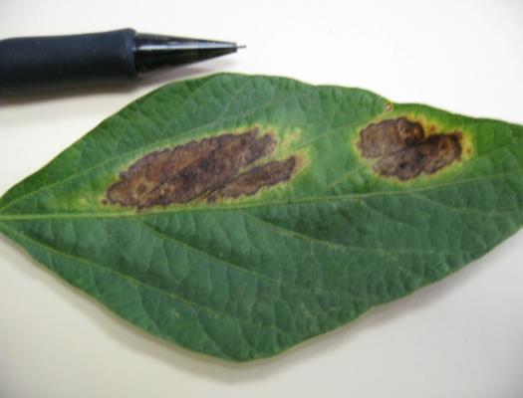
Herbicide Injury??
Johnson County
August 2010

Slide 24
Herbicide Injury or Disease?
Anthracnose
Johnson County
August 2010

Slide 25
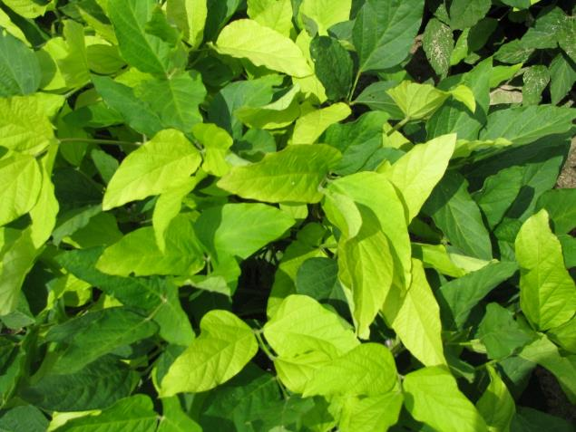
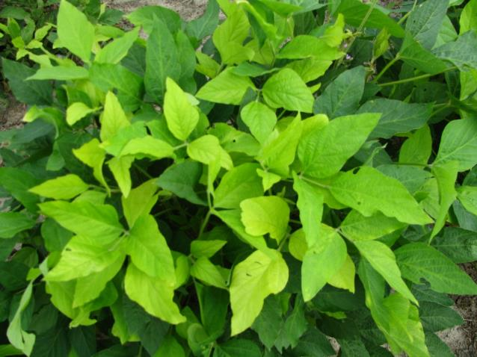
Herbicide Injury?

Slide 26
Herbicide Injury or Nutritional? Yellow Flash
Soil Analysis
pH = 6.6
Mg = 138 lbs/A (high)
Mn = 18 lbs/A (S)
Zn = 4 lbs/A (S)
Plant Analysis
N = 4.94% (4.25-5.00)
Mg = 0.44% (0.25-0.80)
Mn = 54 ppm (15-200)
S = 0.25% (0.20-0.60)

Slide 27
Likely Cause of Glyphosate Yellow Flash
Degradation of glyphosate to AMPA
AMPA reduces chlorophyll content in soybean
AMPA = aminomethylphosphonic Acid

Slide 28
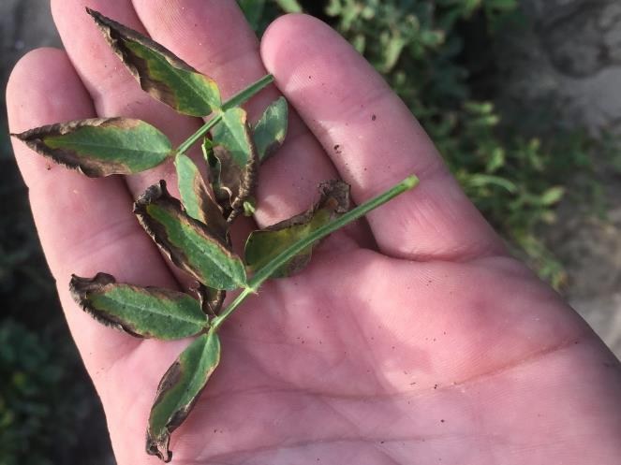
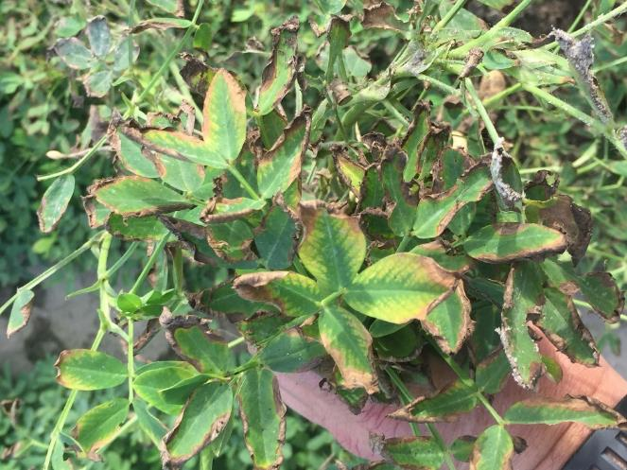
Herbicide Injury?

Slide 29
Herbicide or Nutritional? Boron Toxicity (2019)
350 ppm B in leaf tissue (20-60 ppm = sufficient; 100+ ppm = toxic)

Slide 30
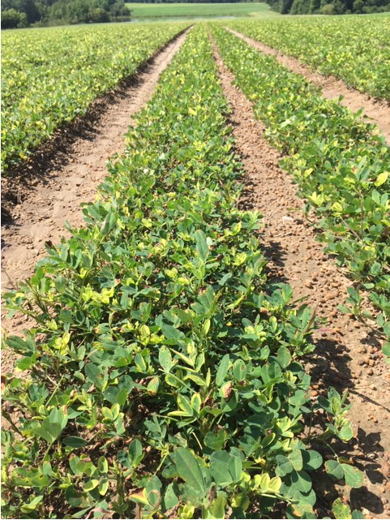
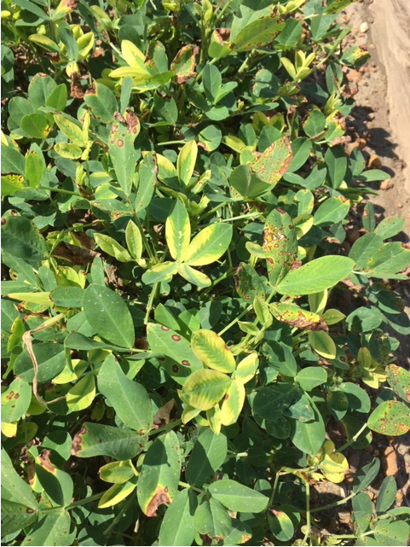
Glyphosate Mishaps Again in 2019
June 28
BS

Slide 31
Peanut Yield Loss Caused By Glyphosate Applied 75-105 DAP in Georgia.
Yield Loss (%)
2
Glyphosate Rate (5.5 lb ai/gal) – oz/A

Slide 32
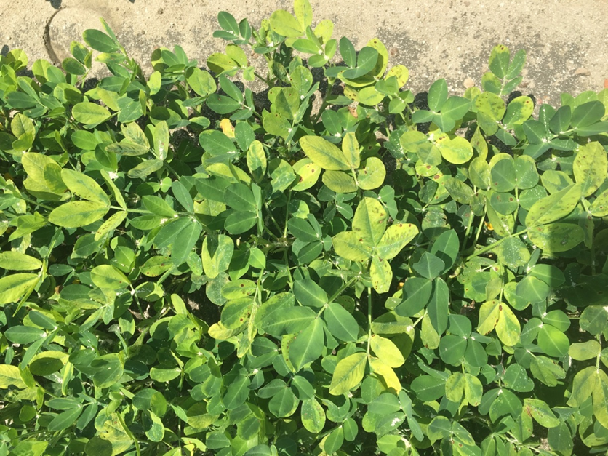
Is this glyphosate? No, it’s diuron!
Planting Date: April 20
Sprayed: June 7
Picture: June 20
Tift Co. 2018
5900+ lbs/A

Slide 33
Peanut (GA-06G) Yield Loss (%) From Diuron 4L
LSD (0.10) = 9
PE-02-19
Time of Application (DAP)

Slide 34
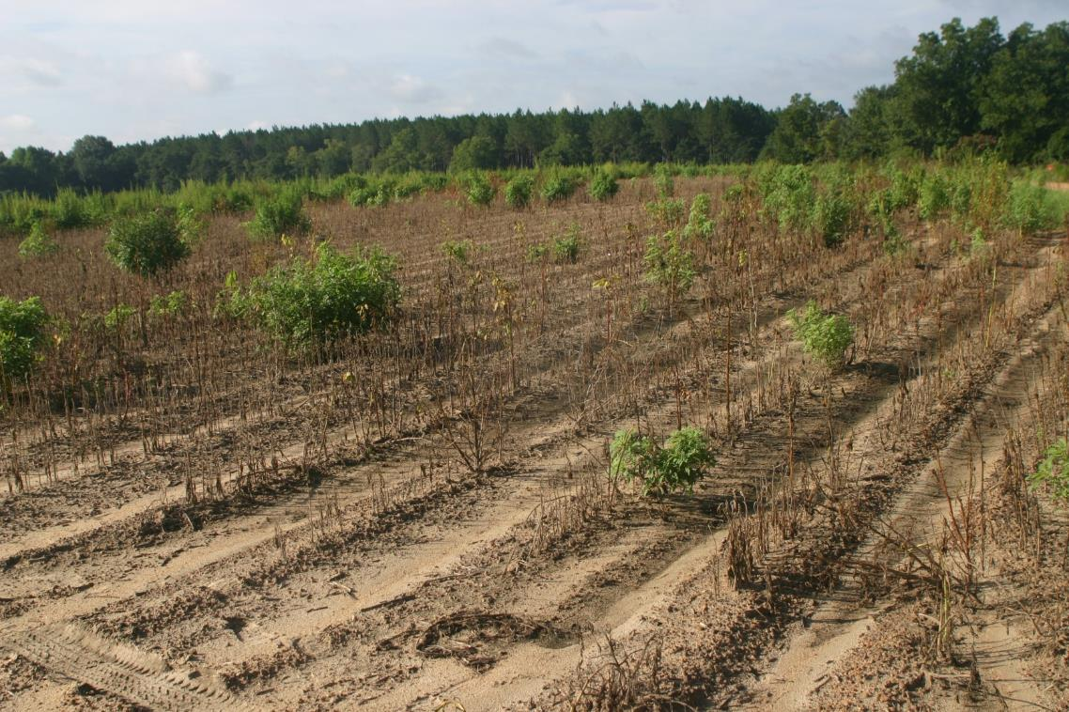
Sometimes you strike out!
Candler County, 2010

Slide 35
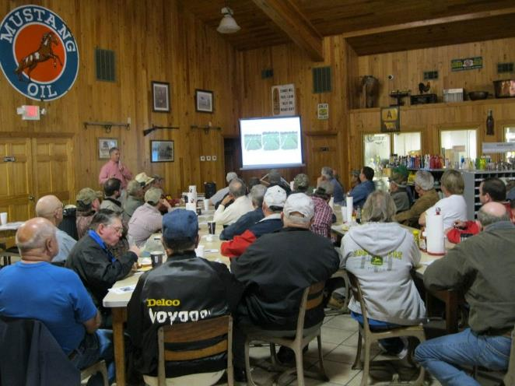
Before You Call or Send Pictures
At the very least …
Last year’s crop
Last year’s pesticides
This year’s crop and variety
This year’s pesticides applied
Last pesticide in sprayer
Your awesome if you have…
Soil Test Results
Nematode Results

Slide 36

A good approach to field problems?
“Eliminate the impossible. Whatever remains, however improbable, must be the truth.”
Sherlock Holmes (i.e. Sir Arthur Conan Doyle)
“The Sign of the Four”

Slide 37
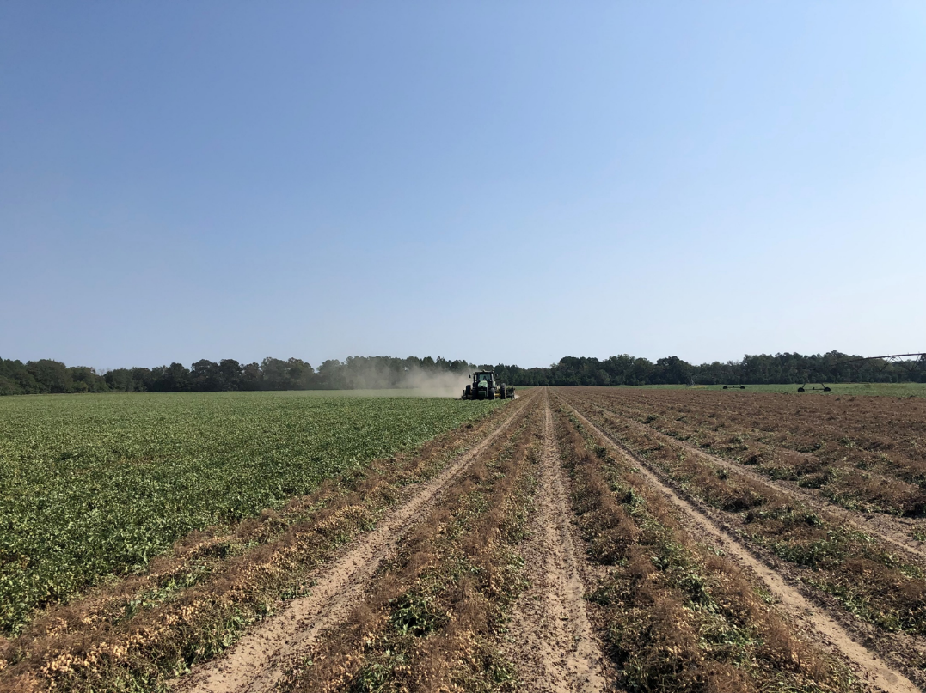

Questions?
www.gaweed.com

