Slide 1
Weed Control in Field Corn 2020
Eric P. Prostko, Ph.D.
Professor/Extension Weed Specialist
Dept. Crop & Soil Sciences

Slide 2
Field Corn Yield Loss (%) Caused by Uncontrolled Weeds in UGA Weed Science Research Trials (2007-2019). Treated vs. Non-treated
200 Bu/A X 0.34 X $4.10 = $279/A

Slide 3
Field Corn Weed Contrl Questions for you?
What technologies are you planting?
RR, LL, Conventional, Enlist (2,4-D)?
Have you used Counter INFR?
Is atrazine still working for you?
What will be planted after the field corn?

Slide 4
Pigweed Should Not Be a Problem!!!!
moisture activated residual?
atrazine resistance
timing/coverage
weeds too big
corn too big
environmental
hot and dry #1 enemy POST’s

Slide 5
A general plan of attack?
MUST START CLEAN!
Use 1 qt/A of Atrazine 4L PRE (or Dual II Magnum, or Warrant, or Outlook)
Follow up with a timely POST program that includes an additional 1.5 qt/A of Atrazine 4L
Lots of options depending upon how you answered previous questions?

Slide 6
Starting Clean
If you are getting ready to plant and get to the field and have pigweed > 6” tall …………
Park the sprayer
Go get your mower, disk, and/or bottom plow

Slide 7
To PRE or Not to PRE?

Slide 8
Anthem Maxx, Dual, Outlook, Warrant, Zidua????

Slide 9
Field Corn Weed Control – 2019 Roundup + Atrazine + Prowl H₂0 (~$18/A)
NTC
Roundup PowerMax @ 32 oz/A
Atrazine @ 64 oz/A
Prowl H₂0 @ 32 oz/A
Applied 23 DAP (V5/8” tall)
CN-07-19
May 13
19 DAT

Slide 10
Field Corn Weed Control – 2019 Roundup + Laudis + Atrazine (~$18/A)
NTC
Roundup PowerMax @ 32 oz/A
Laudis @ 3 oz/A
Atrazine @ 64 oz/A
Applied 23 DAP (V5/8” tall)
CN-07-19
May 13
19 DAT

Slide 11
Field Corn Weed Control – 2019 Halex GT + Atrazine + NIS (~$24/A)
NTC
Halex GT @ 58 oz/A
Atrazine @ 64 oz/A
NIS @ 0.25% v/v
Applied 23 DAP (V5/8” tall)
CN-07-19
May 13
19 DAT

Slide 12
Halex GT + Atrazine + NIS + Fungicides (Trivapro, Headline AMP, Stratego YLD)
CN-07-19
DKC6208
May 3
9 DAT

Slide 13
Field Corn Weed Control – 2019 Liberty + Atrazine (~$18/A)
NTC
Liberty @ 32 oz/A
Atrazine @ 64 oz/A
Applied 22 DAP (V4/8” tall)
CN-04-19
May 13
19 DAT

Slide 14
Field Corn Weed Control – 2019 Roundup + Impact Z (~$14/A)
NTC
Roundup PowerMax @ 32 oz/A
Impact Z @ 8 oz/A
Applied 22 DAP (V4/8” tall)
CN-04-19
May 13
19 DAT

Slide 15
Field Corn Weed Control – 2019 Roundup + Engenia + Prowl H₂0 (~$18/A)
NTC
Roundup W-Max @ 32 oz/A
Engenia @ 6.4 oz/A
Prowl H₂O @ 32 oz/A
Applied 21 DAP (V4/7” tall)
CN-08-19
May 10
18 DAT

Slide 16
Roundup W-Max @ 32 oz/A + Engenia @ 6.4 oz/A + Prowl H₂0 @ 32 oz/A (Applied 9 DAP, V1/2” tall field corn)
CN-08-19
April 16
6 DAT

Slide 17
Roundup W-Max @ 32 oz/A + Engenia @ 6.4 oz/A + Prowl H₂0 @ 32 oz/A (Applied 21 DAP, V4/7” tall field corn)
CN-08-19
April 24
2 DAT

Slide 18
Field Corn Weed Control – 2019 Roundup + Status + Prowl H₂0 (~$31/A)
NTC
Roundup W-Max @ 32 oz/A
Status @ 5.0 oz/A
Prowl H₂O @ 32 oz/A
Applied 21 DAP (V4/7” tall)
CN-08-19
May 10
18 DAT

Slide 19
Field Corn Injury – Status (dicamba)
CN-04-16
Agrigold 6659
7 DAT (April 25, 2016)
Roundup P-Max @ 32 oz/A + Status @ 5 oz/A
Applied 27 DAP
V4-V5; 7” tall
No yield effect

Slide 20
Field Corn Yield (DKC-6208) As Influenced By Herbicide Treatment
LSD (0.10) = 13.2
CV = 7.3
Bu/A
CN-08-19, Averaged over 3 timings (V1, V4, and V6), WEEDY

Slide 21
Field Corn Weed Control – 2019 Atrazine (PRE) fb Roundup + Acuron (POST) ($31/A)
NTC
Atrazine @ 32 oz/A (PRE)
fb
Roundup W-Max @ 32 oz/A
Acuron @ 48 oz/A
Applied 28 DAP (V6/12” tall)
CN-09-19
May 10
10 days after POST

Slide 22
Public Enemy #1 in Field Corn

Slide 23
Lay-By Rig for Morningglory
Ponder Farm
May 9, 2019

Slide 24
Roundup Powermax II @ 32 oz/A + Evik 80DF @ 2 lbs/A – 36 DAT (June 15, 2018)
NTC
7 row middles
Treated
NTC
16 GPA
30 PSI
3.7 MPH
V7-V8
24” tall
FloodJet
TK-VS2
NTC
TREATED

Slide 25
Terrell Co. Lay-By - 2019 Roundup + Tricor
**No difference in weed counts (#/250’) on July 15 (67 DAT)
CN-11-19
May 9

Slide 26
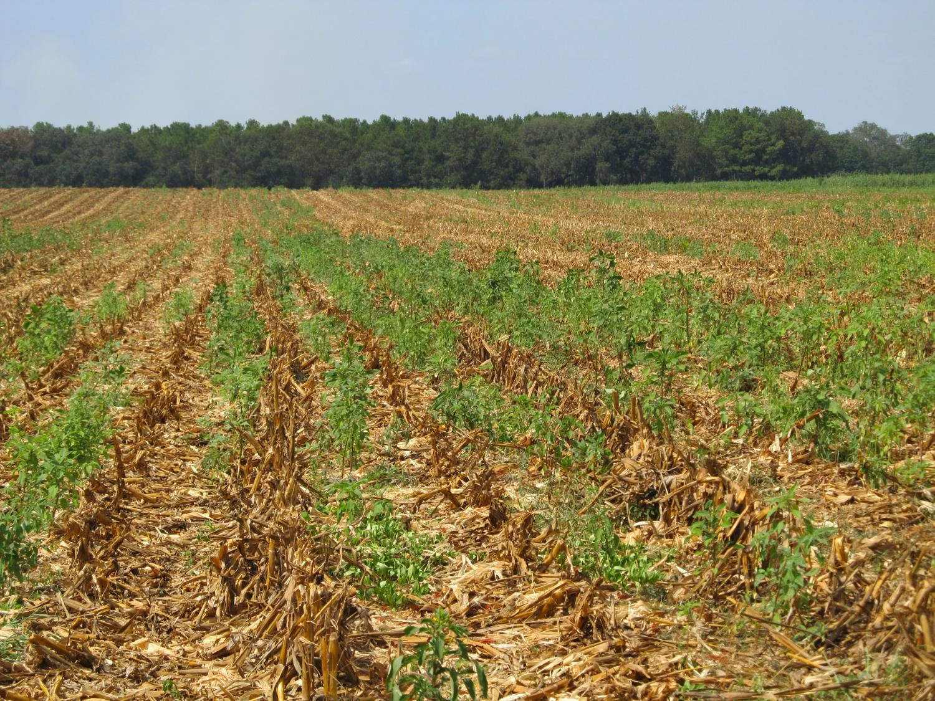
Post-Harvest Palmer Amaranth Populations Must be Managed!

Slide 27
Palmer Amaranth Burndown - 2019 (AMAPA 1-6” tall)
NTC
Gramoxone 3SL @ 32 oz/A
Tricor 4L @ 8 oz/A
Induce @ 0.25% v/v
NC-01-19
May 30
10 DAT

Slide 28
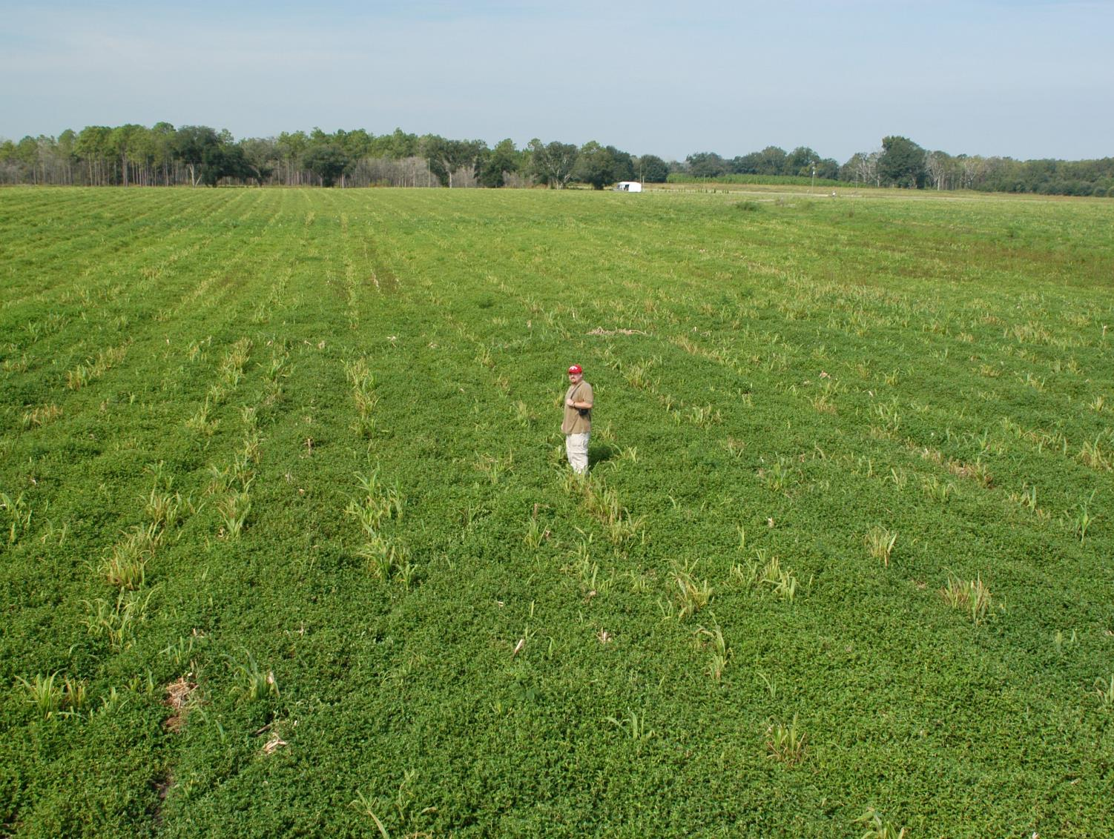
Tropical Spiderwort/Benghal Dayflower (TSW/BD) After Corn Harvest
(need tillage and/or 2 apps of Gramoxone or 2,4-D or Aim)

Slide 29
Post-Harvest Control of TSW/BD with 2 Applications (14 d apart) of Gramoxone (paraquat)
1 week after POST2

Slide 30
Questions/Comments?

