Slide 1
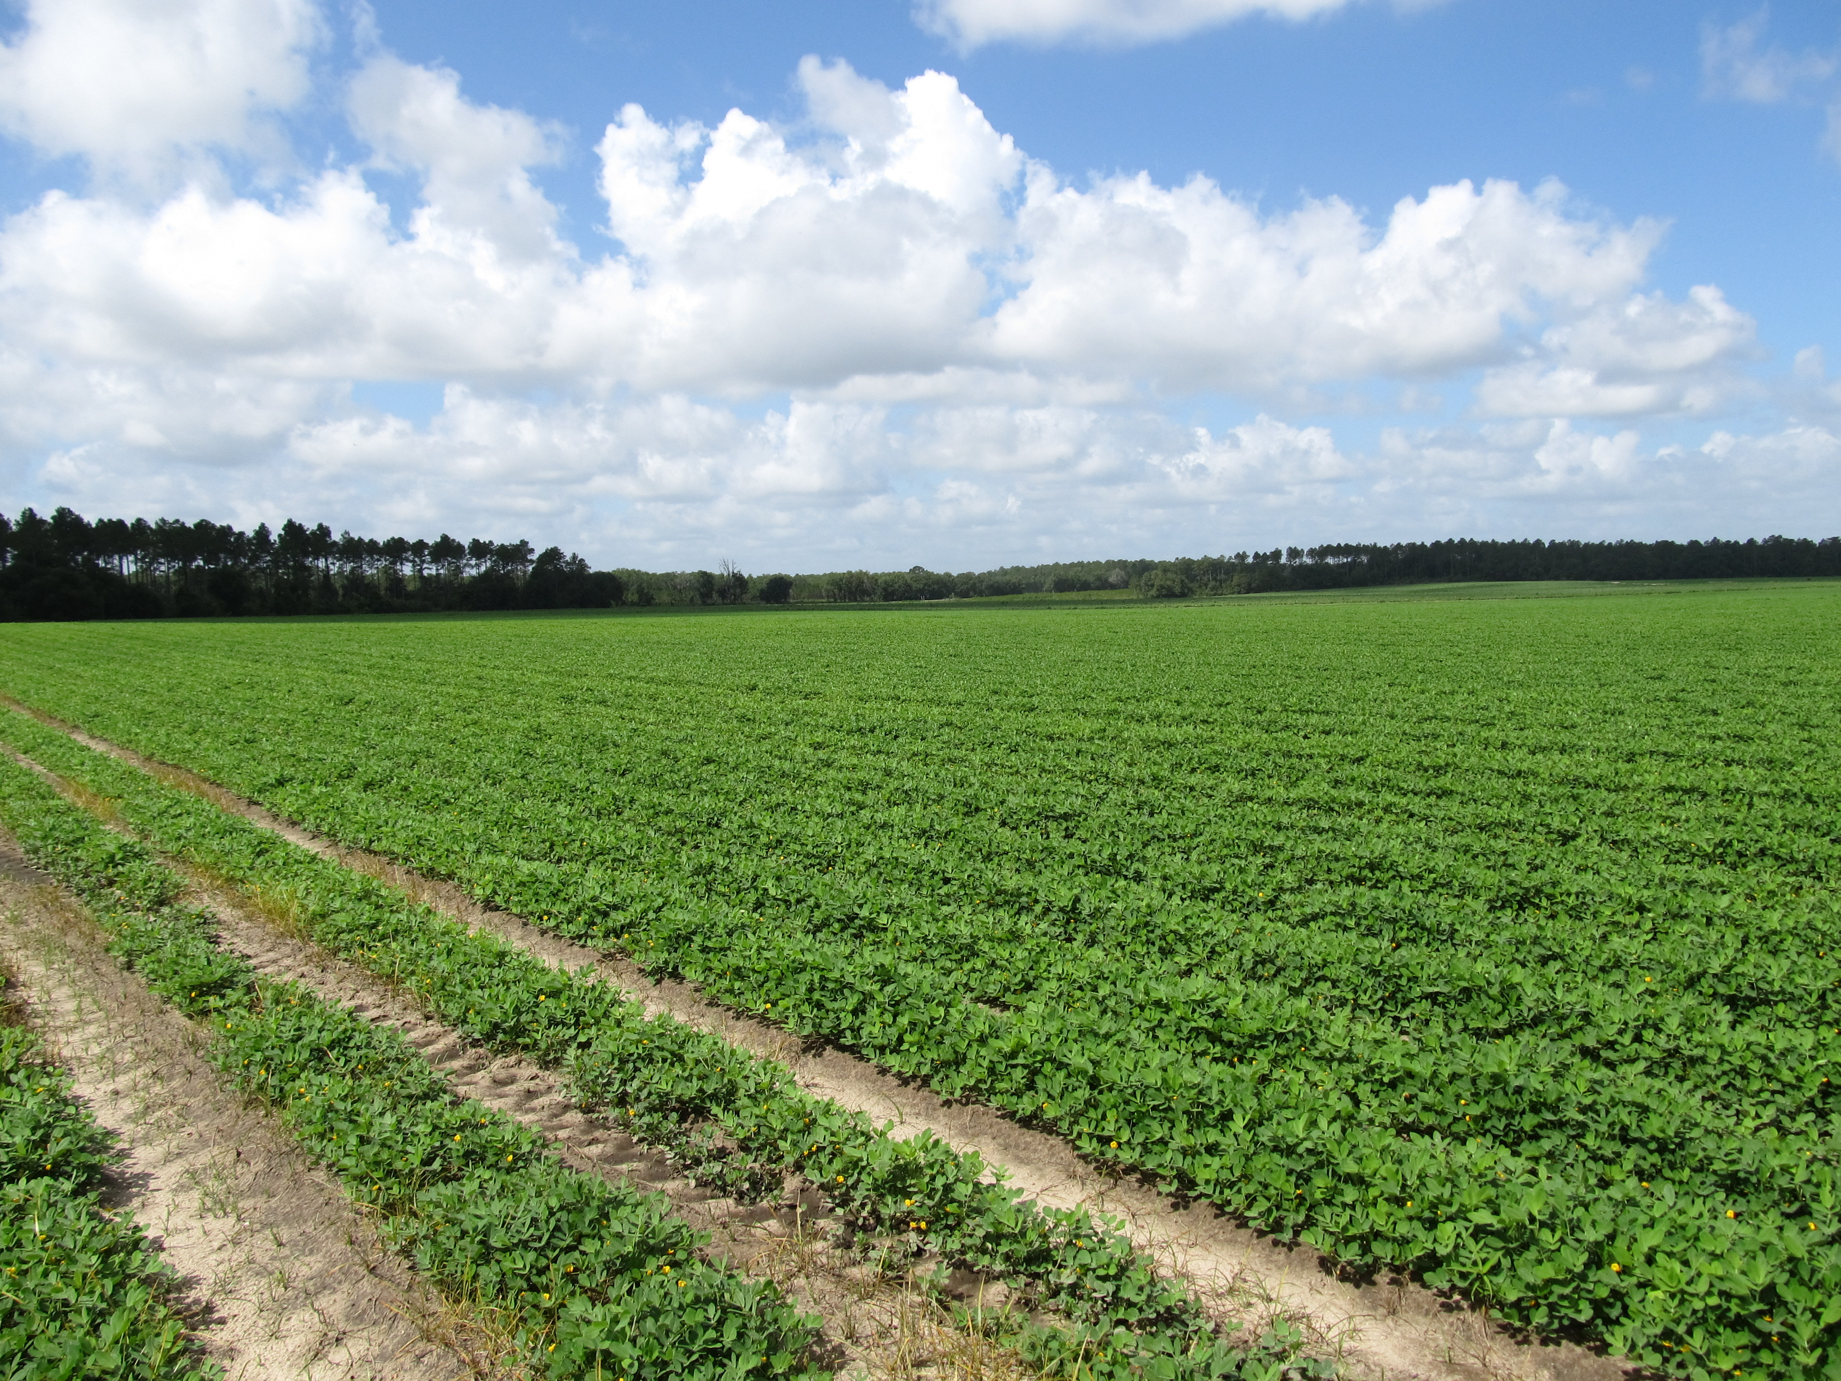

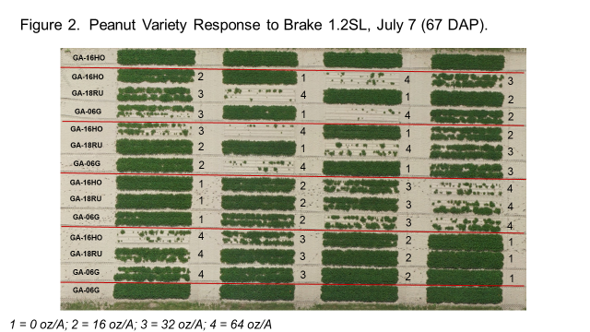
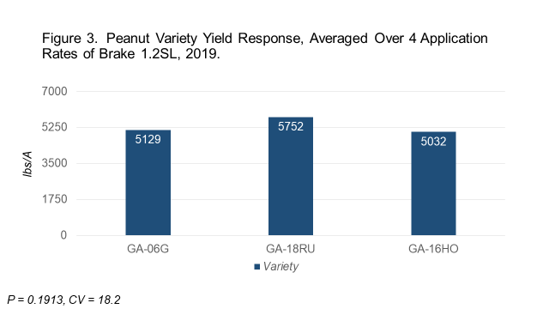
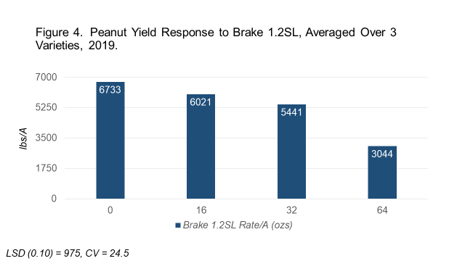
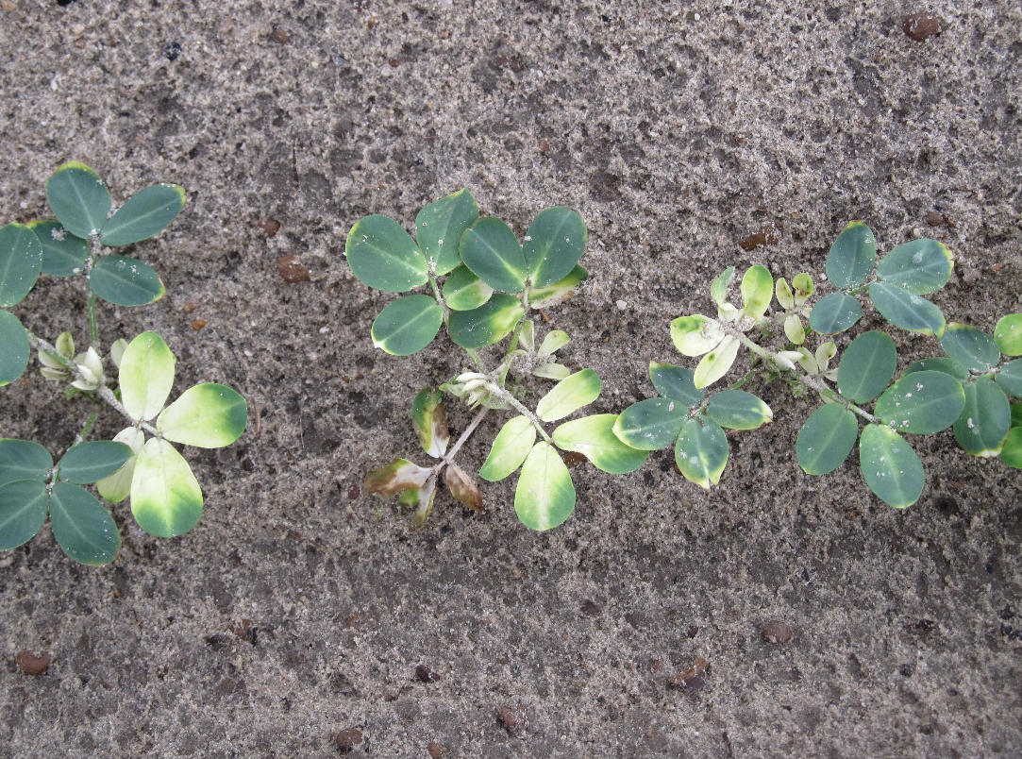
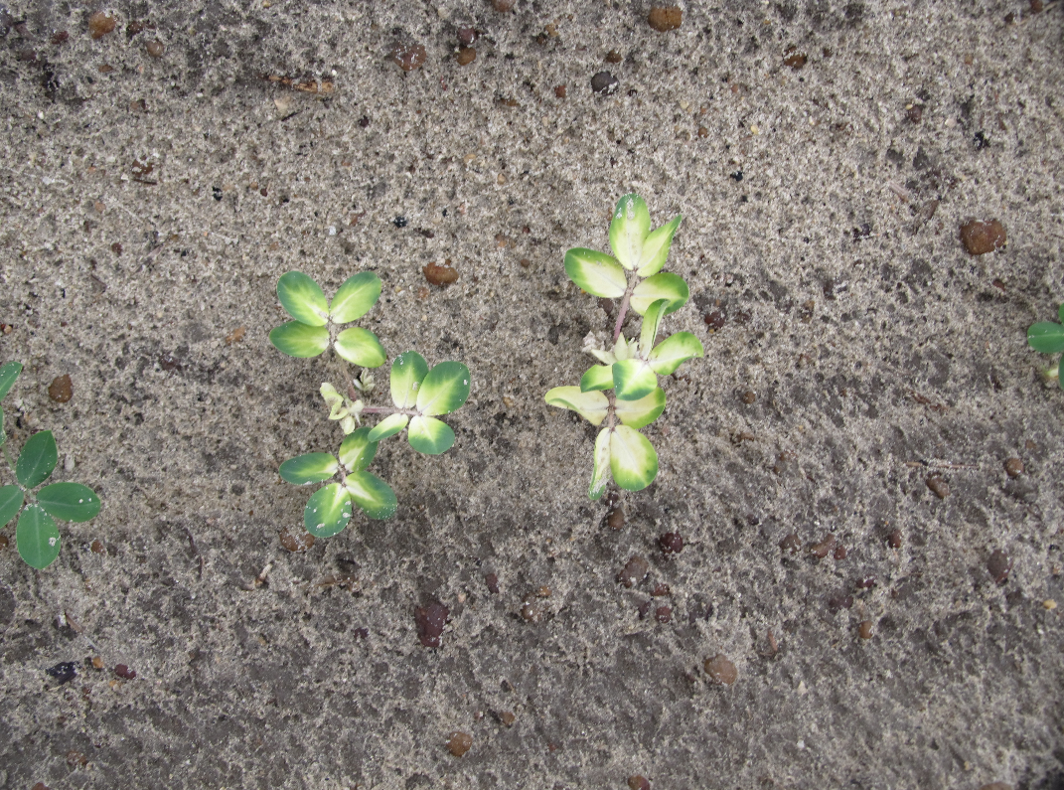
PEANUT VARIETY RESPONSE TO BRAKE®
Eric P. Prostko
Dept. Crop & Soil Sciences
The University of Georgia
INTRODUCTION
Brake® (fluridone), manufactured by SePRO Corporation, is an herbicide under evaluation for potential preemergence (PRE) use in peanut. It was recently registered for PRE use in cotton and is sold in the aquatic weed control market as Sonar®. Brake has a unique mode of action (WSSA #12, inhibitor of phytoene desaturase in carotenoid biosynthesis) that is not currently being used in row crop weed control systems. Thus, its registration in peanut would help delay the inevitable increases of herbicide-resistant weeds. But, limited research has been conducted on the tolerance of newer peanut varieties to Brake. Therefore, the objective of this study was to evaluate the response of several peanut varieties to various rates of Brake 1.2SL applied PRE.
MATERIALS AND METHODS
A small-plot, replicated field trial was conducted in 2019 at the UGA Ponder Research Farm near Ty Ty, Georgia. The soil type was a Fuquay sand with 92% sand, 6% silt, 2% clay, 0.62% organic matter, and a 6.0 pH. Twin-row peanut planting occurred on May 1. Treatments were arranged in a randomized complete block design with a 3 (variety) X 4 (rate) factorial arrangement with 4 replications. Peanut varieties included GA-06G, GA-18RU, and GA-16HO. Brake 1.2SL rates included 0, 16, 32, and 64 oz/A.
All treatments were applied 1 day after planting (DAP) using a CO₂-powered, backpack sprayer calibrated to deliver 15 GPA (38 PSI, 3.5 MPH, 11002AIXR nozzles). At 2 DAP, the plot area was irrigated with 0.6” of water and supplemental irrigation was applied throughout the growing season as needed. The plot area was maintained weed-free using a combination of hand-weeding and labeled herbicides (clethodim, diclosulam, imazapic, pendimethalin, and s-metolachlor).
Data collected included peanut stand, visual estimates of peanut injury (stunting, bleaching), and yield. All data were subjected to ANOVA and means separated using Fisher’s Protected LSD Test (P=0.10).
RESULTS AND DISCUSSION
1) Brake 1.2SL caused significant crop injury in the form of bleaching, stunting, and stand loss, especially at the higher rates of 32 and 64 oz/A (data not reported) (Figures 1 and 2).
2) For peanut yield, there was no interaction between variety and rate (P = 0.5857).
3) When averaged over rate, variety effects on yield were not significant (P = 0.1913) (Figure 3).
4) When averaged over variety, rate effects were significant (P = 0.0004). Brake applied at 32 oz/A and 64 oz/A caused significant yield reductions (19.2% and 54.8%, respectively) (Figure 4).
5) Previous research suggested that the potential Brake 1.2SL use rate in peanut would be 16 oz/A. Although this rate did not significantly reduce yield in this trial, a 2X margin of safety (32 oz/A) was not observed.
Figure 1. Peanut bleaching caused by Brake 1.2SL.

