Slide 1

2018 Soybean Weed Control Update
Eric P. Prostko
Professor and Extension Weed Specialist
Dept. Crop & Soil Sciences

Slide 2
Soybeans in Georgia Planted Acres (X 1000) 1980-2017
Source: NASS

Slide 3
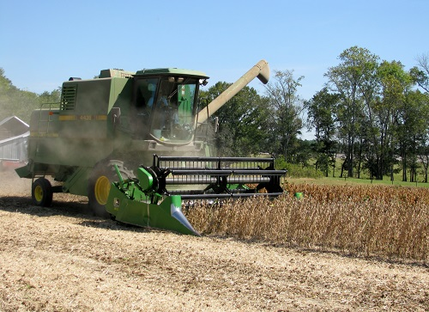
Soybean Weed Control
Start clean, use residuals, timely POST
Narrow rows (<30”)
Systems
Conventional
RR (glyphosate)
LL (glufosinate)
Xtend (dicamba)
Enlist (2,4-D choline)

Slide 4
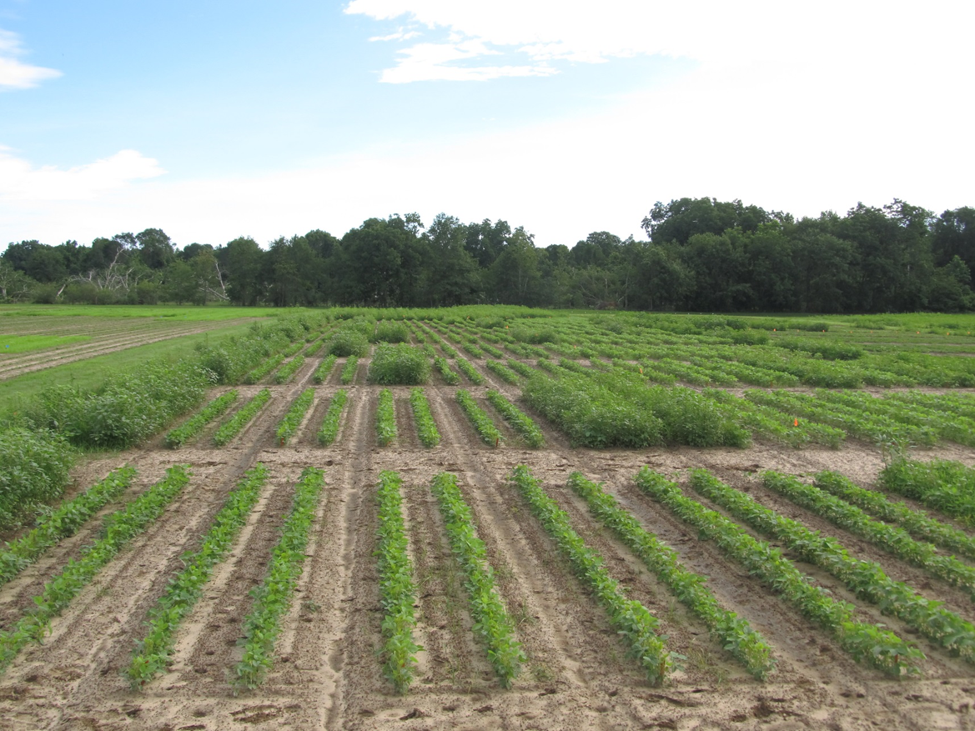
Started Clean + Activated Residual + Timely POST = HOMERUN!
SB-01-17
June 16
38 DAP

Slide 5
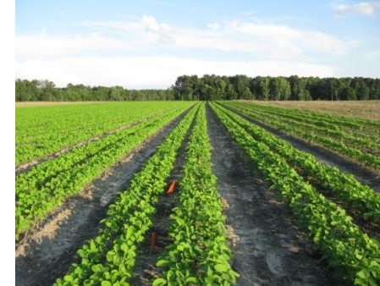
Narrow Rows and Weed Control - Soybeans
“A review of row spacing experiments in which an initial weed management practice had been accomplished revealed that in 64% of the cases (72 of 113 site-years), less late-season weed density and/or biomass, or greater late-season weed control, was achieved in narrow-row (< 30”) compared to wide-row soybean production systems.”
Bradley, K. W. 2006. A review of the effects of row spacing on weed management in corn and soybean. Online. Crop Management doi:10.1094/CM-2006-0227-02-RV.

Slide 6
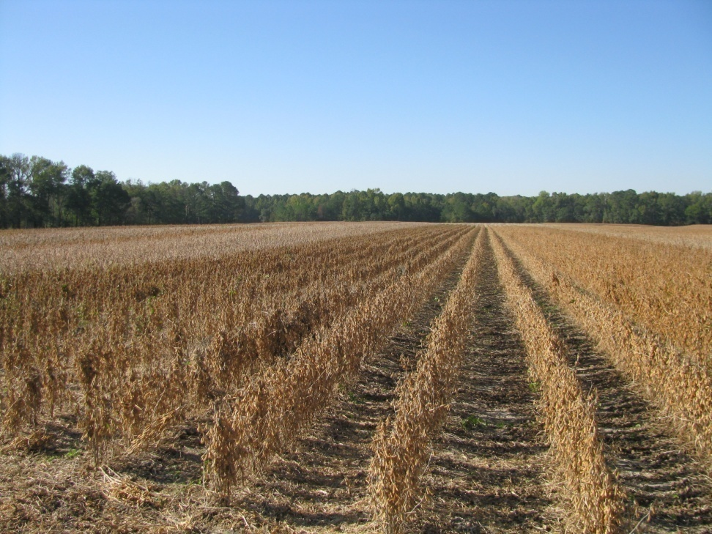
Row Spacing Effects on Soybean Yield In Georgia
Carter and Boerma, 1979 (Athens, GA)
38” to 19” = 11% yield increase
Parker et al., 1981 (Tifton, GA)
36” to 18” = 4% increase
Boerma and Ashley, 1982 (Plains, GA)
36” to 20” = 17% yield increase
Ethredge et al., 1989 (Plains, GA)
30” to 20” = 8% yield increase
30” to 10” = 11% yield increase
20” to 10” = 3% yield increase
Woodruff, 2007-2008 (Camilla, GA)
36” to 24” = 8% yield increase
Whitaker, 2015 (Midville, GA)
22” TO 15” = 19% yield increase
22” TO 7.5” = 30% yield increase

Slide 7
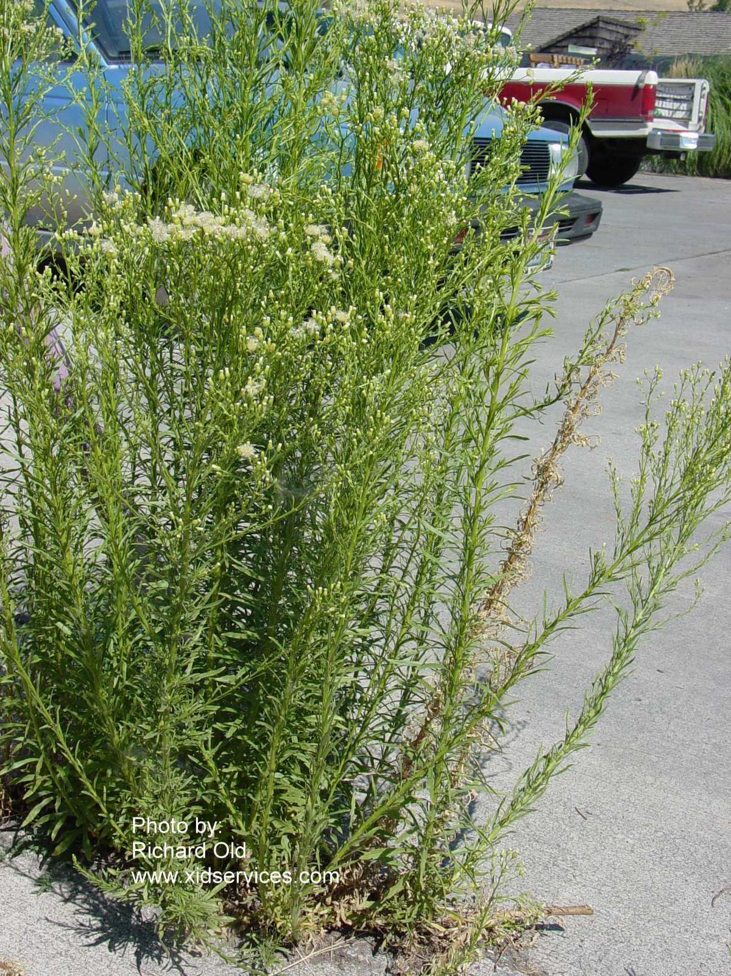
Marestail in Soybean (i.e. Horseweed)
Tillage
Burndown
Liberty (glufosinate)
+ metribuzin?
Glyphosate +
Dicamba or 2,4-D?
Sharpen + MSO
0-30 DBP
Paraquat + metribuzin
Residual
Valor, metribuzin
In-Crop
Liberty (LL)
Dicamba (Xtend)
2,4-D choline (Enlist)
FirstRate or Classic (Any)

Slide 8


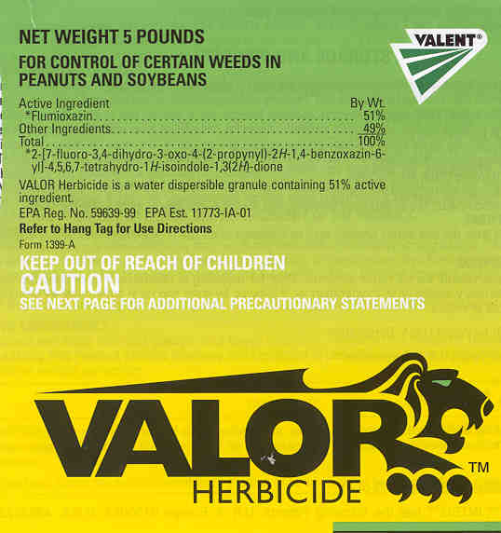
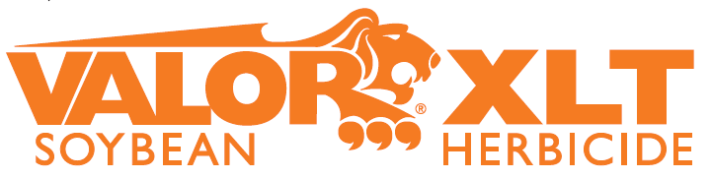
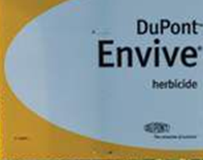

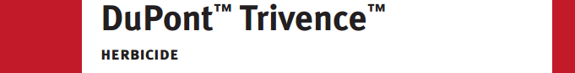
Just thinking???
Fierce or Valor or Envive or Valor XLT or Trivence or Surveil (PRE) followed by Reflex (POST) = great pigweed control but not great …….
Resistance Management
PPO followed by PPO
Not great in cotton and peanut rotations relying on Valor and Reflex
Might be OK in corn/soybean rotation when no PPO is used in corn

Slide 9
Powerful Soybean PRE’S (but PPO’s)
Flumioxazin products
Valor, Rowel, Panther, Outflank, Valor XLT (Valor + Classic), Surveil (Valor + FirstRate), Envive (Valor + Classic + Harmony), Trivence (Valor + Classic + Metribuzin), Fierce (Valor + Zidua), Rowel FX (Rowel + Classic)
Sulfentrazone (S) products
Sonic (S + FirstRate), Authority MTZ (S + Metribuzin), Authority Assist (S + Pursuit), Authority Elite (S + Dual Magnum), Authority First (S + FirstRate), Authority Maxx or Authority XL (S + Classic), Spartan Charge (S + Aim)
Fomesafen products
Reflex, Prefix (Reflex + Dual Magnum), Warrant Ultra (Reflex + Warrant)

Slide 10






Don’t Forget These!

Slide 11


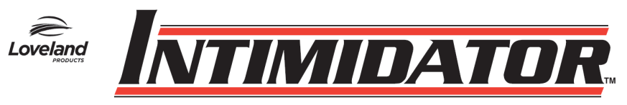
Old + Cheap + Still Good (i.e. metribuzin)
Not a PPO (Valor or Reflex)
Good on pigweed and sicklepod
Can be applied PPI
Dryland fields?
Issues (Be careful!!)
soil texture, OM, pH
Varieties
Rotations
Company support
Lack of incentive at dealer level
TriCor 75DF
Metribuzin 75DF

Slide 12
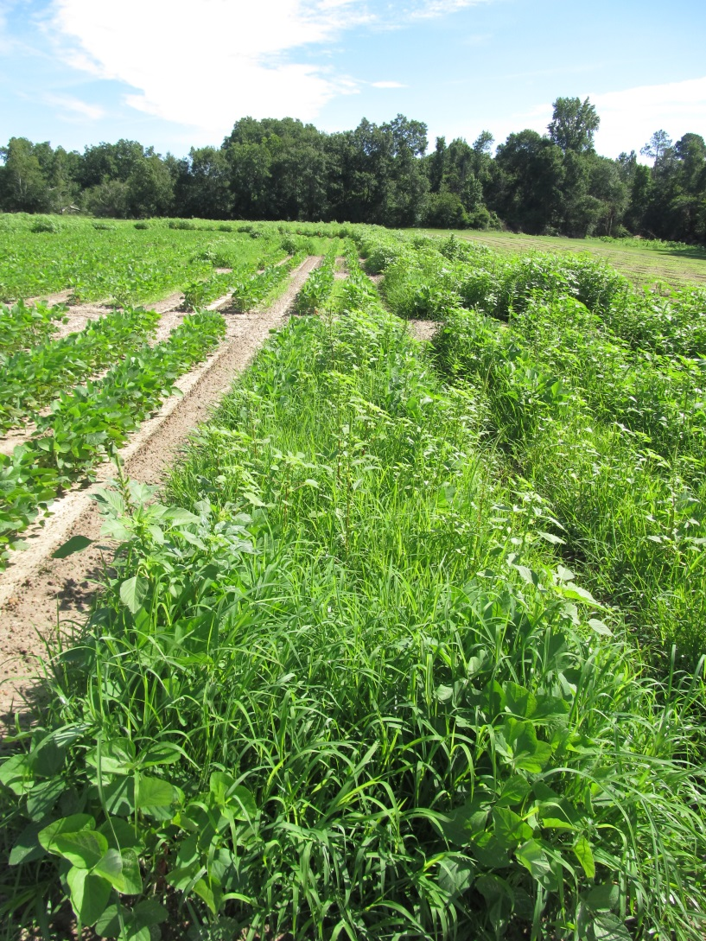
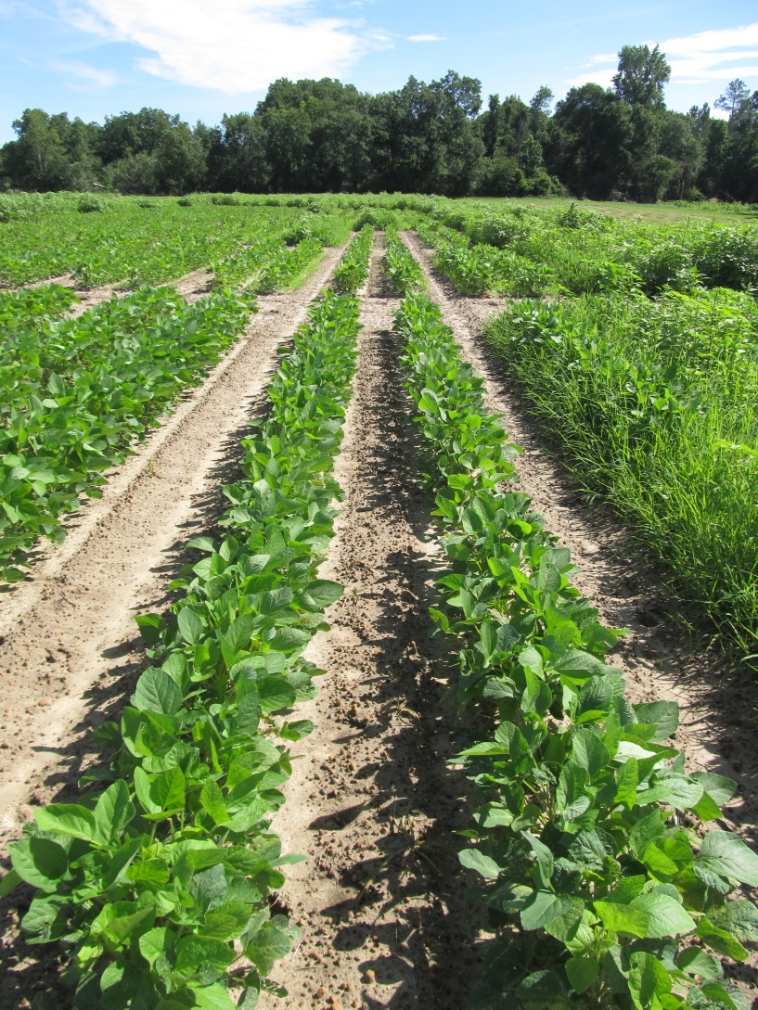
Soybean Weed Control - 2017
NTC
Tricor 4L @ 8 oz/A (PRE)
Roundup P-Max 5.5SL @ 32 oz/A (26 DAP)
Reflex 2SL @ 20 oz/A (26 DAP)
SB-06-17
June 16
38 DAP

Slide 13
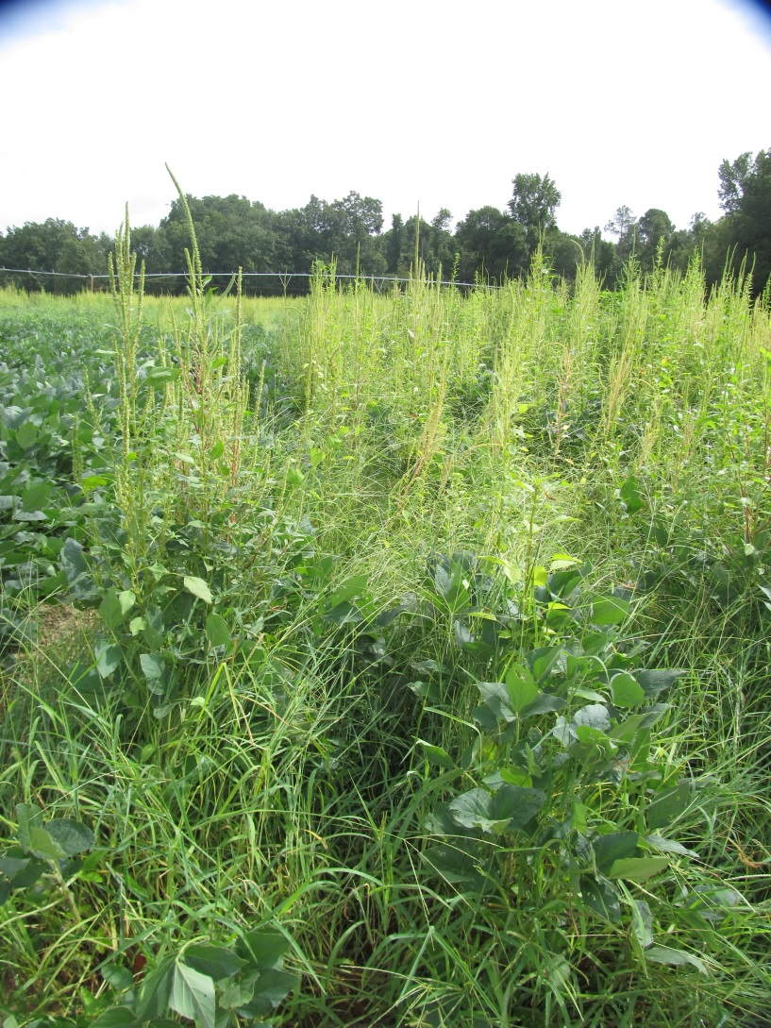
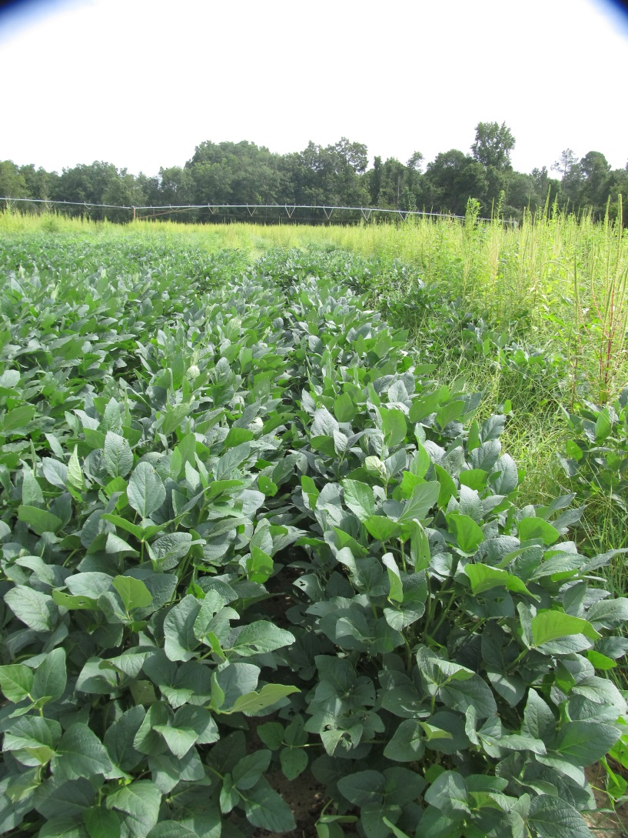
Soybean Weed Control - 2017
NTC
Tricor 4L @ 8 oz/A (PRE)
Roundup P-Max 5.5SL @ 32 oz/A (26 DAP)
Reflex 2SL @ 20 oz/A (26 DAP)
SB-06-17
July 17
69 DAP

Slide 14
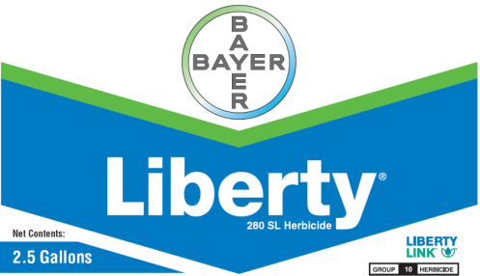
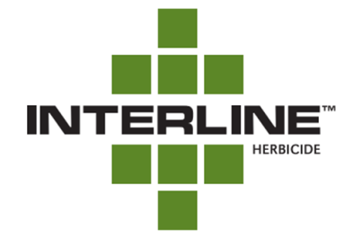
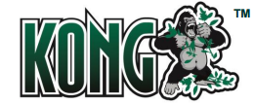


Liberty-Link® Soybeans
Liberty 2.34SL @ 22-36 oz/A or generics
VE-R1
2 applications (65 oz/A/year total)
Tank-mixes with POST grass herbicides may reduce grass control
Assure (10-21%); Fusilade (8-12%); Poast (25-41%); Select (4-22%)
Residuals still needed
**Best Results
15 GPA, medium droplet size, small weeds, 9 am - 6 pm

Slide 15
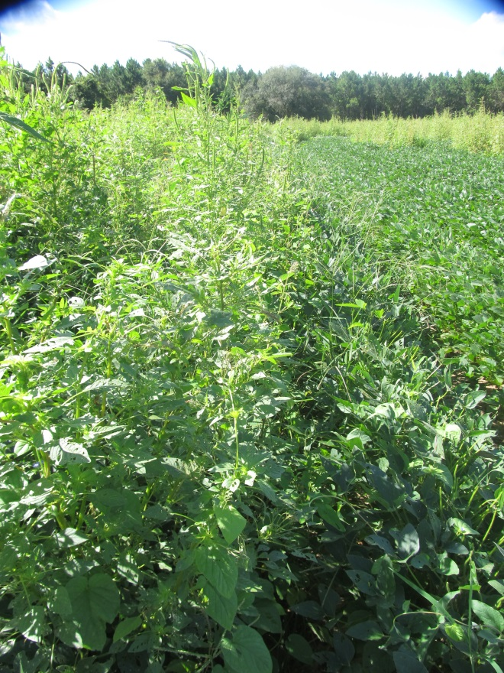
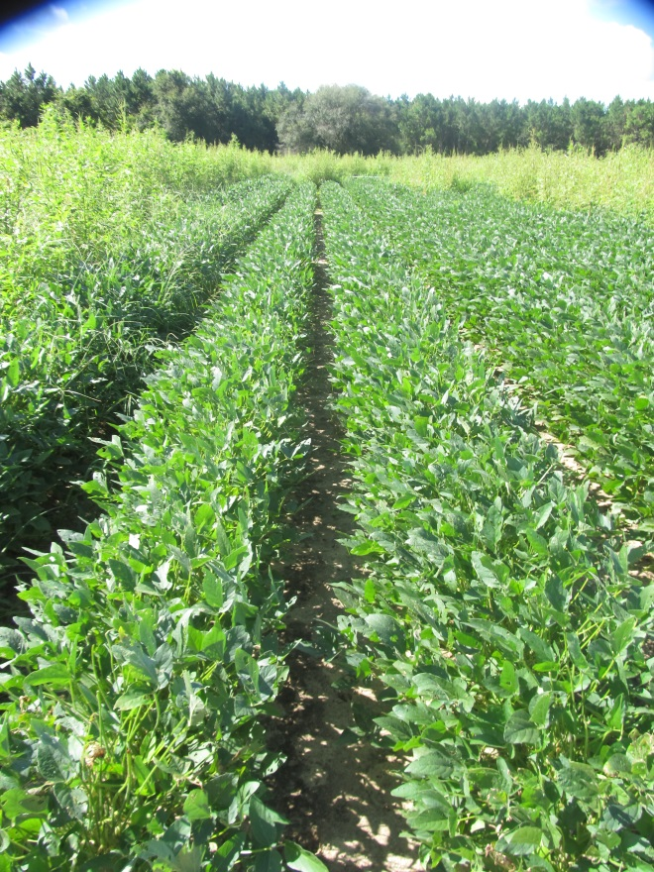


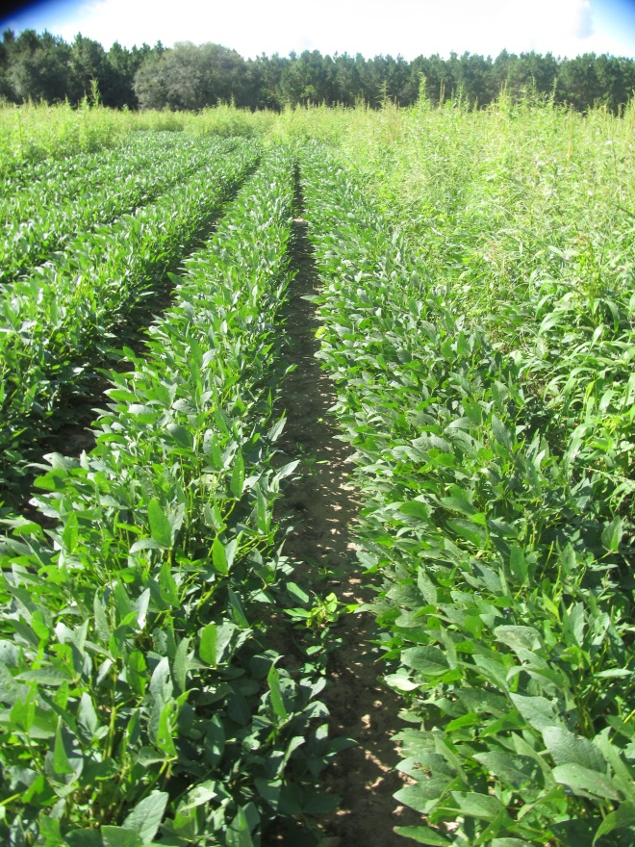
Soybean Weed Control – 2017 Xtend vs. Liberty Systems
NTC
Rowel FX @ 3 oz/A (PRE)
Roundup P-Max @ 32 oz/A (23 DAP)
Xtendimax @ 22 oz/A (23 DAP)
Intact @ 0.5% v/v (23 DAP)
Dual Magnum @ 16 oz/A (PRE)
Liberty @ 29 oz/A (23 DAP)
Reflex @ 20 oz/A (23 DAP)
SB-08-17
August 16
77 DAP

Slide 16
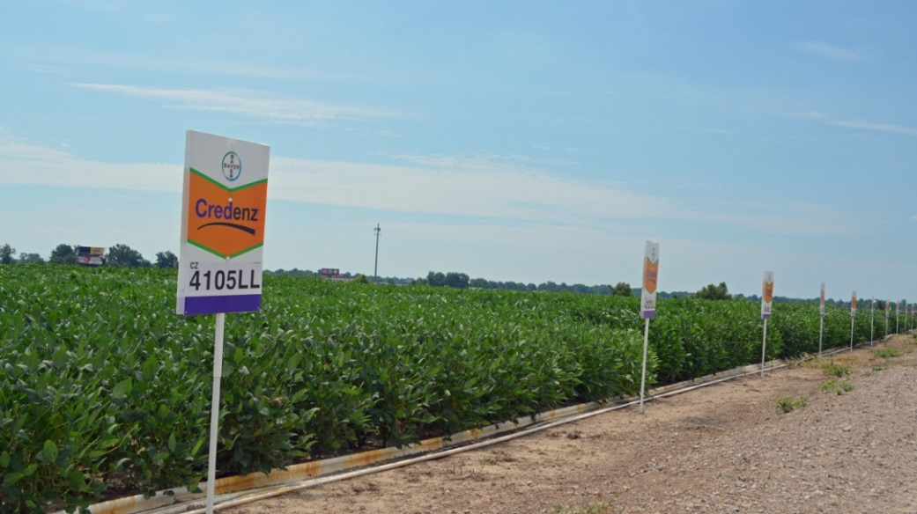
Liberty-Link Varieties
Getting better and better
2017 UGA OVT’s
G13LL-7 and G13LL-44 bred by UGA Team
Group VII’s
Licensed to AgSouth/Meherrin

Slide 17











2,4-D/Dicamba Technologies
2,4-D
dicamba

Slide 18


Enlist Soybeans (2,4-D tolerant)
No China approval yet
2018 Dow/ADM Locations
Mankato, Minnesota
Frankfort, Indiana
Mexico, Missouri
Deerfield, Missouri
Glyphosate + 2,4-D choline
2,4-D choline

Slide 19
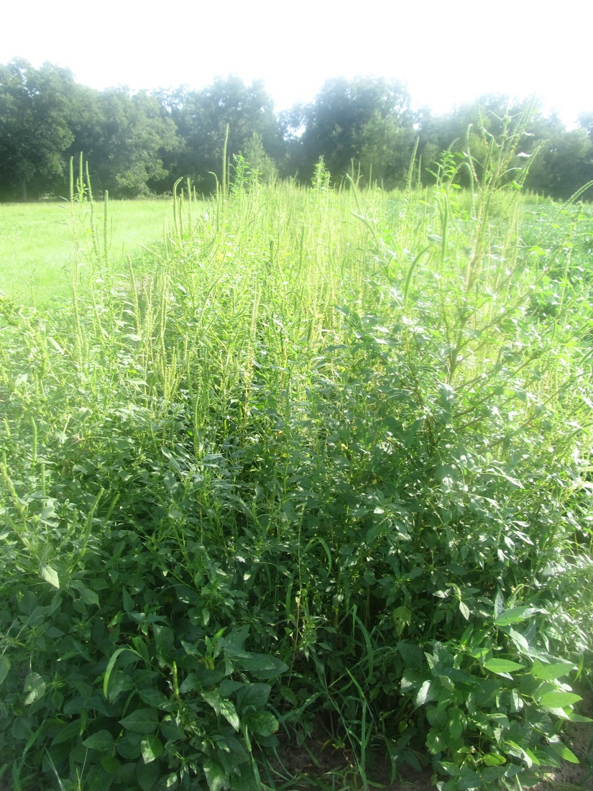
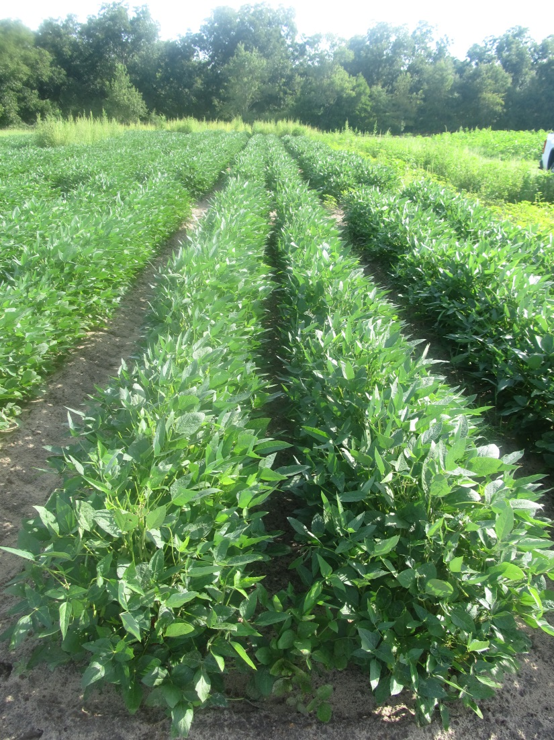
Enlist Soybeans (2016)
NTC
Surveil 48WG @ 2.83 oz/A (PRE)
Enlist Duo 3.33SL @ 75 oz/A (34 DAP)
Dual II Magnum 7.64EC @ 16 oz/A (34 DAP)
AMS @ 2.5% v/v (34 DAP)
SB-13-16
July 22
72 DAP

Slide 20
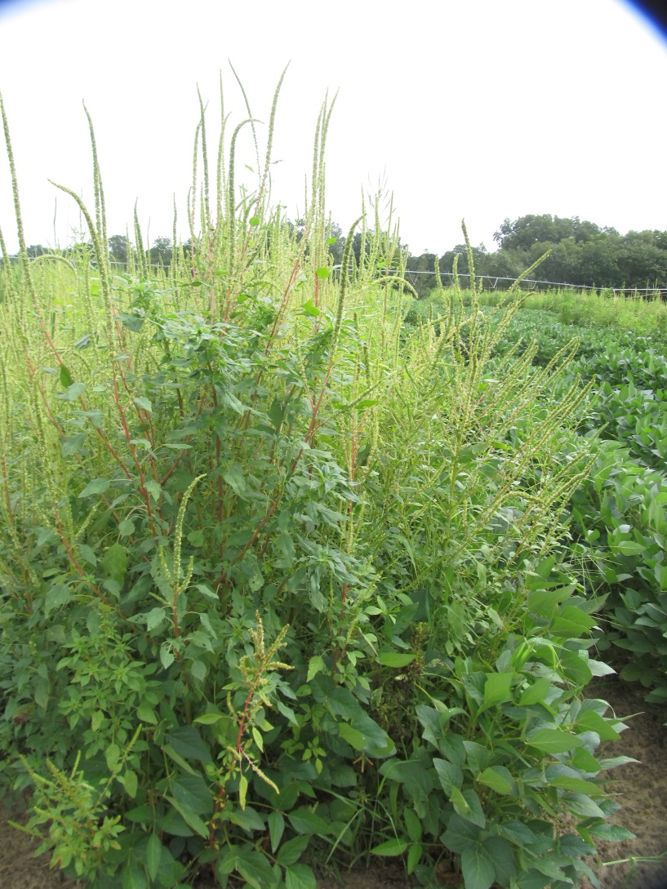
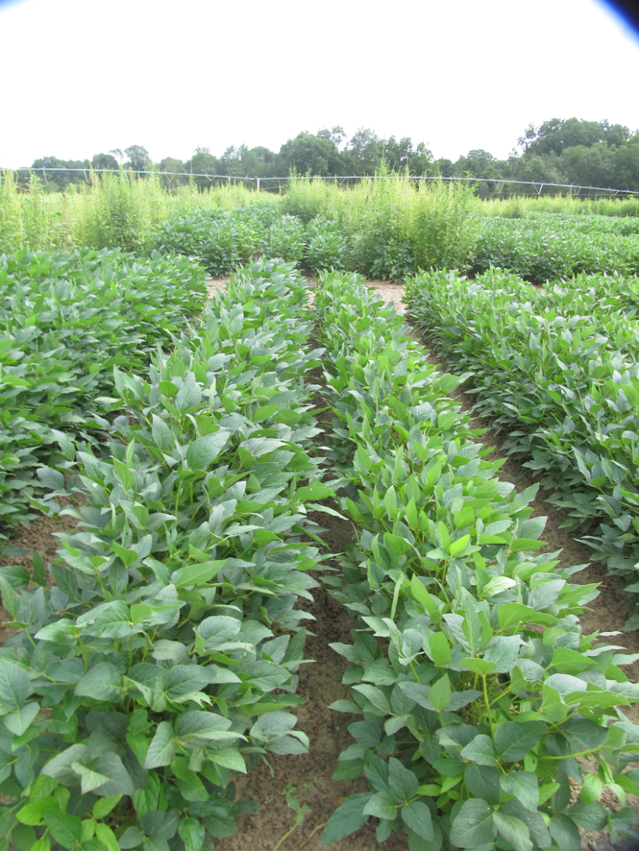
Engenia Program - 2017
NTC
Valor SX 51WG @ 3 oz/A (PRE)
Roundup P-Max 5.5 SL @ 32 oz/A (27 DAP)
Engenia 5SL @ 12.8 oz/A (27 DAP)
Cinch 7.4EC @ 16 oz/A (27 DAP)
SB-01-17
July 17
69 DAP

Slide 21
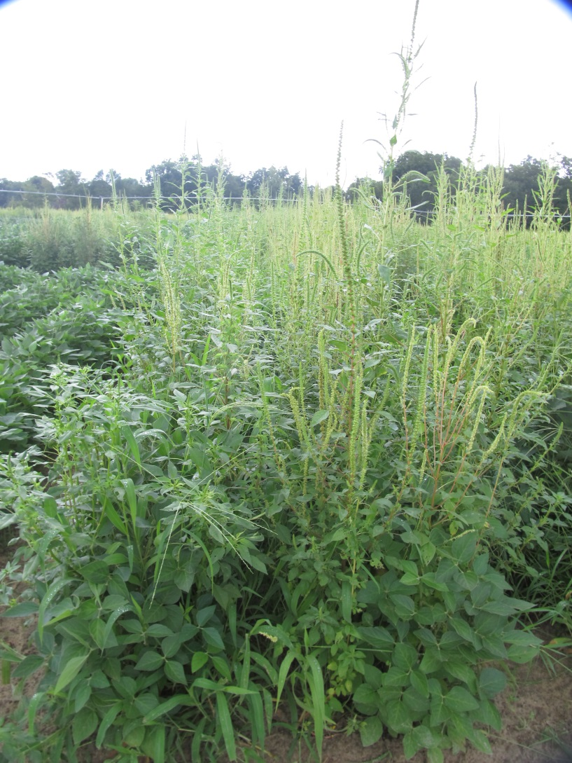
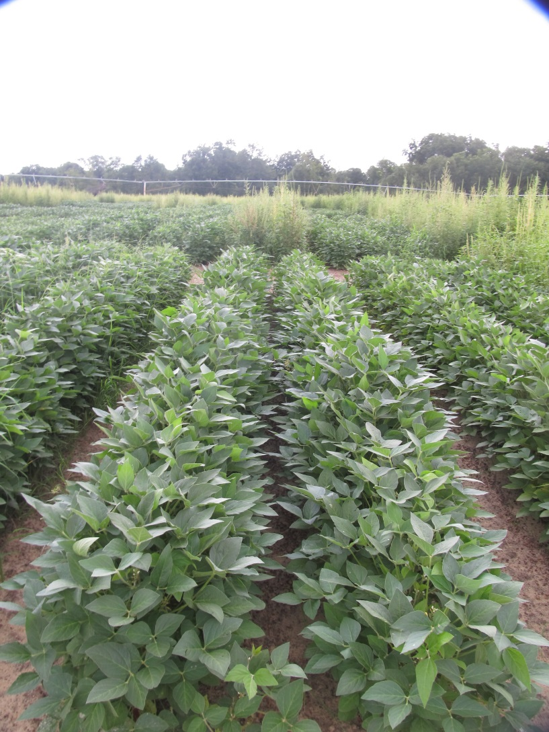
XtendiMax Program - 2017
NTC
Valor SX 51WG @ 3 oz/A (PRE)
Roundup P-Max 5.5 SL @ 28/A (27 DAP)
Xtendimax + VG 2.9SL @ 22 oz/A (27 DAP)
SB-07-17
July 17
69 DAP

Slide 22
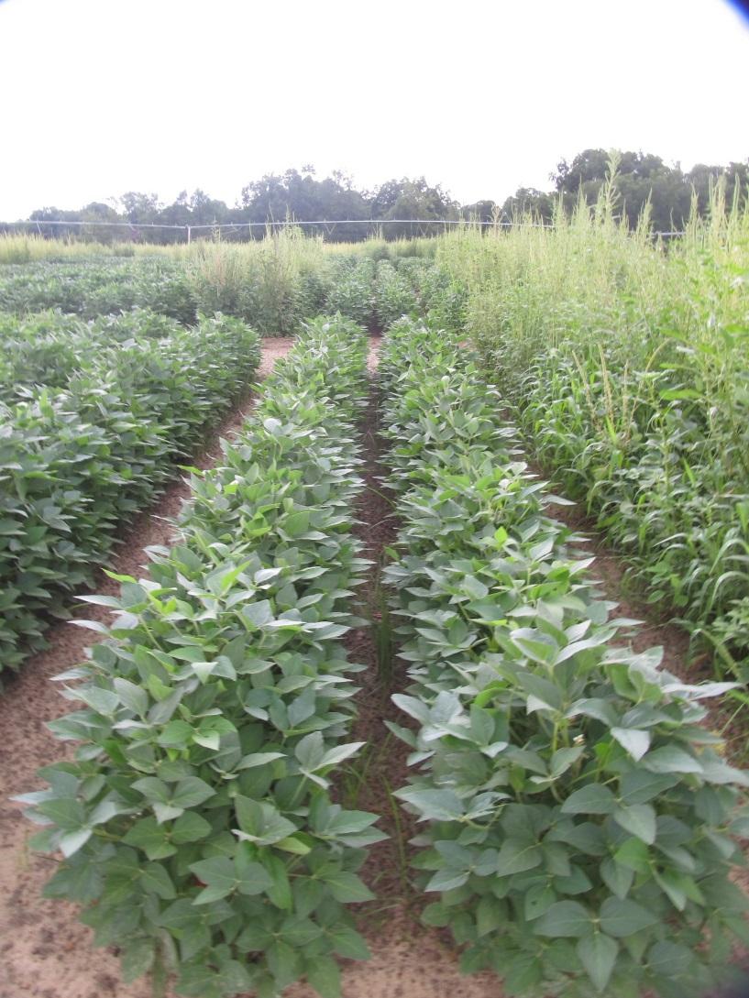
XtendiMax Program - 2017
NTC
Tricor 4L @ 8 oz/A (PRE)
Roundup P-Max 5.5 SL @ 28/A (27 DAP)
Xtendimax + VG 2.9SL @ 22 oz/A (27 DAP)
SB-07-17
July 17
69 DAP

Slide 23
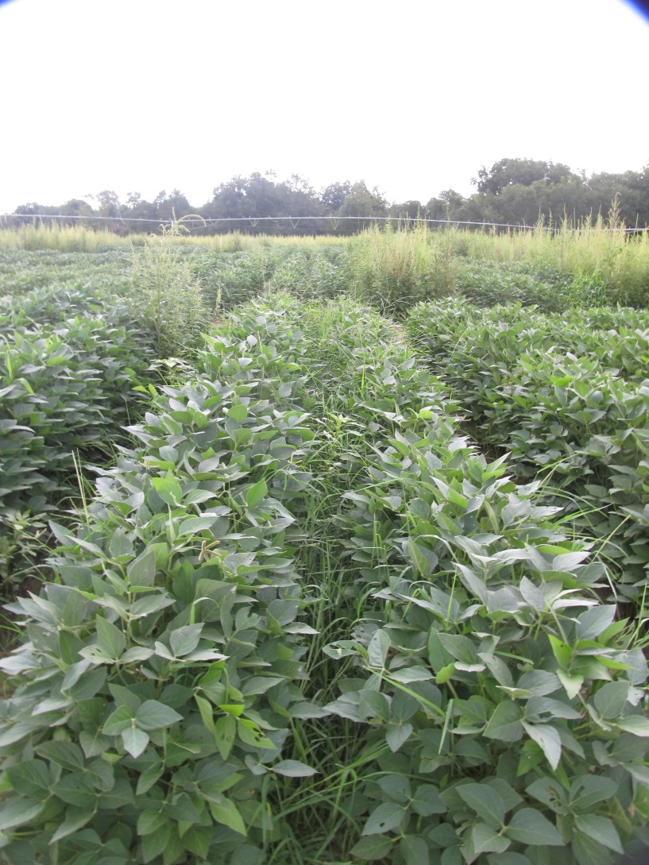
XtendiMax Program – 2017 (NO RESIDUALS)
NTC
Roundup P-Max 5.5 SL @ 28/A (27 DAP)
Xtendimax + VG 2.9SL @ 22 oz/A (27 DAP)
SB-07-17
July 17
69 DAP

Slide 24
2,4-D and Dicamba Crops (Don’t Get Messed Up!)
Crop | Glyphosate | Glufosinate | 2,4-D | Dicamba
2,4-D field corn | YES | YES/NO | YES | YES
2,4-D soybean | YES | YES | YES | NO
2,4-D cotton | YES | YES | YES | NO
Dicamba cotton | YES | YES | NO | YES
Dicamba soybean | YES | NO | NO | YES

Slide 25
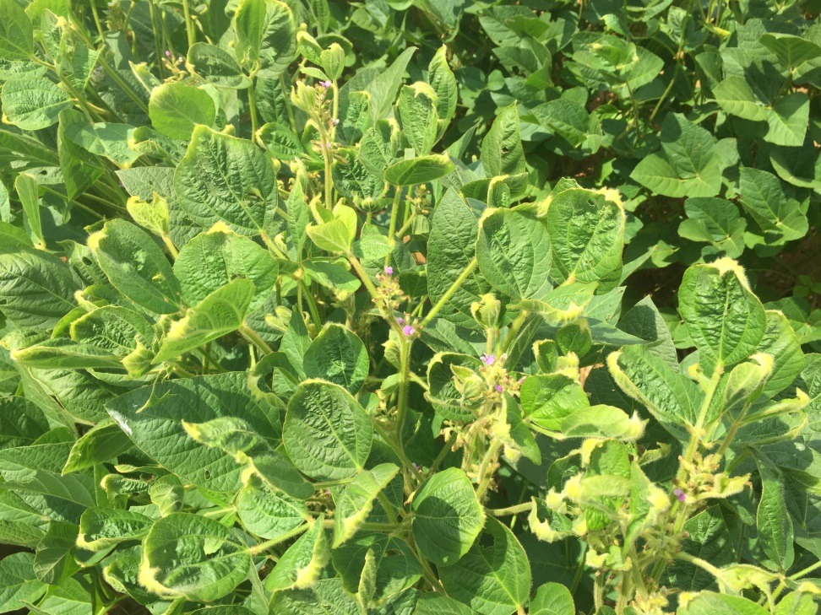
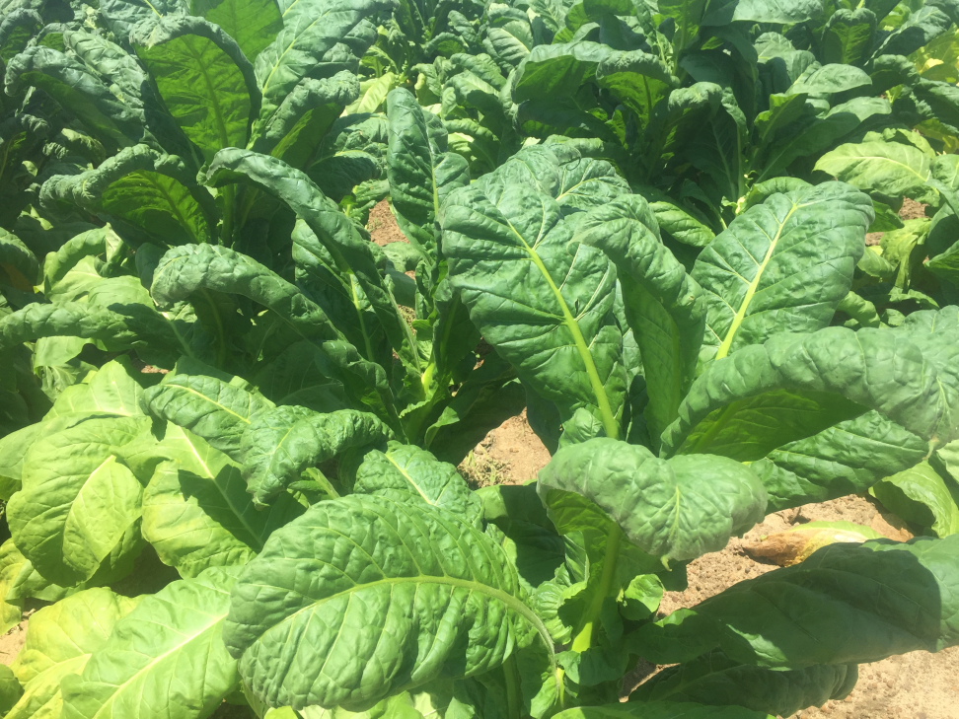
Off-Target Dicamba Problems

Slide 26
Official Dicamba-related Injury Investigations as Reported by State Departments of Agriculture (*as of October 15, 2017)
40
250
2
114
4
93
107
28
0
245
128
0
125
310
2
18
132
15
19
986
3
78
7
0
2
*Total: 2,708
©Dr. Kevin Bradley, University of Missouri

Slide 27
Estimates of Dicamba-injured Soybean Acreage in the U.S. as Reported by State Extension Weed Scientists (*as of October 15, 2017)
250k
265k
250k
<1k
<1k
50k
150k
15k
<1k
600k
55k
325k
1k
100k
<1k
33k
400k
3k
2.5k
900k
<1k
250
k
<1k
<1k
10k
*Total: ~3.6 million
©Dr. Kevin Bradley, University of Missouri

Slide 28
Dicamba Label Changes for 2018 - General
Engenia®, Fexapan™, and Xtendimax® will now be considered Restricted Use Pesticides.
Fexapan™ and Xtendimax® minimum GPA changed to 15 gallons.
Can only be applied from sunrise until sunset and wind speeds from 3 to 10 MPH.
Growers who use Engenia®, Fexapan™, and Xtendimax® will be required to keep the following records for a period of 2 years, records must be generated within 14 days of application, and a record must be kept for every application: UGA-Form????

Slide 29
Dicamba Label Changes for 2018 – Required Records
Certified Applicator Name
Applicator Certification Number
Product Name
EPA registration Number
Total Amount Applied
Application Date
Location of application
Crop or site of application
Size of area treated
Training Requirement: Proof of auxin training
Application timing: PRE or number of days after planting
Receipts of Product Purchase
Products Labels
Buffer Requirements: record buffer distance calculations
Sensitive Crop Awareness: Applicator must survey and document neighboring fields for sensitive areas or crops
Spray Systems Cleanout: Must be documented that applicator complied with label.
Tank-Mix-Products: complete list of all approved products that were tank-mixed
Application Start and Finish Times
Nozzle Selection
Air Temperature: At boom height for start and finish
Wind Speed/Direction: At boom height for start and finish

Slide 30
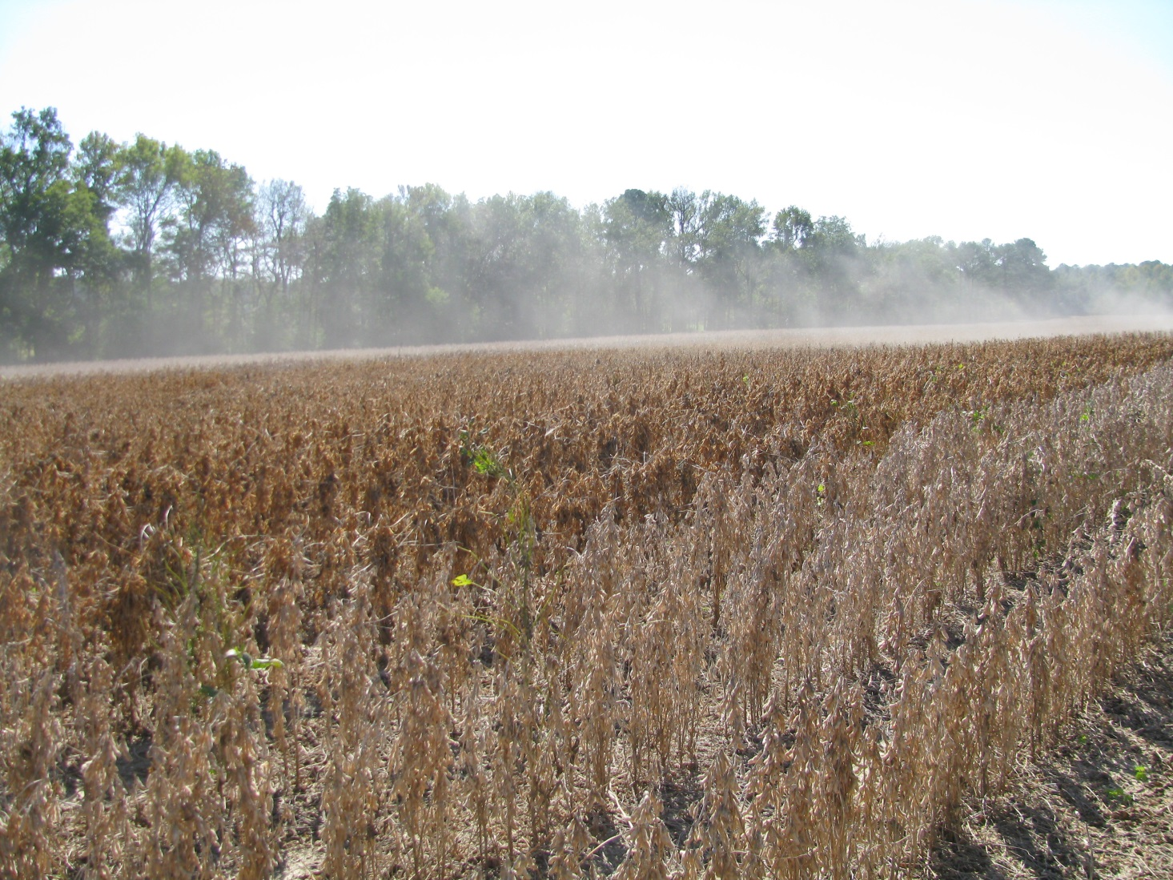
Variety Performance?????

Slide 31
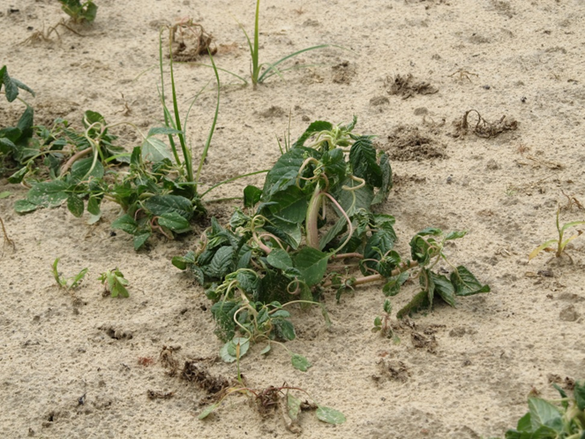
Auxin Resistance Already Out There!
Older chemistries
2,4-D (1945)
dicamba (1967)
36 species worldwide
8 species in US
tall waterhemp (NE, IL)
yellow starthistle (WA)
speading dayflower (HI)
wild carrot (MI, OH)
smooth crabgrass (CA)
barnyardgrass (AR, LA)
kochia (MT, ND, ID, CO, NE, KS, WA)
prickly lettuce (WA)

Slide 32
Important Auxin Web-Sites
Enlist
http://www.enlist.com/en/herbicides
Xtendimax
http://www.xtendimaxapplicationrequirements.com/Pages/default.aspx
Fexapan
http://www.dupont.com/products-and-services/crop-protection/soybean-protection/articles/fexapan-application.html
Engenia
http://agproducts.basf.us/campaigns/engenia/tankmixselector/

Slide 33
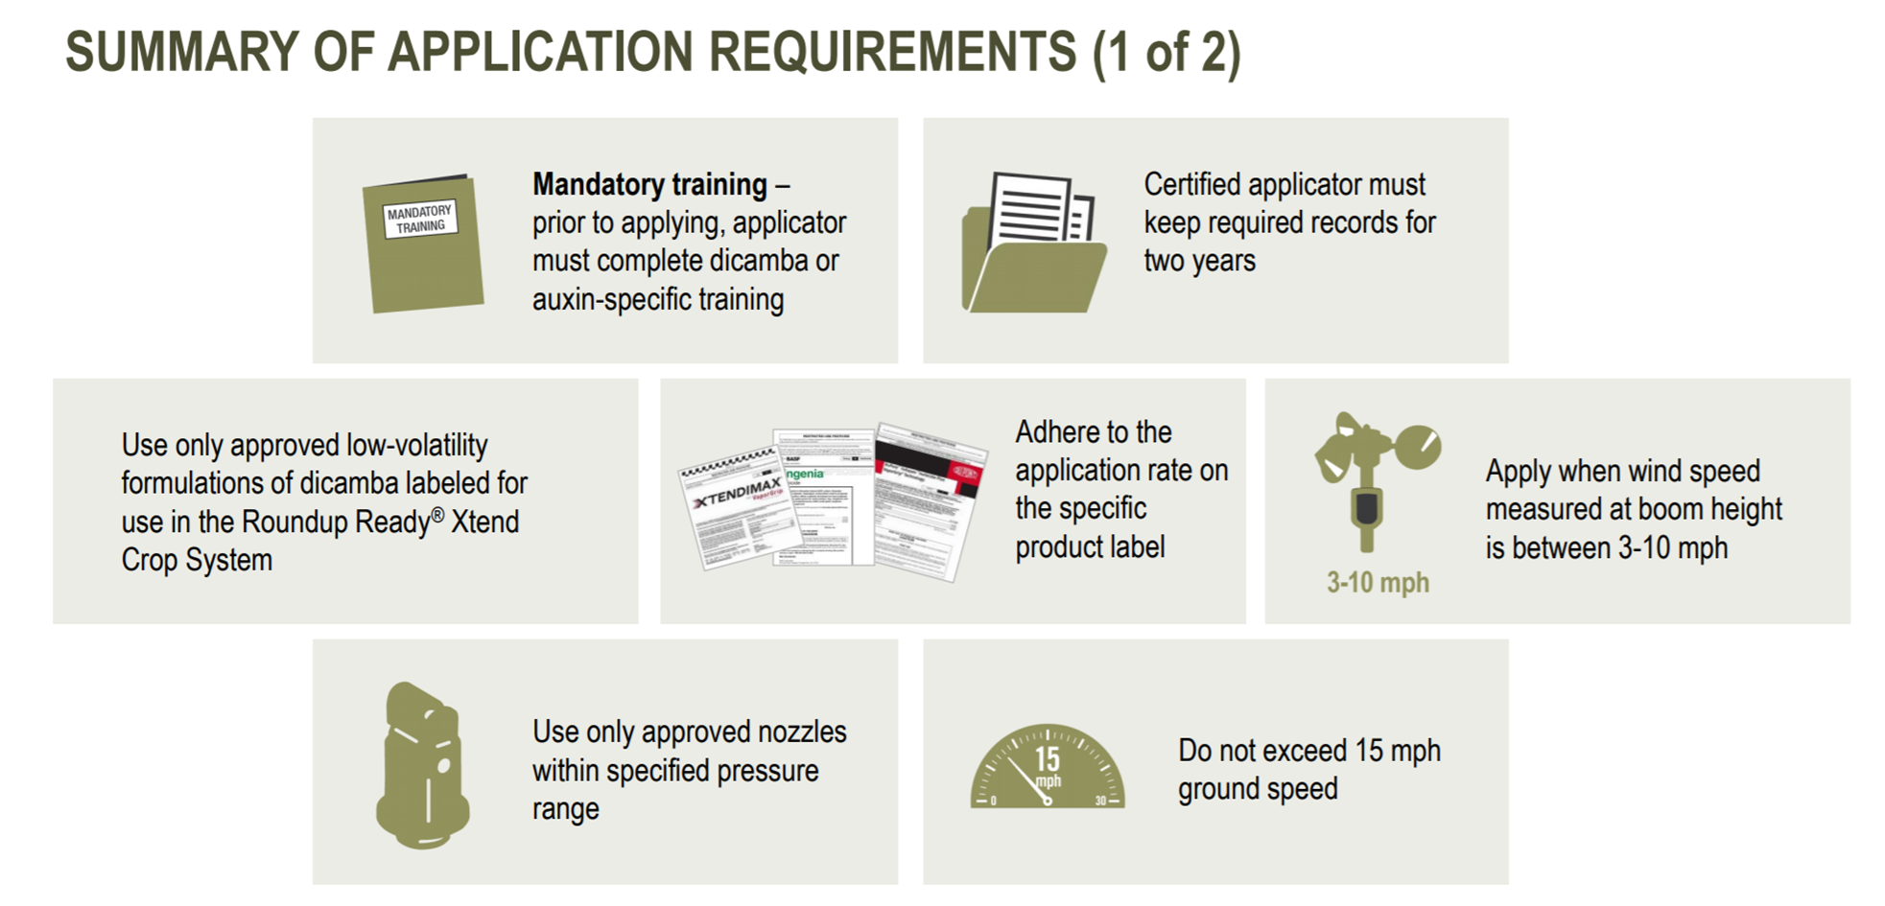
Dicamba Applications Summary - I

Slide 34
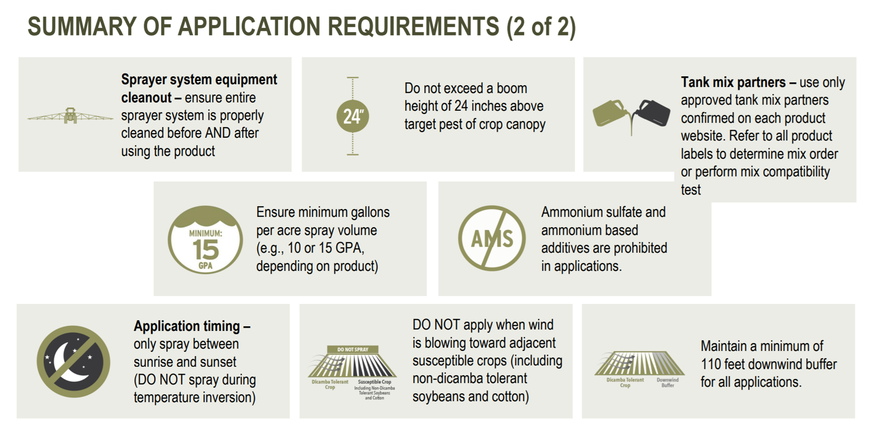
Dicamba Applications Summary - II

Slide 35
Harvest Aids Soybeans
Herbicide | Rate/A (oz) | Adjuvant | Time of Application |  | PHI (days)
 |  |  | Determinate | Indeterminate
Gramoxone 2SL Generic 3 lb/gal | 16 10.7 | NIS @ 0.25% v/v | Fully mature 50% leaf drop Yellow leaves | <30% moisture 65% of pods mature brown | 15
Sharpen 2.85SC | 1-2 | MSO @ 1% v/v | Fully mature 50% leaf drop Yellow leaves | 65% mature brown pods 70% leaf drop < 30% moisture | 3
*Glyphosate and Aim are also labeled (more for weed control than
crop dessiccation).

Slide 36
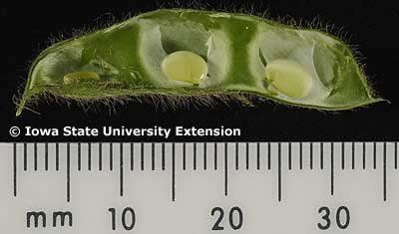
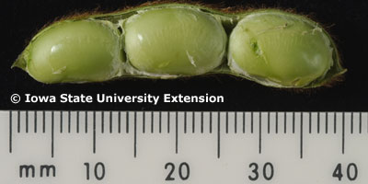
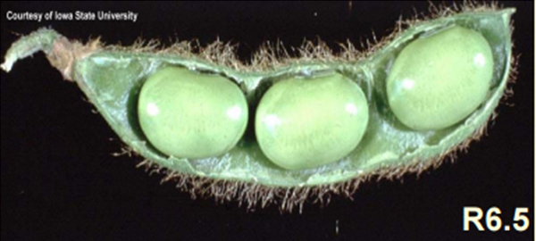
Important Soybean Stages for Harvest Aids
R5
R6
or later
R5-R6 = 11- 20 days (15 avg.)
R6-R7 = 9- 30 days (18 avg.)

Slide 37
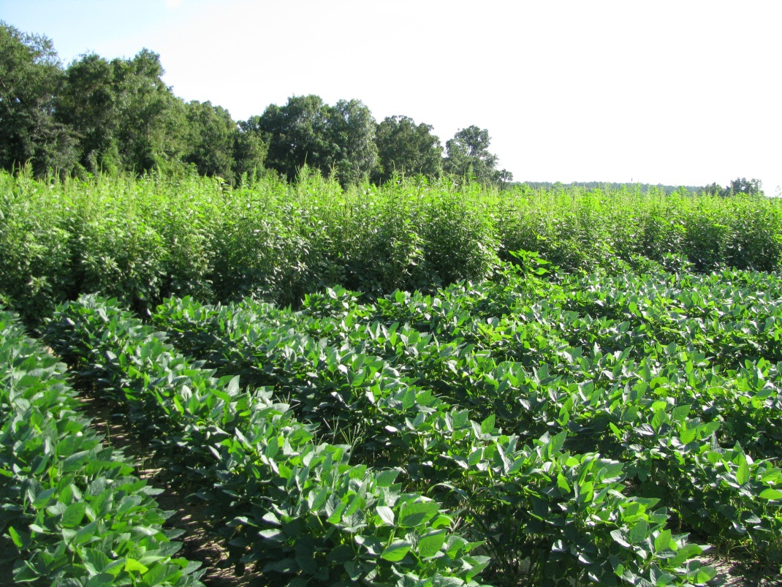
If you want to create more resistance, STOP….
using tillage
using residuals
using multiple modes of action
using labeled rates
being timely
rotating crops
hand-weeding
remembering what happened to glyphosate

Slide 38
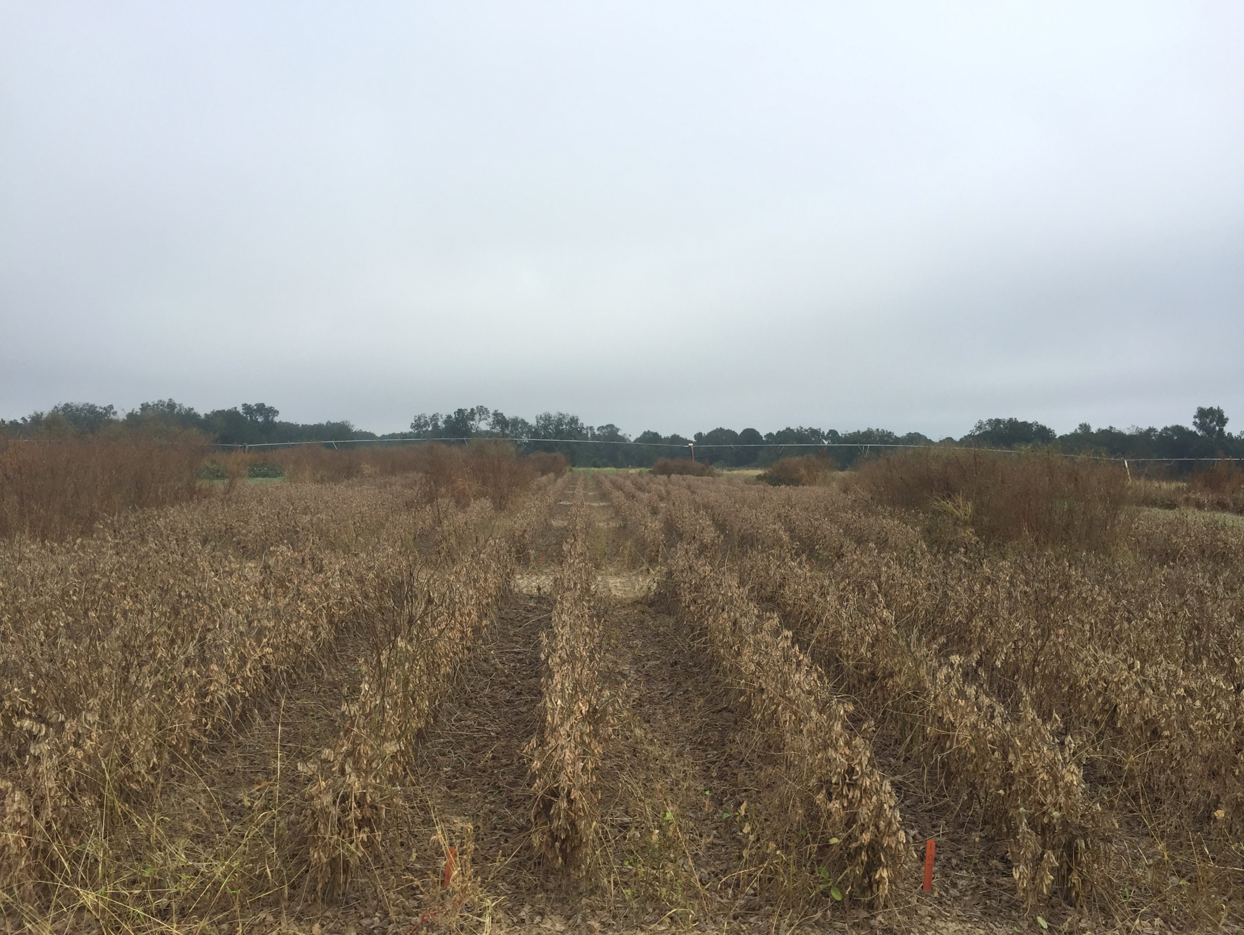

QUESTIONS?

