Slide 1

2017 Field Corn Weed Management Update
Eric P. Prostko
Professor/Extension Weed Specialist
Dept. Crop & Soil Sciences

Slide 2
Figure 1. Field Corn Yield Loss (%) Caused by Uncontrolled Weeds in Georgia Weed Science Research Trials (2007-2016). Treated vs. Non-treated
225 * 0.38 * 4.00 = $342/A

Slide 3
Timing of Herbicide Application DAP or GDD?
V2.7
V1.8
*Assumes crop emergence on March 25 (5 DAP)
Notes:
What is more appropriate when making herbicide recommendations with respect to time of application, GDD or DAP? From this slide it is evident that there can be a significant differences in the accumulation of GDD at 21 DAP. However, applications made at 21 DAP are likely to occur when the crop is in the ideal stage of growth (~V2-V4), assuming 84 GDD per stage.

Slide 4
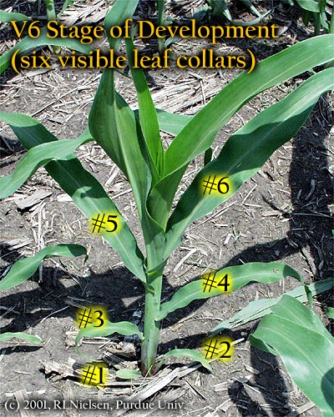
Later POST Applications?
V6 stage
all leaves are initiated
Ear shoot initiation
Kernel rows/ear begins
Tassel initiation
Growing point above soil surface
~500 GDD

Slide 5
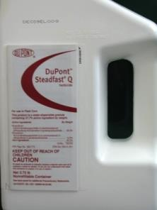


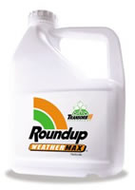

Atrazine + Any of these works just fine!

Slide 6
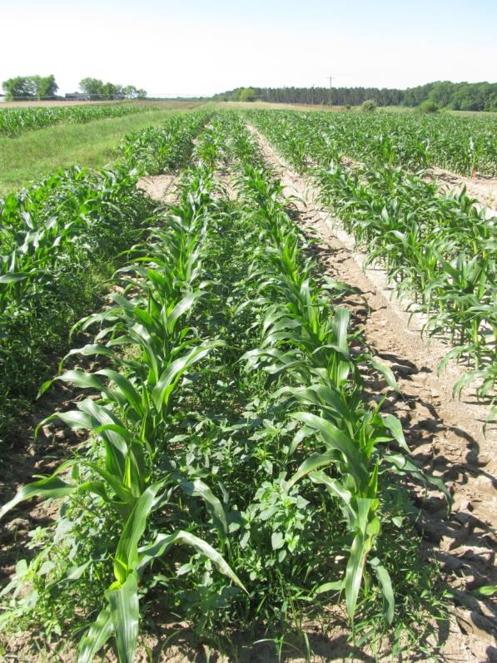
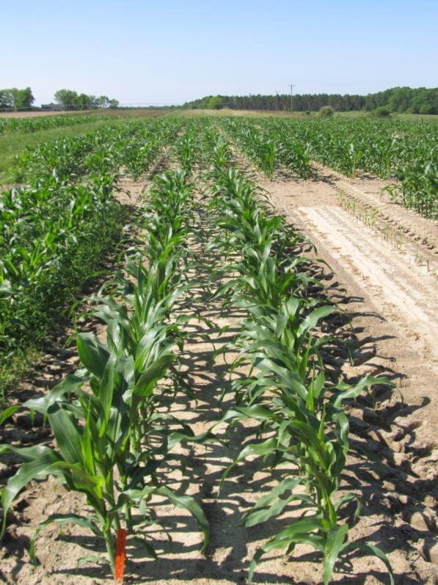
Weed Control in Field Corn - 2016
165 Bu/A
(4 rep avg.)
220 Bu/A
(4 rep avg.)
NTC
Dual II Magnum 7.62EC @ 16 oz/A (PRE)
Roundup P-Max 5.5SL @ 32 oz/A (29 DAP)
Atrazine 4L @ 64 oz/A (29 DAP)
CN-01B-16
May 4
44 DAP

Slide 7
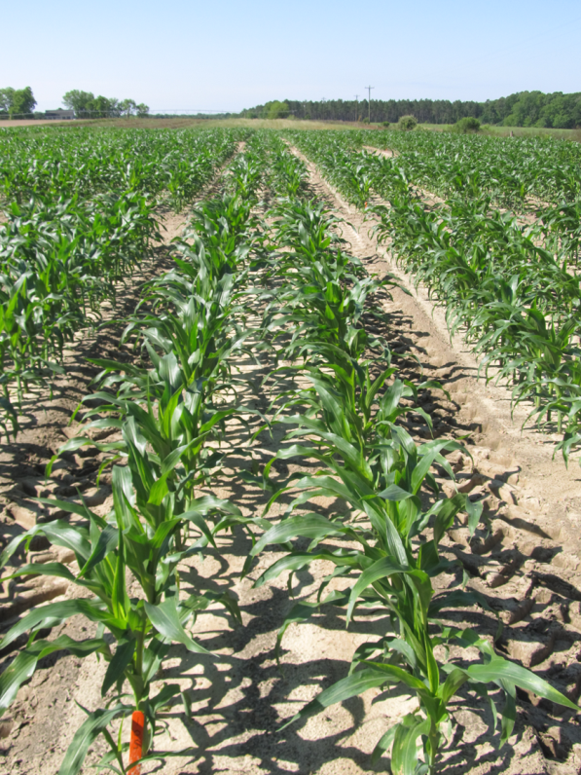
Weed Control in Field Corn - 2016
165 Bu/A
(4 rep avg.)
249 Bu/A
(4 rep avg.)
NTC
Dual II Magnum 7.62EC @ 16 oz/A (PRE)
Laudis 3.5SC @ 3 oz/A (29 DAP)
Atrazine 4L @ 64 oz/A (29 DAP)
MSO @ 1% v/v (29 DAP)
CN-01B-16
May 4
44 DAP

Slide 8
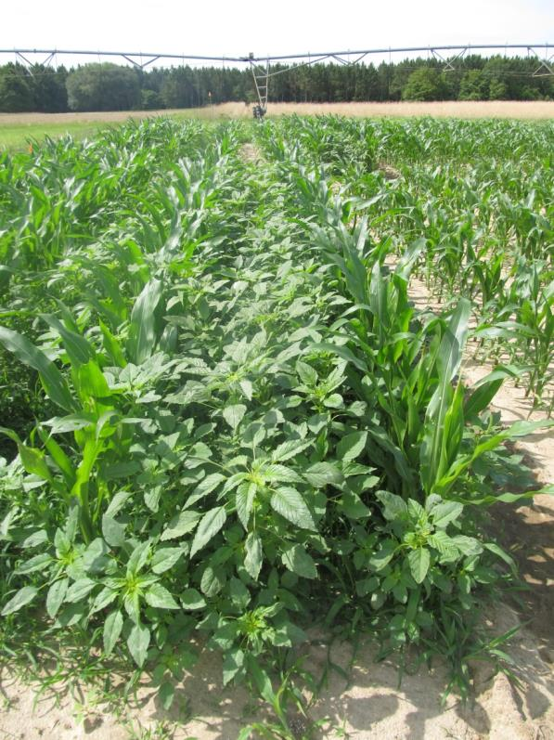
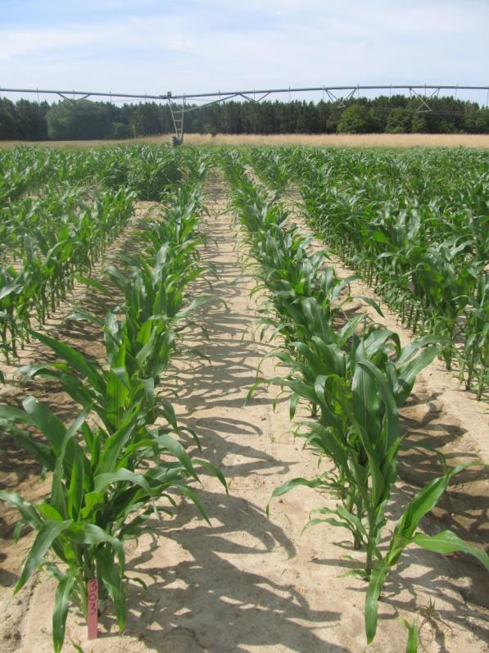
Weed Control in Field Corn - 2016
Dual II Magnum 7.62EC @ 16 oz/A (PRE)
Halex GT 4.39SC @ 58 oz/A (21 DAP)
Atrazine 4L @ 32 oz/A (21 DAP)
COC @ 1% v/v (21 DAP)
NTC
CN-01-16
May 16
35 DAP

Slide 9




Anthem, Dual, Warrant, Zidua????

Slide 10
Palmer Amaranth Control with Zidua, Dual Magnum, and Warrant Applied PRE to Bare-Ground - 2016
Control (%)
Time (DAT)
NC-01-16

Slide 11
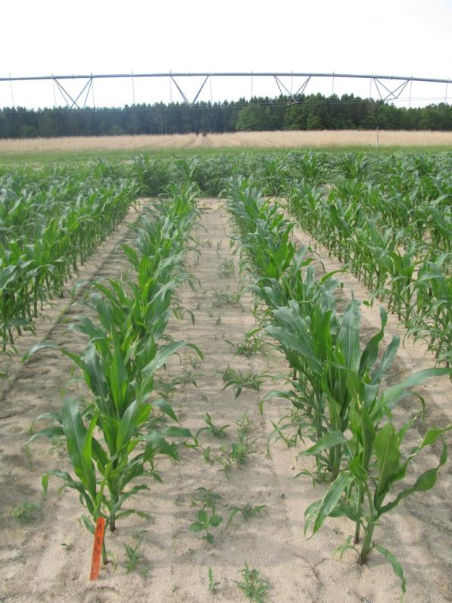
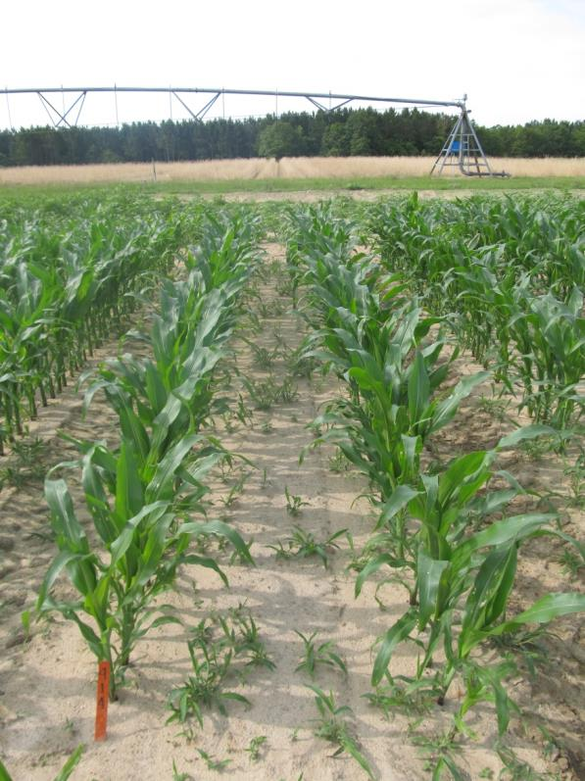
PRE Zidua or Dual on Texas Panicum
Zidua 85WG @ 1.5 oz/A
Dual II Magnum 7.62EC – 21 oz/A
CN-10-16
May 16
35 DAT

Slide 12
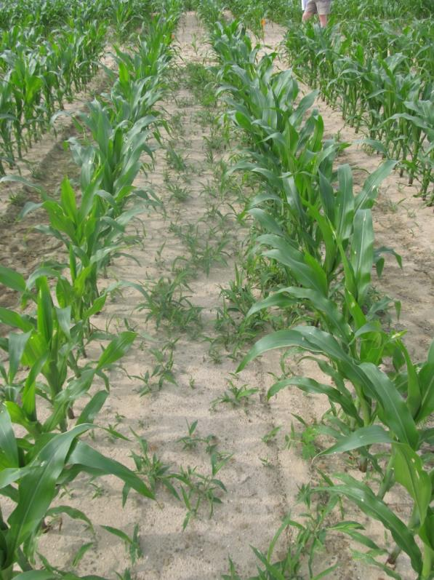
Zidua on Texas Millet?
CN-10-16
May 16
Zidua 85WG @ 1.5 oz/A – PRE
Photo 35 DAT
Plot# 316

Slide 13
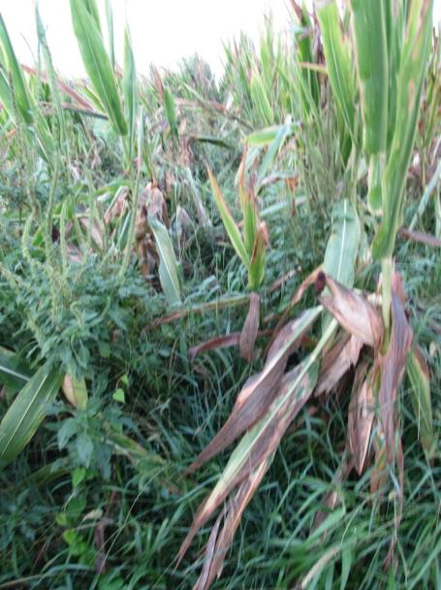
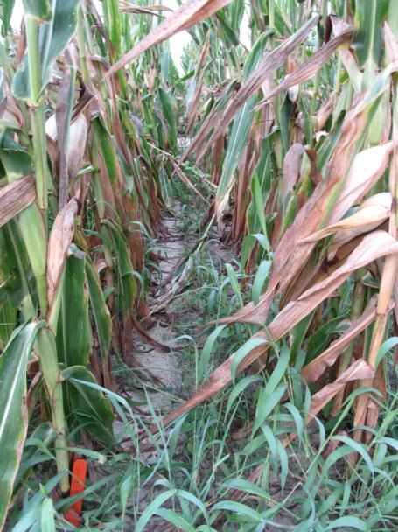
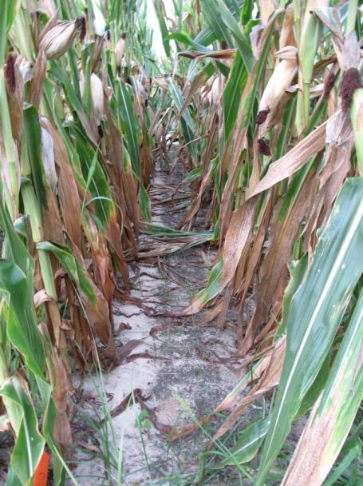
Evik or Not?
NTC
Atrazine 4L @ 32 oz/A (PRE)
Roundup P-Max 5.5SL @ 32 oz/A (POST)
Atrazine 4L @ 48 oz/A (POST)
Atrazine 4L @ 32 oz/A (PRE)
Roundup P-Max 5.5SL @ 32 oz/A (POST)
Atrazine 4L @ 48 oz/A (POST)
Evik 80DG @ 2 lbs/A (PDIR)
NIS @ 0.25% v/v (PDIR)
CN-01-16
July 7
108 DAP

Slide 14
What can you use in field corn if you have resistance to glyphosate, atrazine, and/or ALS herbicides?
Residuals
Zidua
Dual Magnum
Warrant
Postemergence*
Liberty
Status
Revulin Q
Impact/Armezon
Laudis
Capreno
Halex GT
2,4-D
* double-crop soybean rotations?

Slide 15
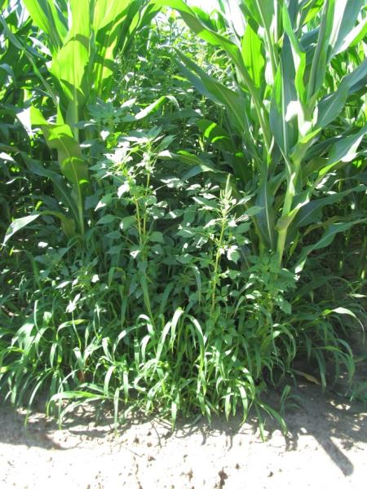
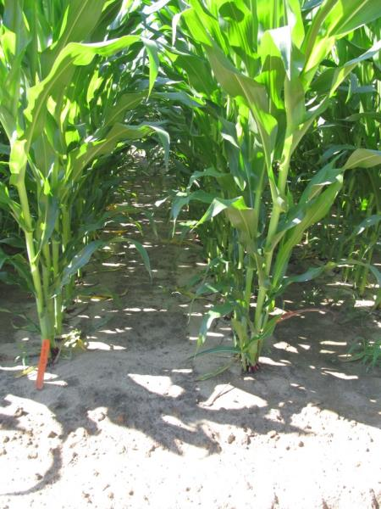
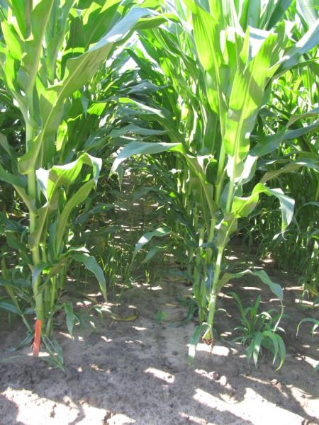
Weed Control in Field Corn Without Atrazine or Glyphsoate
NTC
Dual II Magnum 7.64EC @ 21 oz/A (PRE)
Laudis 3.5SC @ 3 oz/A (POST)
COC @ 1% v/v (POST)
AMS Xtra @ 2.5% v/v (POST)
Warrant 3ME @ 48 oz/A (PRE)
Impact 2.8L @ 1.0 oz/A (POST)
COC @ 1% v/v (POST)
AMS Xtra @ 2.5% v/v (POST)
CN-10-16
June 3
53 DAP

Slide 16
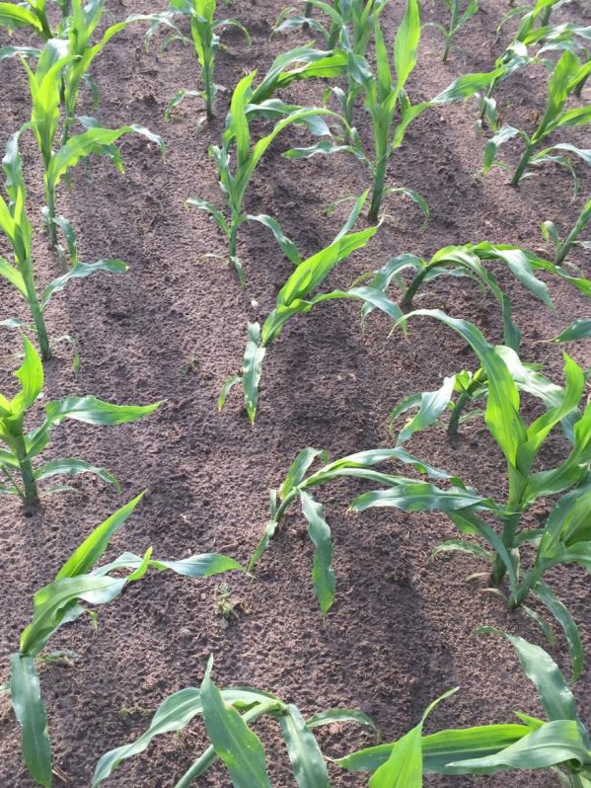
Field Corn Injury - Status
Status
dicamba-NA + diflufenzopyr + isoxadifen
CN-04-16
Agrigold 6659
7 DAT (April 25, 2016)
Roundup P-Max @ 32 oz/A + Status @ 5 oz/A

Slide 17
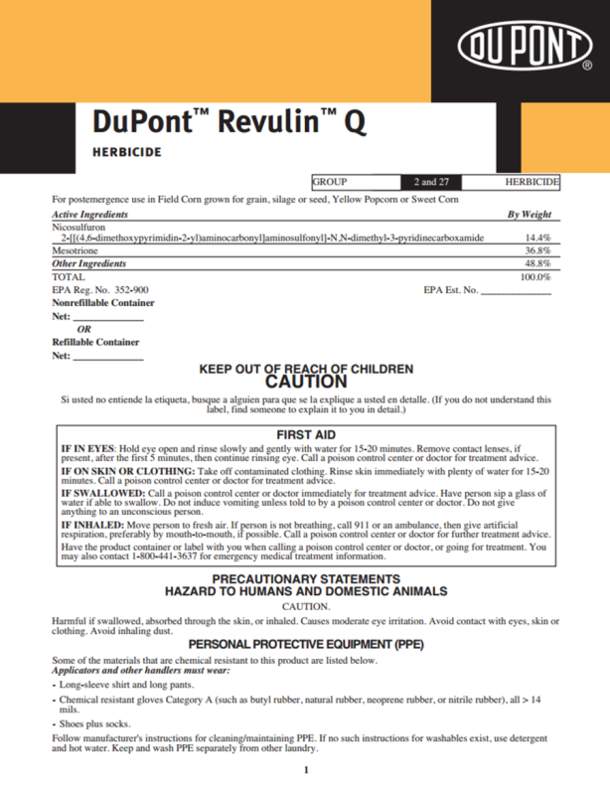
Revulin Q
DuPont
Accent + Callisto + isoxadifen (safener)
MOA = 2 + 27
EPOST (20” tall or V6)
3.4-4.0 oz/A
Tank mix with atrazine
Cotton or soybean = 10 months; peanut = 18 months; small grains = 4 months
No Counter INFR

Slide 18
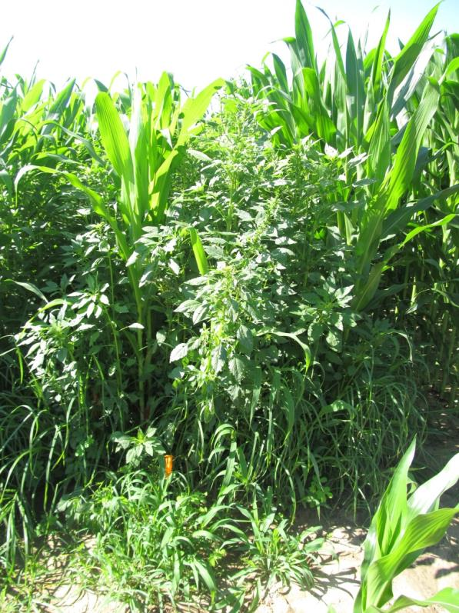
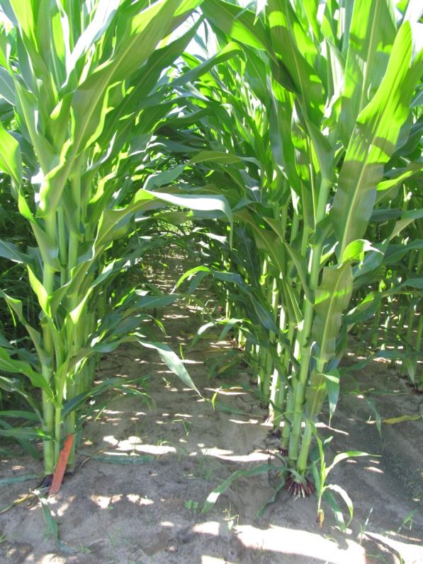
Weed Control with Revulin Q - 2016
Revulin Q 51.2WG @ 3.4 oz/A
Atrazine 4L @ 64 oz/A
COC @ 1% v/v
AMS Xtra @ 2.5% v/v
Applied 17 DAP
NTC
CN-09-16
June 3
53 DAP

Slide 19
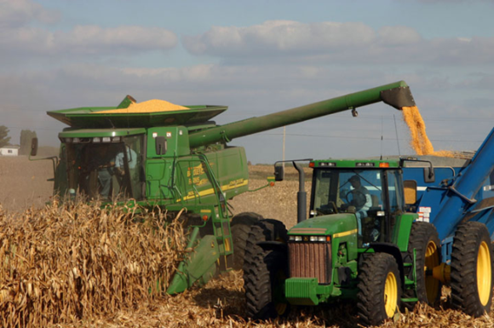
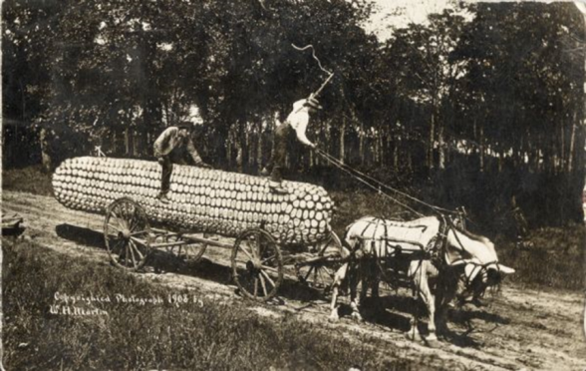
Something to think about?
Some GA growers are pushing yield limits (250+ Bu/A)
75%-80% irrigated
At lower yield/input levels, are herbicide stresses masked by other stresses?
At higher yield/input levels (i.e. most stresses are controlled), what about herbicides?

Slide 20
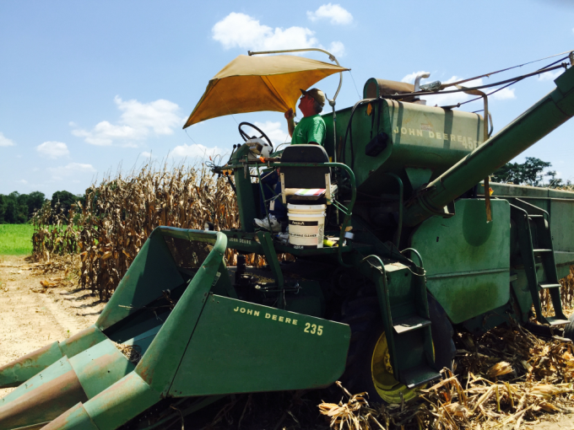
Herbicides and High Yield Corn
After 3 years of testing under weed-free condtions……..
various herbicides applied at recommended time (V2-V5) did not reduce corn yields.
glyphosate + atrazine applied from V2 to V8 did not reduce corn yields.

Slide 21
Herbicide Effects on Field Corn Yield in a High Input Environment (RU = Roundup W-Max, ATZ = Atrazine, PW = Prowl, LIB = Liberty, STDQ = Steadfast Q, CAP = Capreno, LAD = Laudis, HGT = Halex GT, SAN = Sandea) – Average of 3 years (2014 + 2015 + 2016)
BC
A
ABC
C
C
AB
C
C
Applied 17 -27 DAP
~V2-V5 STAGE (178-337 GDD)
Weed-free
Dowdy Farms (Brooks Co.)
Pairwise t-tests: LS Means
P= 0.10
Notes:
The 3 year average effects of herbicides on field corn yield when applied approximately between 178 to 337 GDD (high yield environment and weed-free). No herbicide caused a significant yield loss when compared to the NTC. However, Roundup + Atrazine + Prowl and Laudis + Atrazine resulted in higher yields than certain other treatments.

Slide 22
Roundup P-Max (32 oz/A) + Atrazine (48 oz/A) + AMS Xtra (2.5% v/v) Timing Effects on Field Corn Yield in a High Input Environment – YEAR 3
CN-05-16
Agrigold 6659
P = 0.5029
CV = 7.57

Slide 23
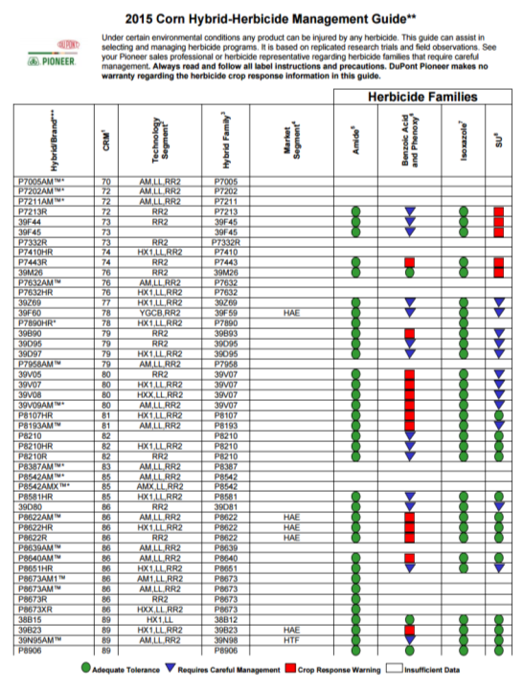
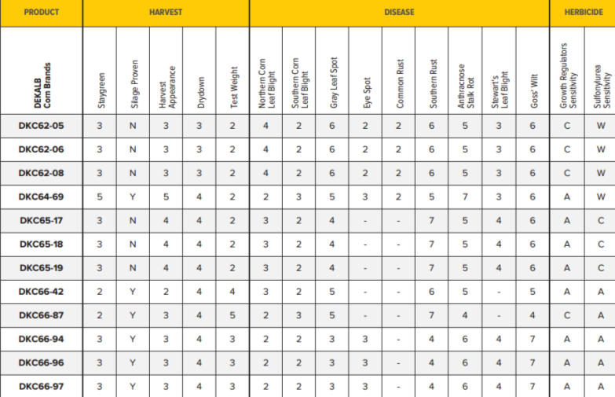


Pay Closer Attention to Hybrid/Herbicide Mgt. Guidelines

Slide 24
ALS-Sensitive Field Corn Hybrids
Dekalb
WARNINGS
DKC 62-05
DKC 62-06
DKC 62-08
DKC 63-44
DKC 63-47
DKC 63-55
DKC 64-69
CAUTIONS
65-17, 65-18, 65-20
70-01, 70-03
RX940, RX940RR2
Pioneer
WARNINGS
P1324HR
P1360
P1360AM
P1360CHR
P1360HR
P1739R
P1739YR
CAUTIONS
P1637R, P1637VYHR, P1637YHR
P1690,P1690HR, P1690R
P2088R, P2089YHR

Slide 25
Can ALS herbicide formulations that contain a crop safener (isoxadifen) be used on ALS sensitive corn hybrids?
Steadfast Q = nicosulfuron + rimsulfuron + isoxadifen
Resolve Q = rimsulfuron + thifensulfuron + isoxadifen
Realm Q = mesotrione + rimsulfuron + isoxadifen
Accent Q = nicosulfuron + isoxadifen
Revulin Q = mesotrione + nicosulfuron + isoxadifen
Capreno = tembotrione + thiencarbazone + isoxadifen

Slide 26
ALS-Sensitive Field Corn Yield as Influenced by POST Herbicide Treatment in Georgia (2014-2015)**
α= 0.10
A
ABC
AB
BC
C
BC
C
**Averaged over 2 years (2014-2015) and 2 corn hybrids (DKC 64-69 and DKC 62-08)
Al treatments also included atrazine @ 2 lb ai/A + COC @ 1% v/v.
Weed-free

Slide 27
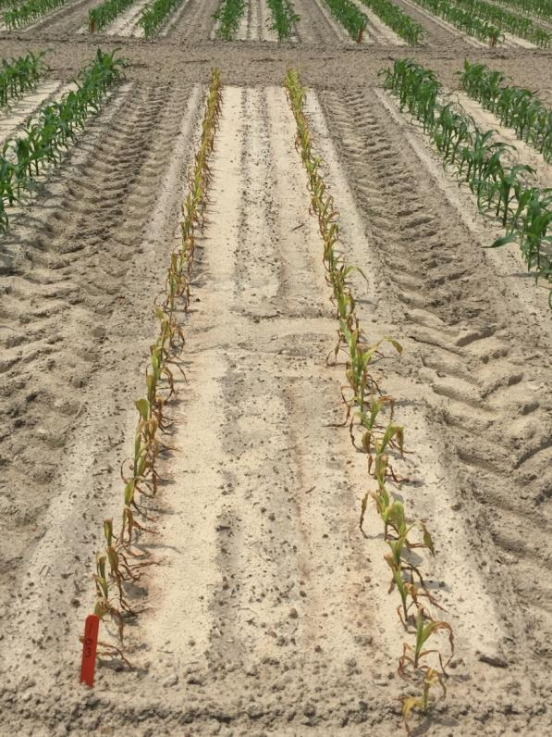
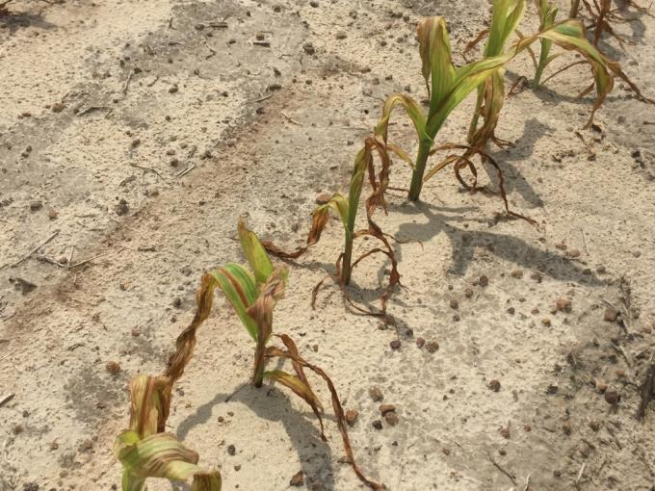
What happens when you spray Liberty on a non-LL corn hybrid?
CN-01B-16
DKC 66-59
Liberty @ 29 oz/A + Atrazine @ 48 oz/A
6 DAT (April 25, 2016)
Still made 28 Bu/A!!!!!

Slide 28
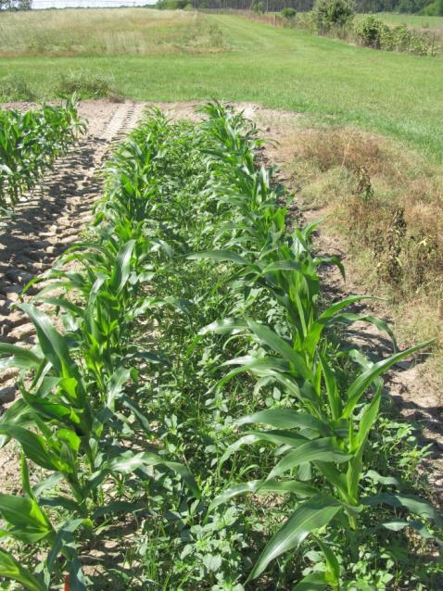
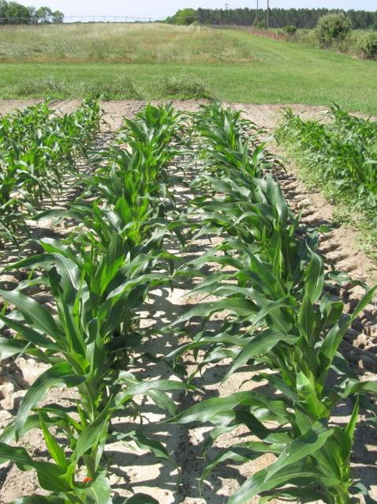
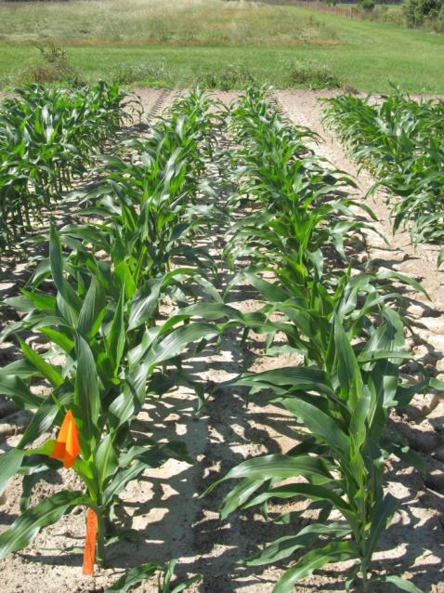
Roundup + Atrazine + AMS + MgSO₄
NTC
Roundup P-MAX 5.5SL @ 22 oz/A
Atrazine 4L @ 64 oz/A
AMS Xtra @ 2.5% v/v
Roundup P-MAX 5.5SL @ 22 oz/A
Atrazine 4L @ 64 oz/A
AMS Xtra @ 2.5% v/v
MgSO₄ @ 4 lb/A
CN-13-16
May 4, 2016
14 DAT

Slide 29
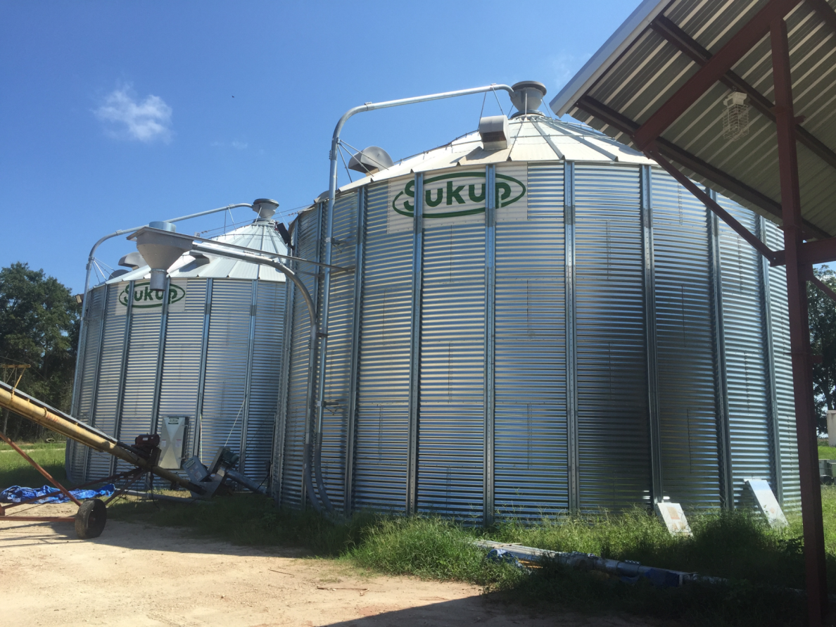


Question/Comments

