Slide 1

Peanut Weed Control Update - 2016
Eric P. Prostko, Ph.D.
Professor and Extension Weed Specialist
Department of Crop & Soil Sciences

Slide 2
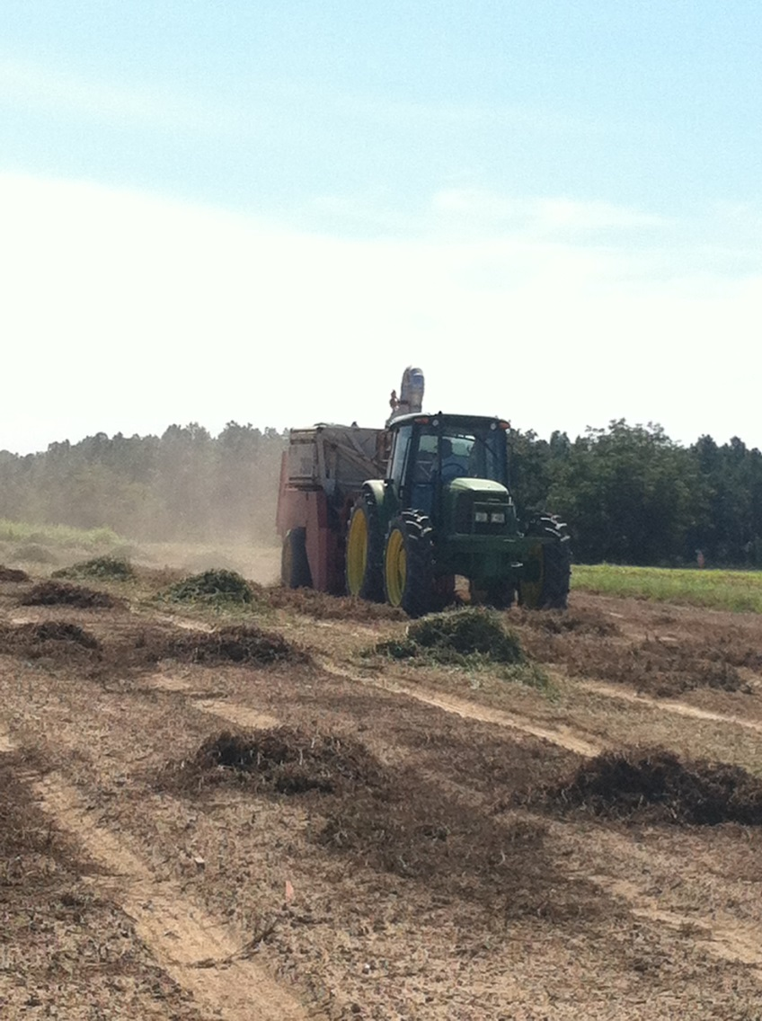
Peanut Weed Control General Thoughts
Done by 40-45 DAP
Do you really need Gramoxone in Valor treated fields under irrigation?
Warrant or Dual + Valor at planting for pigweed?
Herbicide resistance or Farmer resistance?
Too big – too dry - too fast – too high

Slide 3
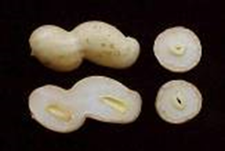
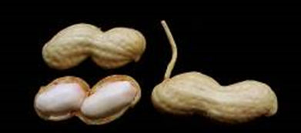
Herbicide Sensitive Peanut Growth Stages
R5
R6

Slide 4
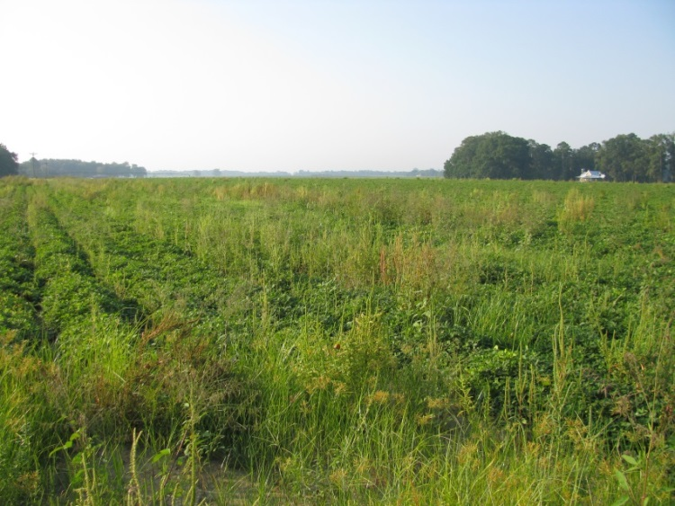
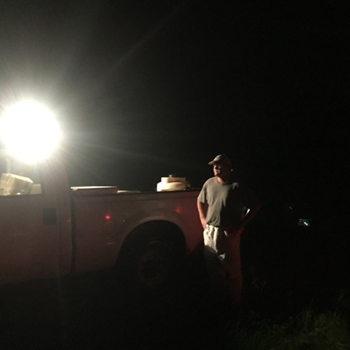
Current Peanut Weed Science Research at UGA
Variety Tolerance
New Herbicides
Pyroxasulfone
Zidua, Anthem Flex
Fluridone
Brake
Nozzle Types
Time of Day
Fine Tuning Existing Programs
Tank-Mixtures

Slide 5
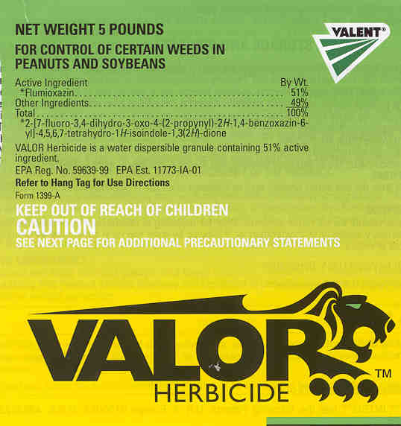



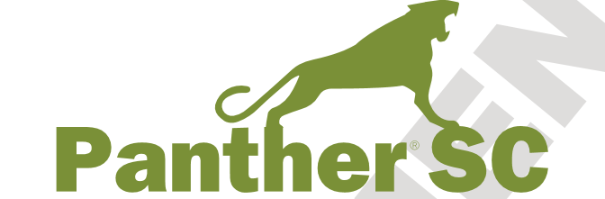
Flumioxazin

Slide 6
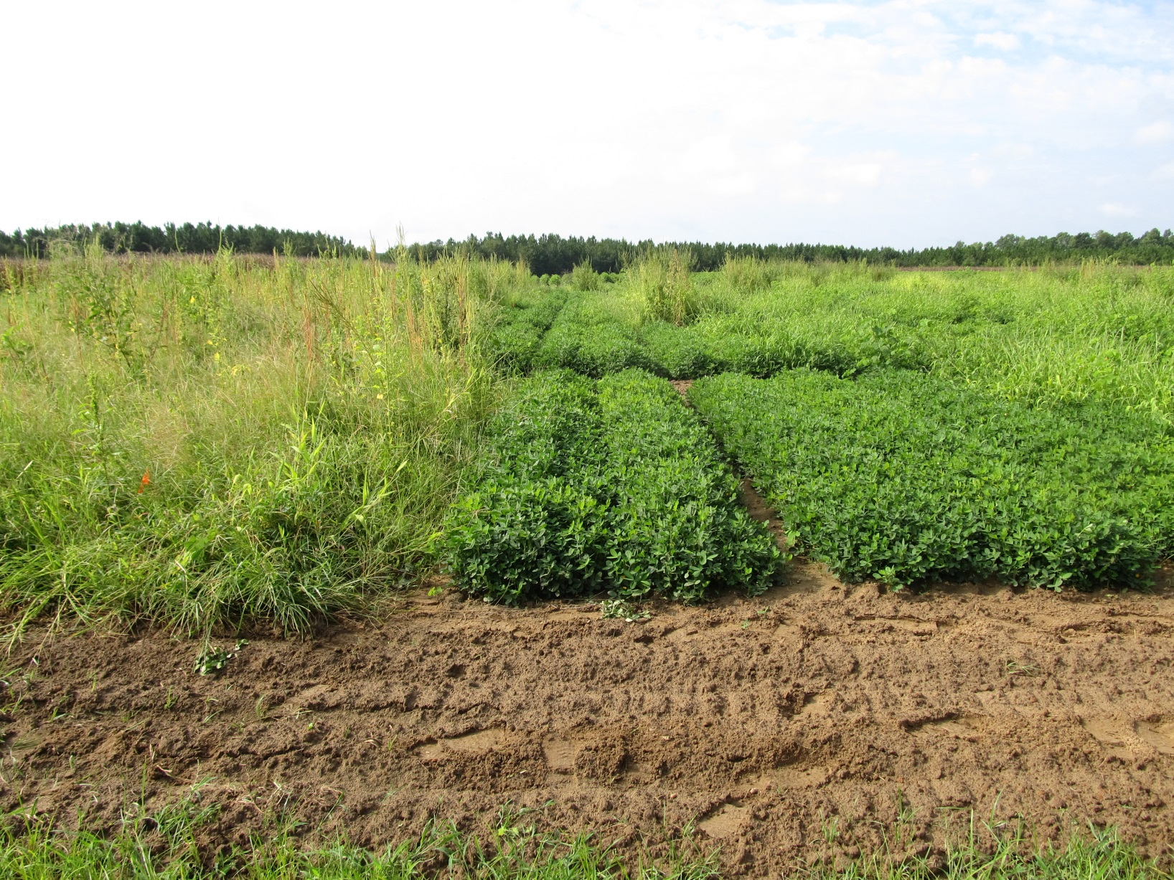
Peanut Weed Control – 2015 (Valor-Based Programs)
Prowl H₂0 @ 32 oz/A (PRE)
Valor @ 3.0 oz/A (PRE)
Strongarm @ 0.225 oz/A (PRE)
Cadre @ 4 oz/A – 36 DAP
Dual Magnum @ 16 oz/A – 36 DAP
2,4-DB @ 18 oz/A – 36 DAP
Prowl H₂0 @ 32 oz/A (PRE)
Valor @ 3.0 oz/A (PRE)
Strongarm @ 0.225 oz/A (PRE)
Cadre @ 4 oz/A – 36 DAP
Warrant @ 48 oz/A – 36 DAP
2,4-DB @ 18 oz/A – 36 DAP
NTC
PE-13-15
August 12
100 DAP

Slide 7
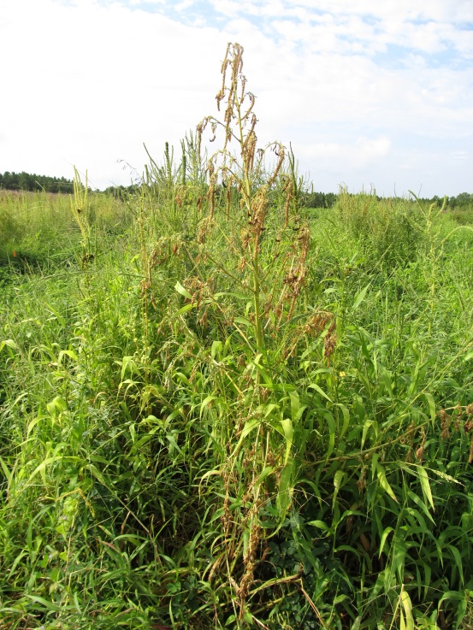
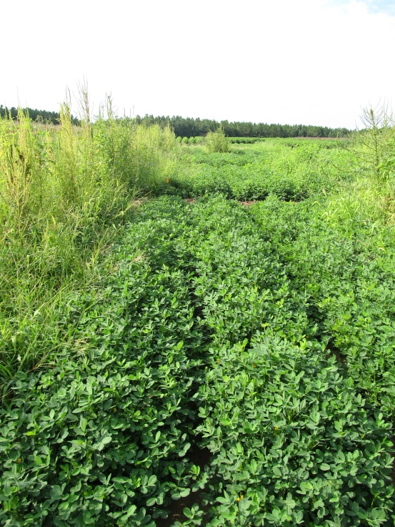
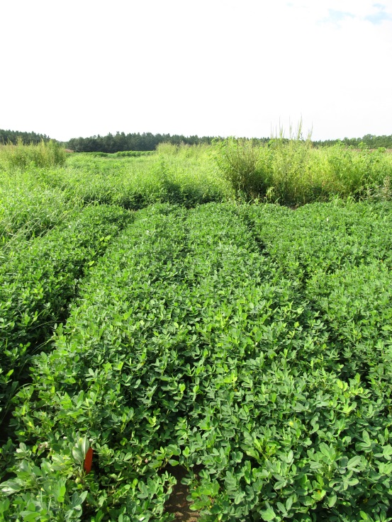
Peanut Weed Control – 2015 (Paraquat-Based Programs)
NTC
Prowl H₂0 @ 32 oz/A – PRE
Gramoxone @ 12 oz/A – 17 DAP
Storm @ 16 oz/A – 17 DAP
Dual Magnum @ 16 oz/A – 17 DAP
Cadre @ 4 oz/A – 36 DAP
Dual Magnum @ 16 oz/A – 36 DAP
2,4-DB @ 18 oz/A – 36 DAP
Prowl H₂0 @ 32 oz/A – PRE
Gramoxone @ 12 oz/A – 17 DAP
Storm @ 16 oz/A – 17 DAP
Warrant @ 48 oz/A – 17 DAP
NIS @ 0.25% v/v – 17 DAP
Cadre @ 4 oz/A – 36 DAP
Warrant @ 48 oz/A – 36 DAP
2,4-DB @ 18 oz/A – 36 DAP
NIS @ 0.25% v/v – 36 DAP
PE-13-15
August 12
100 DAP

Slide 8
Cadre (CD), Cobra (CB), 2,4-DB, Dual Magnum (DM), and Warrant (W) Effects on Peanut Yield - III
P = 0.4691
PE-14-15
Averaged over 2 timings
(31 and 45 DAP)
Weed-free

Slide 9
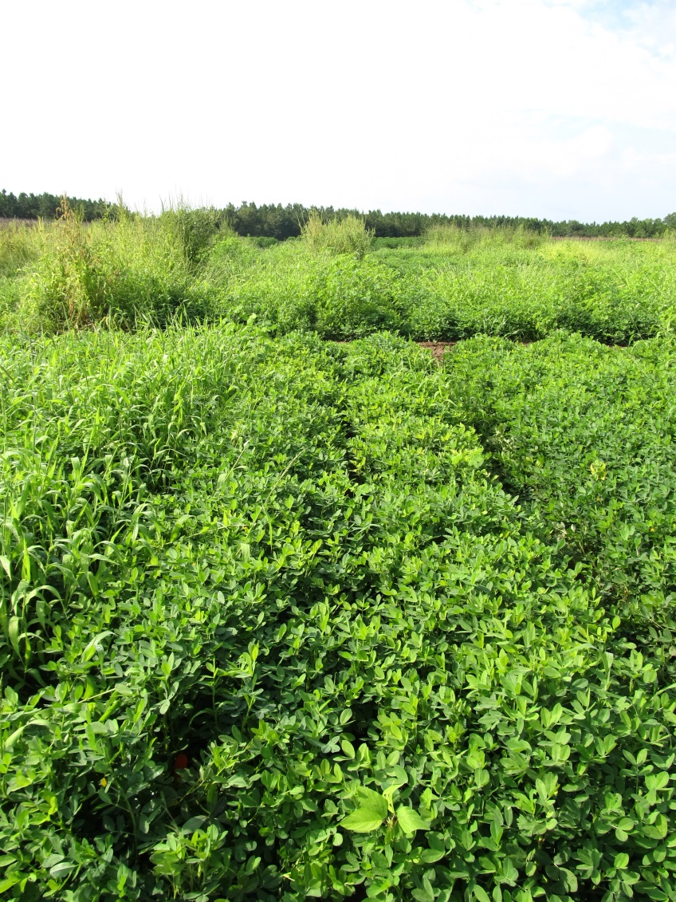
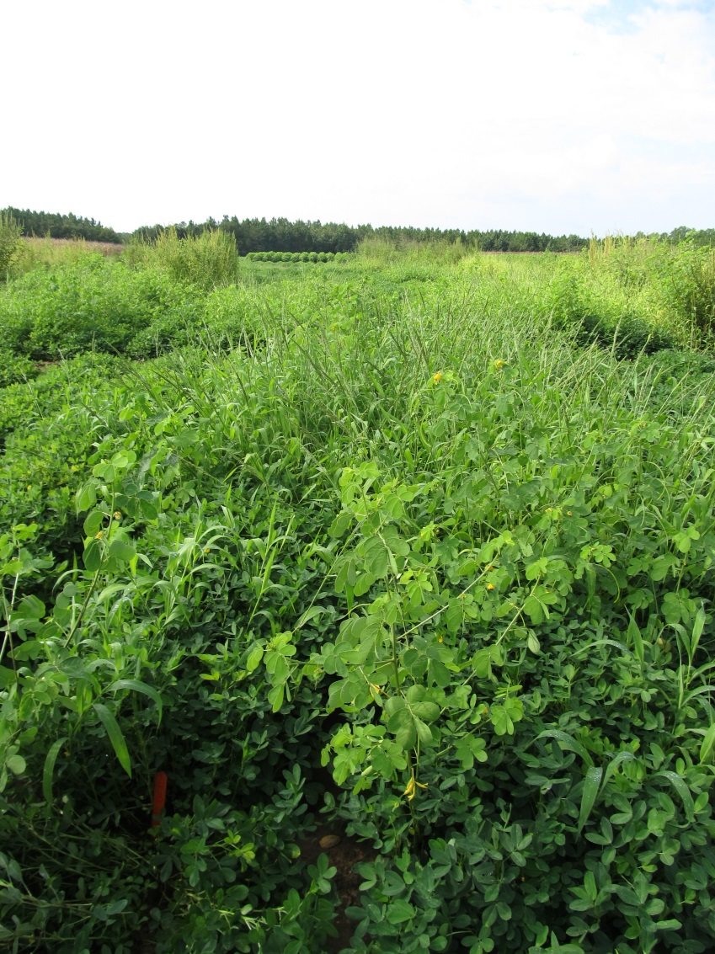
Sicklepod Control in 2015
+ Cadre
- Cadre
PE-13-15
August 12
100 DAP

Slide 10
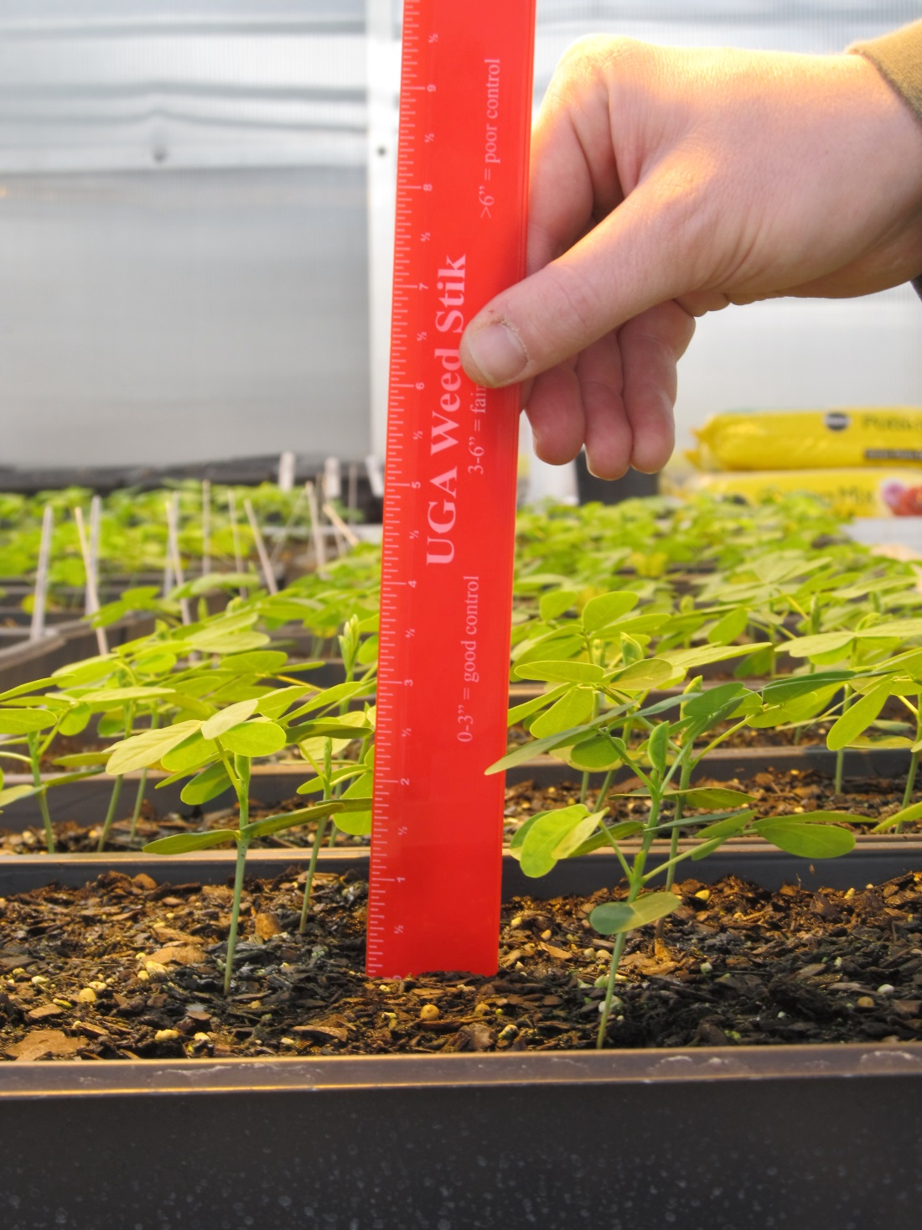
This is what
a 3” tall
sicklepod
looks like!

Slide 11
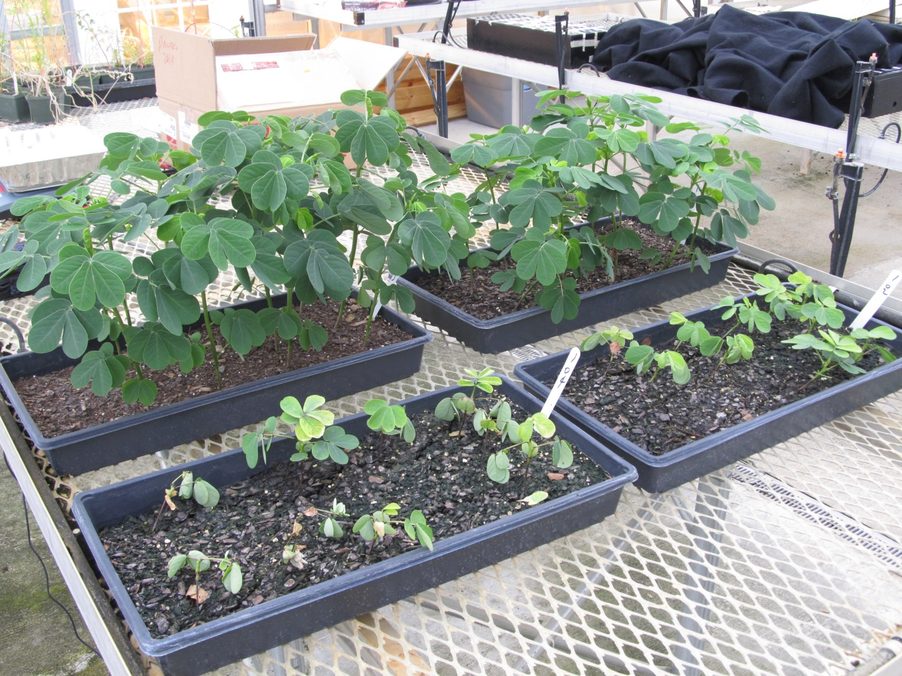
AZ1(L) and DC4(R) Response to Cadre @ 4 oz/A + COC @ 1% v/v – 21DAT

Slide 12
New Peanut Variety Yield Response to POST Herbicides - 2015
Treatment | Timing | GA-12Y (lb/A) | GA-13M (lb/A)
NTC | -- | 6203 | 6484
Gramoxone + Storm + Dual Magnum | 14 DAP | 6471 | 6143
Cadre + Dual Magnum | 37 DAP | 6574 | 6155
Gramoxone + Storm + Dual Magnum Cadre + Dual Magnum | 14 DAP 37 DAP | 6514 | 6378
Gramoxone + Storm + Warrant + NIS | 14 DAP | 6544 | 6369
Cadre + Warrant + NIS | 37 DAP | 6538 | 6559
Gramoxone + Storm + Warrant + NIS Cadre + Warrant + NIS | 14 DAP 37 DAP | 6284 | 6369
Gramoxone + Storm + Zidua + NIS | 14 DAP | 6652 | 6164
Cadre + Zidua + NIS | 37 DAP | 6544 | 6149
Gramoxone + Storm + Zidua + NIS Cadre + Zidua + NIS | 14 DAP 37 DAP | 6293 | 6008
P-value |  | 0.1104 | 0.2189
CV |  | 3.4 | 4.71
PE-15-15
PE-16-15
Weed-free

Slide 13
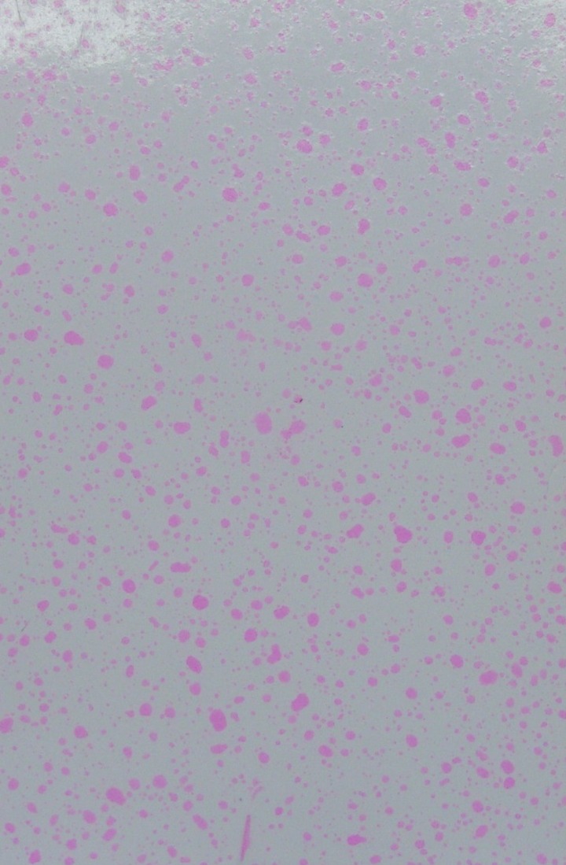
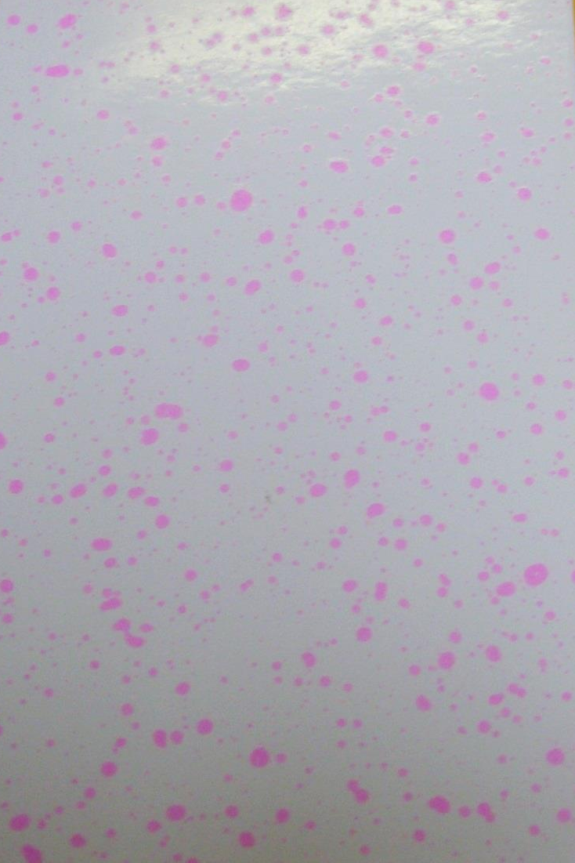
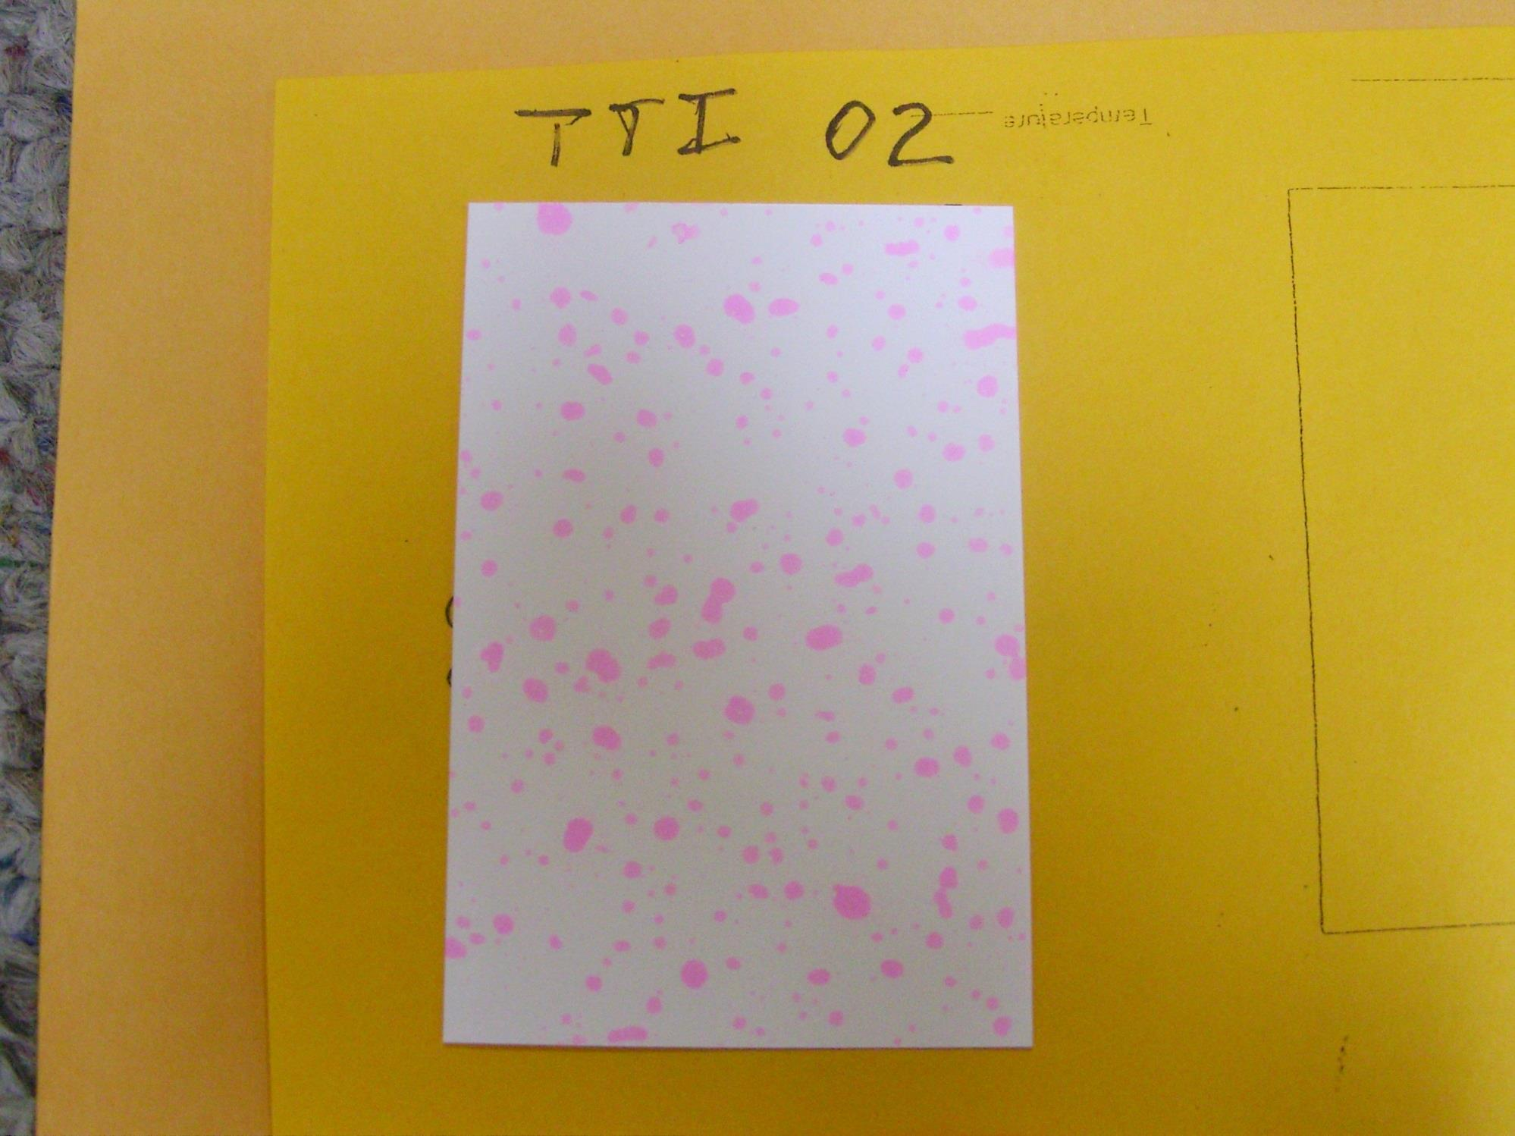
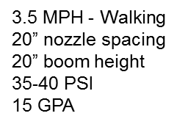
11002DG
VMD₅₀ = 322 (C)
AIXR 11002
VMD₅₀ = 402 (VC)
TTI 02
VMD₅₀ = 524 (EC)

Slide 14
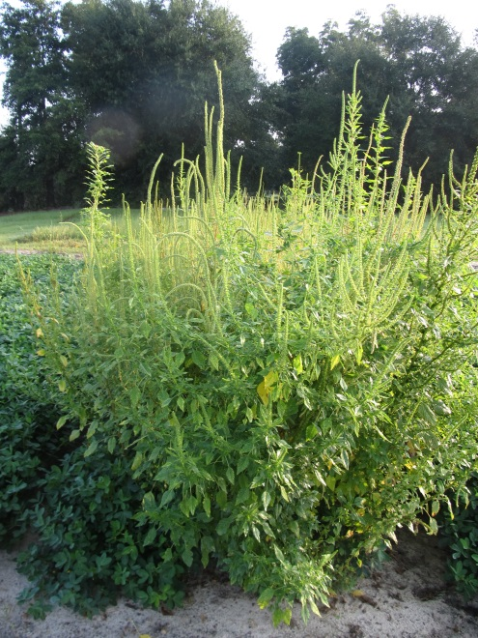
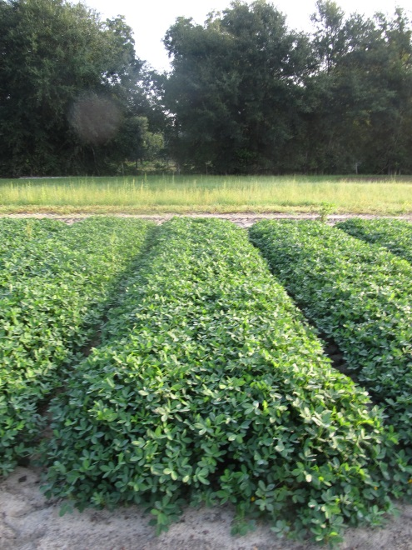
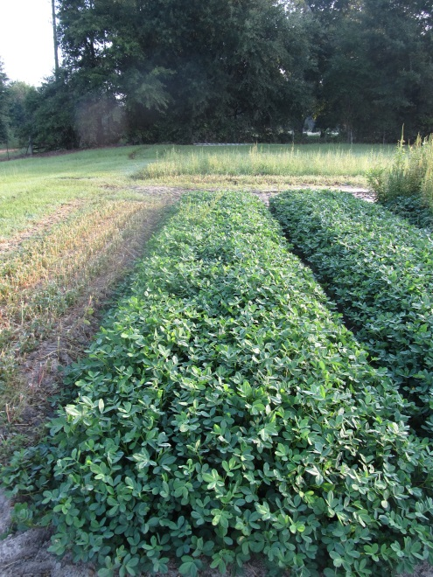
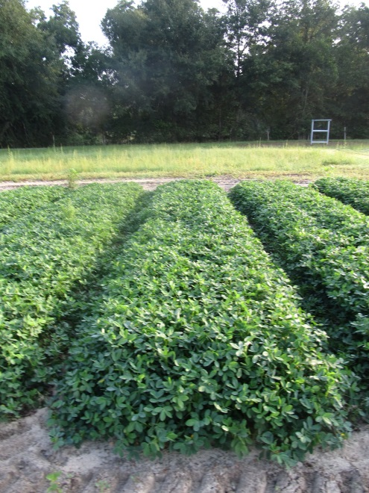
Nozzle Type Effects on Peanut Weed Control - I
NTC
11002DG
Prowl H₂O @ 32 oz/A
(PRE)
Gramoxone @ 12 oz/A +
Storm @ 16 oz/A +
Dual Magnum @ 16 oz/A
(15 DAP)
Cadre @ 4 oz/A +
Dual Magnum @ 16 oz/A +
2,4-DB @ 16 oz/A
(42 DAP)
15 GPA
3.0 MPH
20” Boom Height
11002 AIXR
TTI 02
PE-05A-15
July 29
90 DAP

Slide 15

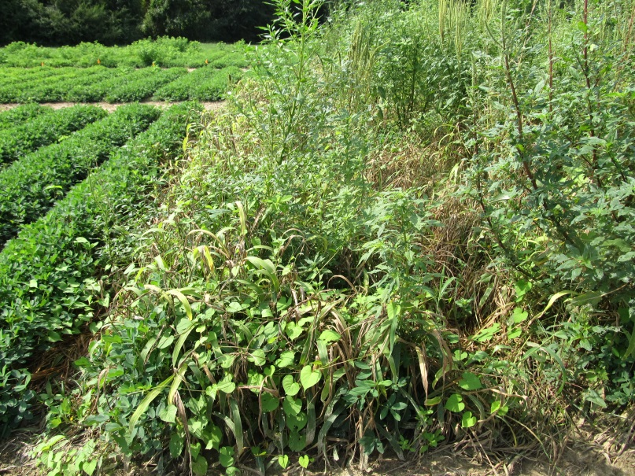
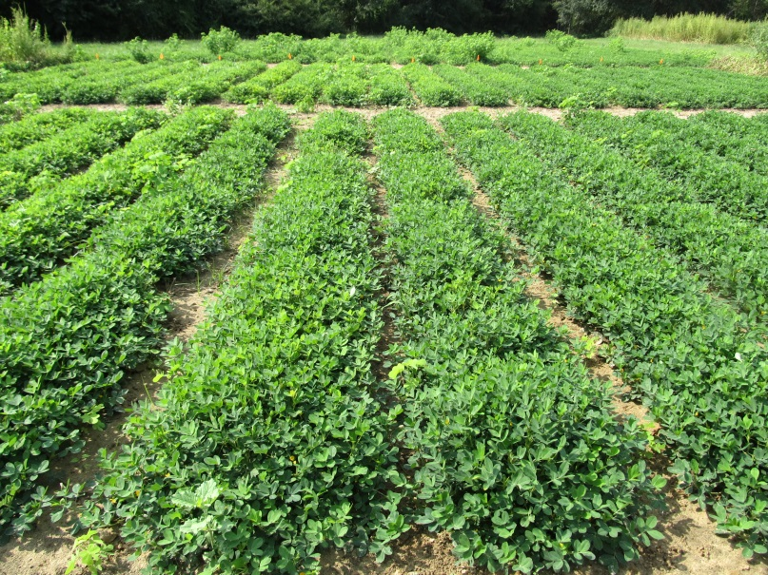

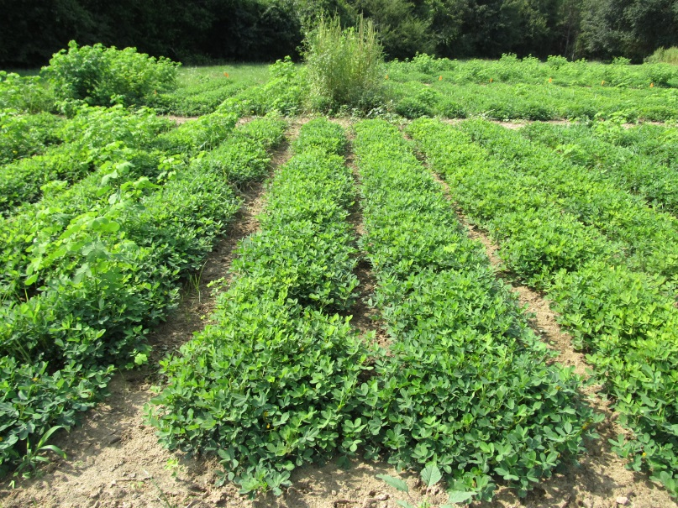
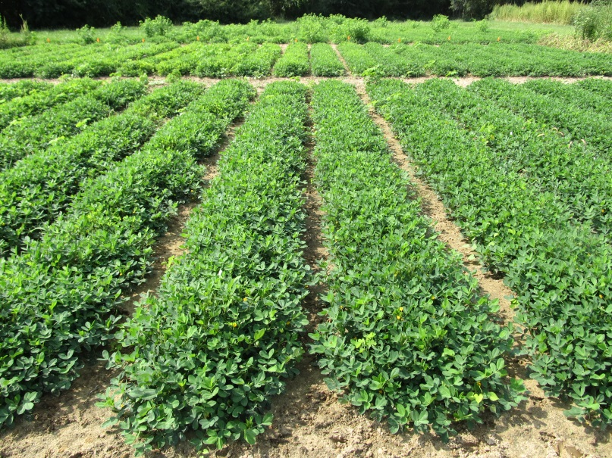

Nozzle Type Effects on Peanut Weed Control - II
Prowl H₂O @ 32 oz/A
(PRE)
Gramoxone @ 12 oz/A +
Storm @ 16 oz/A +
Dual Magnum @ 16 oz/A
(23 DAP)
Cadre @ 4 oz/A +
Dual Magnum @ 16 oz/A +
2,4-DB @ 16 oz/A
(36 DAP)
15 GPA
3.0 MPH
20” Boom Height
11002 AIXR
PE-05B-15
August 3
91 DAP

Slide 16
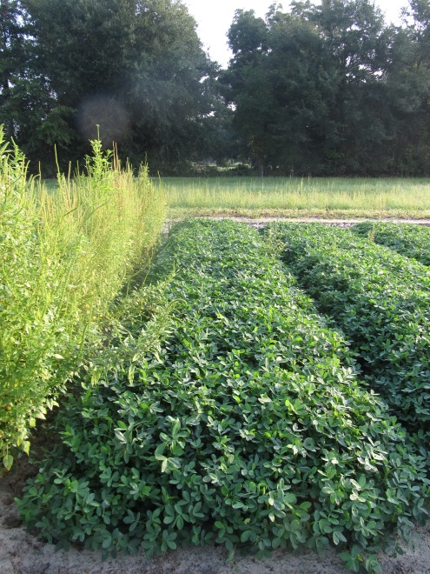

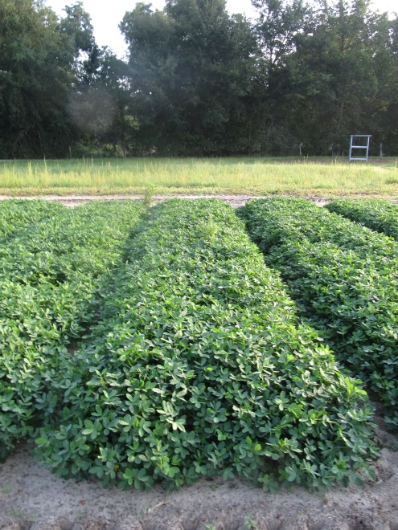
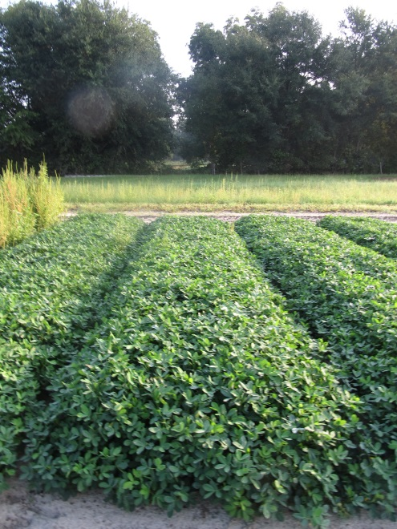


Nozzle Type Effects on Peanut Weed Control - III
NTC
11002DG
Prowl H₂O @ 32 oz/A
(PRE)
Gramoxone @ 12 oz/A +
Storm @ 16 oz/A +
Dual Magnum @ 16 oz/A
(15 DAP)
Cobra @ 12.5 oz/A +
Dual Magnum @ 16 oz/A +
2,4-DB @ 16 oz/A
(42 DAP)
15 GPA
3.0 MPH
20” Boom Height
PE-05A-15
July 29
90 DAP

Slide 17
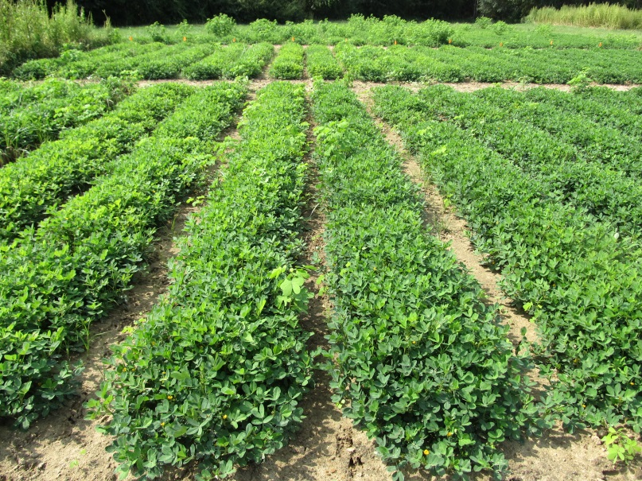
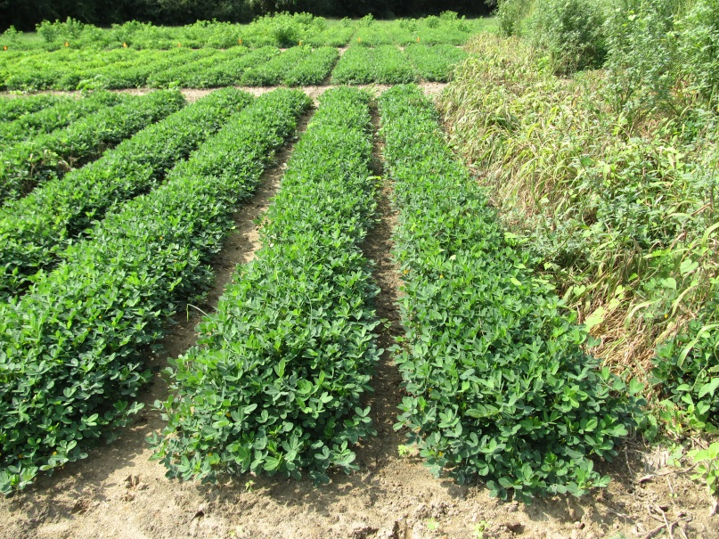
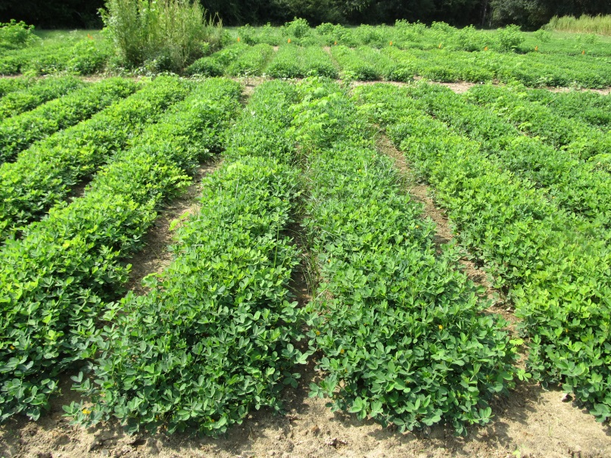


Nozzle Type Effects on Peanut Weed Control - IV
Prowl H₂O @ 32 oz/A
(PRE)
Gramoxone @ 12 oz/A +
Storm @ 16 oz/A +
Dual Magnum @ 16 oz/A
(23 DAP)
Cobra @ 12.5 oz/A +
Dual Magnum @ 16 oz/A +
2,4-DB @ 16 oz/A
(36 DAP)
15 GPA
3.0 MPH
20” Boom Height
PE-05B-15
August 3
91 DAP

Slide 18
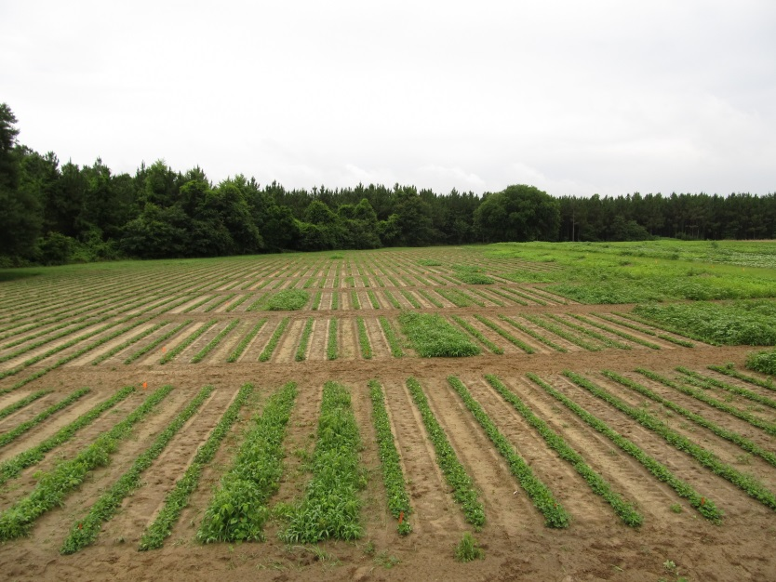

Time of Day Research
Afternoon showers are a problem
Hard to see
No real benefit
Nyctinasty
Leaves close at night
sicklepod

Slide 19
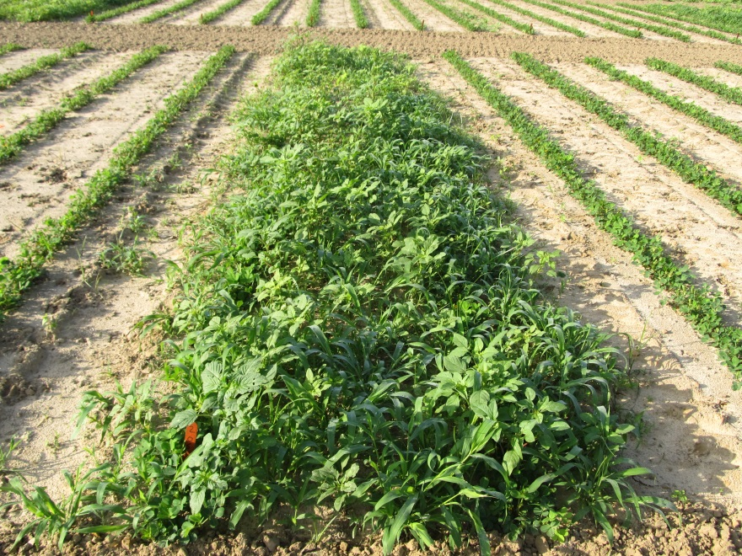
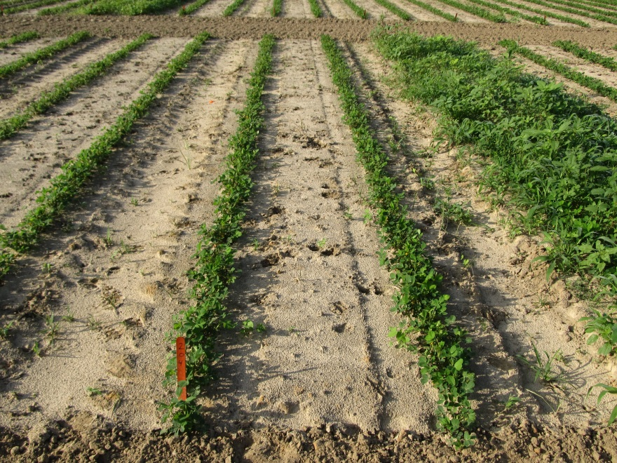
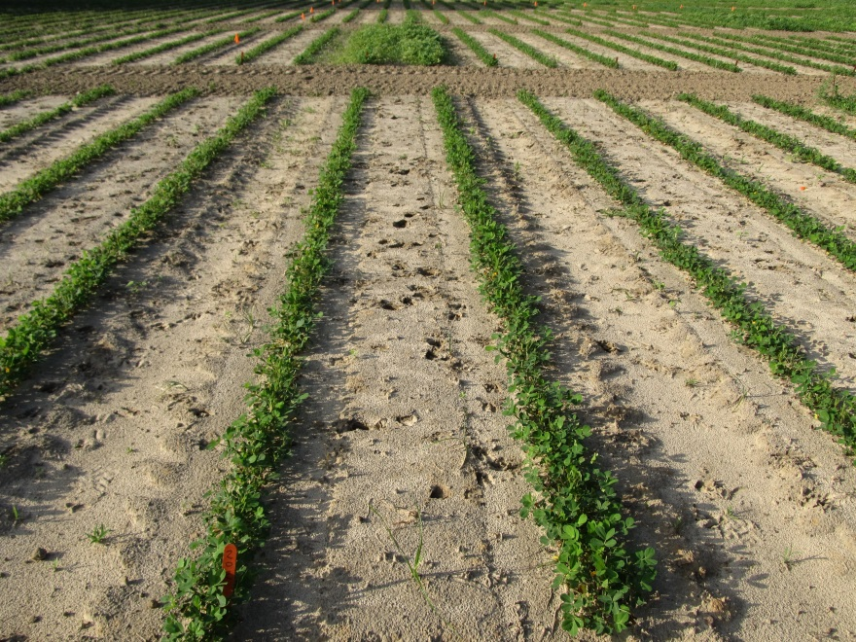
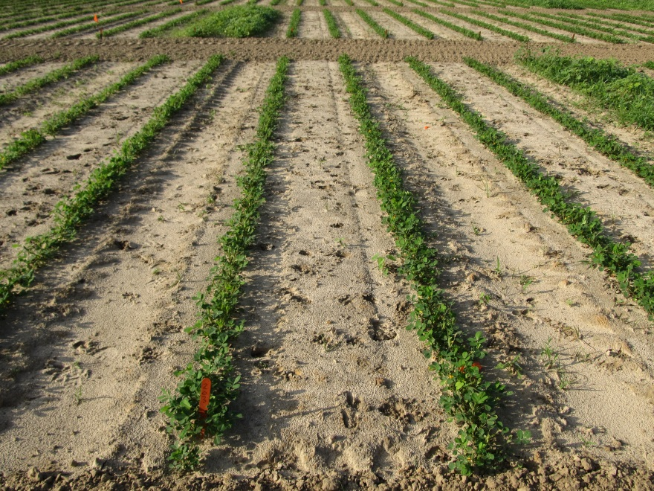
Time of Day Effects on Gramoxone (12 oz/A) + Storm (16 oz/A) + Dual Magnum (16 oz/A)
7 am
12 pm
5 pm
PE-04B-14
June 5
15 DAT

Slide 20
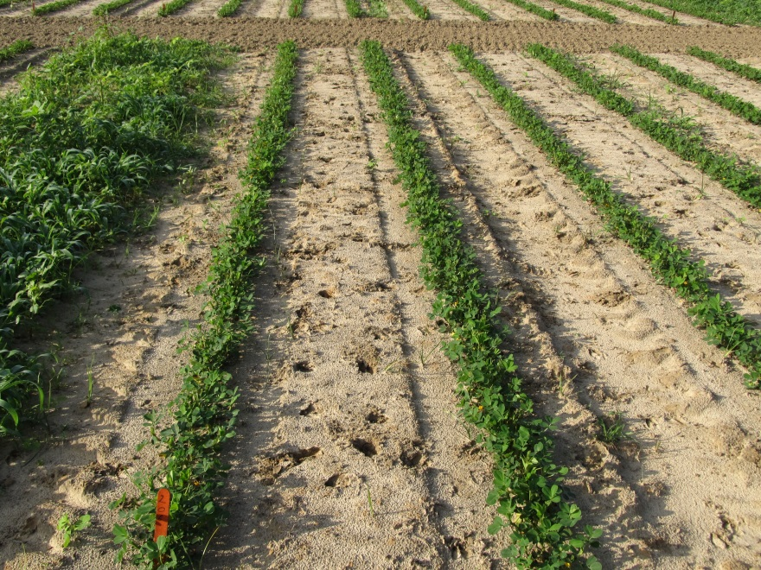
Time of Day Effects on Gramoxone (12 oz/A) + Storm (16 oz/A) + Dual Magnum (16 oz/A)
NTC
10 PM
PE-04B-14
June 5
15 DAT

Slide 21
Time of Day Effects of Gramoxone + Storm + Dual Magnum on Palmer Amaranth Control (14-15 DAT) – 2015
15 GPA
11002DG
38-40 PSI
3.5 MPH
* Not significantly different at any location

Slide 22
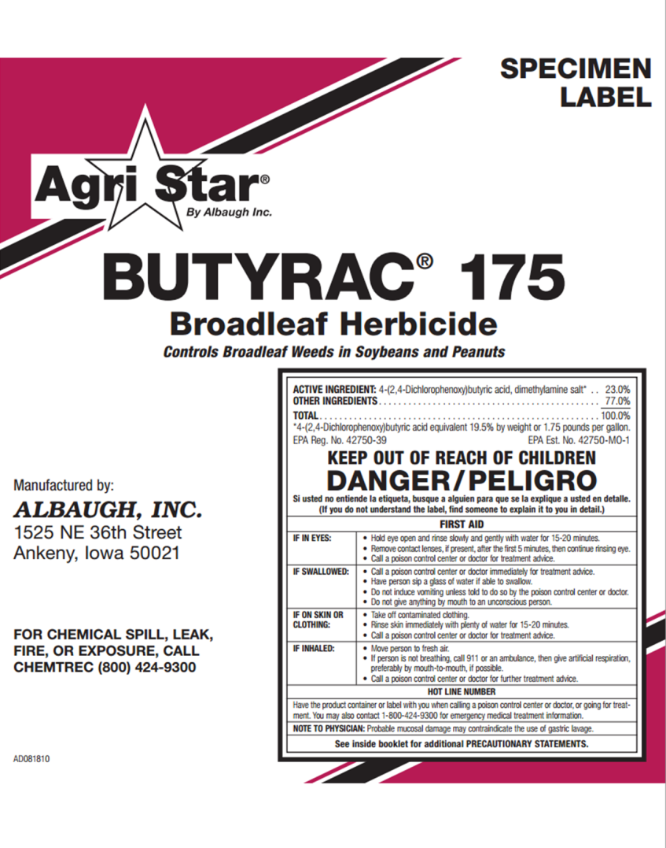
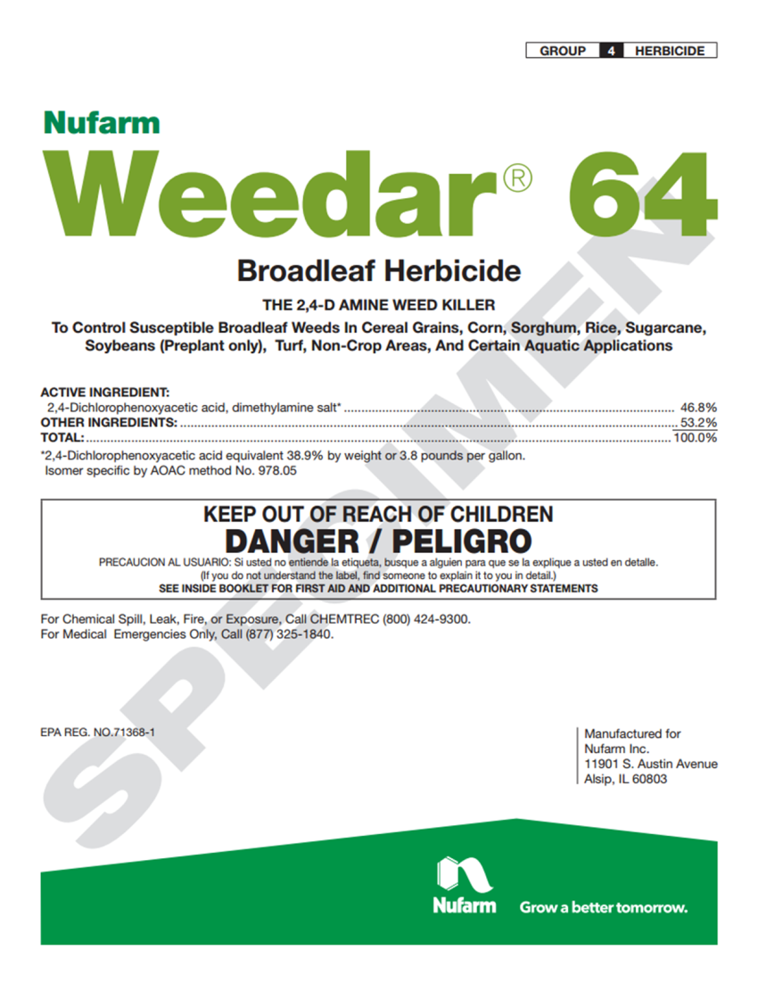
Pay Attention!!!!! 2,4-DB and 2,4-D are not the same thing!!!!

Slide 23
How much 2,4-DB? (as of June 29, 2015)
Product | Manufacturer | Rate/A (oz) | Time of Application | Total # Applications /Year | PHI (days)
2,4-DB 175 | Winfield/AgriSolutions | 14.4-17.6 | 2-12 WAPª | 2 | 45
2,4-DB 175 | ACETO | 16.0-28.0 | No later than late bloom (90-100 DAP^{b}) | 2 | 60
2,4-DB 200 | Winfield/AgriSolutions | 12.8-16.0 | 2-12 WAP | 2 | 60
2,4-DB 200 | ACETO | 14.4-25.6 | No later than late bloom (90-100 DAP^{b}) | 2 | 60
AgriStar Butyrac 175 | Albaugh/AgriStar | 14.4-17.6 | 2-12 WAP | 2 | 45
AgriStar Butyrac 200 | Albaugh/AgriStar | 12.8-16.0 | 2-12 WAP | 2 | 45
ªWAP = weeks after planting; ^{b}DAP = days after planting

Slide 24
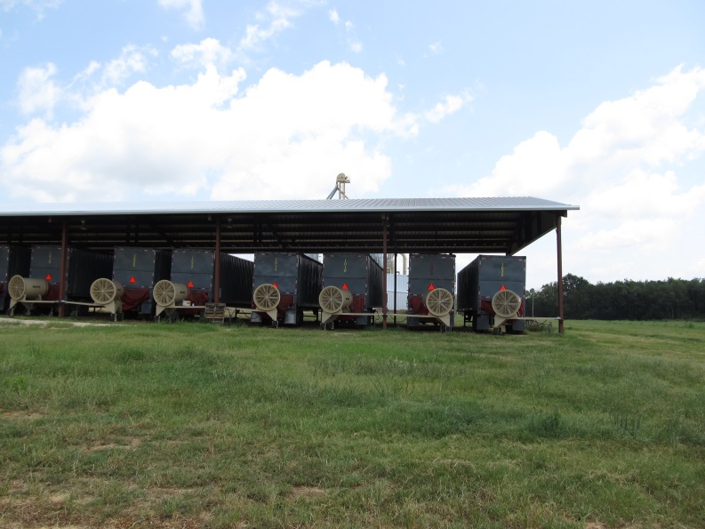
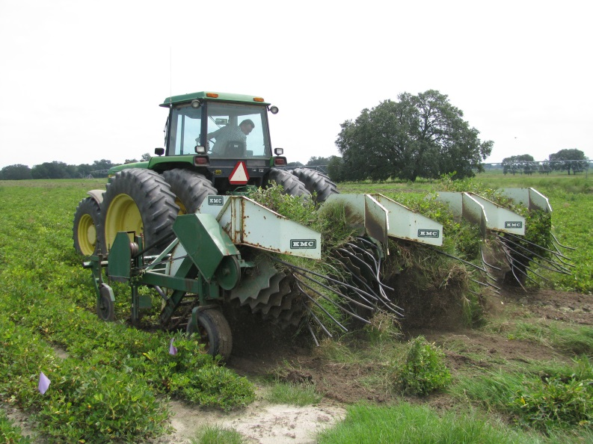
2,4-DB and Peanut Tolerance
2015
GA-06G
Weed-free
24 oz/A of 2,4-DB 1.75SL + COC @ 1% v/v, applied throughout the season, had no effect on peanut yield or pod size

Slide 25
2,4-DB Effects on Peanut Yield (GA-06G) – 2015
2,4-DB 1.75 SL
24 oz/A
1% COC
Weed-free
P = 0.7391
CV = 8.49
PE-06-15

Slide 26
2,4-DB Effects on Peanut Pod Size (GA-06G) – 2015
2,4-DB 1.75 SL
24 oz/A
1% COC
Weed-free
P = 0.3120
CV = 8.23
PE-06-15

Slide 27
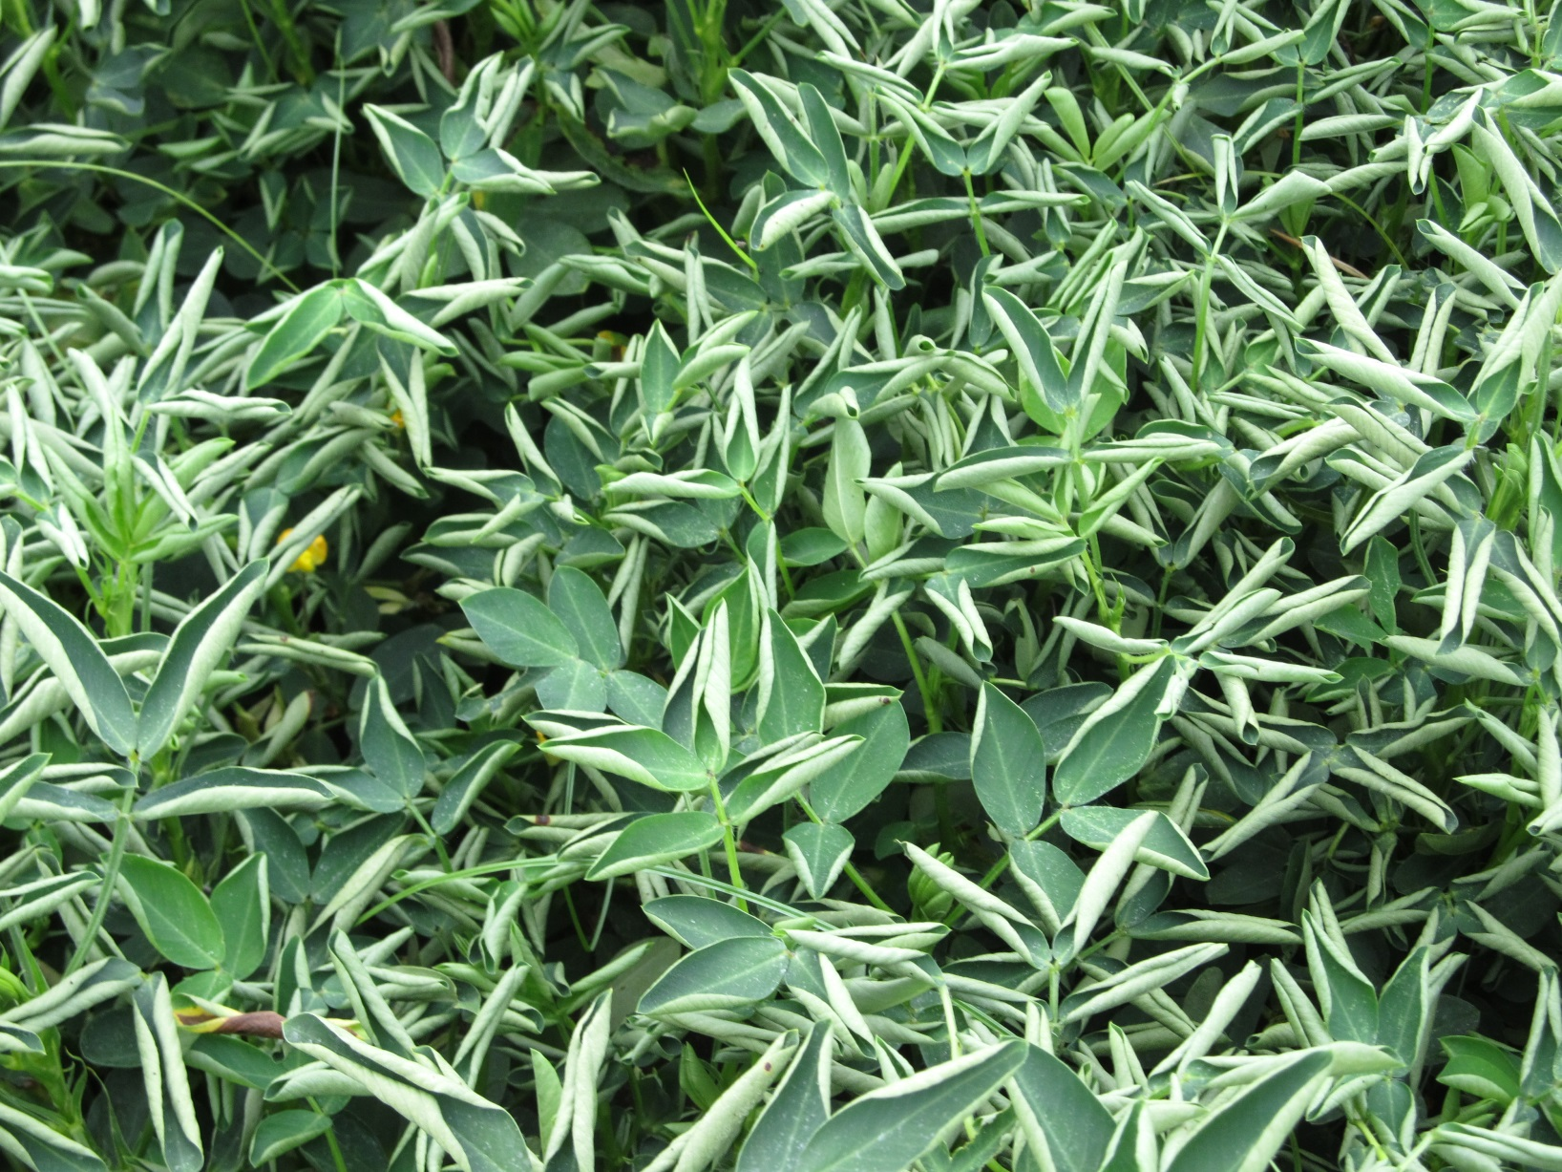
Grazon P+D 2.54SL 1/10X rate (2.4 oz/A) – Applied 63 DAP
PE-11-15
August 11
112 DAP

Slide 28
Grazon P+D 2.54SL Effects on Peanut Yield (lb/A)
P = 0.4355
PE-11-15

Slide 29
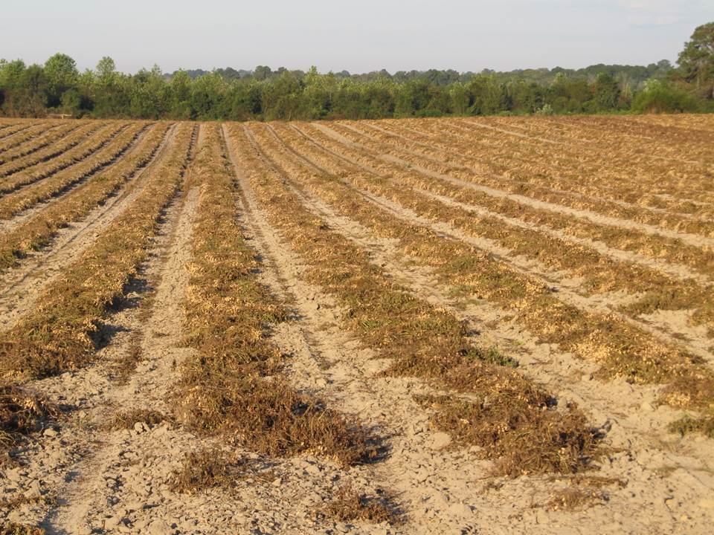

What do the top Georgia peanut growers do? 2014 Georgia Peanut Achievement Club Winners
10 growers
6312 lb/A average yield
GA State Avg. = 4135 lb/A
10/10 - irrigated
8/10 - bottom plow
10/10 - twin rows
Rotations
peanuts every 3rd or 4th year
Herbicides
8/10 - Sonalan
9/10 - Valor
3/10 - Dual
8/10 - Cadre
6/10 - 2,4-DB
2/10 - Prowl
3/10 - Strongarm

Slide 30
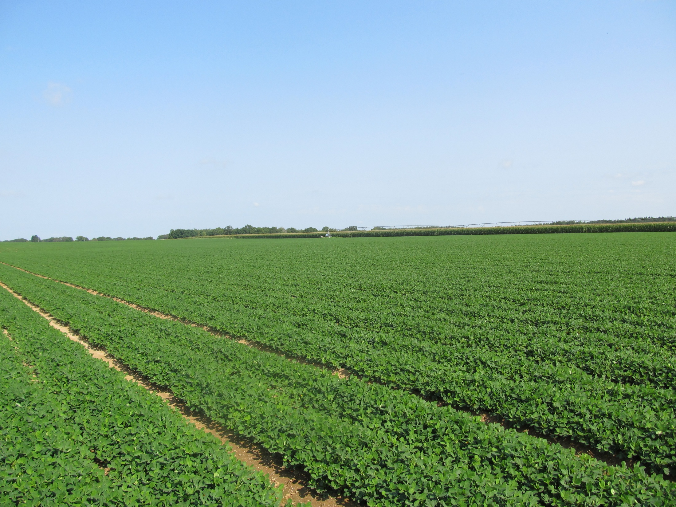

Questions?
eprostko@uga.edu
www.gaweed.com

