Slide 1
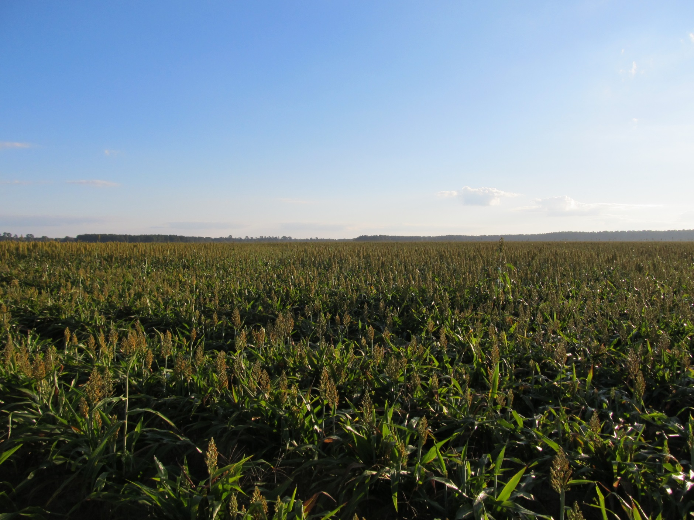
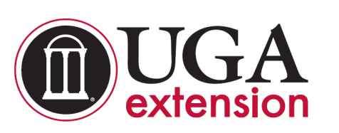
GRAIN SORGHUM WEED CONTROL UPDATE – 2016
Eric P. Prostko, Ph.D.
Professor and Extension Weed Specialist
Dept. Crop & Soil Sciences

Slide 2
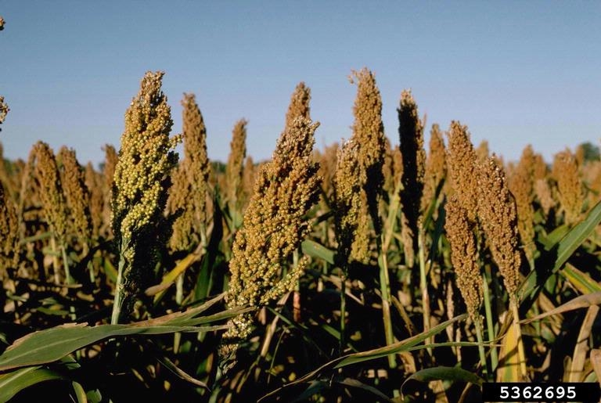
GRAIN SORGHUM WEED CONTROL
Start clean!
Concep treated seed
Dual Magnum or Warrant (PRE)
Atrazine (POST)
Paraquat (Hooded sprayer)
Mechanical Cultivation

Slide 3
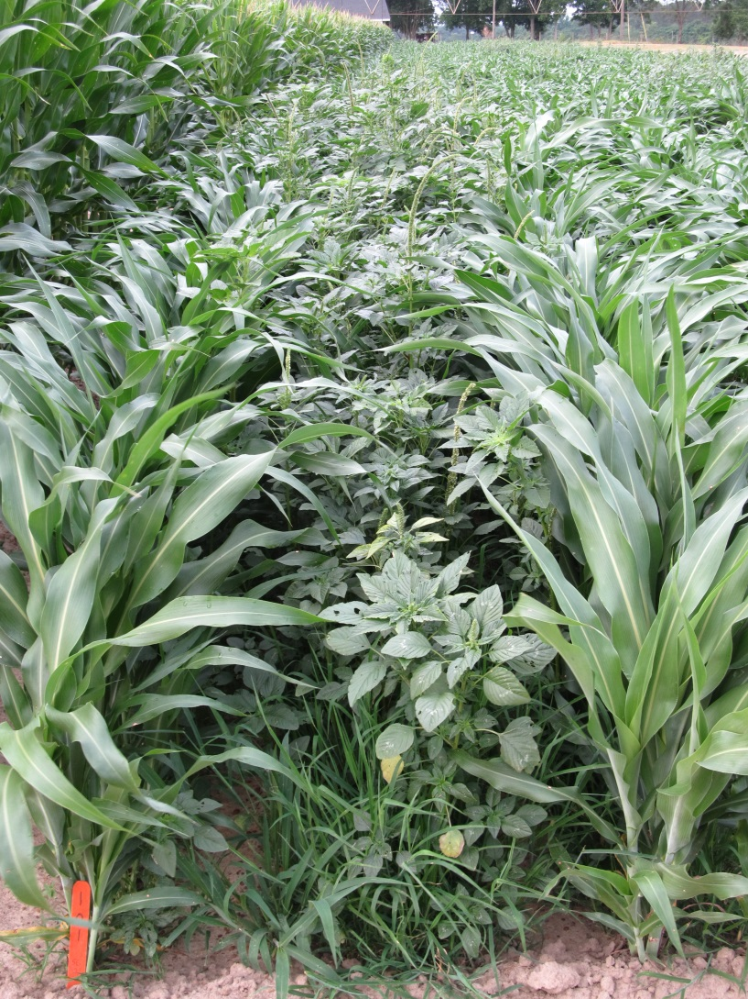
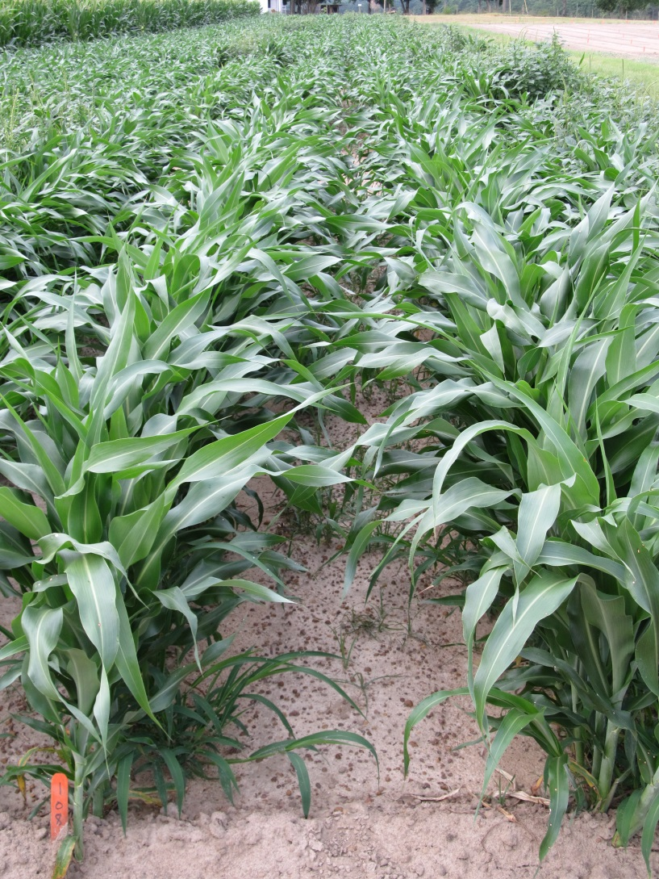
Weed Control in Grain Sorghum - 2015
NTC
Warrant @ 48 oz/A – PRE
Atrazine @ 48 oz/A – 23 DAP
COC @ 1% v/v – 23 DAP
SG-01-15
May 26
49 DAP

Slide 4
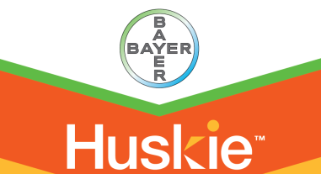
A New Product to Consider?
Huskie 2.06EC
Bayer CropScience
Buctril (1.75 lbs/gal) + pyrasulfotole (0.31 lbs/gal)
MOA = 6 + 27
Postemergence (13-16 oz/A)
3-leaf to 12” tall sorghum
Broadleaf weeds, good on pigweed
Tank-mix with atrazine (16 oz/A)

Slide 5
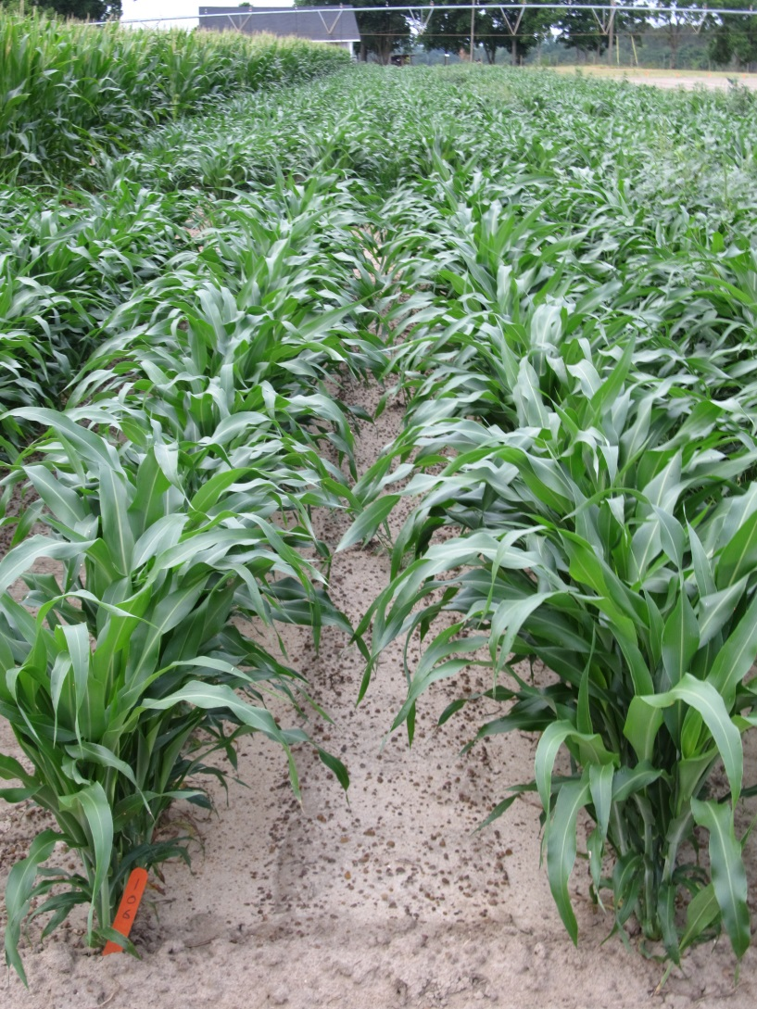

Weed Control in Grain Sorghum - 2015
NTC
Dual II Magnum @ 16 oz/A – PRE
Huskie @ 13 oz/A – 23 DAP
Atrazine @ 16 oz/A – 23 DAP
AMS Xtra @ 2.5% v/v – 23 DAP
NIS @ 0.25% v/v – 23 DAP
SG-01-15
May 26
49 DAP

Slide 6
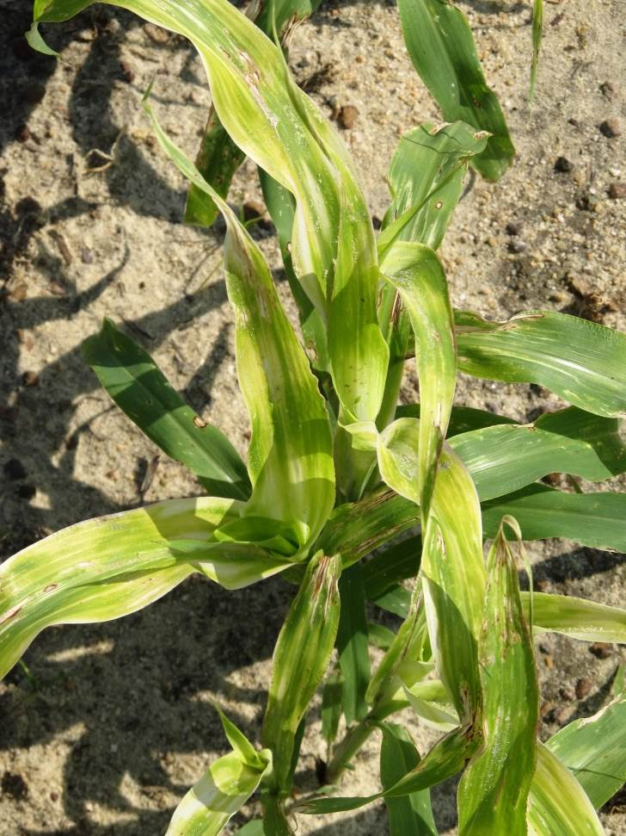
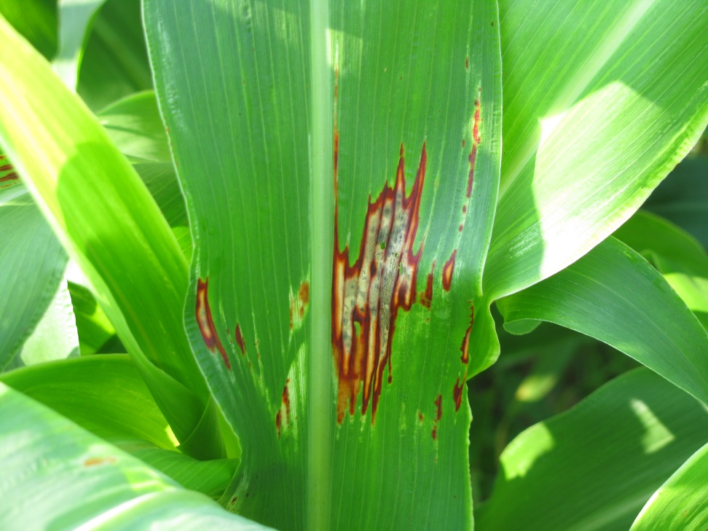

Huskie Injury on Sorghum

Slide 7
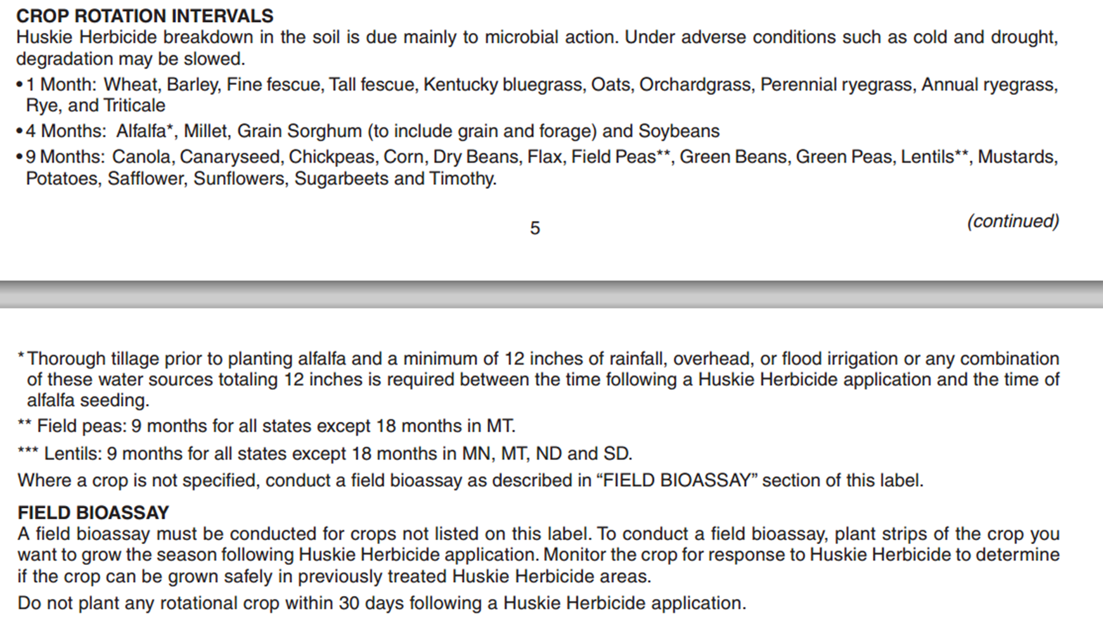

Huskie Rotation Restrictions
(cotton and peanut are not listed)

Slide 8
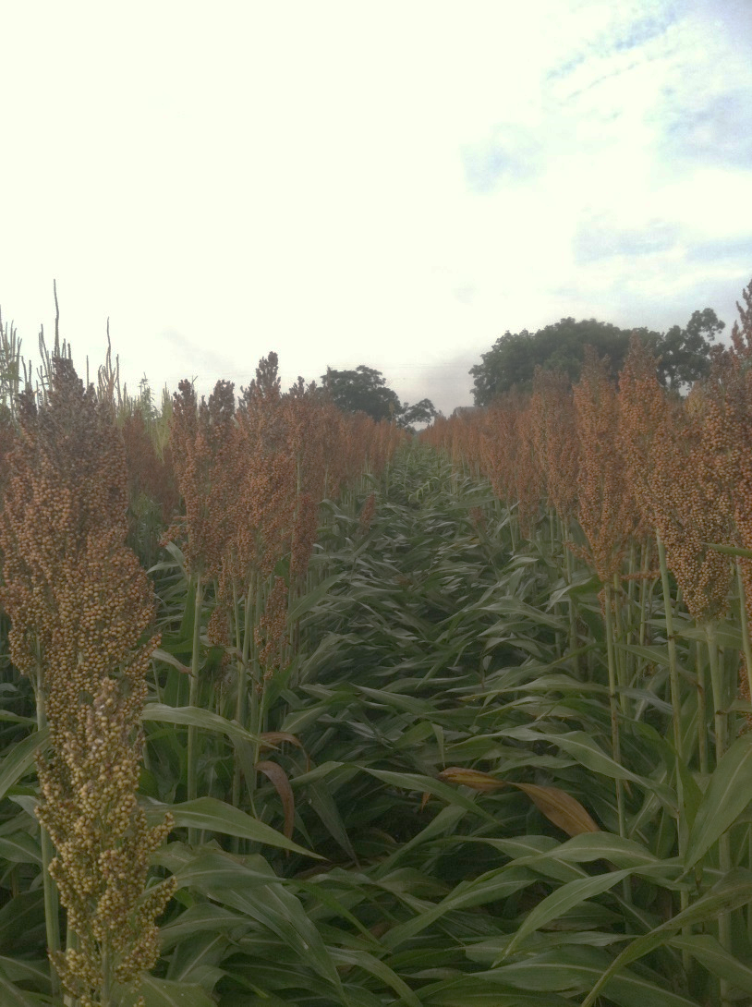
Inzen™ Z Grain Sorghum
Kansas State Univ.
DuPont/Advanta US
Resistance to POST applications of ALS herbicides
Non-GMO
  ALS-resistant shattercane
Dual/Cinch/Warrant PRE a must in my opinion
  Concep treated seed
Stewardship!!!
Zest (liquid Accent)

Slide 9
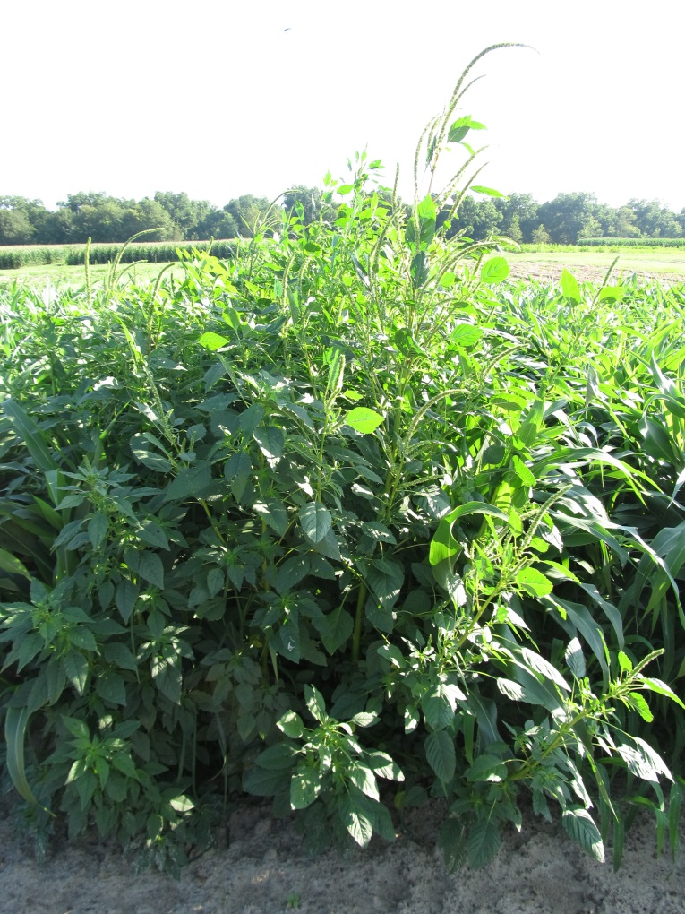
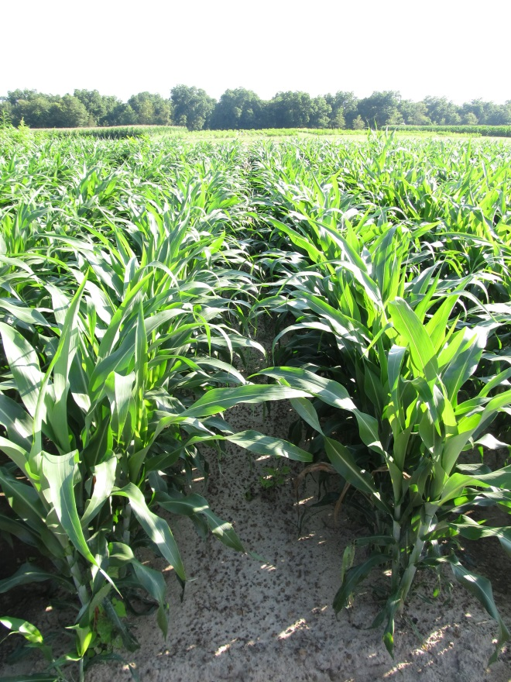
Weed Control in Inzen Sorghum - 2014
NTC
Dual II Magnum 7.62EC @ 16 oz/A – PRE
Zest 0.33SC @ 12 oz/A – POST +
Atrazine 90DF @ 13.3 oz/A – POST +
COC @ 1% v/v - POST
SG-01-14
June 19
31 DAP

Slide 10
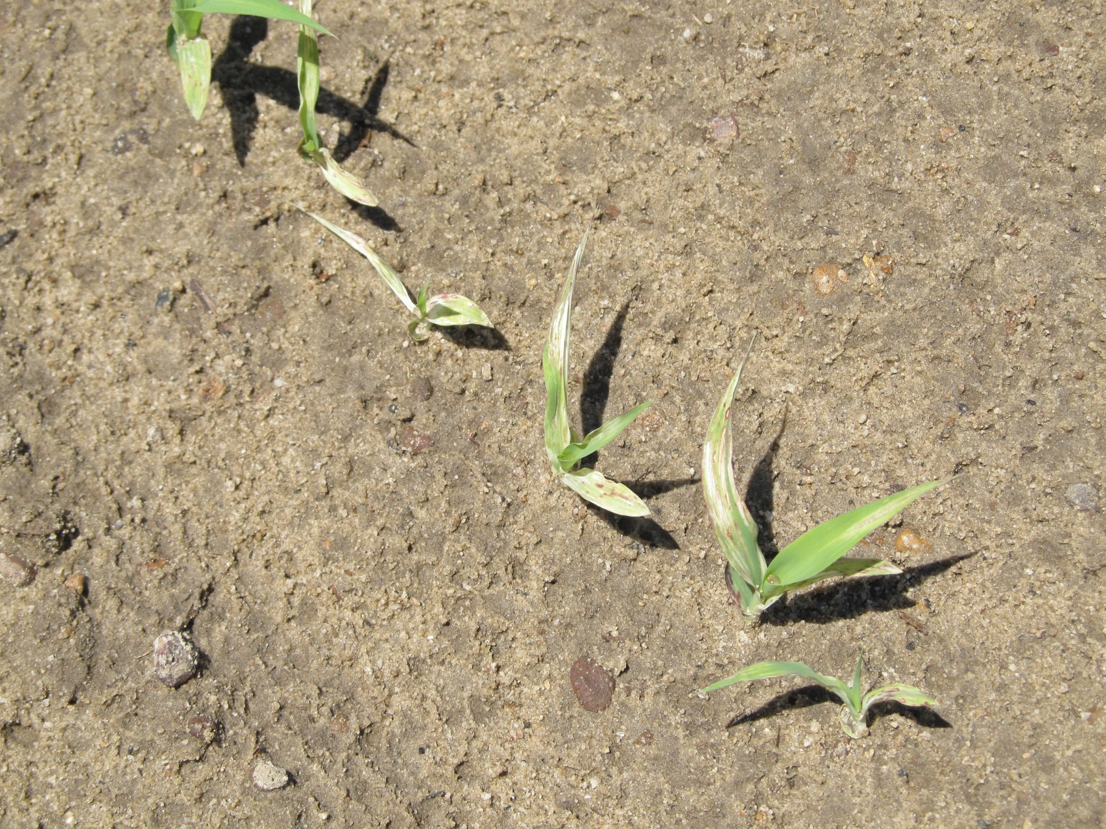
Don’t Plant Sorghum in Fields Treated with Reflex in the same year!!!!

Slide 11
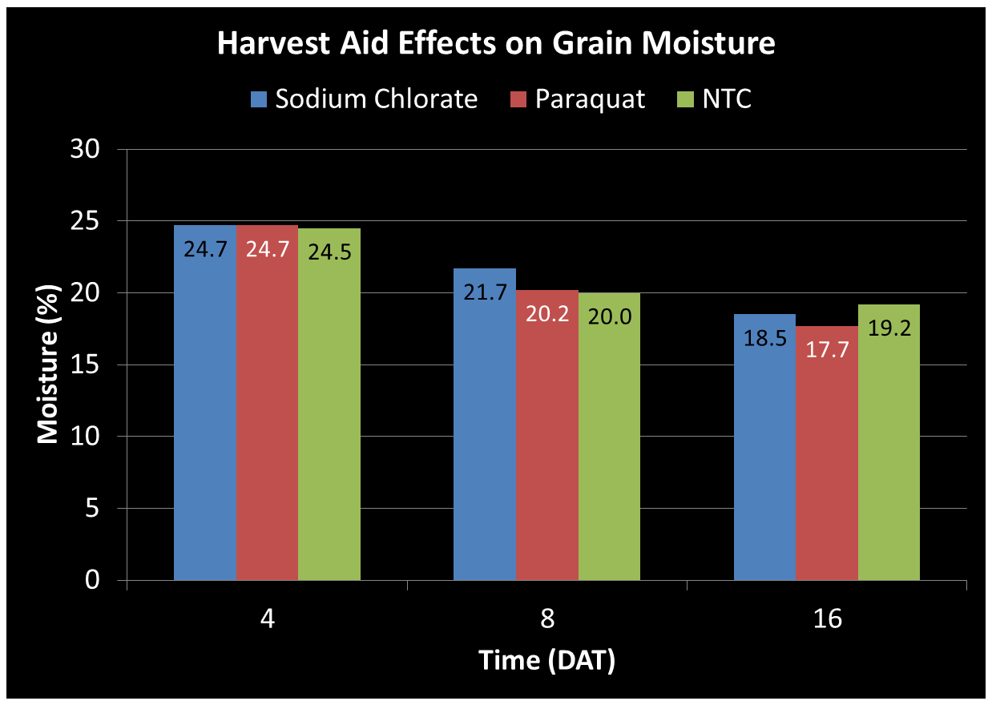
GRAIN SORGHUM – Harvest Aids
Initial moisture was 24.4%
Source: Olson et al. 2001

Slide 12
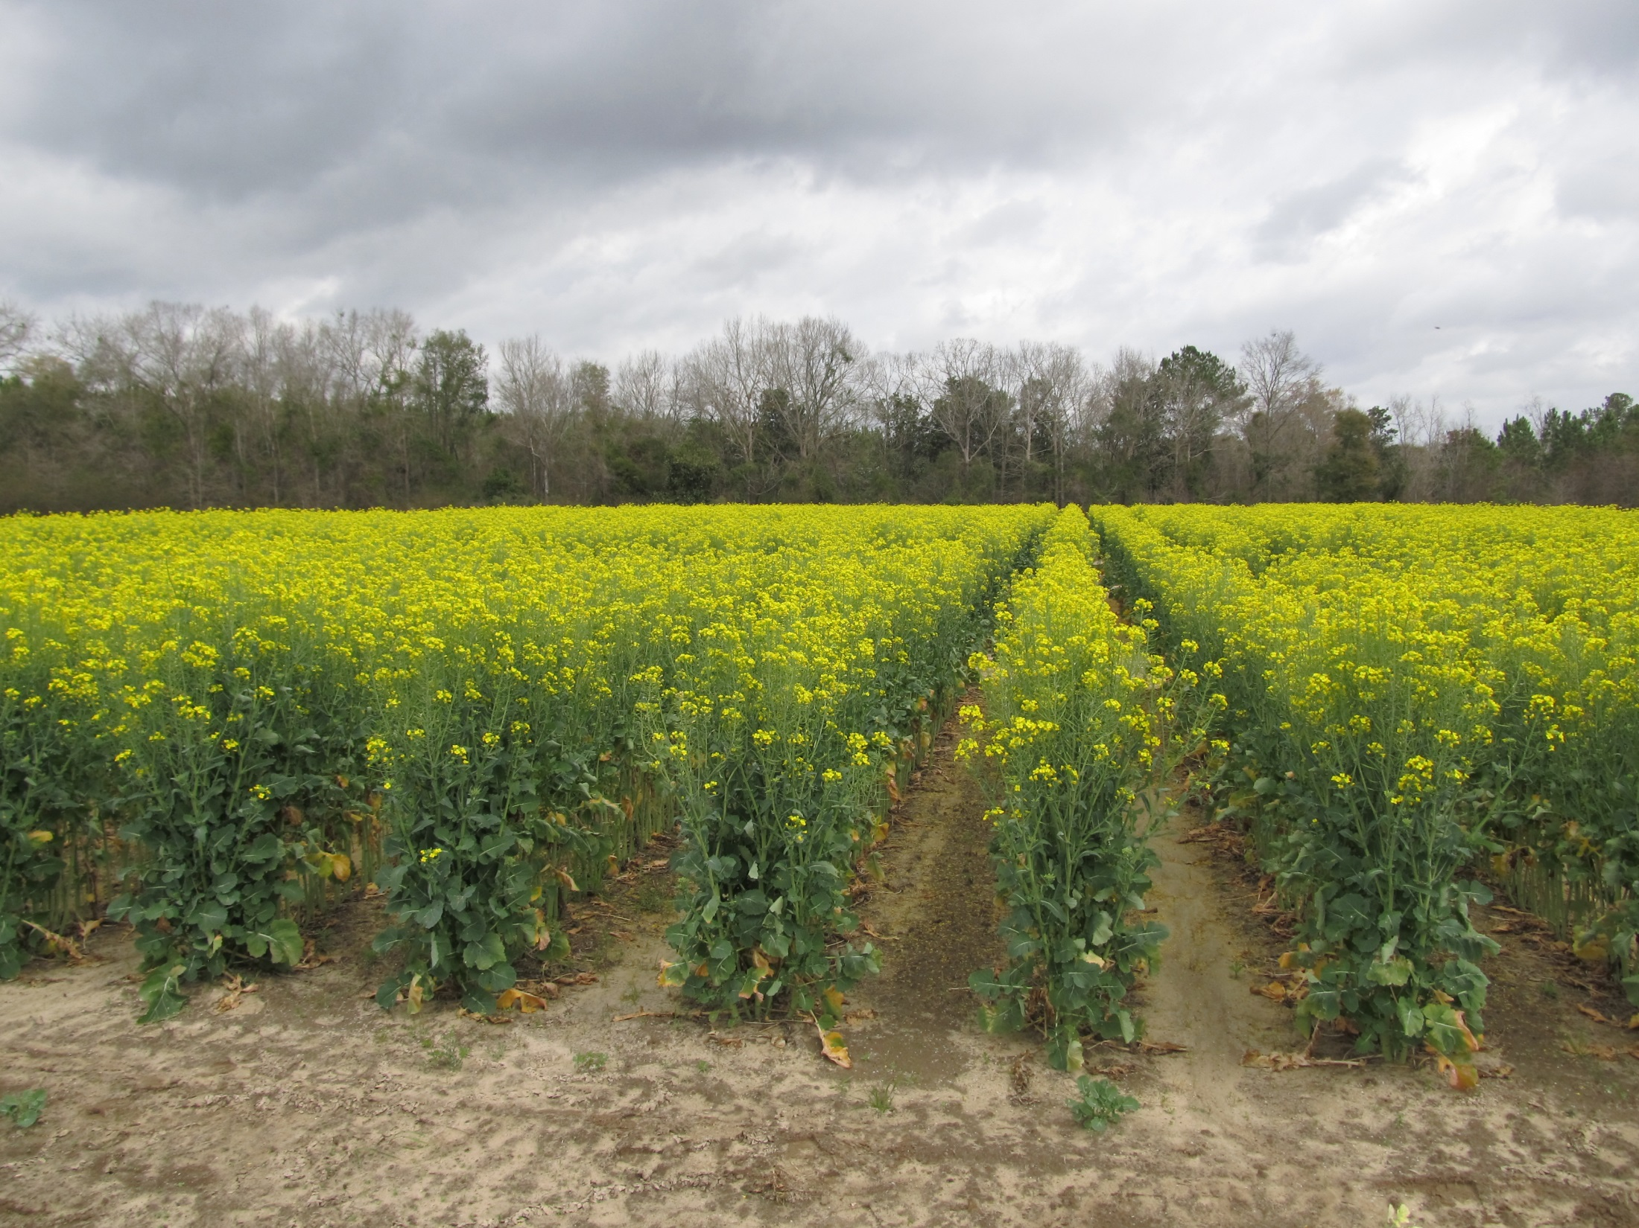
Canola Weed Control

Slide 13
2014 GA Canola Production
8765.78 acres planted (28 counties)
County | Acres | County | Acres
Burke | 330.50 | Clarke | 136.27
Crawford | 90.00 | Decatur | 636.30
Elbert | 1004.00 | Franklin | 281.95
Gordon | 1398.30 | Greene | 219.14
Hart | 830.14 | Houston | 130.00
Jackson | 71.80 | Jefferson | 60.00
Laurens | 431.15 | Macon | 58.00
Madison | 248.80 | Miller | 29.20
Morgan | 1198.09 | Murray | 179.50
Newton | 35.99 | Peach | 133.50
Pierce | 340.99 | Pike | 0.75
Putnam | 259.70 | Seminole | 105.00
Walton | 369.60 | Warren | 65.60
Washington | 90.00 | Wilkes | 31.51
Source: FSA Crop Acreage Data Report (January 2015)

Slide 14
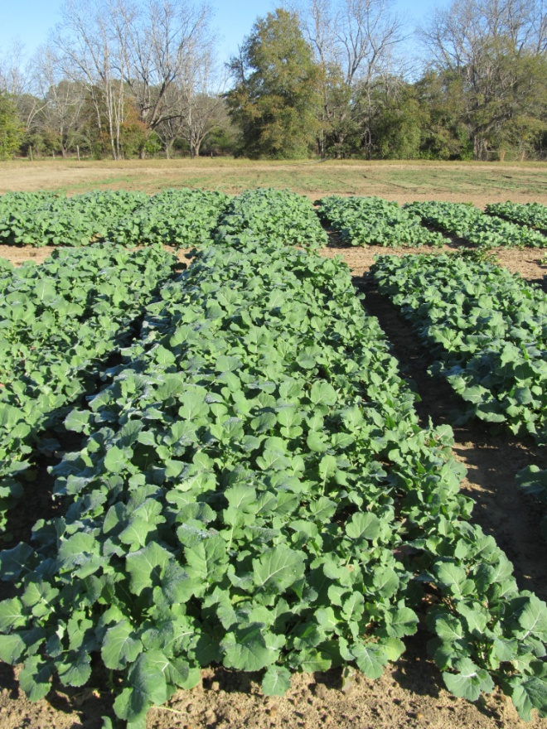
Canola Weed Management
consider herbicide residues from previous crop
Optimum Planting Date/Fertility
Use Treflan if you can
Clearfield Canola + Beyond may be best overall legal option
Critical period for weed control in canola is 4 leaf stage (17-38 DAP)

Slide 15

Do not plant canola is fields treated this year with the following herbicides:
Reflex
Prefix
Staple (could plant Clearfield*)
Cadre (could plant Clearfield*)
Steadfast Q (maybe Clearfield*?)
Strongarm (maybe Clearfield*?)
Envive (could plant Clearfield*)
Classic (could plant Clearfield*)
Envoke (could plant Clearfield*)
Diuron (???)
*Some crop stunting may still likely occur.

Slide 16
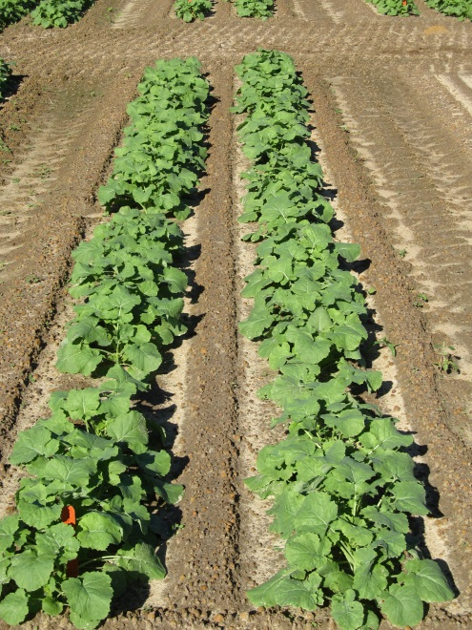
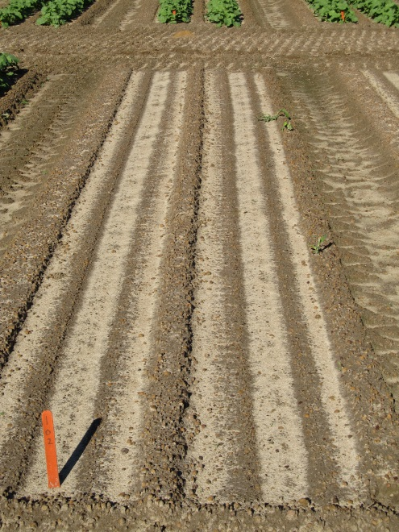
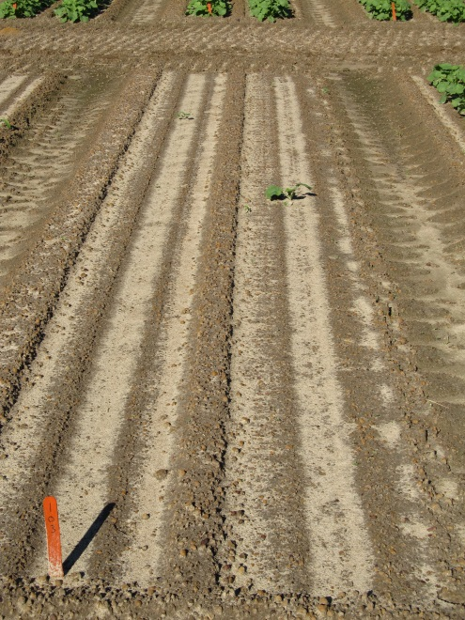
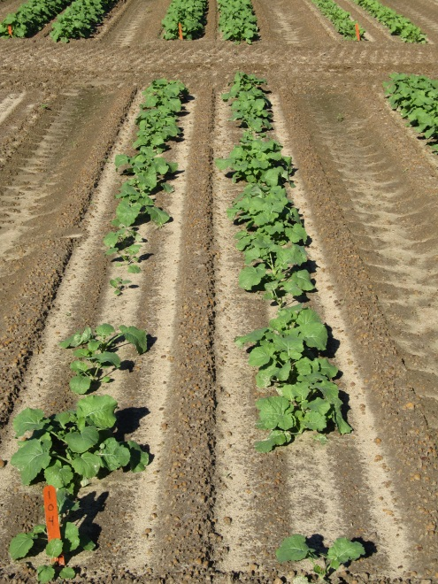
Clearfield Canola (5525CL) Response to Reflex – 2015/2016
NTC
Reflex 2SL @ 8 oz/A
Reflex 2SL @ 4 oz/A
Reflex 2SL @ 2 oz/A
CAN-02-15
11/11/2015
30 DAT

Slide 17
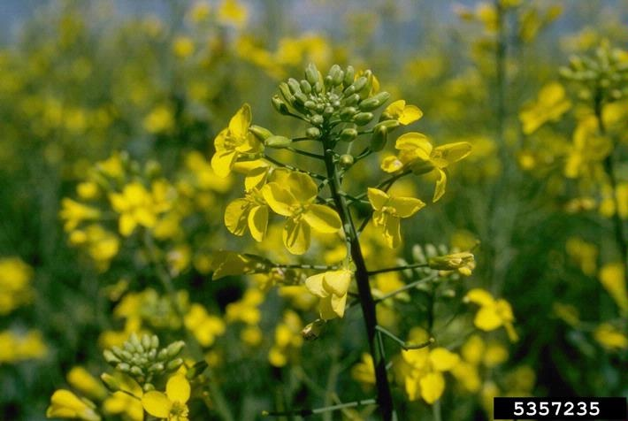
Current UGA Canola Weed Control Research
Howard F. Schwartz, Colorado State University, Bugwood.org

Slide 18
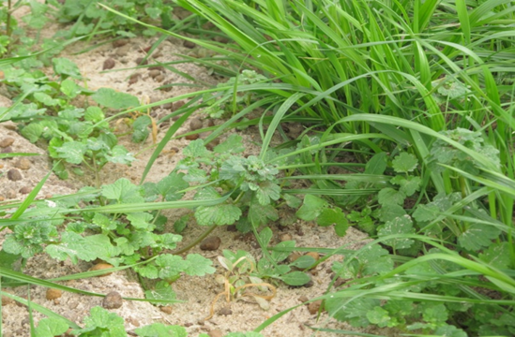


Henbit and Ryegrass Control?
** Command and Dual Magnum are NOT yet labeled for use in canola grown in GA. Research is underway to evaluate crop and weed response.

Slide 19
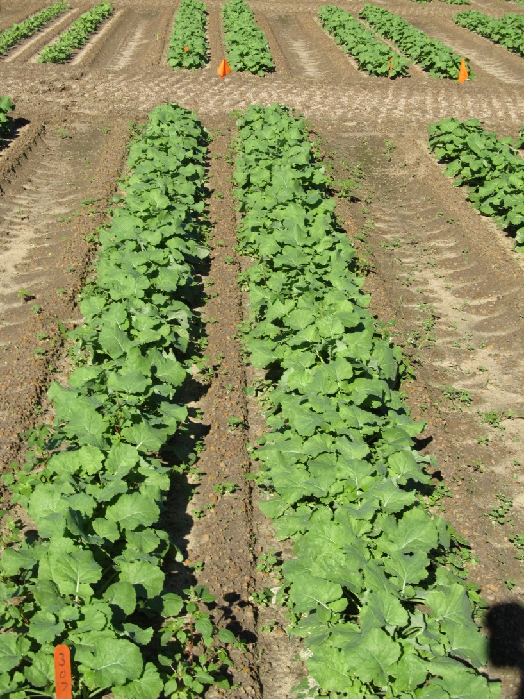
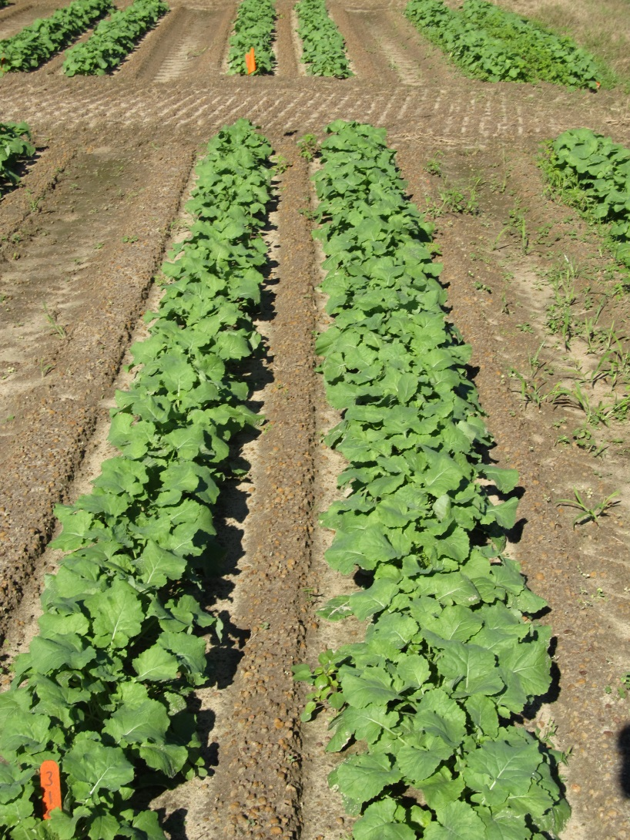
Canola Weed Control – 2015/2016
NTC
Command 3ME @ 3.5 oz/A - PRE
CAN-01-15
11/11/2015
30 DAT

Slide 20
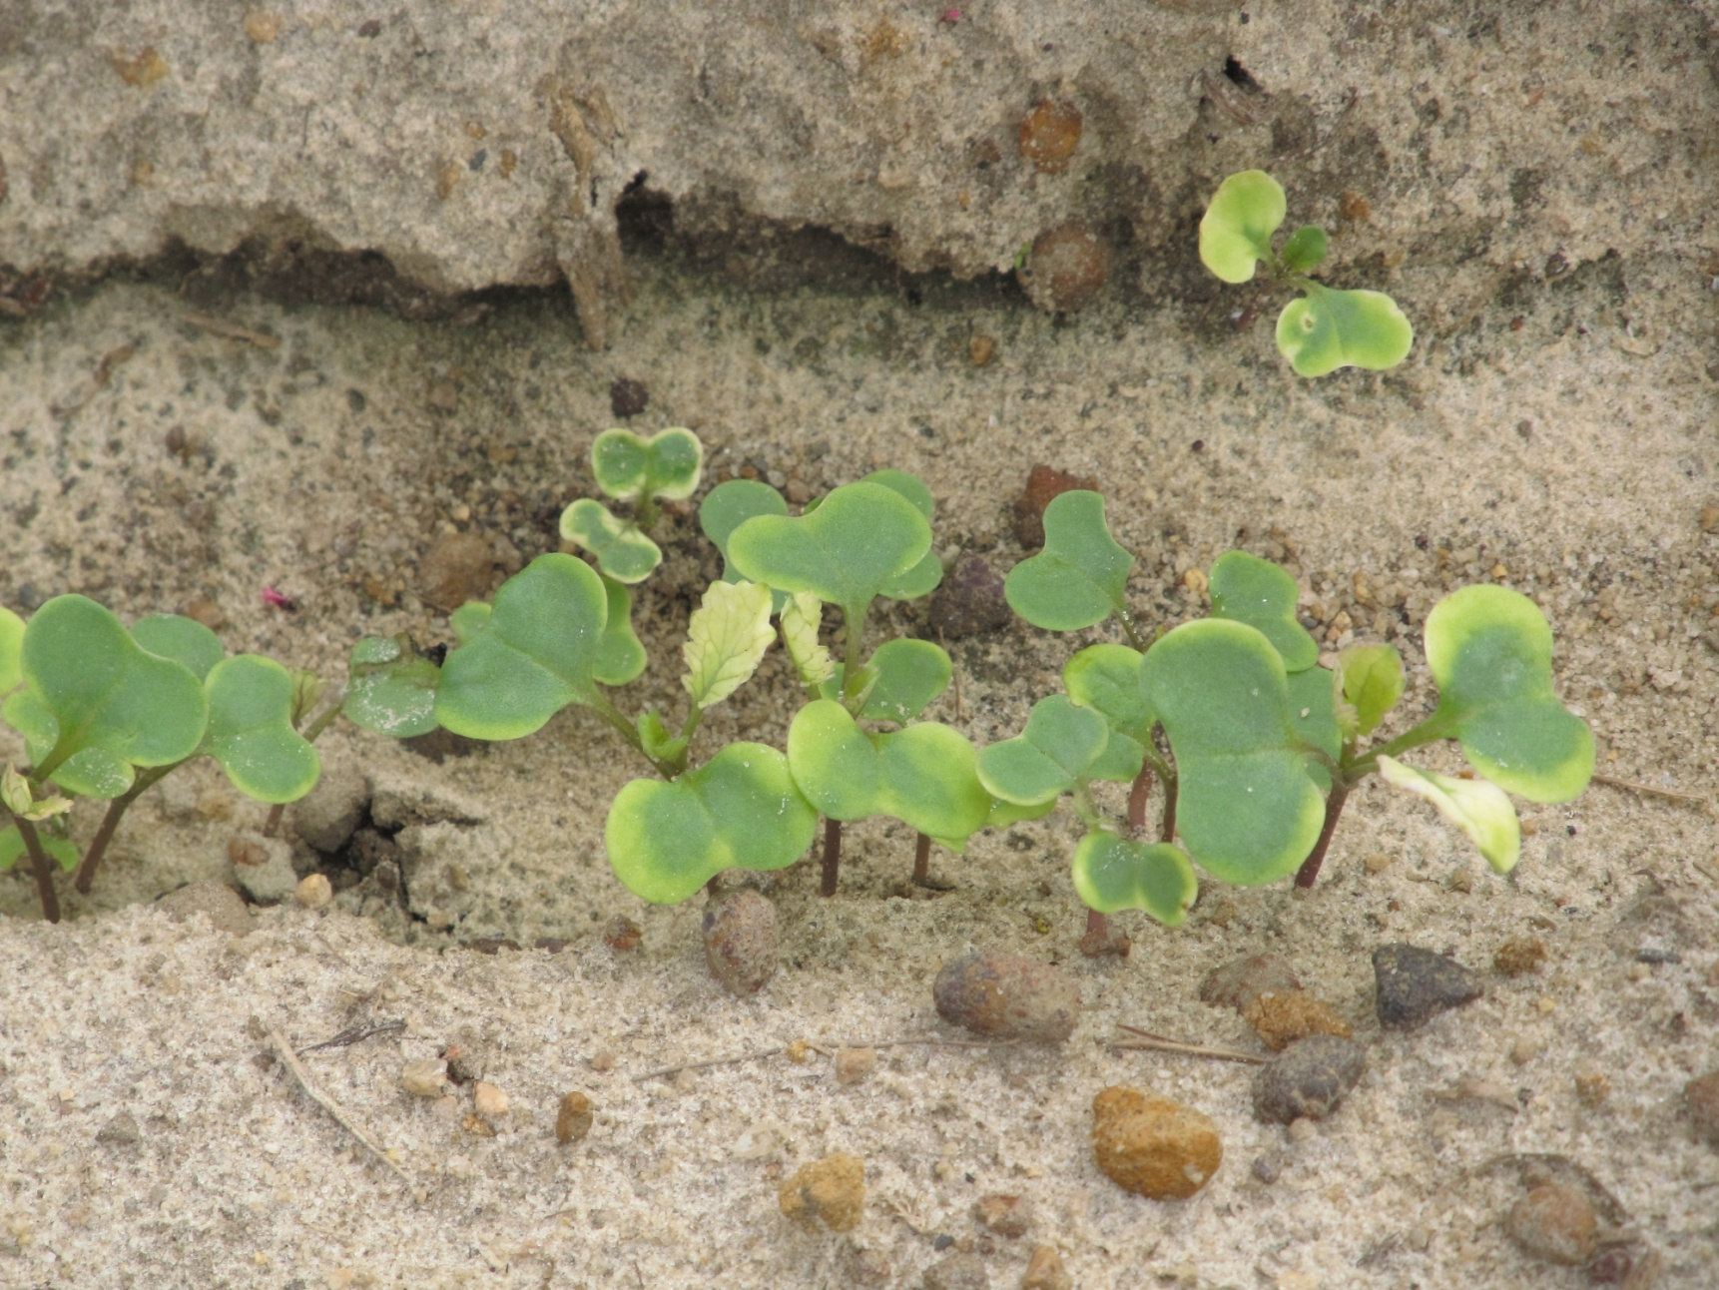
Command 3ME Injury on Canola - 2 WAT

Slide 21
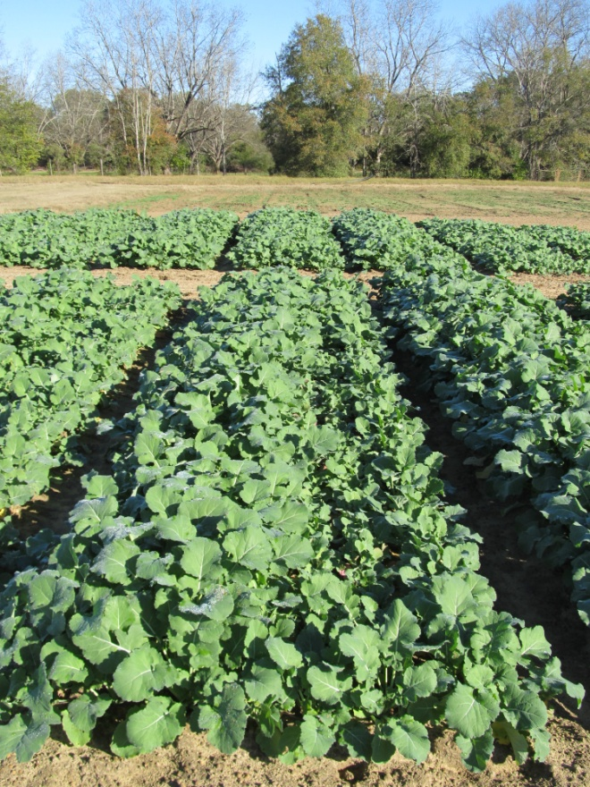
Registration Status for Command and Dual Magnum in Canola
submitted required information to IR-4 Program in July 2013
Command received an A priority at IR4 – September 2015

Slide 22
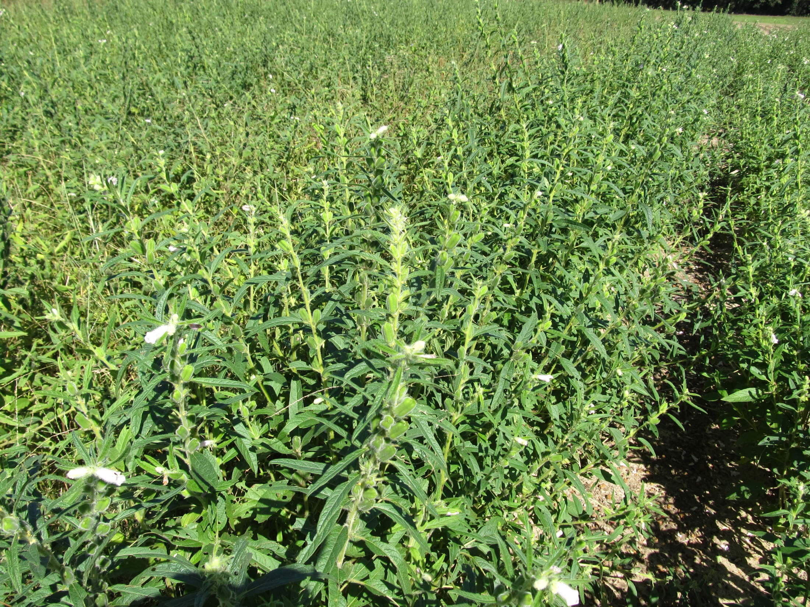
Sesame Weed Control
(~9533 Acres in GA in 2015)

Slide 23
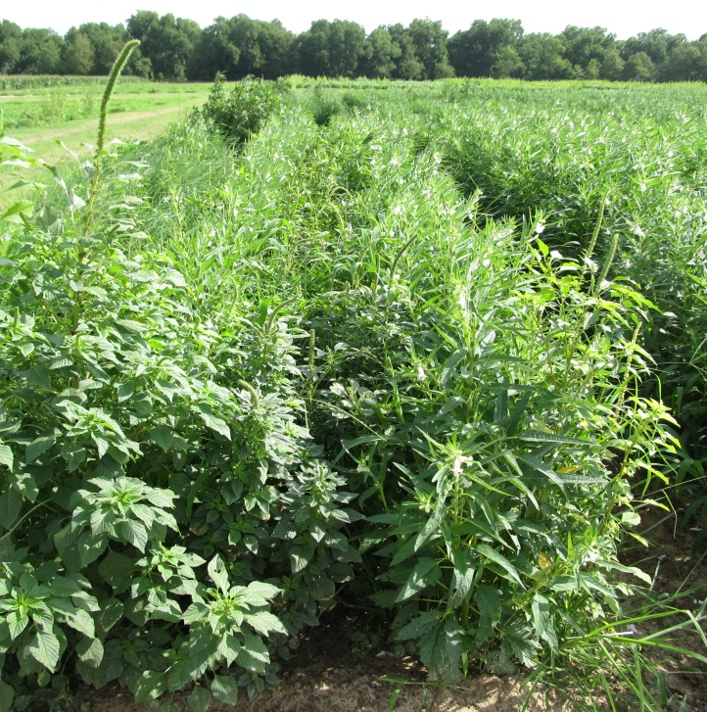
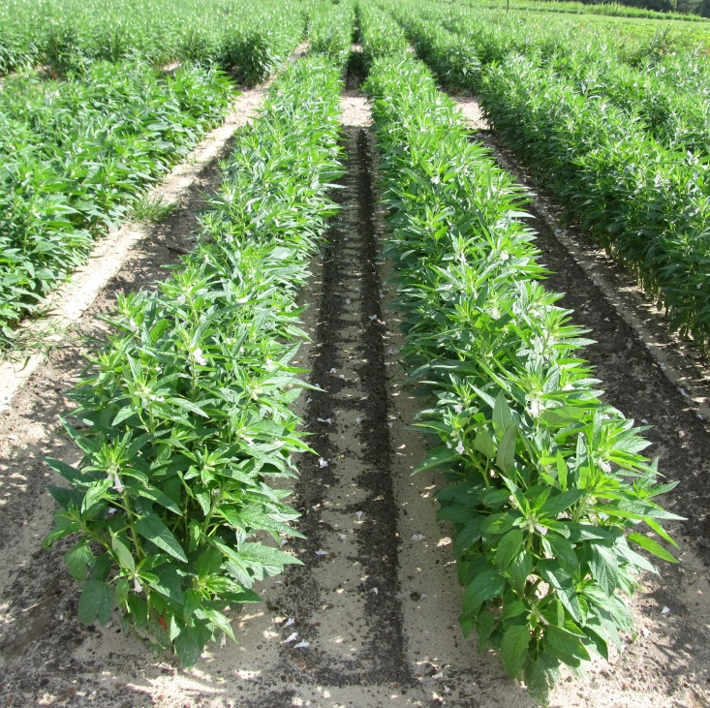
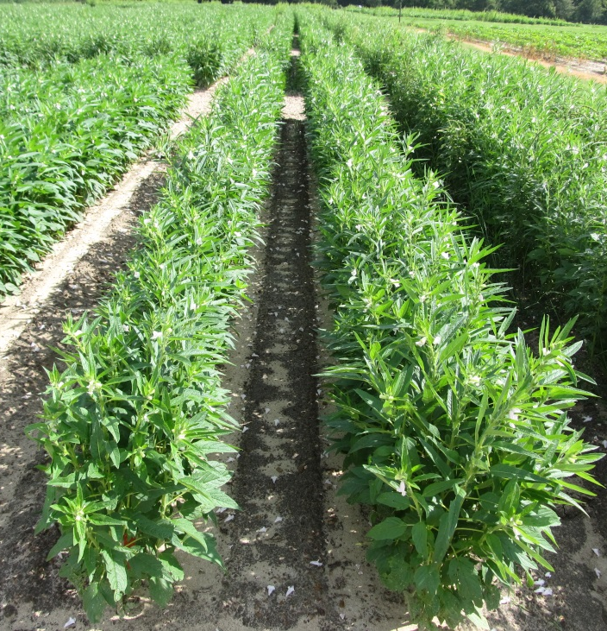
Weed Control in Sesame - 2015
NTC
Dual Magnum 7.62EC @ 16 oz/A – PRE
+
Direx 4L @ 32 oz/A – POST (36 DAP)
NIS @ 0.25% v/v – POST (36 DAP)
Warrant 3ME @ 48 oz/A – PRE
+
Direx 4L @ 32 oz/A – POST (36 DAP)
NIS @ 0.25% v/v – POST (36 DAP)
SM-02-15
June 30
68 DAP

Slide 24
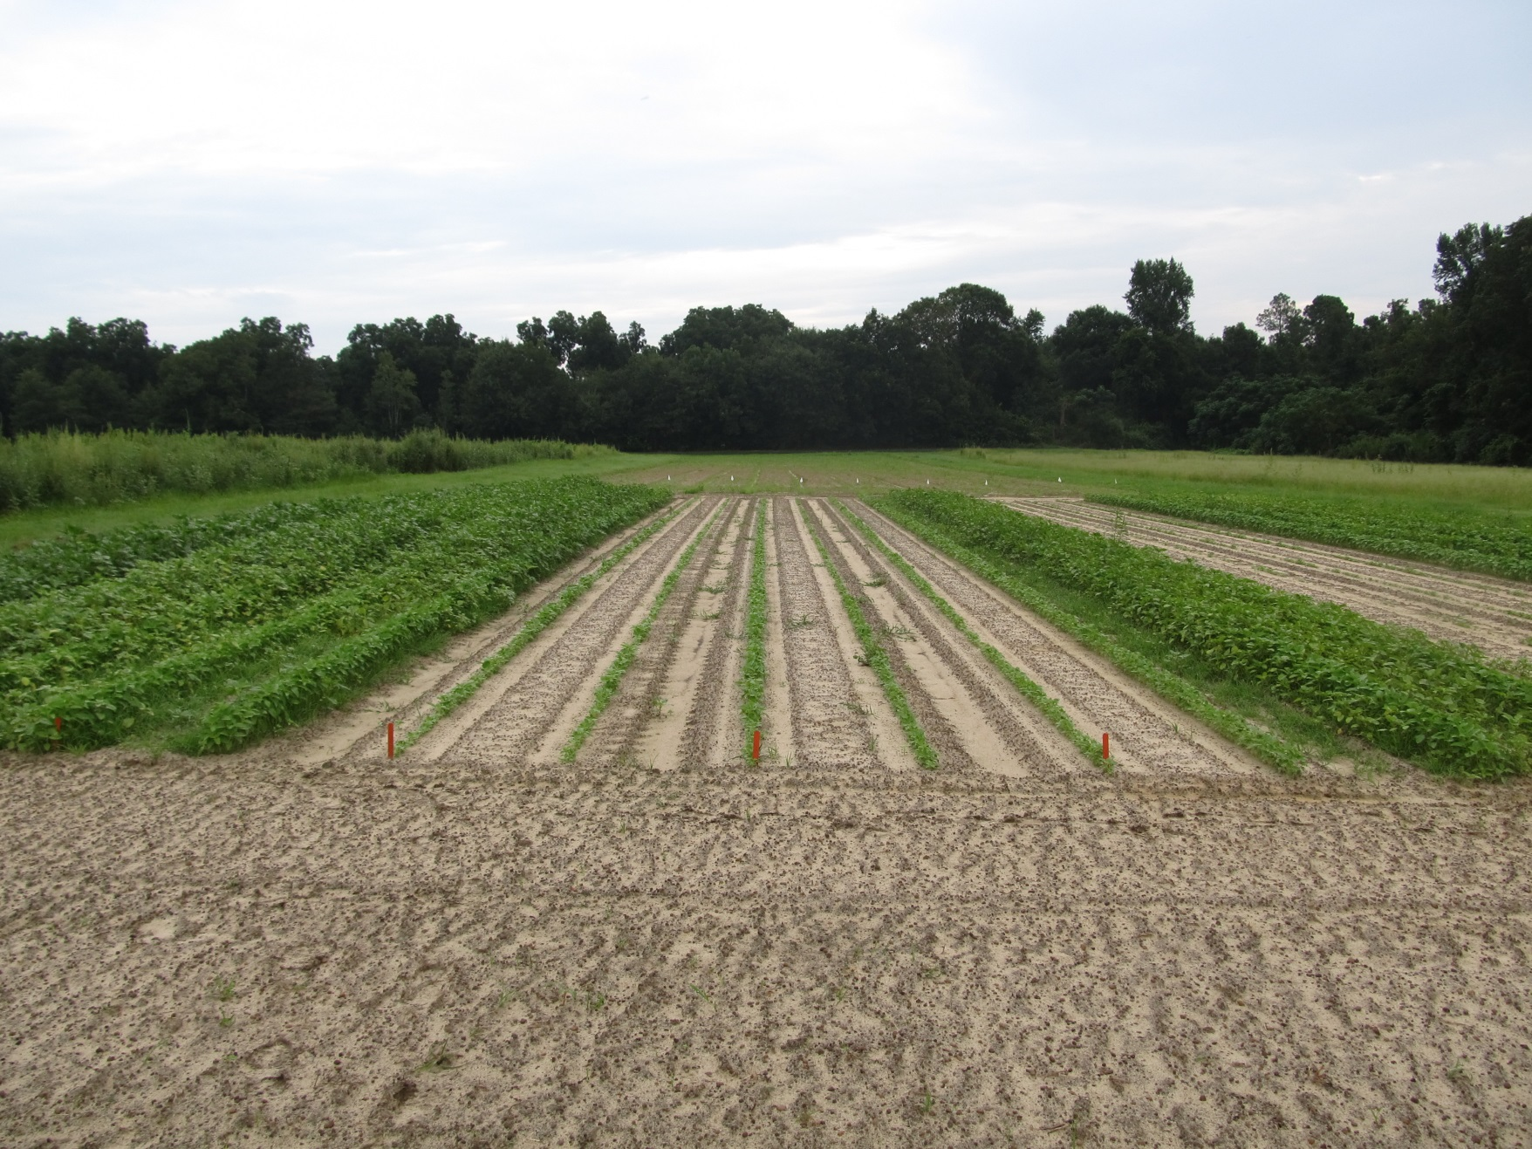
Sesame Demo – August 11, 2015
19 DAT – Planted/Sprayed July 23
7/23- 0.3” I
7/27 – 0.5” I
7/28 – 0.06” R
7/29 – 0.37” R
7/30 – 0.04” R
7/31 – 0.16” R
8/1 – 0.06” R
8/2 – 0.71” R
8/6 – 1.44” R
8/7 – 0.03” R
8/11 – 1.21” R
NTC
Dual
Magnum
16 oz/A
Warrant
48 oz/A
Direx
32 oz/A

Slide 25
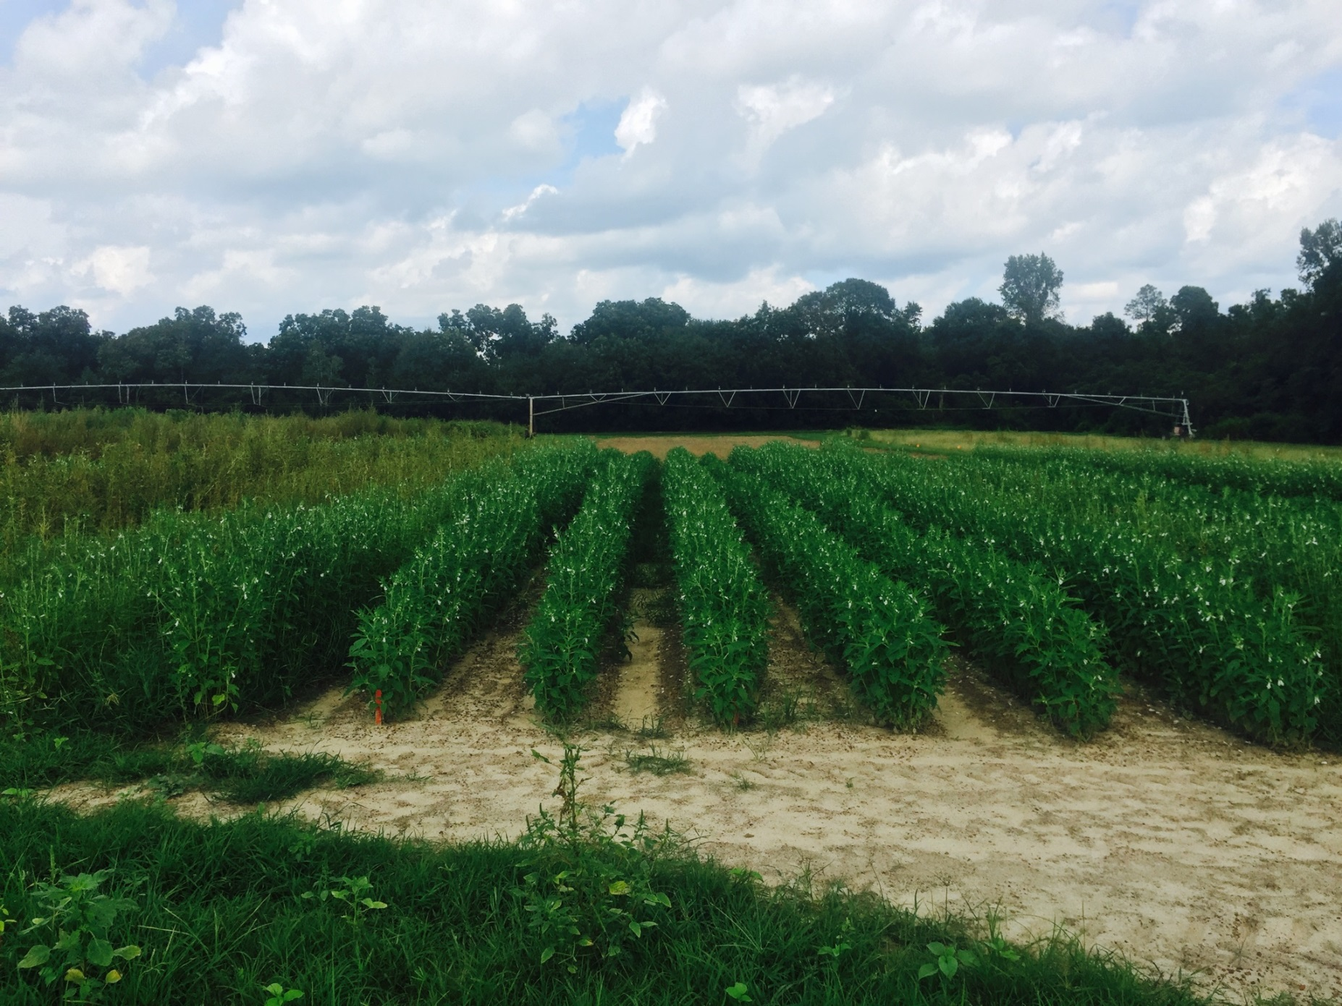
Sesame Demo – September 9, 2015
48 DAT – Planted/Sprayed July 23
7/23- 0.3” I
7/27 – 0.5” I
7/28 – 0.06” R
7/29 – 0.37” R
7/30 – 0.04” R
7/31 – 0.16” R
8/1 – 0.06” R
8/2 – 0.71” R
8/6 – 1.44” R
8/7 – 0.03” R
8/11 – 1.21” R
NTC
Dual
Magnum
16 oz/A
Warrant
48 oz/A
Direx
32 oz/A

Slide 26
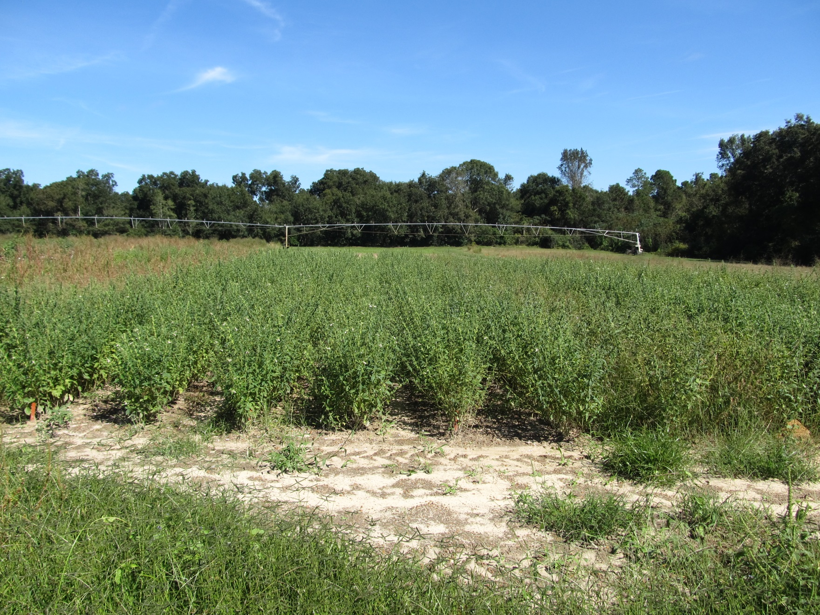
Sesame Demo – October 8, 2015
77 DAT – Planted/Sprayed July 23
7/23- 0.3” I
7/27 – 0.5” I
7/28 – 0.06” R
7/29 – 0.37” R
7/30 – 0.04” R
7/31 – 0.16” R
8/1 – 0.06” R
8/2 – 0.71” R
8/6 – 1.44” R
8/7 – 0.03” R
Dual
Warrant
Direx
NTC
Dual
Magnum
16 oz/A
Warrant
48 oz/A
Direx
32 oz/A

Slide 27
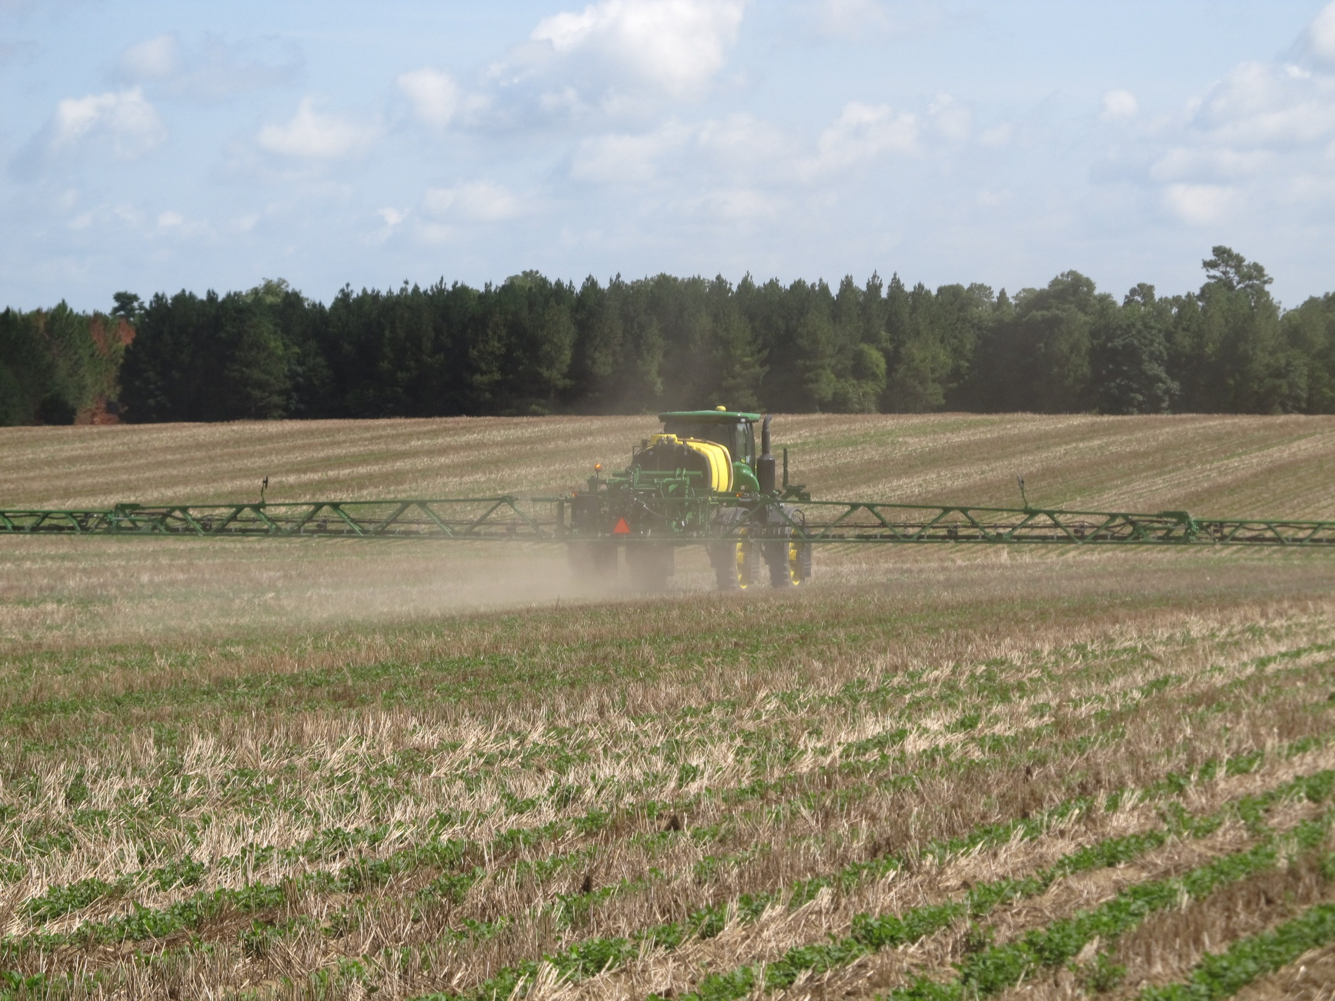
The New Norm????

Slide 28
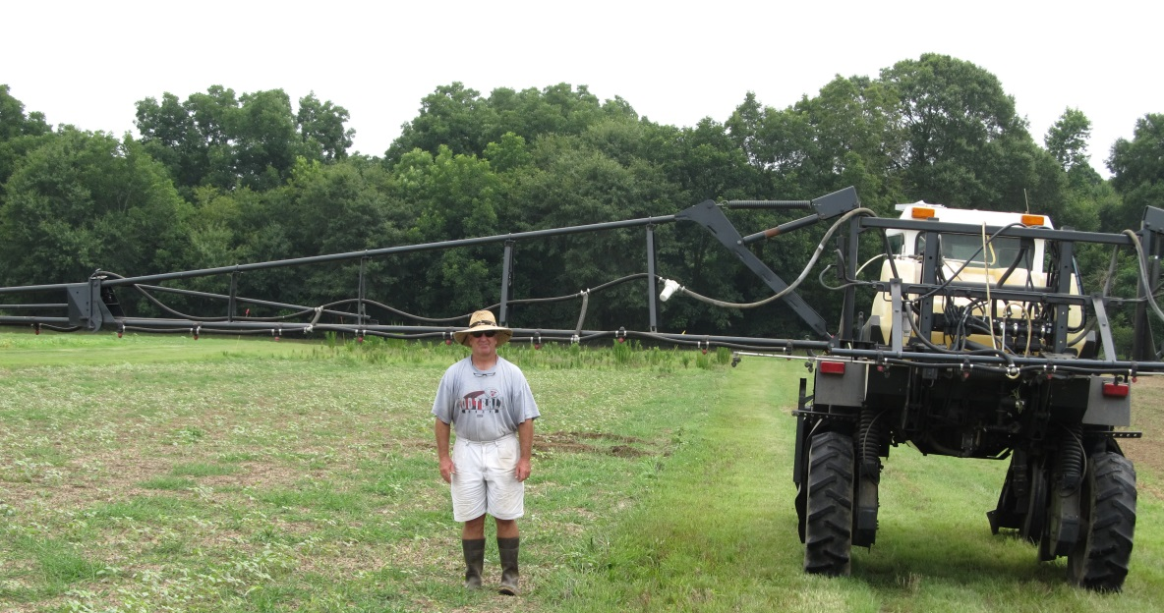

Is this a bad combination????
6 ft

Slide 29
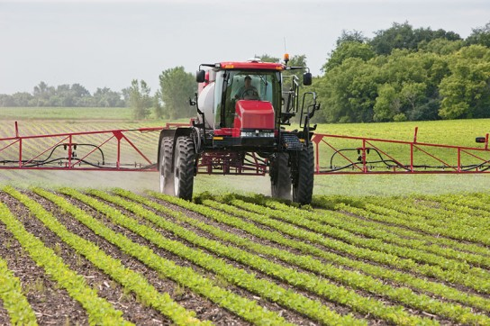
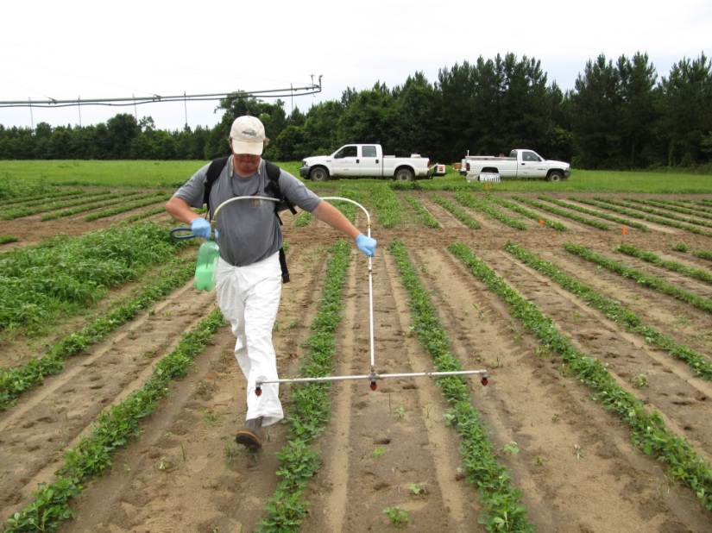
Farm vs. Research?
Concerns
Tractor Speed
Boom Height
Coverage
Quality vs. Quantity?

Slide 30
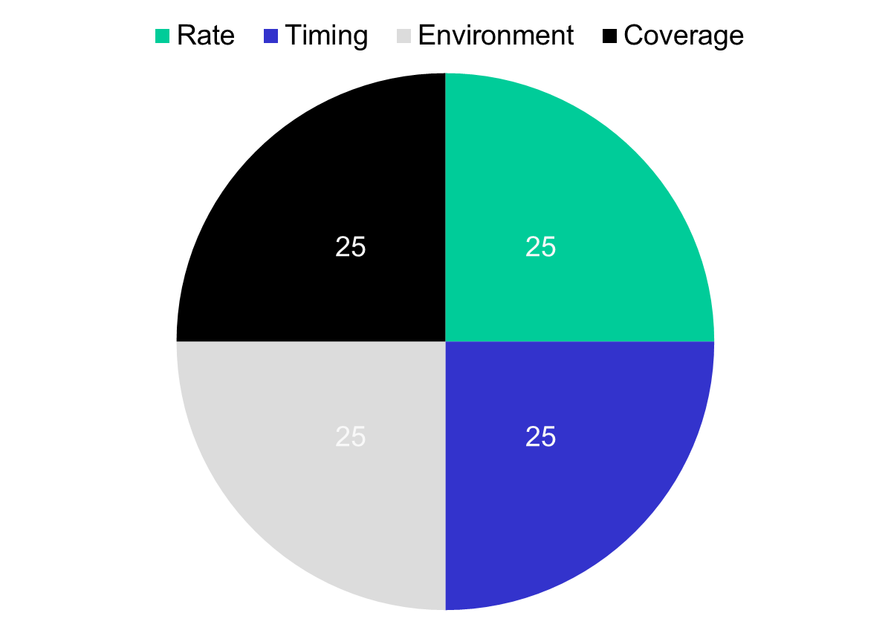
Herbicide Efficacy
Coverage
Nozzle Type
GPA
Pressure
Boom Height
Tractor Speed

Slide 31
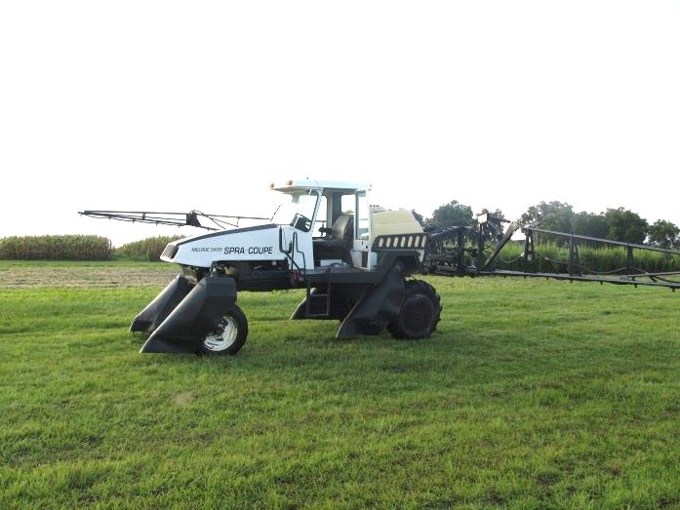
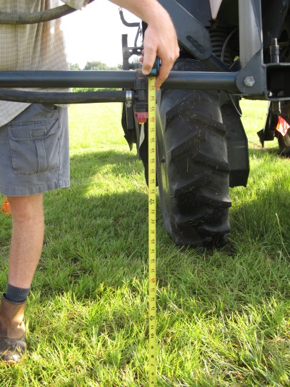
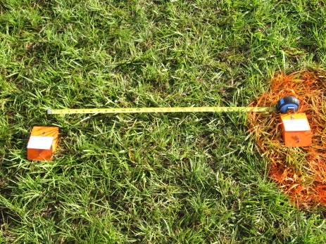
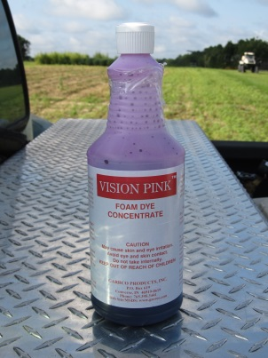
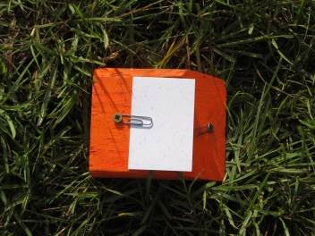
Materials and Methods
July 24, 2015
Melroe 3430 Spra-Coupe
Tractor Speeds
  4.4, 6.5, and 9.5 MPH
Boom Heights
  30, 45, 60 in
  Wind ≤ 3.0 MPH
15 GPA (water + dye)
DG TeeJet Drift Guard Nozzle Tips (20” spacing)
  8002DG, 8003DG, 8004DG
    40-53 PSI
    Medium Droplet Size
2 locations in sprayer path
  8’ from tractor center (L1)
  30” parallel from L1 (L0)
5 Kromekote cards (2” X 3”)
  10’ apart
Dropletscan (WRK of Arkansas, LLC)

Slide 32
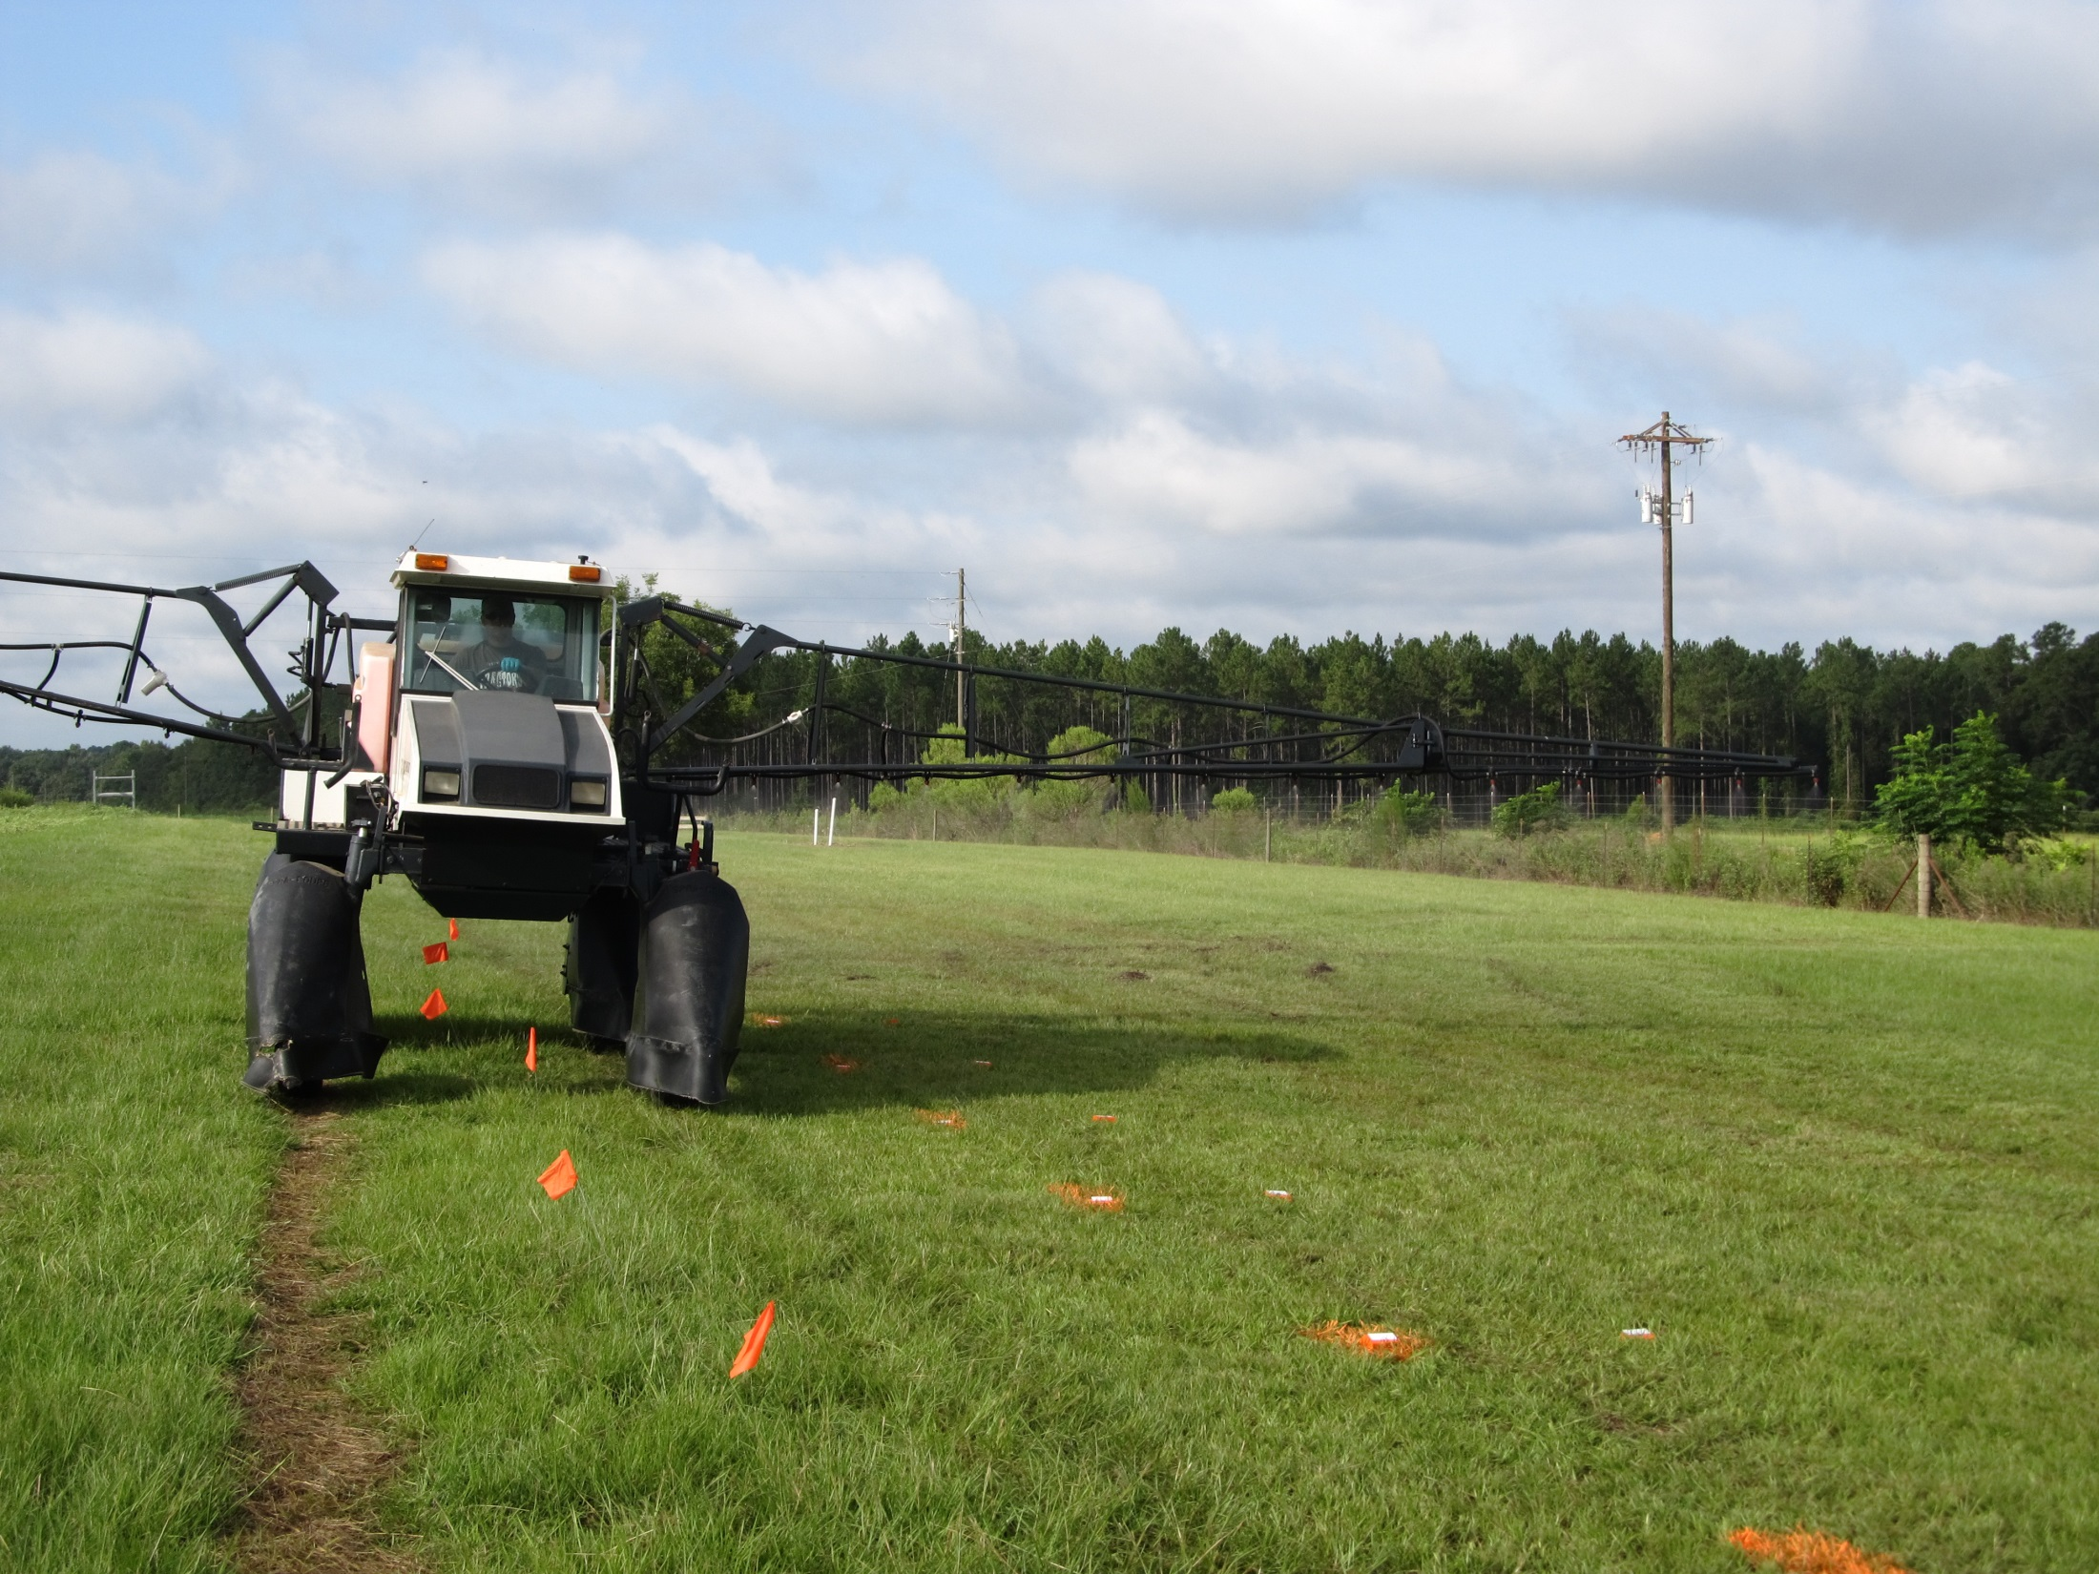
8’
10’
30”

Slide 33
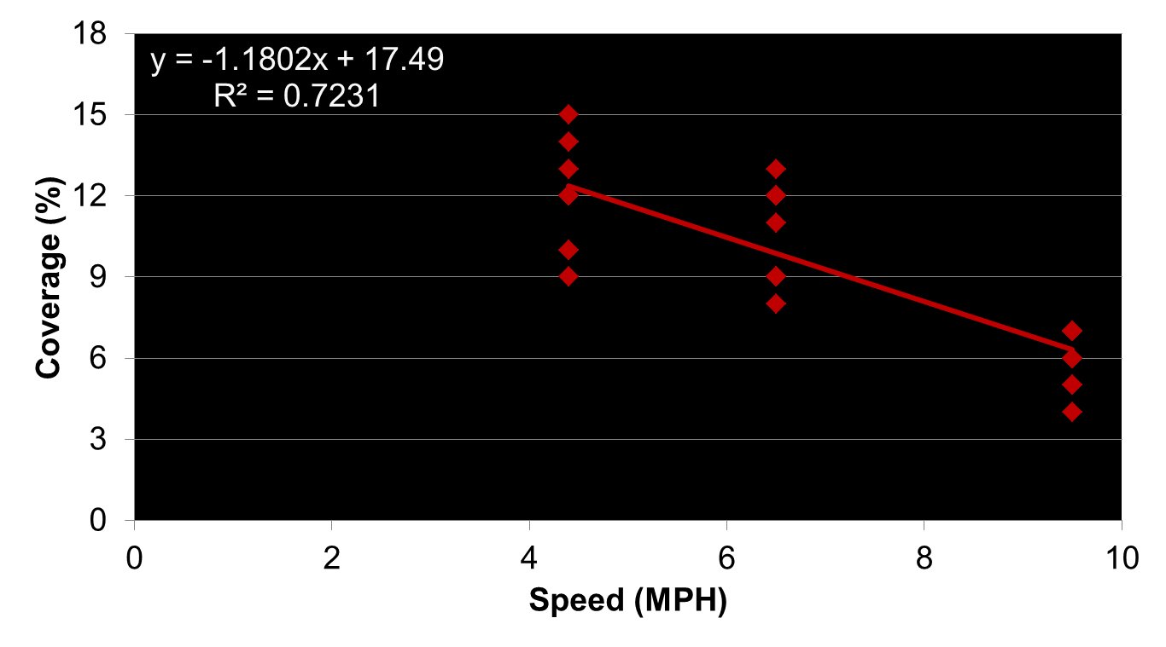
Tractor Speed Effects on Spray Coverage (%) – 30” Boom Height
N = 30

Slide 34
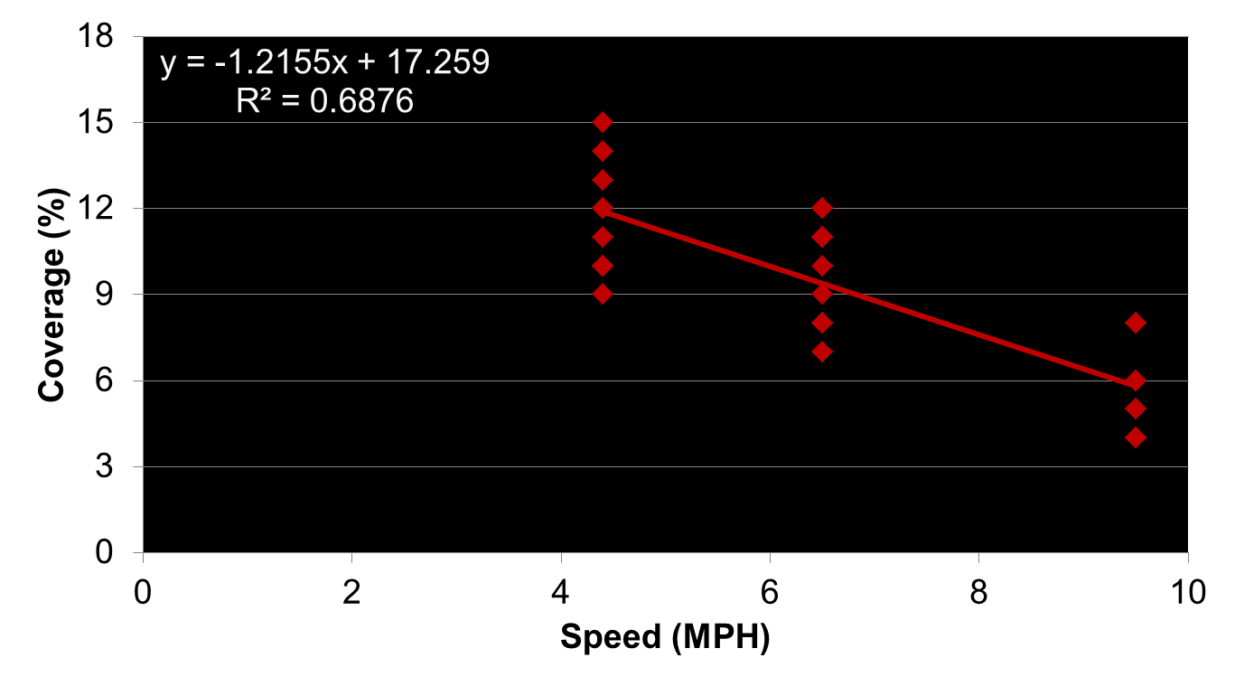
Tractor Speed Effects on Spray Coverage (%) – 60” Boom Height
N = 30

Slide 35

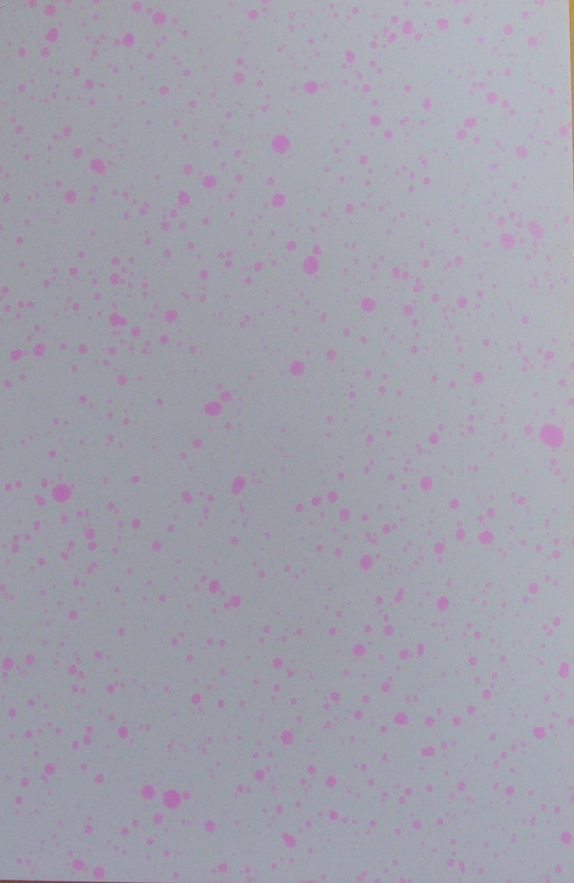

Spray Coverage - 60” Boom Height
4.4 MPH
6.5 MPH
9.5 MPH

Slide 36
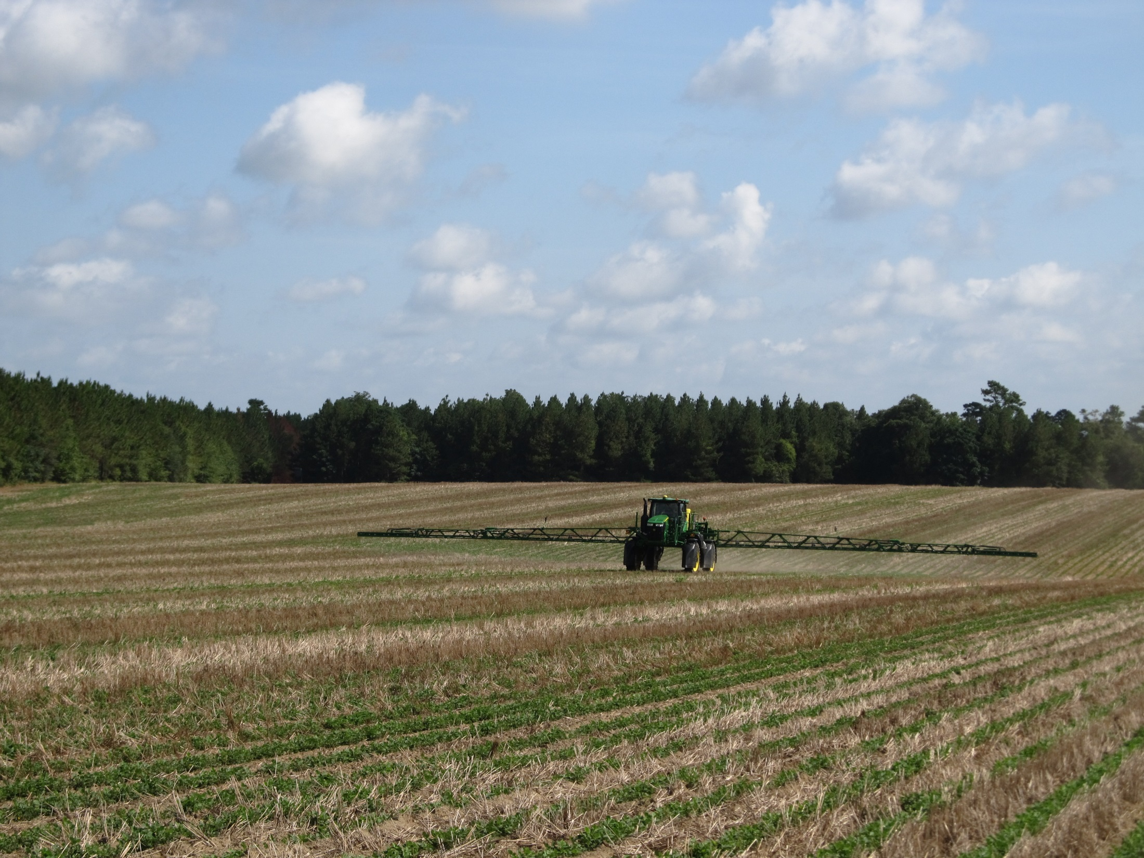

QUESTIONS?
eprostko@uga.edu
www.gaweed.com

