Slide 1
2016 Field Corn Weed Management Update
Eric P. Prostko
Professor/Extension Weed Specialist
Dept. Crop & Soil Sciences

Slide 2
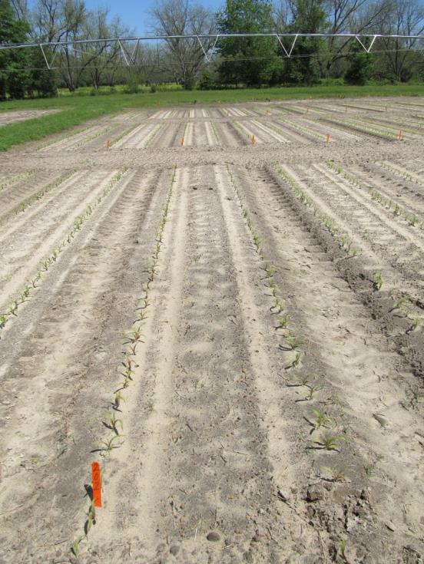
Nematodes and Early Season Herbicide Injury

Slide 3
Nematode Control
Telone II
Seed Treatments
Avicta Duo Corn
Poncho/Votivo
Counter - INFR

Slide 4
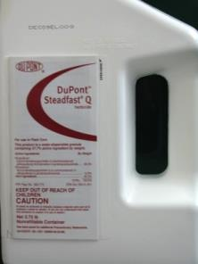
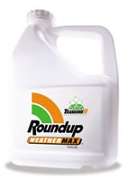
Atrazine + Any of these works just fine!

Slide 5
(L) - Non-Treated Control; (R) – Atrazine 4L @ 32 oz/A – PRE fb Roundup WM @ 22 oz/A + Atrazine @ 48 oz/A – Applied 21 DAP: Photo @ 33 DAP
CN-05-15
May 4
(N83D-3000GT)

Slide 6
Anthem, Dual, Warrant, Zidua????

Slide 7
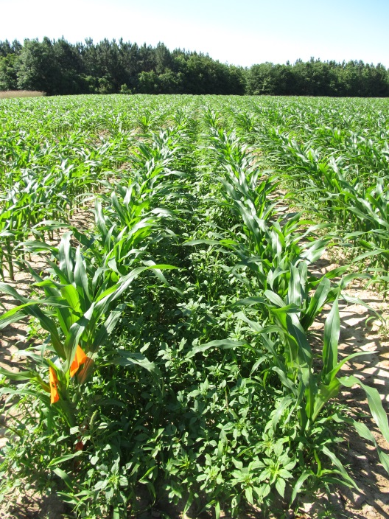
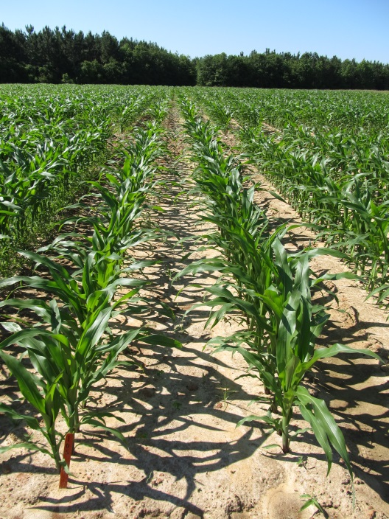
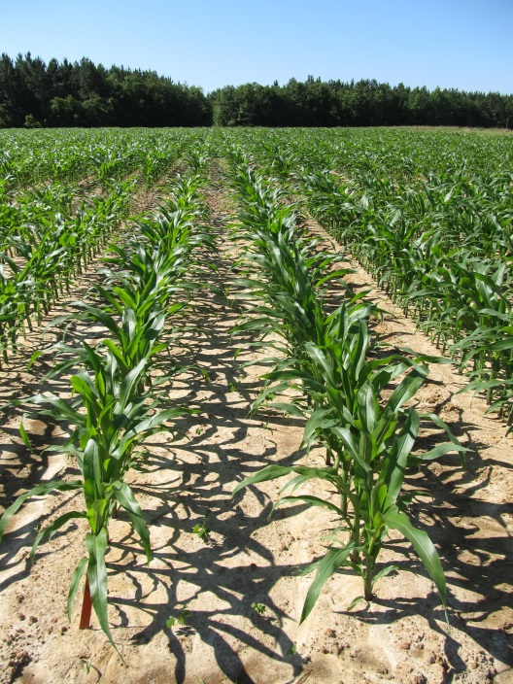
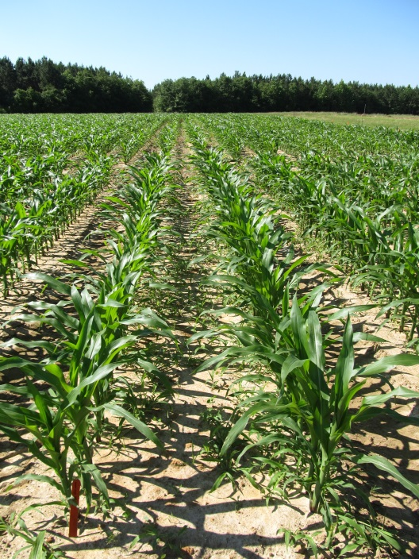
PRE Applied Zidua, Dual II Magnum, and Warrant in Field Corn - 2015
NTC
Zidua 85WG
1.5 oz/A
Dual II Magnum 7.62EC
21 oz/A
Warrant 3ME
48 oz/A
CN-13-15
May 4
33 DAP

Slide 8
Chloroacetamide Injury on Field Corn (Dual, Warrant, Zidua)
Rate
Planting Depth
Hybrid
Temperature
Moisture

Slide 9
Pay Closer Attention to Hybrid/Herbicide Mgt. Guidelines

Slide 10
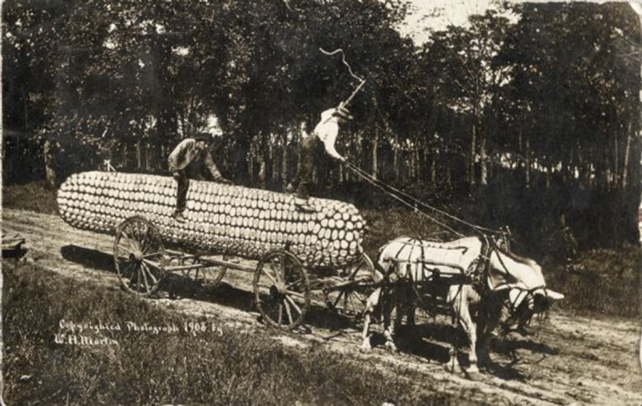
Something to think about?
Some GA growers are pushing yield limits (250+ Bu/A)
75%-80% irrigated
At lower yield/input levels, are herbicide stresses masked by other stresses?
At higher yield/input levels (i.e. most stresses are controlled), what about herbicides?

Slide 11
Herbicide and High Yield Corn
After 2 years of testing
various herbicides applied at recommended time (V2-V5) had no effect on corn yield
glyphosate + atrazine applied from V2 to V7 had no effect on corn yield

Slide 12
Herbicide Effects on Field Corn Yield in a High Input Environment (RU = Roundup W-Max, ATZ = Atrazine, PW = Prowl, LIB = Liberty, STDQ = Steadfast Q, CAP = Capreno, LAD = Laudis, HGT = Halex GT, SAN = Sandea) – YEAR 2
CN-01-15
Applied 17 DAP
V3 (292 GDD)
Pioneer 1197
LSD 0.10 = 28
CV = 7.2

Slide 13
Roundup W-Max (32 oz/A) + Atrazine (48 oz/A) + AMS Xtra (2.5% v/v) Timing Effects on Field Corn Yield in a High Input Environment – YEAR 2
CN-02-15
Pioneer 1197
LSD 0.10 = 14
CV = 3.33

Slide 14
Corn Stage of Growth
CN-02-15
April 21
32 DAP
V7

Slide 15
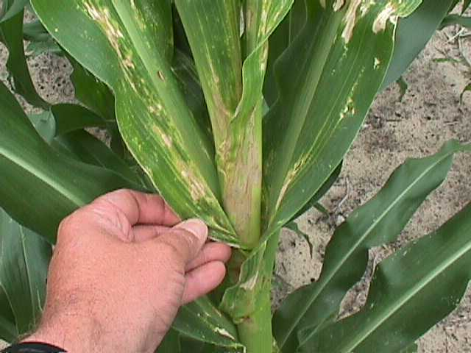
Valor Drift on Field Corn

Slide 16
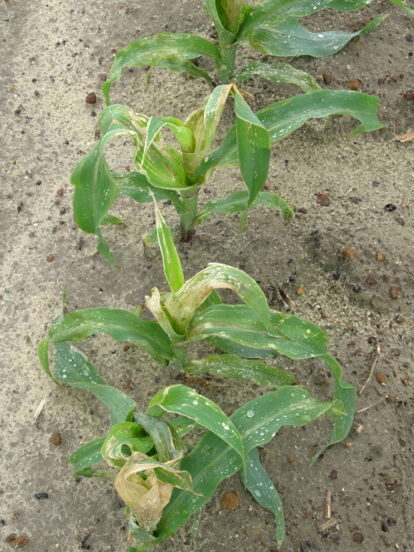
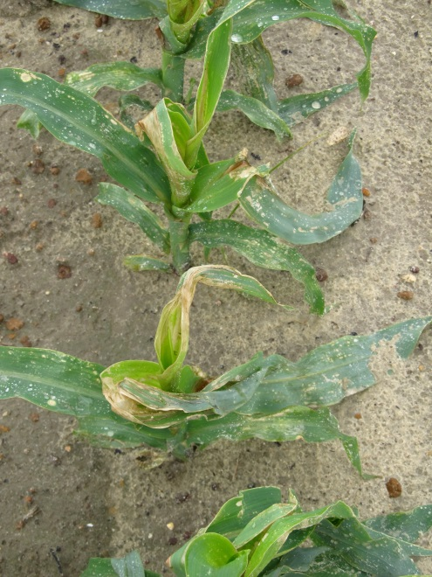
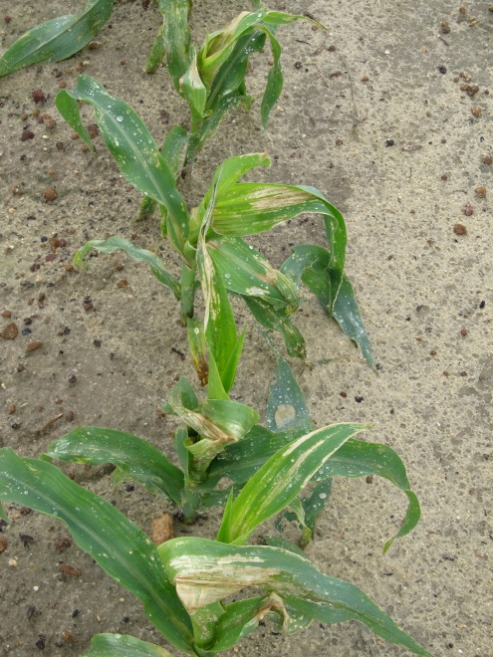
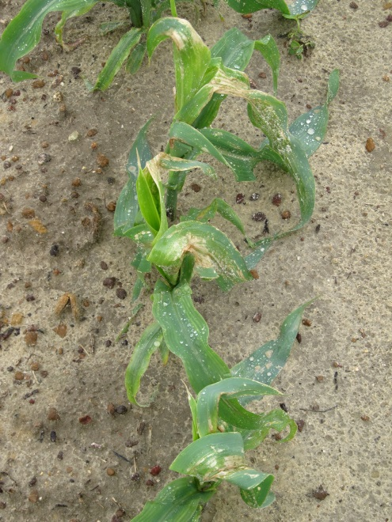
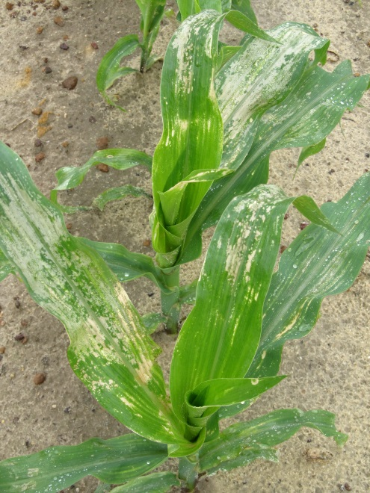
Valor Injury – Applied V6 – 3 DAT
3 oz/A
1.5 oz/A
0.75 oz/A
CN-02-14
May 1
0.375 oz/A
0.188 oz/A

Slide 17
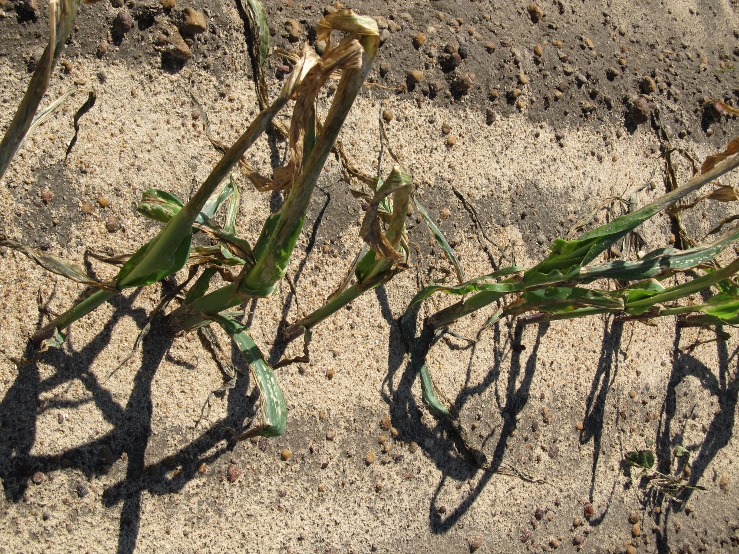
Valor @ 3 oz/A Applied at V5-V6 Picture taken 6 DAT - 2015

Slide 18
Field Corn (Pioneer 1794) Yield Response to Valor 51WG (oz/A) - 2015
CN-10-15
LSD 0.10 = 16
CV = 4

Slide 19
Morningglory Control in Field Corn

Slide 20
Morningglory Control in Corn
as much atrazine as possible
1.0 lb/A – PRE fb 1.5 lb/A – POST
small grain rotations
2,4-D, Clarity, Status, Aim, ET, Evik (PDIR)
Enlist Corn???
Liberty-Link® Corn Systems
split applications of glyphosate (RR corn)
* 1st application + atrazine
Harvest Aids
Aim
Early-harvest

Slide 21
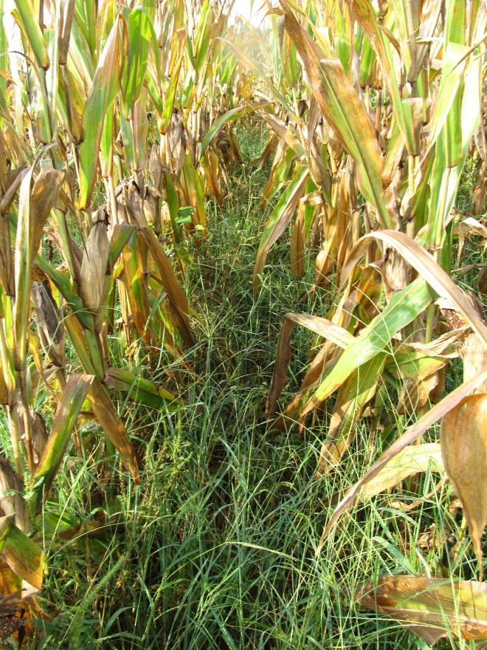
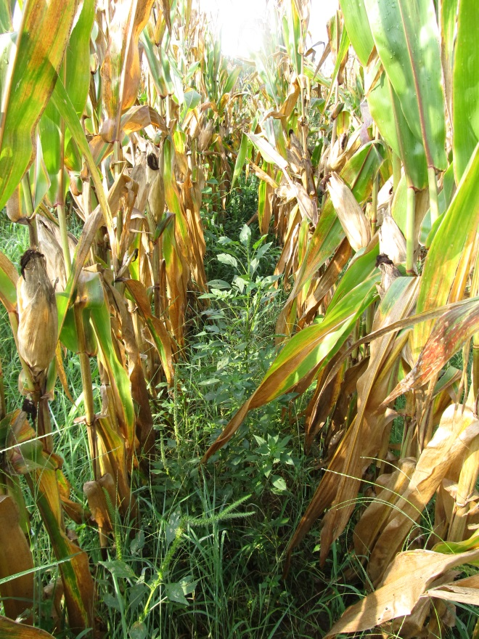
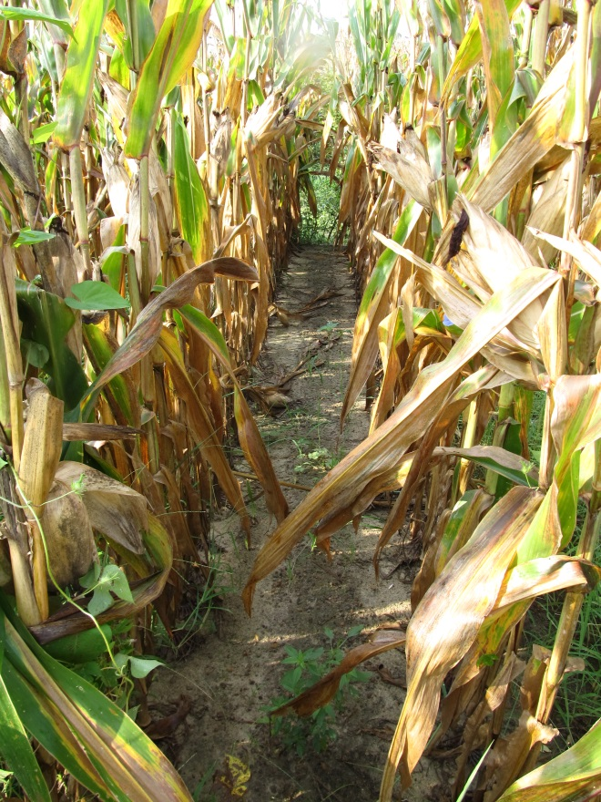
Do we need to rethink laybys????
NTC
Atrazine 4L @ 32 oz/A (PRE)
Roundup WM @ 32 oz/A +
Atrazine @ 48 oz/A (21 DAP)
Atrazine 4L @ 32 oz/A (PRE)
Roundup WM @ 32 oz/A +
Atrazine @ 48 oz/A (21 DAP)
Evik @ 2 lb/A + NIS (37 DAP)
CN-06-15
July 29
133 DAP

Slide 22
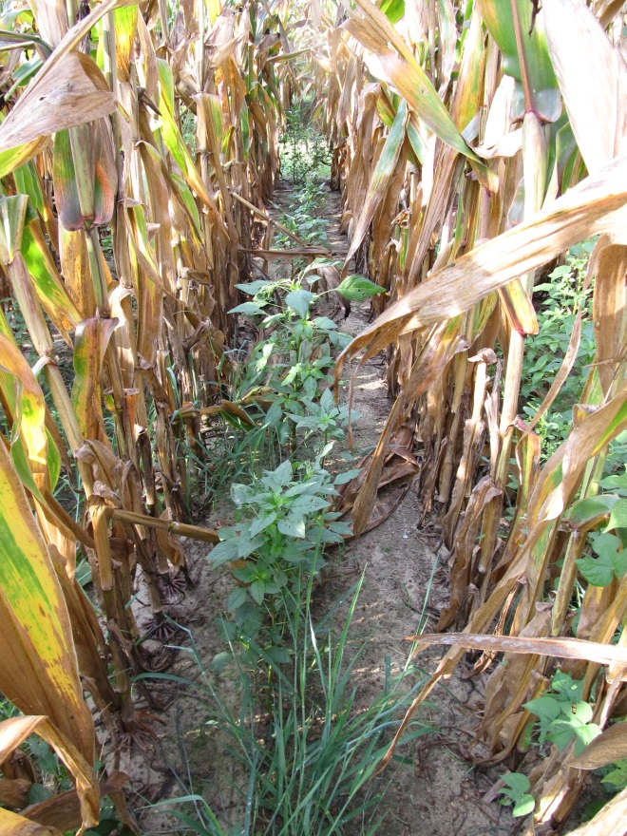
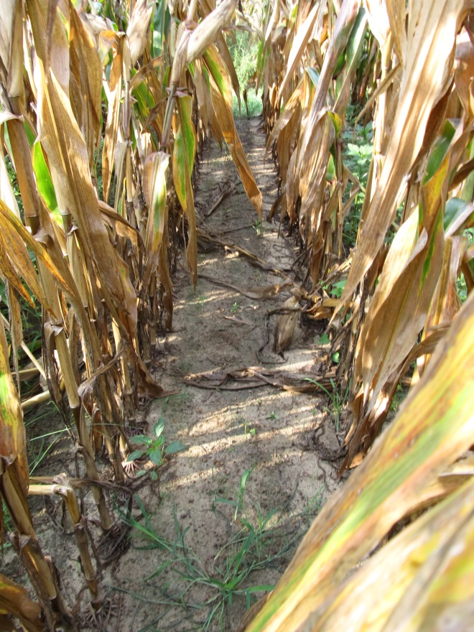
Do we need to rethink laybys????
NTC
Dual II Magnum @ 16 oz/A (PRE)
Roundup WM @ 32 oz/A +
Atrazine @ 64 oz/A (21 DAP)
Dual II Magnum @ 16 oz/A (PRE)
Roundup WM @ 32 oz/A +
Atrazine @ 64 oz/A (21 DAP)
Evik @ 2 lb/A + NIS (37 DAP)
CN-06-15
July 29
133 DAP

Slide 23
New (er) Stuff

Slide 24
Acuron
Syngenta
Dual Magnum + Atrazine + Callisto + bycyclopyrone
MOA = 5 + 15 + 27
PRE or EPOST
12” tall
Soybean, cotton and peanuts = 10 months
80 oz/A
Can tank-mix with glyphosate
Price???????

Slide 25
Acuron - 2015
NTC
Acuron 3.44CS
80 oz/A (PRE)
CN-12-15
May 11
47 DAT

Slide 26
Revulin Q
DuPont
Accent + Callisto + isoxadifen (safener)
MOA = 2 + 27
EPOST (20” tall or V6)
3.4-4.0 oz/A
Tank mix with atrazine
UGA only has 1 year of data?????
Cotton or soybean = 10 months; peanut = 18 months
No Counter INFR

Slide 27
Revulin Q - 2015
NTC
Revulin Q 51.2WG @ 3.4 oz/A
COC @ 1% v/v
AMS Xtra @ 2.5% v/v
(Applied 22 DAP)
CN-11-15
May 15
52 DAP

Slide 28
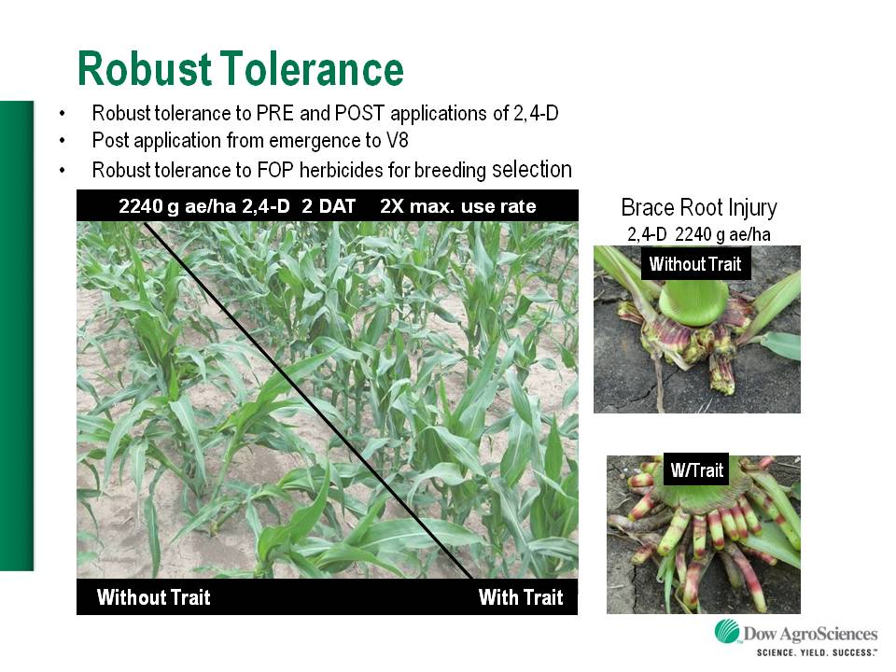
Enlist™ Herbicide Tolerant Corn
tolerance to 2,4-D and Assure + GLY
Trait was deregulated in September 2014 and herbicide in October 2014
Colex-D™ technology
2,4-D choline
lower volatility
lower drift potential
enhanced handling/mixing characteristics
reduced odor
1 PRE application + 2 POST applications (30” or V8 stage)
Enlist™ Duo
DMA-Glyphosate (1.71 lb ae/gal) + 2,4-D choline (1.63 lb ae/gal)
2015 Product Launch
IA, IL, IN, OH, SD, WI (first)
AR, KS, LA, MN, MO, MS, NE, ND, OK, TN (next)
Mycogen/Monsanto/Dekalb license????
2,4-D choline

Slide 29
Enlist Duo Recent Problems

Slide 30
Question/Comments
eprostko@uga.edu
www.gaweed.com

