Slide 1
2015 Field Corn Weed Management Update
Eric P. Prostko
Professor/Extension Weed Specialist
Dept. Crop & Soil Sciences

Slide 2
Starting Clean
If you are getting ready to plant and get to the field and have pigweed > 6” tall …………
Park the sprayer
Go get your mower, disk, and/or bottom plow

Slide 3
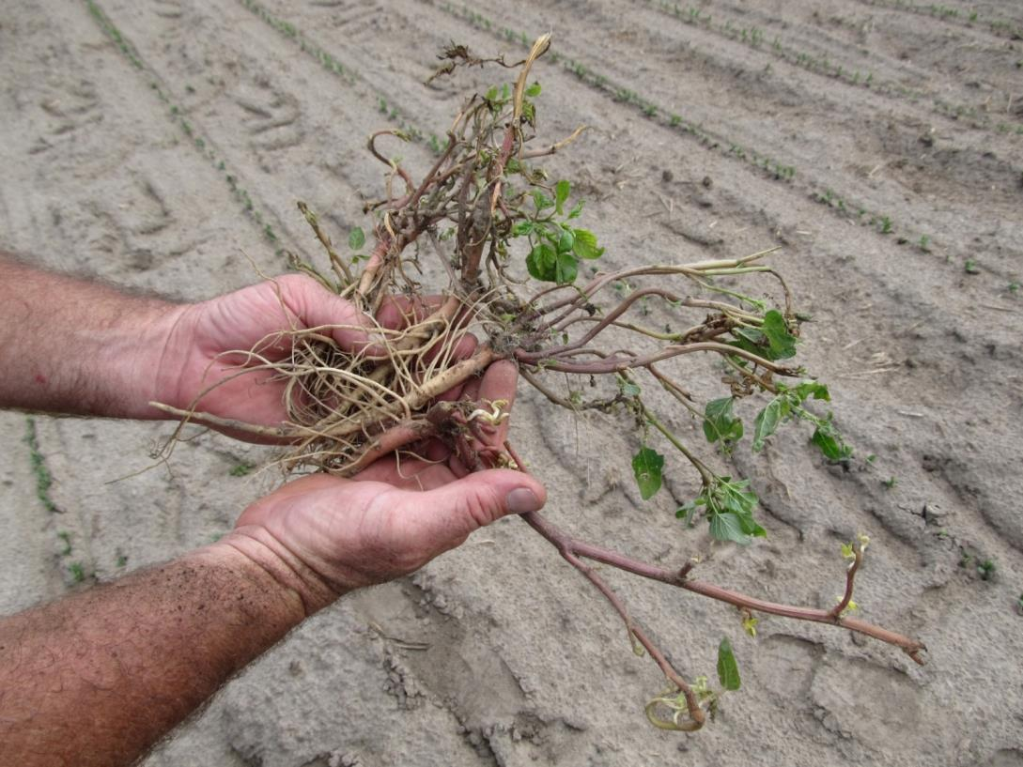
Did you really start clean???? A disk may not be good enough!

Slide 4
Strongarm Carryover or Nematodes???

Slide 5
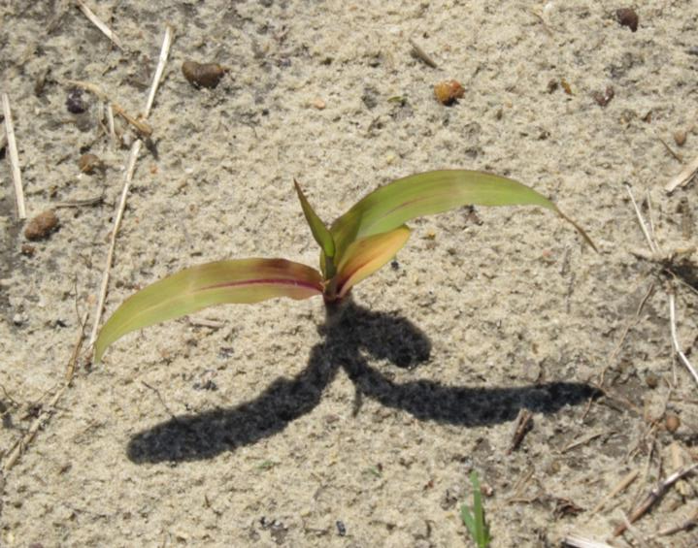
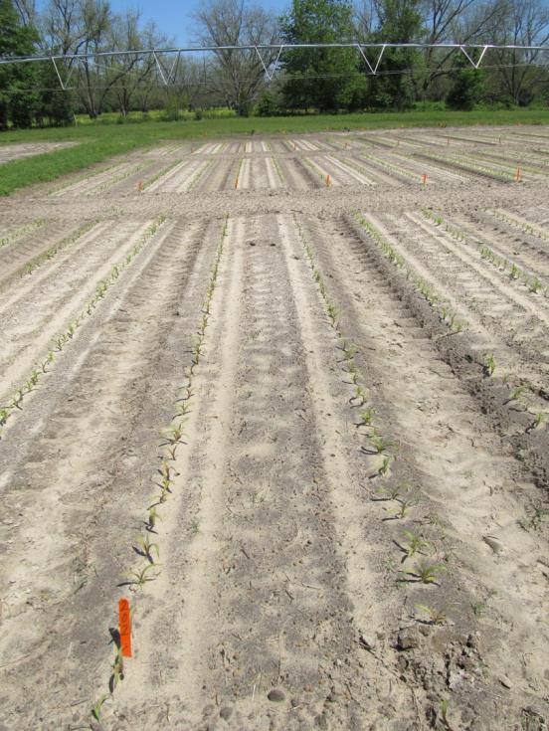
Corn Injury – April 16
pH = 6.21
P = 82.82 lbs/A (H)
K = 90.32 lbs/A (M)
Mg = 45.82 lbs/A (M)
Mn = 9.26 lbs/A
Zn = 2.7 lbs/A (M)
Ca = 367 lbs/A (M)
Nematodes
Sting = 15 (1)
Stubby Root = 4
Ring = 10
Pioneer 2023BVT
Planted March 25
No ALS in 3 years

Slide 6
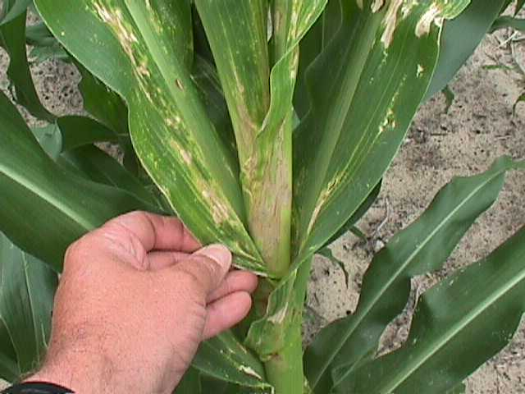
Valor Drift on Field Corn

Slide 7
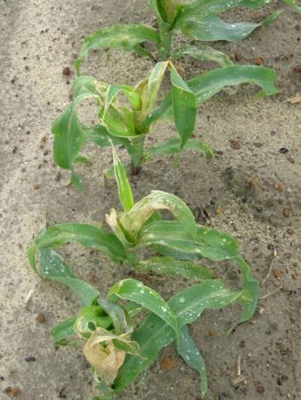
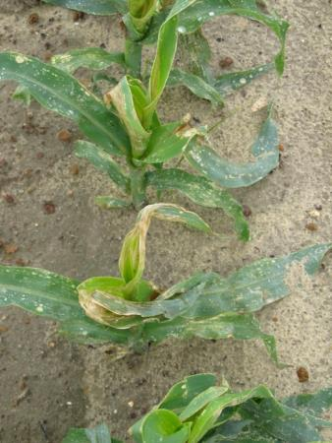
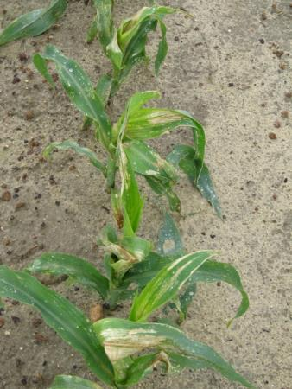
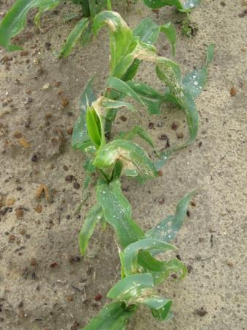
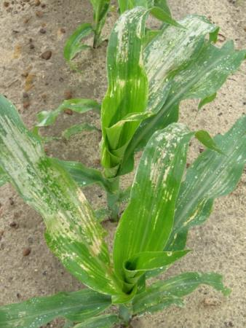
Valor Injury – Applied V6 – 3 DAT
3 oz/A
1.5 oz/A
0.75 oz/A
CN-02-14
May 1
0.375 oz/A
0.188 oz/A

Slide 8
Field Corn Yield Loss Caused By Valor SX 51WG
LSD 0.10 = 3
CN-02-14
Averaged over 2 timings (V2, V6)

Slide 9
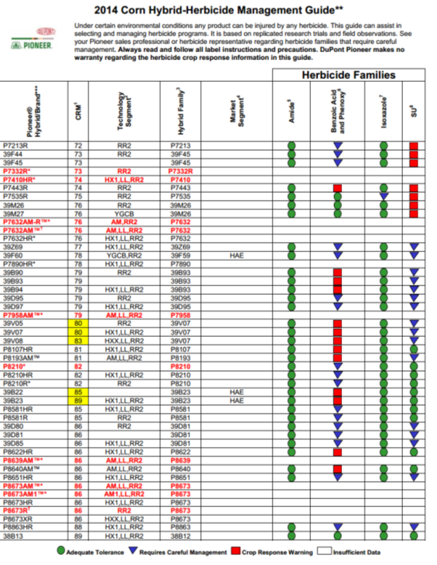
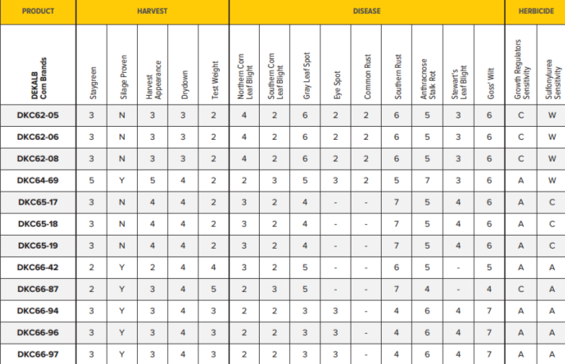
Pay Closer Attention to Hybrid/Herbicide Mgt. Guidelines

Slide 10
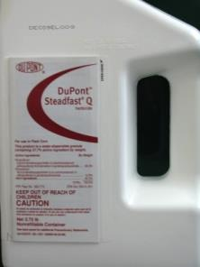
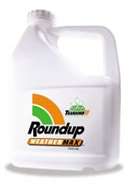
Atrazine + Any of these works just fine!

Slide 11
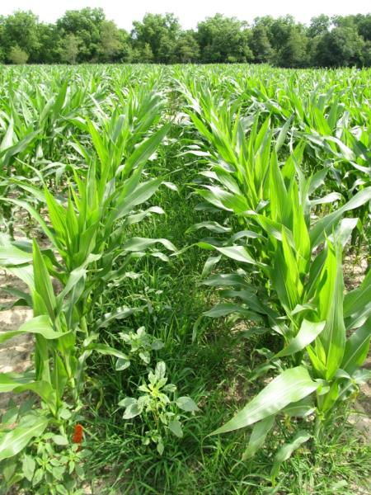
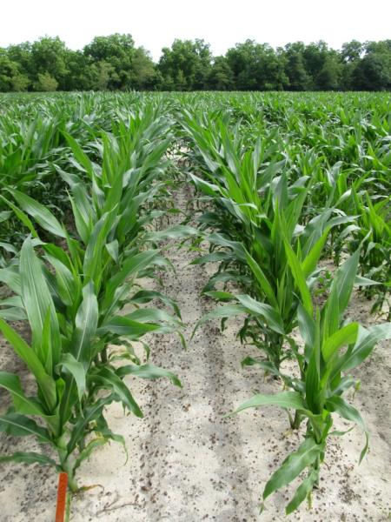
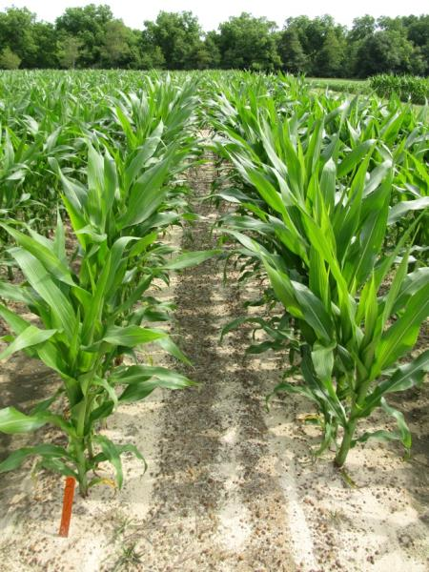
Weed Control in Field Corn – 2014
NTC
Roundup WMAX @ 22 oz/A
Aatrex @ 64 oz/A
Prowl H₂0 @ 32 oz/A
POST
Aatrex @ 32 oz/A - PRE
Roundup WMAX @ 22 oz/A
Aatrex @ 48 oz/A
POST
CN-12-14
May 20
15 days after POST

Slide 12
Weed Control in Field Corn - 2014
NTC
Atrazine – PRE
Liberty – POST
Atrazine - POST
CN-15-14
May 22
51 DAP

Slide 13
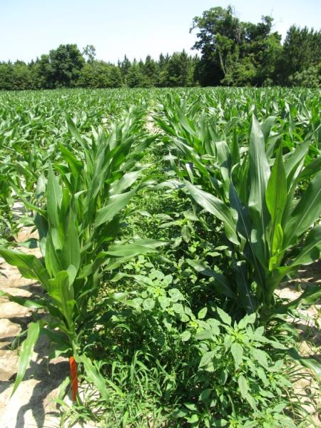
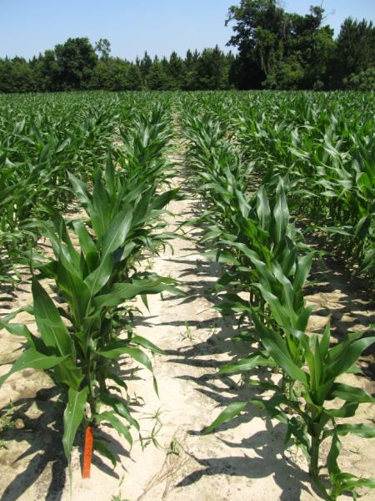
Weed Control in Field Corn – 2014
NTC
Steadfast Q @ 1.5 oz/A
Aatrex @ 64 oz/A
COC @ 1% v/v
POST
CN-16-14
May 22
30 days after POST

Slide 14
Are SU “sensitive” hybrids tolerant of safened herbicides?
CN-05-14
Averaged over 2 hybrids
DKC 62-08, DKC 64-69
LSD 0.10 = 9

Slide 15
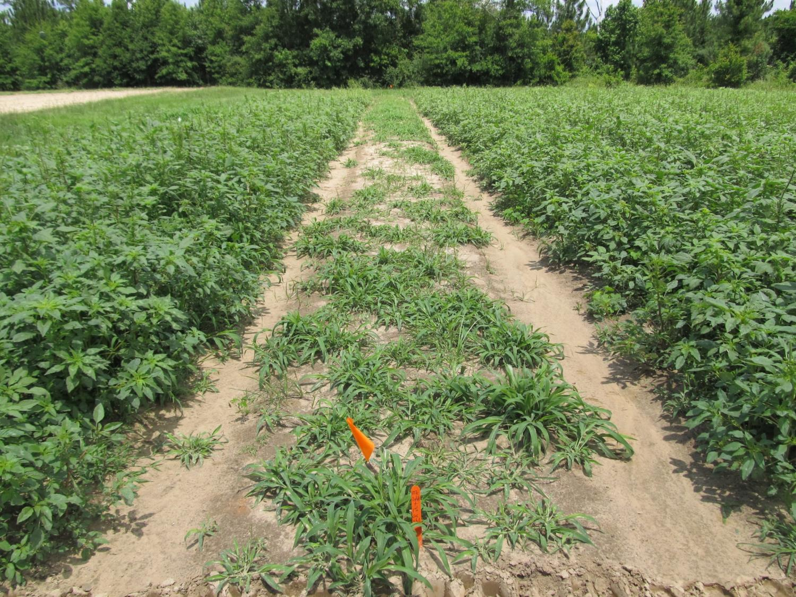
Atrazine 4L @ 2 qts/A + COC @ 1% v/v
Applied to 4”-9” Palmer Amaranth (6” average)
Photo 13 DAT

Slide 16
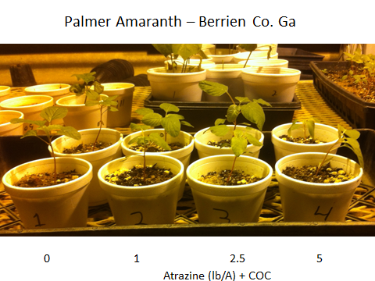
What about atrazine resistance?
2014

Slide 17
2014 Atrazine Resistance Survey
11 samples collected
Populations 1,2,3,5,and 10 = 0.5 lb ai/A
Populations 4 and 6 = 1-2.5 lb ai/A
Population 7 = 5 lb ai/A (Dodge)
Population 9 did not germinate (Berrien)
12 and 13 ?????

Slide 18
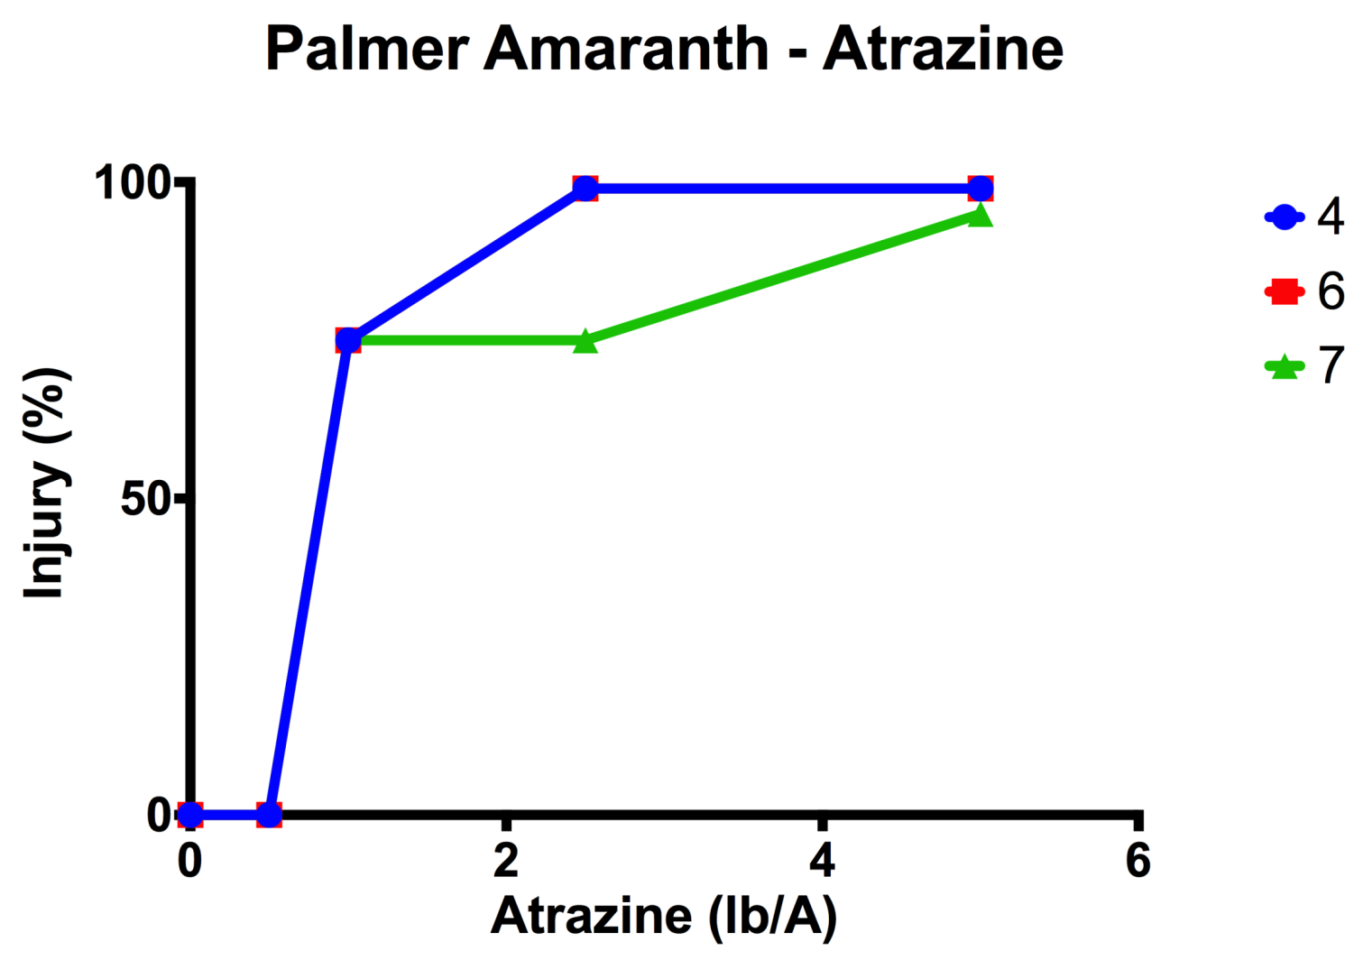

Slide 19
Atrazine Resistant Palmer Amaranth in GA Confirmed Counties as of October 2014
Berrien and Dodge
2X resistance level
5 lbs/A to control
Evik will control

Slide 20
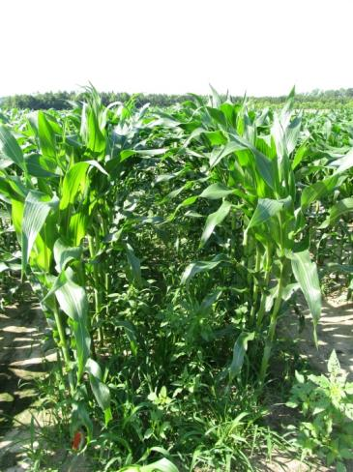
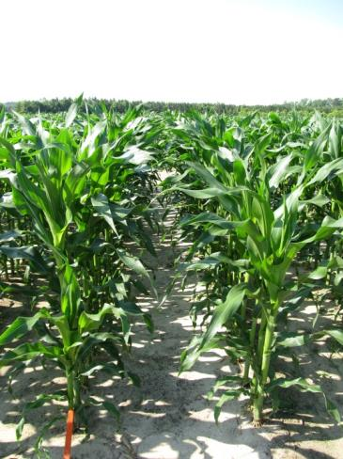
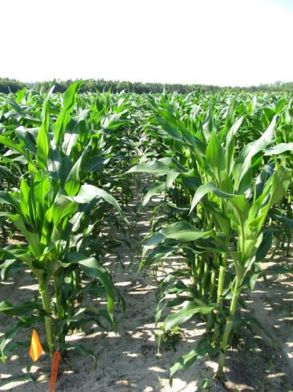
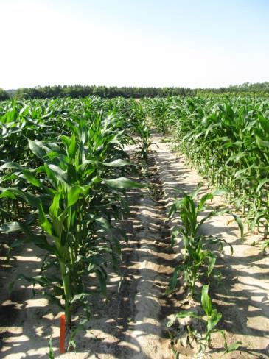
Non-Atrazine or Glyphosate Weed Control Programs Capreno
NTC
Dual II – PRE
Capreno - POST
COC - POST
AMS XTRA - POST
Warrant – PRE
Capreno - POST
COC - POST
AMS XTRA - POST
Zidua – PRE
Capreno - POST
COC - POST
AMS XTRA - POST
PE-09B-14
May 22
52 DAP

Slide 21
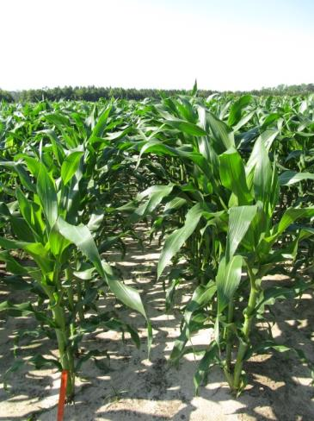
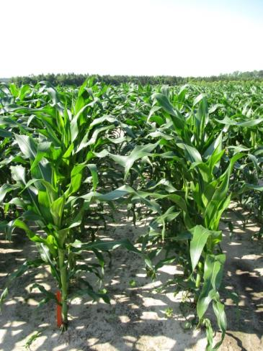
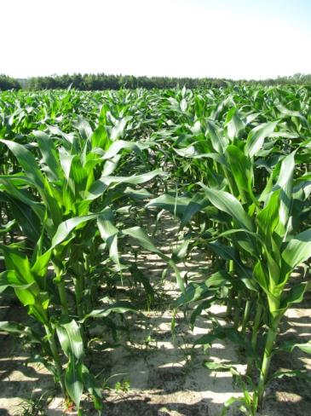
Non-Atrazine or Glyphosate Weed Control Programs Impact
NTC
Dual II – PRE
Impact - POST
COC - POST
AMS XTRA - POST
Warrant – PRE
Impact - POST
COC - POST
AMS XTRA - POST
Zidua – PRE
Impact - POST
COC - POST
AMS XTRA - POST
PE-09B-14
May 22
52 DAP

Slide 22
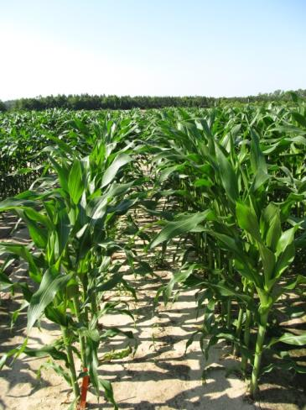
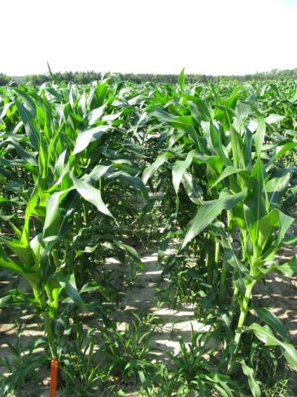
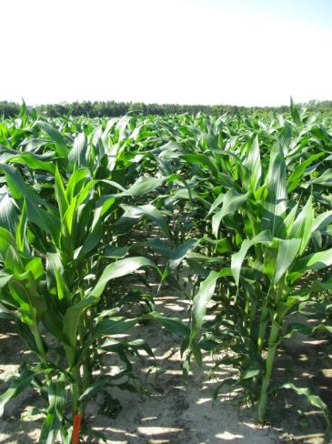
Non-Atrazine or Glyphosate Weed Control Programs Callisto
NTC
Dual II – PRE
Callisto - POST
COC - POST
AMS XTRA - POST
Warrant – PRE
Callisto - POST
COC - POST
AMS XTRA - POST
Zidua – PRE
Callisto- POST
COC - POST
AMS XTRA - POST
PE-09B-14
May 22
52 DAP

Slide 23
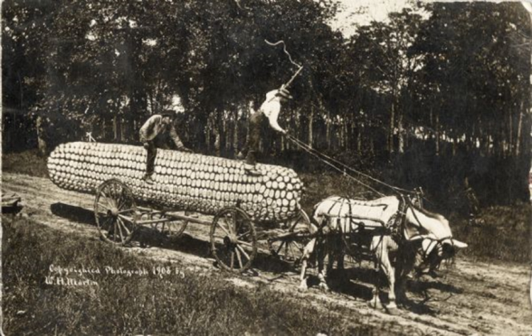
Something to think about?
Some GA growers are pushing yield limits (250+ Bu/A)
75%-80% irrigated
weed science researcher (me) typically does not make 225+ Bu/A yields
At lower yield/input levels, are herbicide stresses masked by other stresses?
At higher yield/input levels (i.e. most stresses are controlled), what about herbicides?

Slide 24
Herbicide Effects on Field Corn Yield in a High Input Environment - 2014
P = 0.4165
CV = 12.32
CN-01-14
Applied 21 DAP
V3-V4
Pioneer 1685

Slide 25
Roundup W-Max (32 oz/A) + Atrazine (48 oz/A) + AMS Xtra (2.5% v/v) Timing Effects on Field Corn Yield in a High Input Environment - 2014
P = 0.1430
CV = 6.56
Pioneer 1685

Slide 26
Morningglory Control in Field Corn

Slide 27
Morningglory Control in Corn
as much atrazine as possible
1.0 lb/A – PRE fb 1.5 lb/A – POST
small grain rotations
2,4-D, Clarity, Status, Aim, ET, Evik (PDIR)
Enlist Corn???
Liberty-Link® Corn Systems
split applications of glyphosate (RR corn)
* 1st application + atrazine
Harvest Aids
Aim
Early-harvest

Slide 28
New (er) Stuff

Slide 29
New for 2015 UGA Rec’s
FMC
Zidua + Cadet
5 - 8 oz/A
PRE or early POST (V4)
Tank-mix with atrazine, glyphosate or glufosinate.
Anthem ATZ = Anthem + atrazine
MOA = 15 + 14

Slide 30
Anthem for Weed Control in Field Corn - 2014
Anthem (PRE)
Cadet (POST)
Roundup W-Max (POST)
AMS + COC (POST)
NTC
NTC
CN-11-14
May 22
16 days after POST

Slide 31
Corn Herbicides You Might Hear About But UGA is Not Recommending (Yet/Ever?)
Isoxaflutole + thiencarbazone + safener
Isoxaflutole + safener
acetochlor (2.7 lb) + atrazine (1.34 lb)
acetochlor (3.1 lb) + atrazine (2.5 lb)
Atrazine + s-metolachlor + mesiotrione + bycyclopyrone + safener

Slide 32
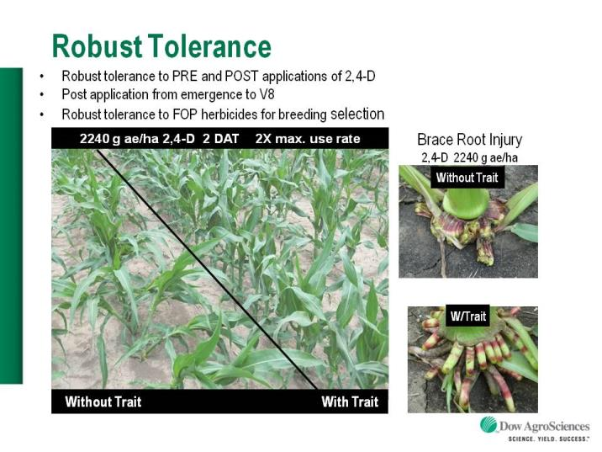
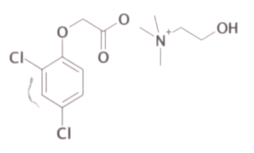
Enlist™ Herbicide Tolerant Corn
tolerance to 2,4-D and Assure + GLY
Trait was deregulated in September 2014 and herbicide in October 2014
Colex-D™ technology
2,4-D choline
lower volatility
lower drift potential
enhanced handling/mixing characteristics
reduced odor
1 PRE application + 2 POST applications (30” or V8 stage); 30-48” = drops
Enlist™ Duo
DMA-Glyphosate (1.7 lb ae/gal) + 2,4-D choline (1.6 lb ae/gal) = 3.5-4.75 pt/A
2015 Product Launch
IA, IL, IN, OH, SD, WI (first)
AR, KS, LA, MN, MO, MS, NE, ND, OK, TN (next)
2,4-D choline

Slide 33
Enlist™ Duo Label Requirements (10-09-14)
Can only use nozzles and pressure listed on label (chart)
Winds speeds < 15 MPH
30’ downwind buffer from sensitive areas
Wind cannot be blowing toward tomatoes, other fruiting vegetables (Crop Group 8), cucurbits (Crop Group 9), grapes, and cotton
Specific sprayer clean-out directions

Slide 34
Enlist™ Duo Nozzle Tips/Pressure

Slide 35
Enlist™ Duo Sprayer Cleanout

Slide 36
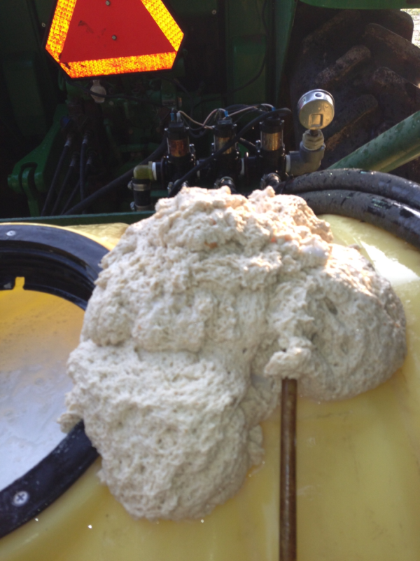
The Tank-Mixes Blues!
Reflex + Zidua + B-Moly +
Glyphosate + Brandt Smart
Trio (N + S + B + Mn + Zn)
*Always pre-slurry dry formulations
in water before adding to tank!!!

Slide 37
Question/Comments
eprostko@uga.edu
www.gaweed.com

