Slide 1

2015 Soybean Weed Control Update
Eric P. Prostko
Professor and Extension Weed Specialist
Dept. Crop & Soil Sciences

Slide 2
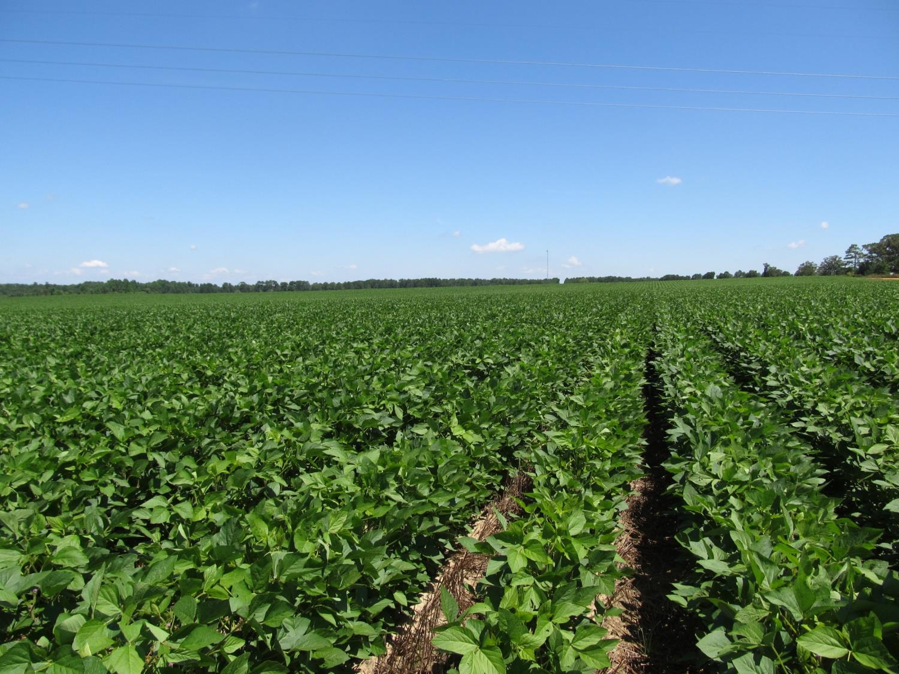
Decatur County
July 29, 2014
Prefix – PRE
Roundup + Classic – POST
(strip-till wheat stubble)

Slide 3
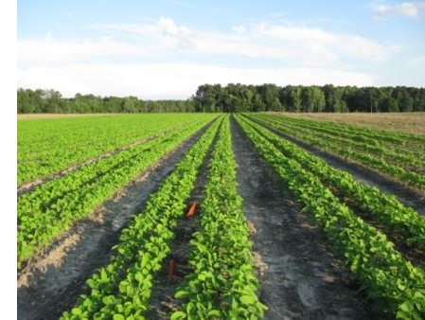
Narrow Rows and Weed Control - Soybeans
“A review of row spacing experiments in which an initial weed management practice had been accomplished revealed that in 64% of the cases (72 of 113 site-years), less late-season weed density and/or biomass, or greater late-season weed control, was achieved in narrow- compared to wide-row soybean production systems.”
Bradley, K. W. 2006. A review of the effects of row spacing on weed management in corn and soybean. Online. Crop Management doi:10.1094/CM-2006-0227-02-RV.

Slide 4

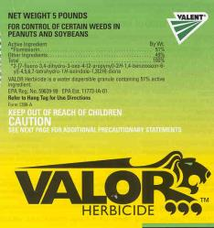



Just thinking???
Fierce or Valor or Envive or Valor XLT (PRE) followed by Reflex (POST) = great pigweed control but not great …….
Resistance Management
PPO followed by PPO
Not great in cotton and peanut rotations relying on Valor and Reflex
Might be OK in corn/soybean rotation when no PPO is used in corn

Slide 5
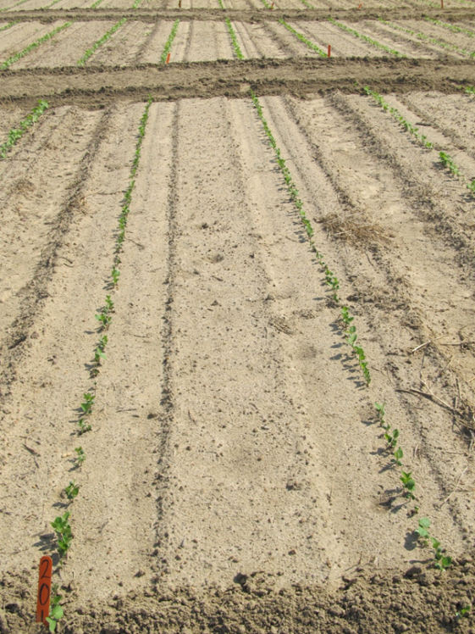
STS/SR Soybeans (sulfonylurea tolerant, sulfonylurea ready)
May want to consider these if using Envive or Canopy
Help minimize PRE injury from Classic in adverse conditions (i.e. cool, wet)

Slide 6



Don’t forget about metribuzin on soybean?
Not a PPO (Valor or Reflex)
Good on pigweed and sicklepod
Can be applied PPI
Dryland fields?
Issues (Be careful!!)
soil texture, OM, pH
Varieties
Rotations
Company support
Lack of incentive at dealer level
TriCor 75DF
Metribuzin 75DF

Slide 7
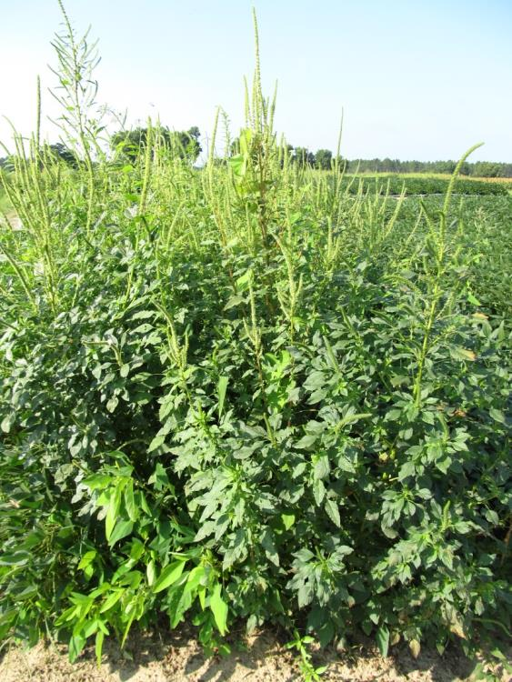
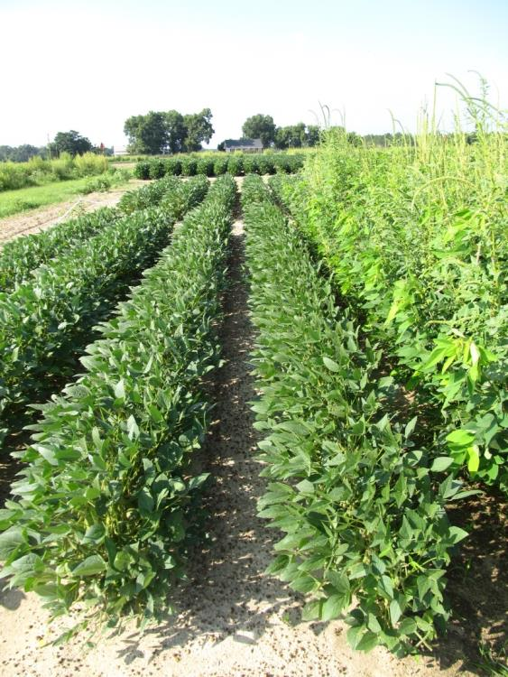
Metribuzin Based Soybean Weed Control Program - 2014
NTC
Boundary – PRE
Flexstar GT - POST
SB-14-14
July 24
66 DAP

Slide 8
For Growers in Peanut/Cotton Rotations Who Want to Protect Valor and Reflex
RR Soybeans
Warrant or Dual Magnum or Zidua or Anthem fb Glyphosate + Reflex (Flexstar GT) or Glyphosate + Prefix/Statement
Tricor or Boundary or Canopy or Authority MTZ (metribuzin herbicides) fb Glyphosate + Reflex (Flexstar GT) or Glyphosate + Prefix/Statement
LL Soybeans
Warrant or Dual Magnum or Zidua or Anthem fb Liberty + Reflex or Prefix/Statement
Reflex or Valor or Prefix fb Liberty + Warrant or Dual Magnum or Zidua or Anthem
No metribuzin on LL varieties
Herbicide
Resistance?

Slide 9
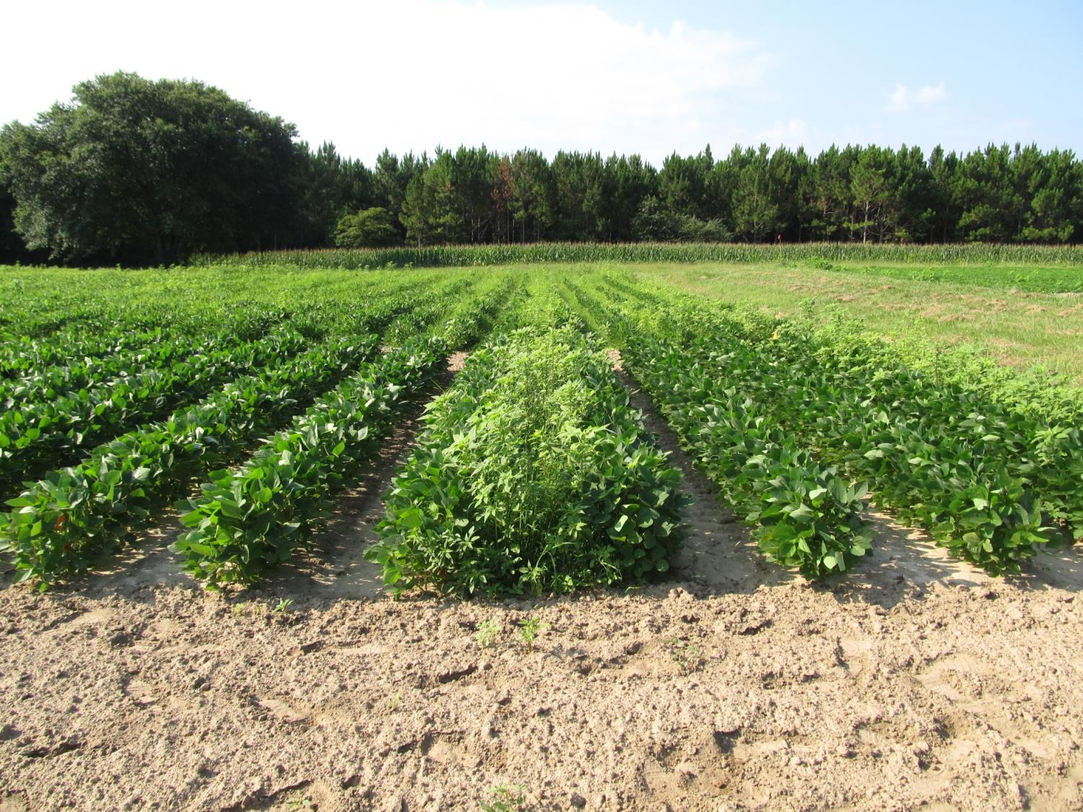
Soybean Weed Control - 2014
Dual (PRE)
Gly + Reflex (POST)
46 Bu/A
NTC
Warrant (PRE)
Gly + Reflex (POST)
46 Bu/A
SB-12-14, July 7
13 Days after POST

Slide 10
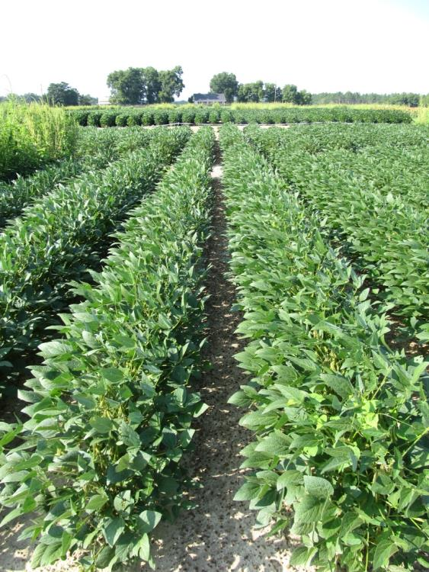
Soybean Weed Control - 2014
NTC
Dual Magnum @ 16 oz/A (PRE)
Roundup W-Max @ 22 oz/A (POST)
Reflex @ 24 oz/A (POST)
SB-14-14
July 22
64 DAP

Slide 11
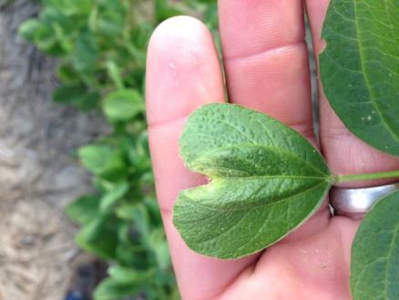
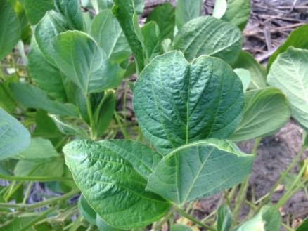
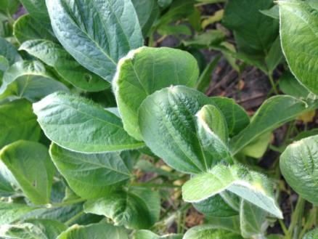
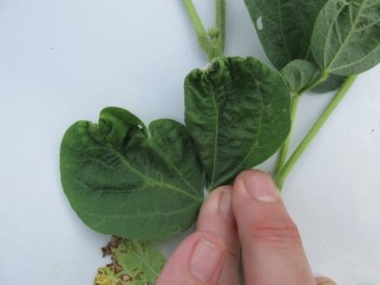
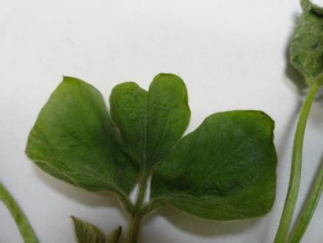
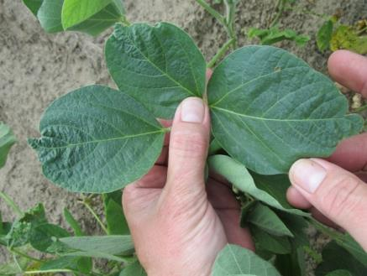
Warrant Injury on Soybean??

Slide 12


Liberty-Link® Soybeans
Liberty 2.34SL @ 22-36 oz/A
VE-R1
2 applications (65 oz/A/year total)
Tank-mixes with POST grass herbicides may reduce grass control
Assure (10-21%); Fusilade (8-12%); Poast (25-41%); Select (4-22%)
Residuals still needed
Variety performance?
Getting better
**Best Results
15 GPA, medium droplet size, small weeds, 9 am - 6 pm

Slide 13
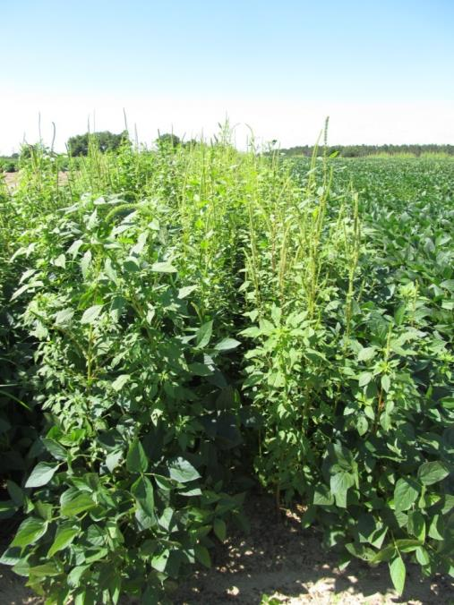
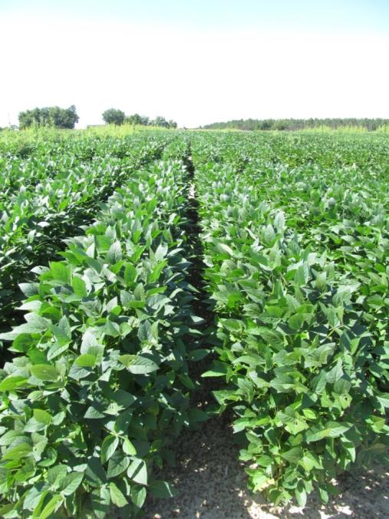
Weed Control in LL Soybeans
NTC
Dual Magnum @ 16 oz/A (PRE)
Liberty @ 29 oz/A (MPOST)
Reflex @ 16 oz/A (MPOST)
SB-23-13
July 17
64 DAP

Slide 14

Liberty-Link Soybean Variety Rankings 2014 UGA Irrigated Variety Trials
Variety | Location
 | Tifton | Griffin | Calhoun
HBK LL4950 | 17 | 9 | 8
AGS 533LL | 21 | 15 | 17
Halo 5:01 | 35 | 38 | 4
Halo 5:45 | 21 | 31 | 25
SS LL 595N | 38 | 24 | 11
Halo 5:26 | 42 | 13 | 37
HBK LL4850 | 23 | 44 | 33
Halo 4:95 | 25 | 42 | 36
Halo 5:25 | 30 | 12 | 28
Halo 4:97 | 31 | 35 | 35
Halo 4:94 | 34 | 41 | 42
HBK LL4953 | 37 | 33 | 30
GoSoy 5911LL | 45 | 30 | 34
11/25/2014

Slide 15
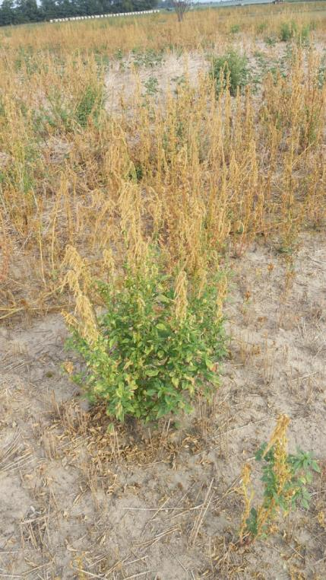
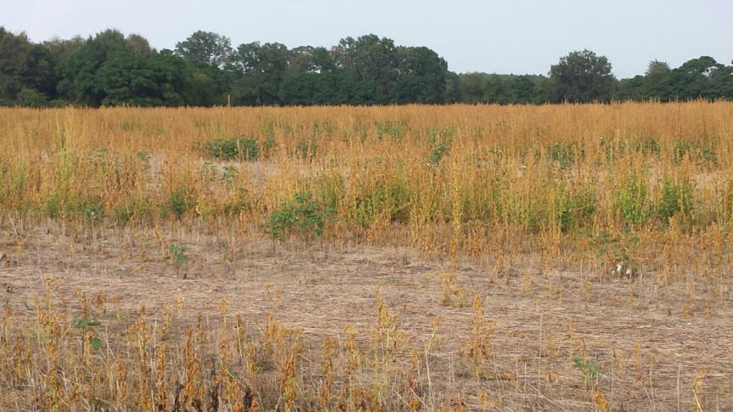
This Must Be Stopped!!! Liberty on Large Pigweed!!!!!

Slide 16
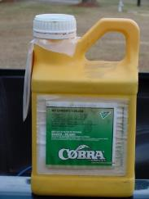
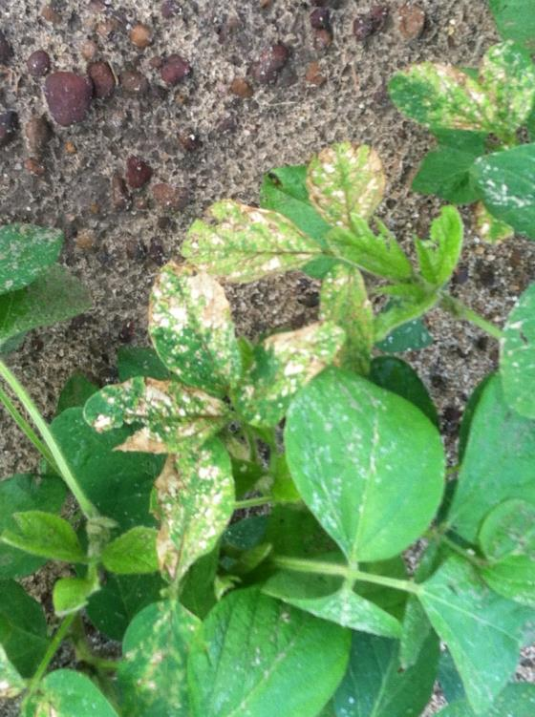
Do early applications of Cobra increase soybean yields?
Nebraska (2013)
Decreases in yield were observed by destroying apical meristem by both clipping at V2 and applications of Cobra
Arkansas
V3 stage
21% increase in yield (2011)
No difference in yield (2012)
Iowa (2011)
V2.5 stage
No positive effect
Multi-State (MN, WI, MI, IA, KS, IL, IN, AR, KY)
2012
V4 stage
No positive effect from Cobra alone
Increased yield with SOYA + Cobra (+8.9%) but not different from SOYA alone.
Mississippi (2014)
V2 stage
No effect on nodes, heights, or yield

Slide 17
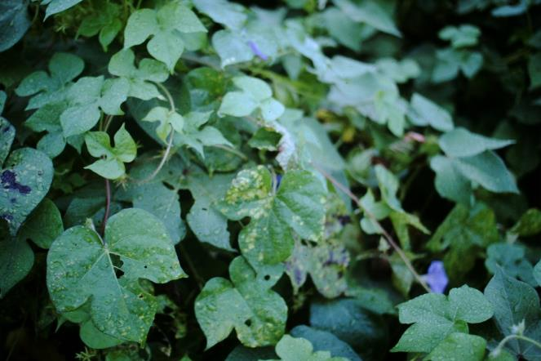
What about Morningglory?
Metribuzin – PRE
Tricor, Canopy, Boundary
Glyphosate + Reflex/Prefix + Classic or FirstRate
3 way tank-mix?????
Glyphosate + Reflex/Prefix fb Roundup + Classic or Firstrate
Liberty

Slide 18
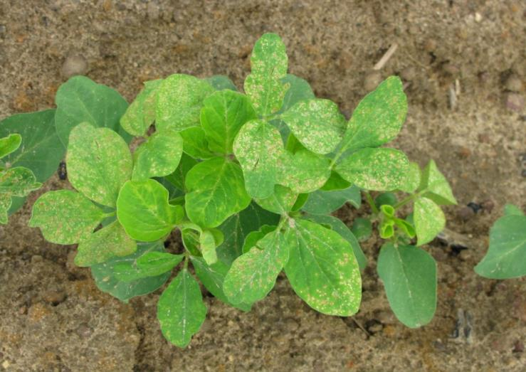
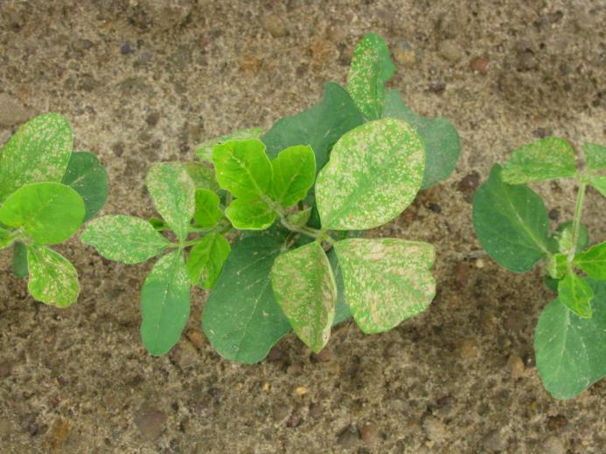
Reflex @ 16 oz/A + Classic @ 0.5 oz/A + Clethodim @ 20 oz/A + 80/20 @ 0.25% v/v – 3 DAT.

Slide 19

Future Technologies
2,4-D resistance
Dicamba resistance
“Balance” beans
MGI soybeans

Slide 20

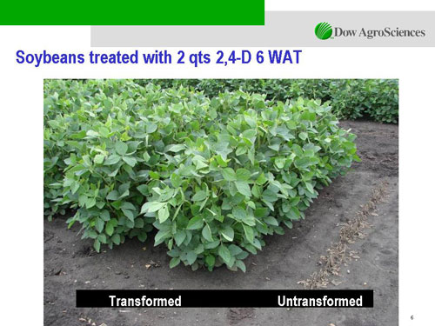

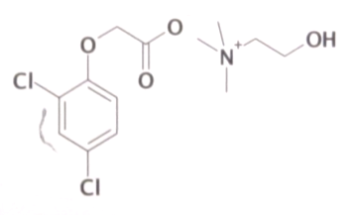
Enlist™ Herbicide Tolerant Soybean
tolerance to 2,4-D + glyphosate + glufosinate (Liberty)
Trait was deregulated in September 2014 and herbicide in October 2014
Colex-D™ technology
2,4-D choline
lower volatility
lower drift potential
enhanced handling/mixing characteristics
reduced odor
1 Burndown/PRE application + 2 POST applications (R2 stage)
Enlist™ Duo
DMA-Glyphosate (1.7 lb ae/gal) + 2,4-D choline (1.6 lb ae/gal) – (3.5-4.75 pt/A)
2015 Product Launch
IA, IL, IN, OH, SD, WI (first)
AR, KS, LA, MN, MO, MS, NE, ND, OK, TN, (next)
2,4-D choline

Slide 21
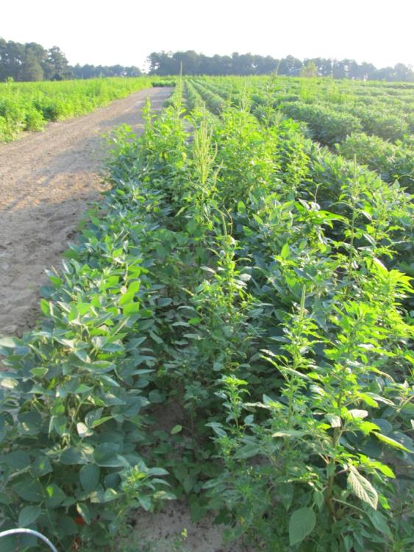
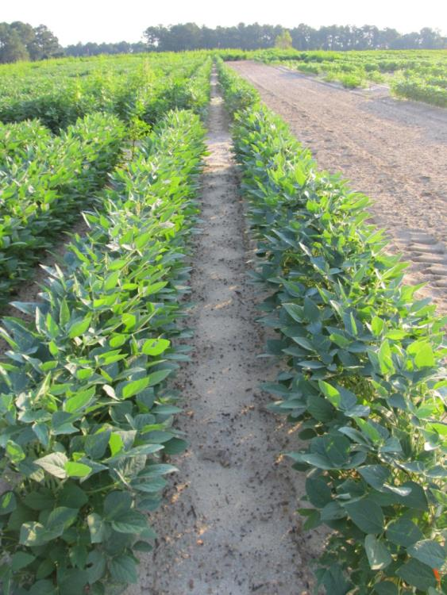

Enlist Soybeans - 2012
NTC
Valor SX 51WG - PRE (May 4)
Enlist Duo - MPOST (June 1)
N-PAK AMS - MPOST (June 1)
SB-09-12
Planted May 3
Photo: June 29

Slide 22

Enlist™ Duo Label Requirements (10-09-14)
Can only use nozzles and pressure listed on label (chart)
Winds speeds < 15 MPH
30’ downwind buffer from sensitive areas
Wind cannot be blowing toward adjacent tomatoes, other fruiting vegetables (Crop Group 8), cucurbits (Crop Group 9), grapes, and cotton
Specific sprayer clean-out directions

Slide 23

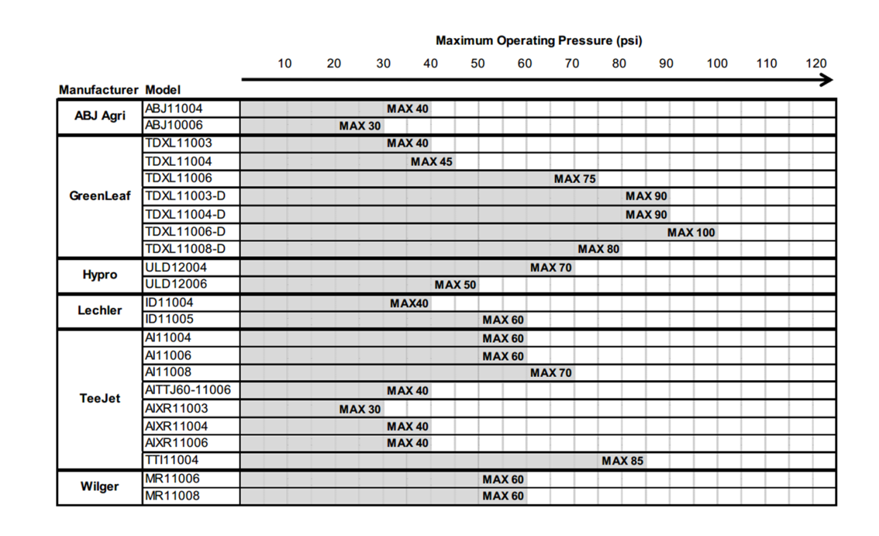
Enlist™ Duo Nozzle Tips/Pressure

Slide 24
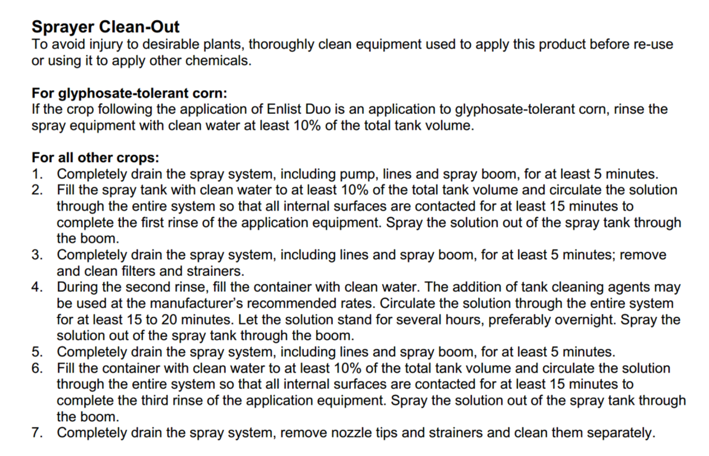
Enlist™ Duo Sprayer Cleanout

Slide 25





Dicamba-Tolerant (DT) Soybeans
Monsanto/BASF
Roundup Ready 2 Xtend (Monsanto)
XtendiMax
Reduced volatility dicamba
Roundup Xtend
Reduced volatility dicamba + glyphosate
Engenia™ (BASF)
Reduced volatility formulation of dicamba
Banvel = dicamba-DMA
Clarity = dicamba-DGA
Engenia = dicamba–BAPMA
PRE or POST
RESIDUAL STILL NEEDED!!!!!!!!!!!!!!!!!!!!!!!
Could be registered in 2015 but will not likely be sold until 2016 (China issues)?

Slide 26

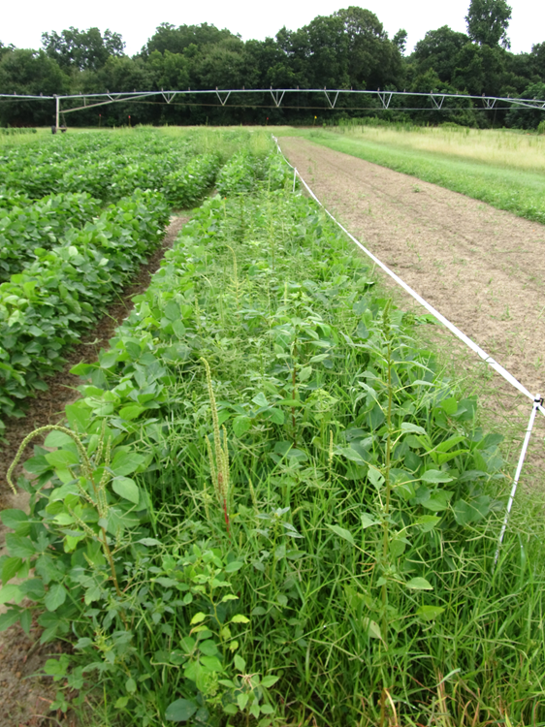
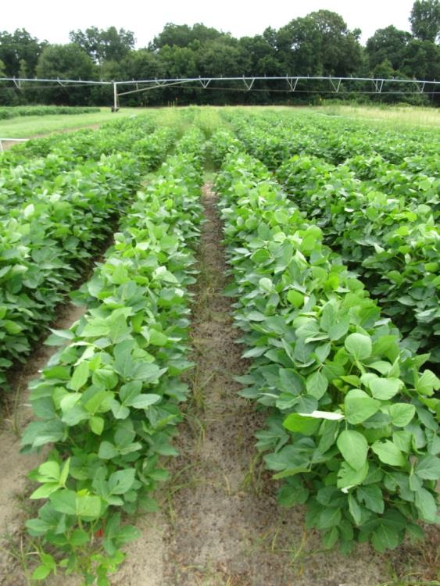
Roundup Xtend - 2014
NTC
Valor – PRE
Roundup Xtend - POST
SB-10-14
July 21
D after
POST

Slide 27

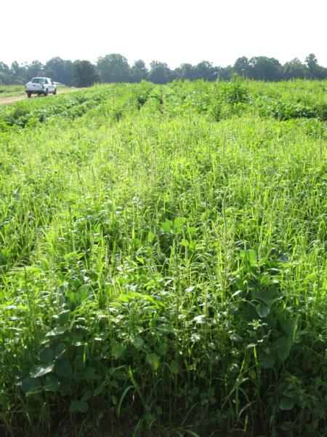
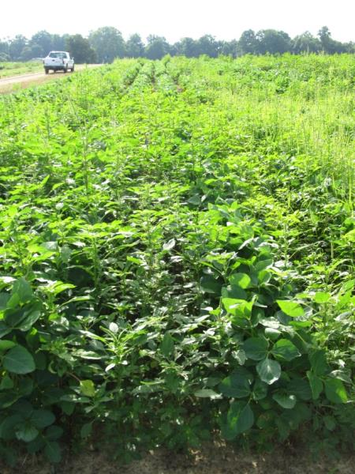
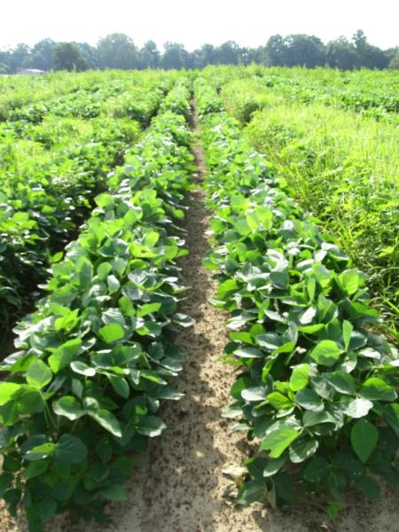
Engenia Program – DT Soybeans 2014 (EPOST Applied 13 DAP)
NTC
Roundup P-Max +
Induce
EPOST
Prowl H₂0 – PRE
Zidua + Roundup P-Max
+ ENGENIA + Induce
EPOST
New-2014, July 14
27 d after EPOST

Slide 28
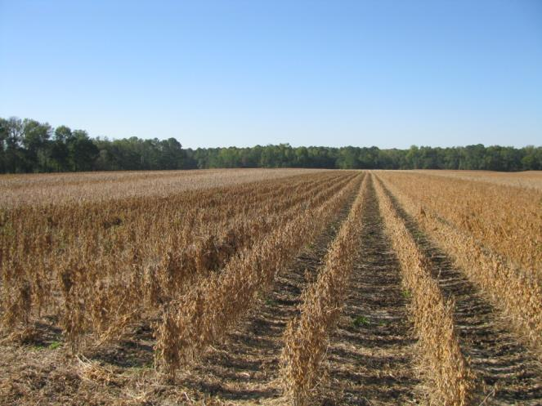
2,4-D and Dicamba Tolerant Soybeans
Still need a residual!
Still need to be timely (3-4” tall weeds)!
Will also need Liberty!
Not on Xtend beans though!
Must significantly improve in the areas of drift and sprayer contamination management

Slide 29
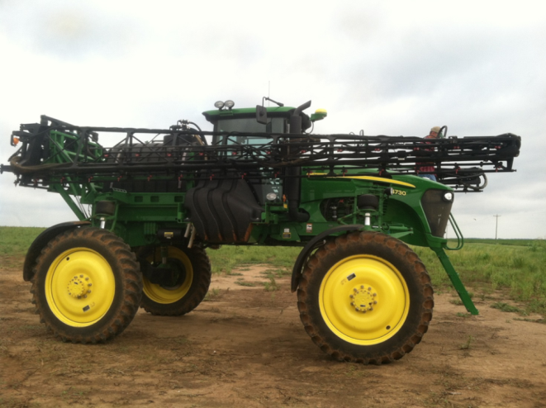
2,4-D and Dicamba Soybeans Stewardship
Droplet size (VMD)
Nozzle selection
Pressure
GPA
Tractor speed
Boom Height
Wind Speed/Direction
Buffers
Sprayer cleanout

Slide 30



On the Next Horizon
HPPD resistant soybeans
Bayer/MS Technologies
“Balance” beans
Glyphosate + isoxaflutole
2015?????
Syngenta + Bayer
“MGI” beans
Mesotrione (Callisto)
Glufosinate (Liberty)
Isoxaflutole (Balance)
2015-2020????

Slide 31
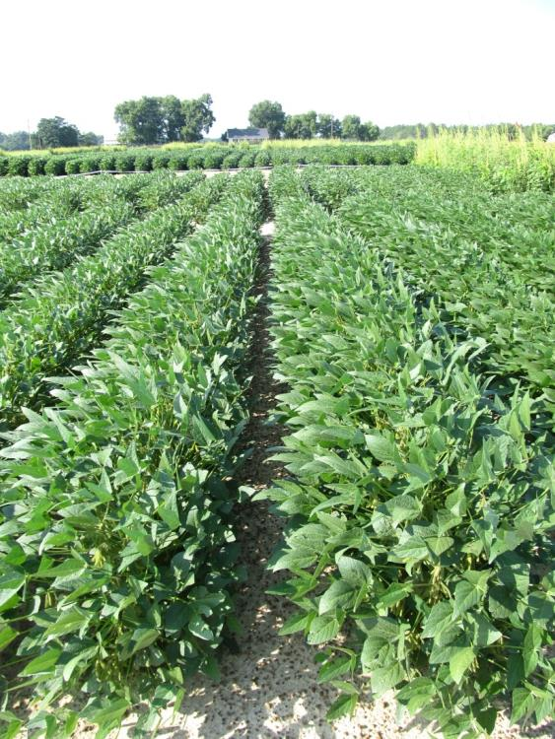
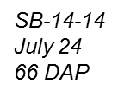
MGI Soybeans - 2014
NTC
Zemax – PRE
Flexstar GT - POST
Zemax = Dual Magnum + Callisto

Slide 32
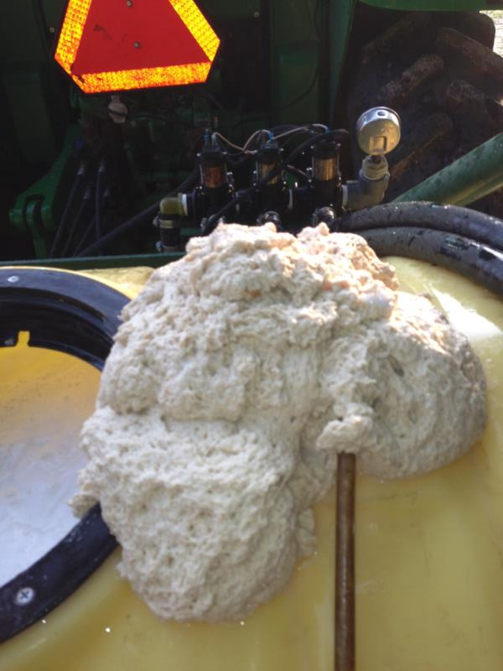
The Tank-Mixes Blues!
Reflex + Zidua + B-Moly
Glyphosate + Brandt Smart
Trio (N + S + B + Mn + Zn)
*Always pre-slurry dry formulations
in water before adding to tank!!!

Slide 33
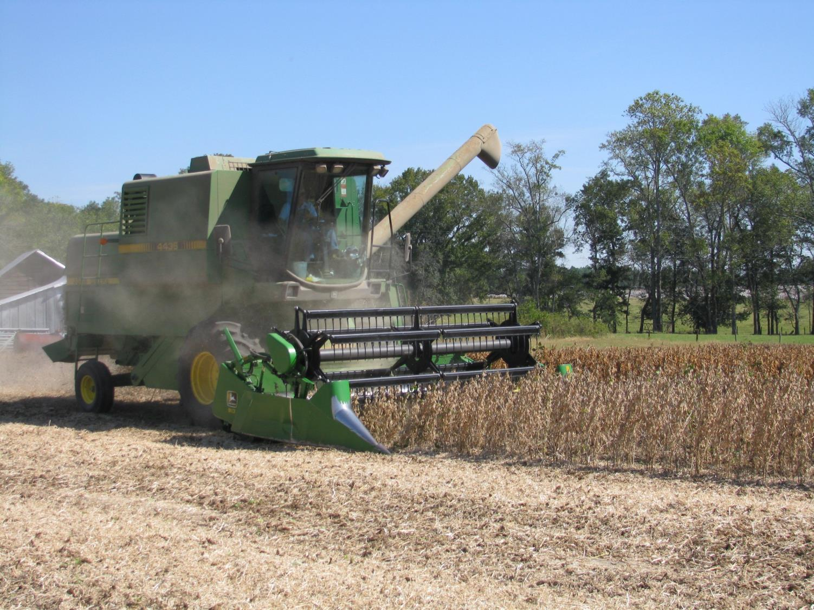
QUESTIONS?
www.gaweed.com

