Slide 1
Field Corn Weed Management Update
Eric P. Prostko
Professor/Extension Weed Specialist
Dept. Crop & Soil Sciences

Slide 2
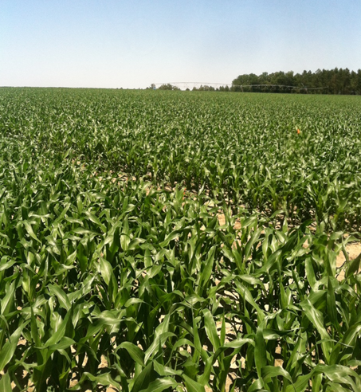
2013 Field Corn Weed Science Issues
RR1 vs. RR2 Hybrids
Steadfast Q on ALS Sensitive Hybrids
Strongarm carryover?
Atrazine/Roundup Mixing Issues
Late-Season Morningglory
Pest Control Updates

Slide 3
RR1 vs. RR2 Hybrid – The Issues
different trait events
RR1 = GA21 (1998)
RR2 = NK603 (2001)
different rate/timing structures
RR1: 0.75 lb ae/A, 2 apps, 30” or V8
RR2: 0.75-1.12 lb ae/A, 2 apps, 30” or V8, 30-48 (drops)
Some glyphosate brands no longer listed RR1 on their label?
How tolerant are RR1 hybrids?

Slide 4
RR1 Field Corn (Pioneer 2023BVT) Yield Response to Roundup WeatherMax
Bu/A
Applied 28 DAP, V5, 5” tall corn
All trts included Aatrex 4L @ 64 oz/A
+ COC @ 1% v/v
P = 0.2275
CV = 3.8

Slide 5
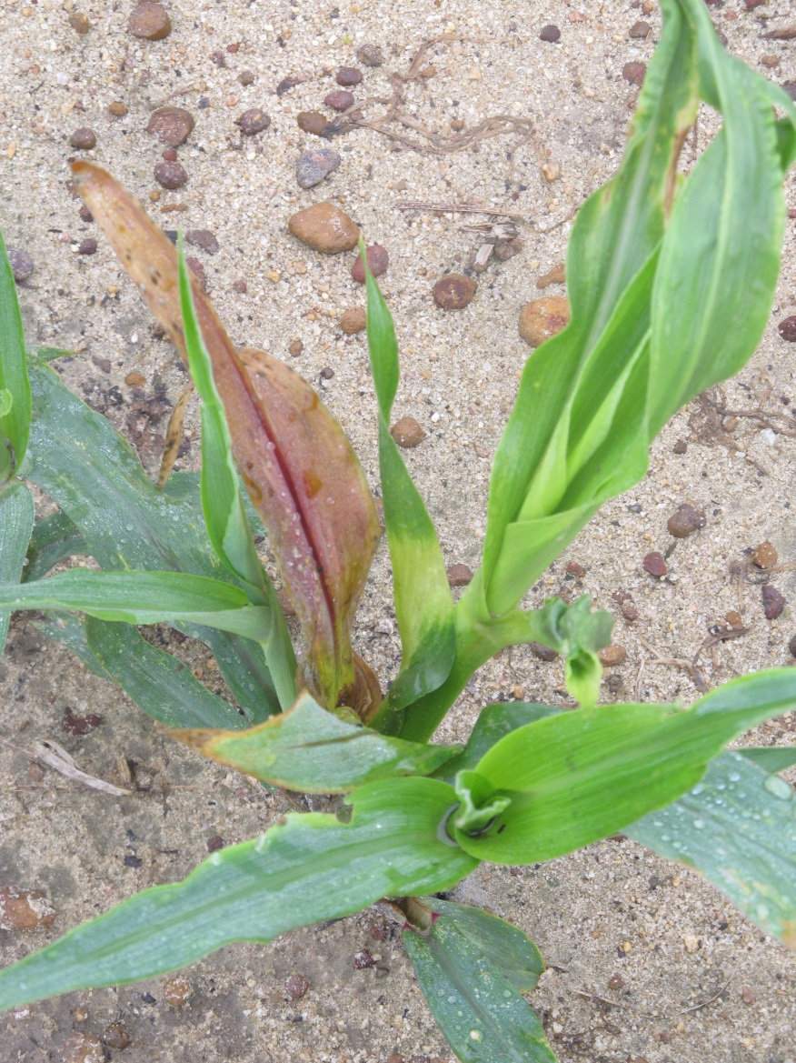
Corn Hybrid/Herbicide Interactions
some corn hybrids are sensitive to certain herbicides
Companies screen for tolerance to …….
Amides (Dual)
Benzoic Acid/phenoxy – (dicamba)
HPPD (Callisto)
ALS (Steadfast)
DuPont Q Products
Steadfast Q, Resolve Q
Isoxadifen (safener)

Slide 6
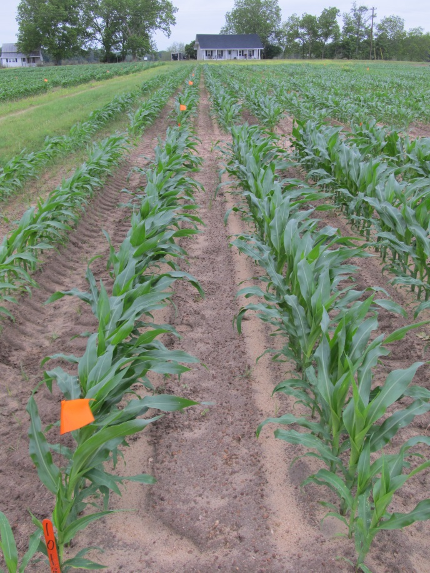
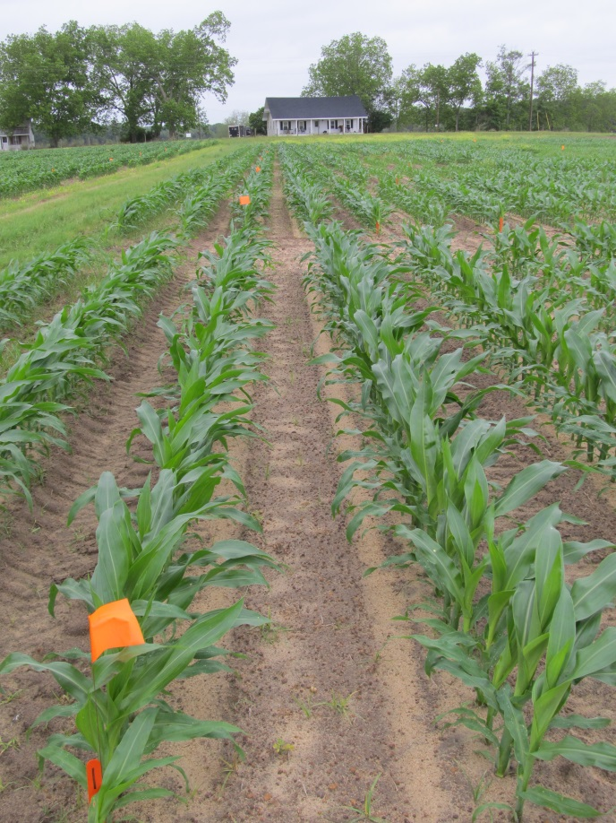
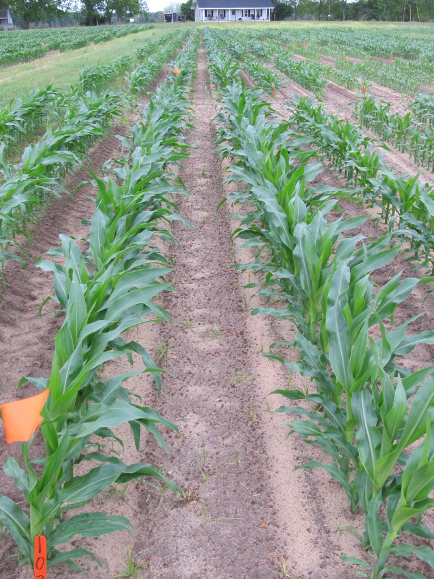
DKC-6469 Response to Steadfast Q
Roundup WeatherMax @ 22 oz/A Aatrex @ 64 oz/A
Roundup WeatherMax @ 22 oz/A
Steadfast Q @ 1.5 oz/A Aatrex @ 64 oz/A
Roundup WeatherMax @ 22 oz/A
Steadfast Q @ 3.0 oz/A Aatrex @ 64 oz/A
CN-18-13
May 3
16 DAT

Slide 7
‘DKC 64-69’ Yield Response to POST Applications of Steadfast Q (RUWM @ 22 oz/A, ATZ @ 64 oz/A, STDQ @ 1.5 or 3 oz/A)
Bu/A
P = 0.5017
CV = 1.75
Applied 28 DAP
V4, 6” tall corn

Slide 8
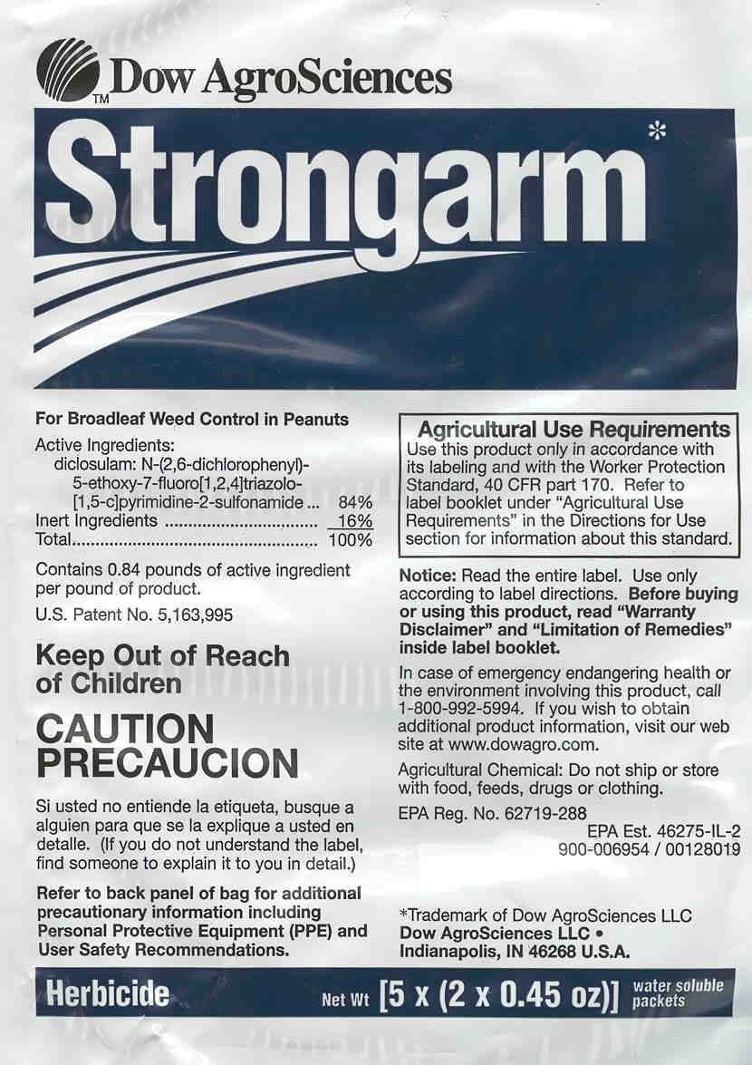
Field Corn/Strongarm Concerns
Increases in corn acres
GA Harvested Acres
2012 = 310,000
2013 = 450,000
Corn is a great rotation for peanut!
Strongarm has 18 month rotation restriction for field corn
Reported ½-life is 33-65 days (WSSA Herbicide Handbook)

Slide 9
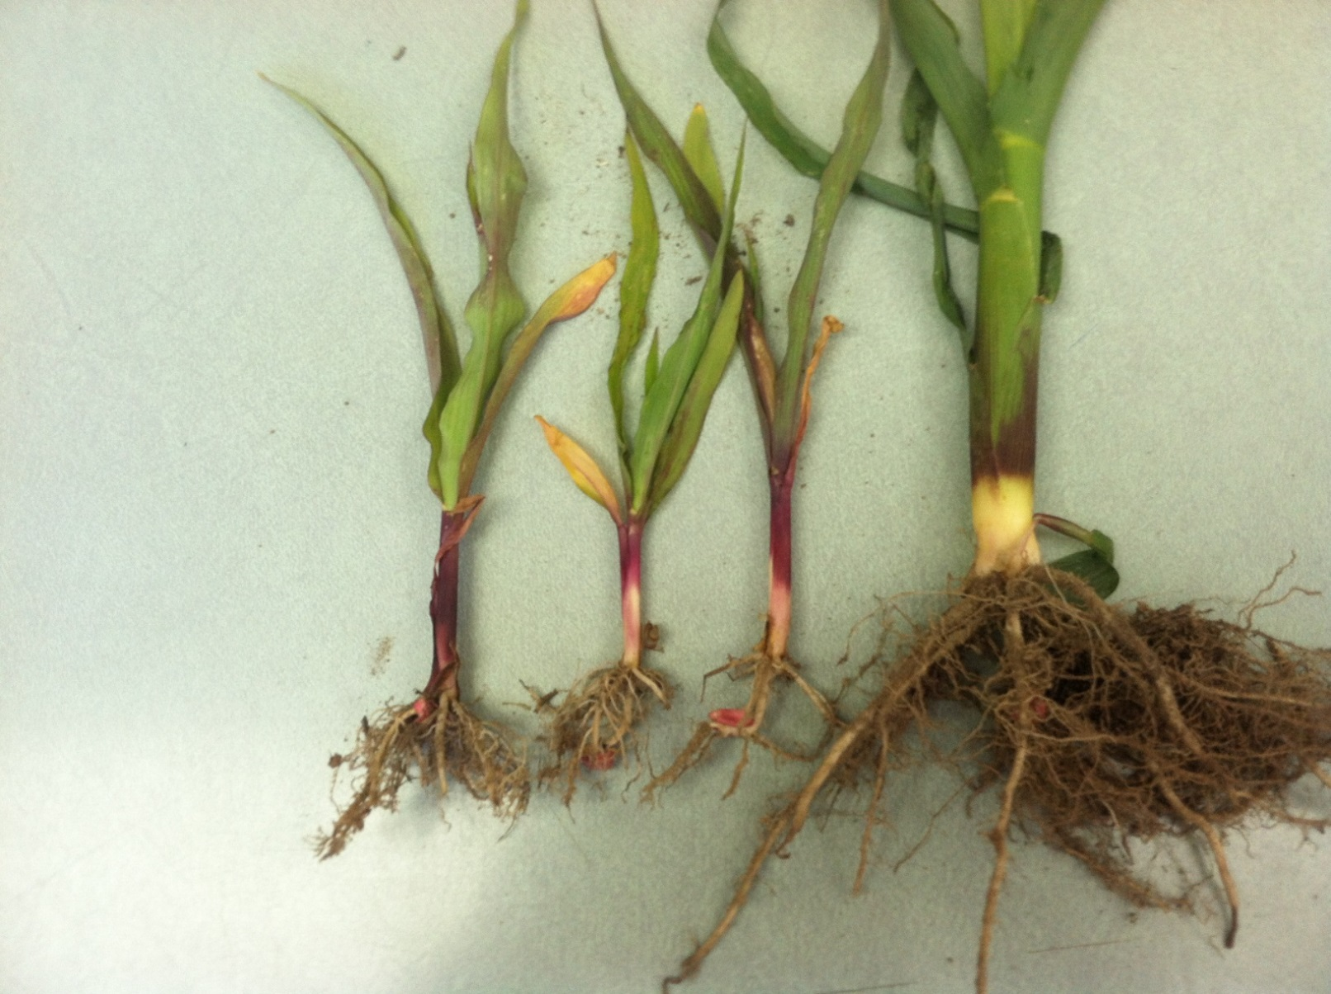
Turner County Field Problem - 2013

Slide 10
Average Daily Air and Soil (2”) Temperatures March 1-April 15 (UGA Ponder Farm)
F⁰
Optimal Day = 77-91⁰F
Optimal Night = 62-74⁰F
Year

Slide 11
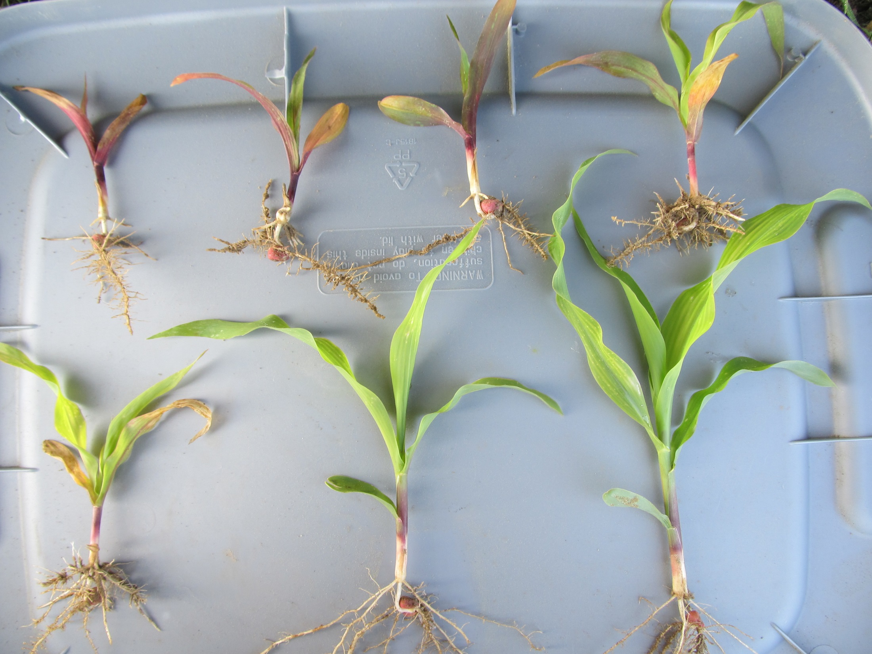
1/4X
1X
1/2X
2X
1/16X
1/8X
Strongarm Injury
22 DAT
CN-03-13
1X = 0.45 oz/A
NTC

Slide 12
Field Corn Yield As Influenced by PRE Applications of Strongarm 84WG - 2013
Bu/A
Rate/A (oz)
LSD 0.10 = 28
Rate/A (oz)
LSD 0.10 = 52

Slide 13
Strongarm/Field Corn
Assuming normal degradation, it is highly probable that field corn could be planted after 5 ½-lives (165-325 days) rather than 540 days (18 months) currently labeled.

Slide 14

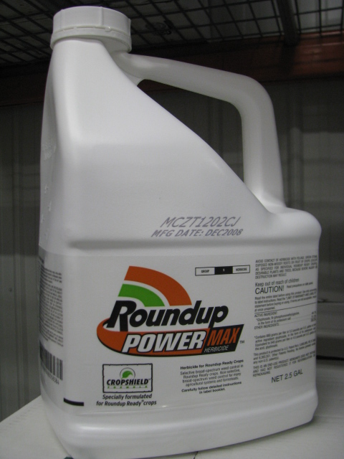
Atrazine/Roundup Mixing Compatibility
Does not happen all the time?
Cold water temperatures
Low water volumes
Mixing order
Less likely with generic glyphosates?

Slide 15


Slide 16

Morningglory Control in Field Corn

Slide 17
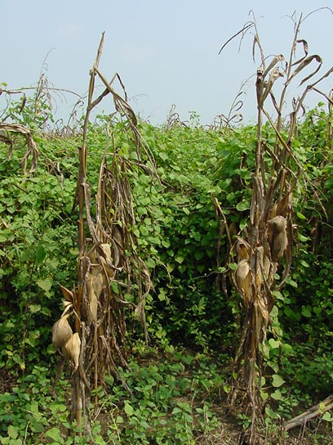
Morningglory Control in Corn
as much atrazine as possible
1.0 lb/A – PRE fb 1.5 lb/A – POST
small grain rotations
2,4-D, Clarity, Status, Aim, ET, Evik (PDIR)
Liberty-Link® Corn Systems
split applications of glyphosate (RR corn)
* 1st application + atrazine
Harvest Aids
Aim
Early-harvest

Slide 18
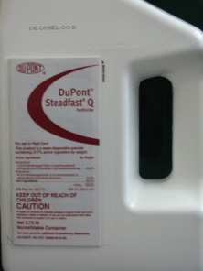


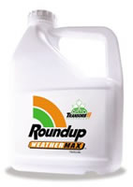
Current GA Field Corn Weed Control
For most in GA …….
Atrazine +
Glyphosate (RR corn)
Liberty (LL corn)
Steadfast Q
Laudis or Capreno
Halex GT (glyphosate + Callisto + Dual)
If I was King, I would make every GA grower use 1 qt/A Atrazine PRE fb 1.5 qt/A + 1 of the above!

Slide 19
Steadfast Q (S) + Atrazine (A) vs. Roundup (R) + Atrazine (A) - Corn Yields - 2013
Bu/A
Trial#
Not significantly different at 0.10

Slide 20
2014 Field Corn Pest Control Handbook Changes
POST timing table
Valor burndown warning
Deleted irrelevant products
Zidua use rate on coarse soils (1.5 oz/A)
New ryegrass control rec’s
Q products on any hybrid

Slide 21

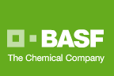
Zidua 85WG
PPI, PRE, EPOST (V4)
Pyroxasulfone (KIH-485)
Residual control of annual grasses and certain broadleaf weeds including pigweed
Same MOA as Dual or Warrant but used at lower rates. May also be better on FL beggarweed ?
Use rates: 1.0-2.75 oz/A
$6.50/oz?
Registered June 2012

Slide 22
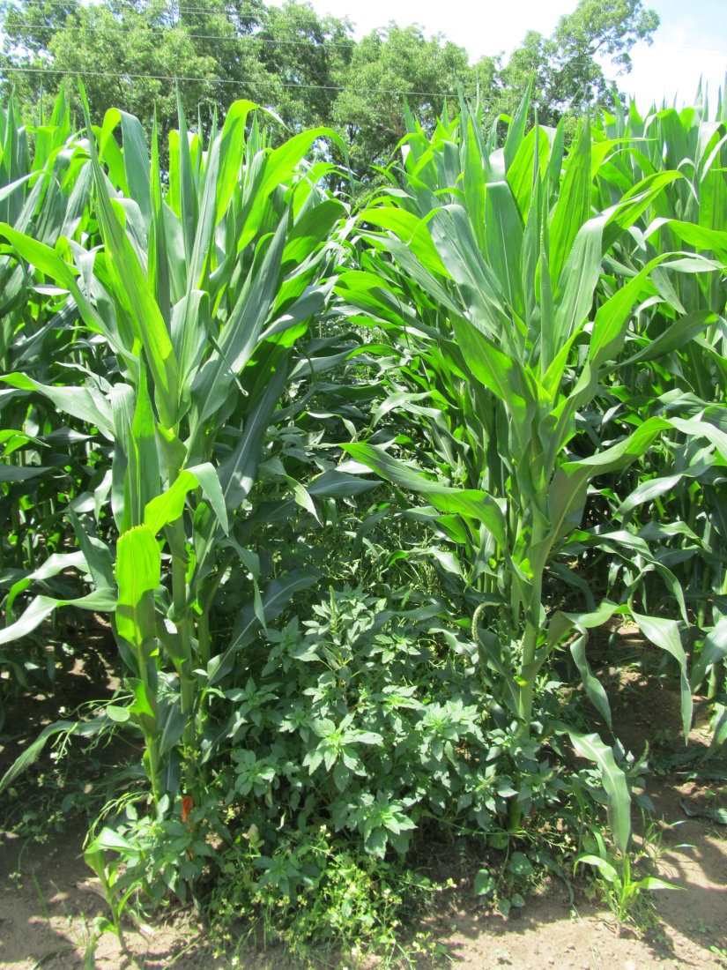
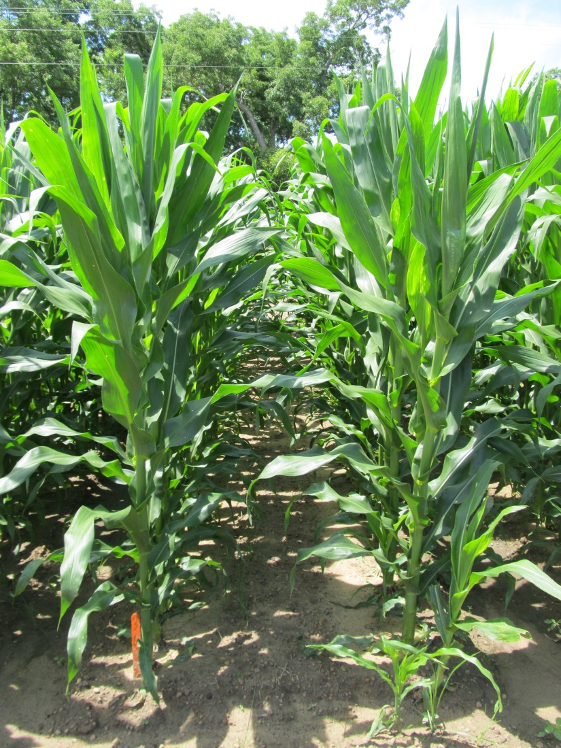
Weed Control in Field Corn with Zidua – 2013
NTC
Zidua 85WG @ 2 oz/A (PRE)
Roundup W-Max 5.5SL @ 22 oz/A (POST)
Aatrex 4L @ 64 oz/A (POST)
CN-15-13
May 28
69 DAP

Slide 23
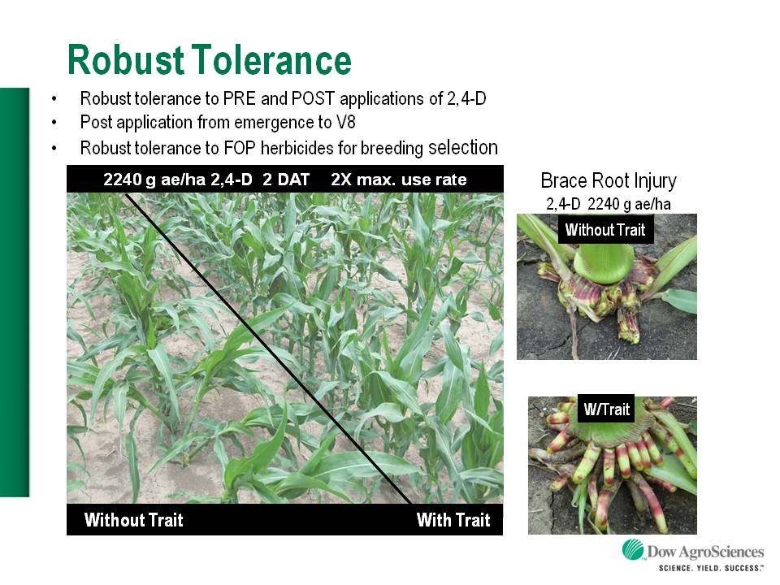

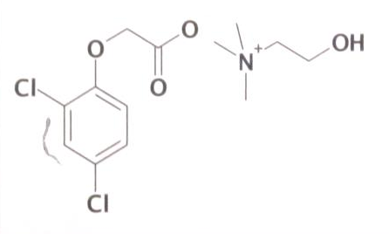
Enlist™ Herbicide Tolerant Corn
tolerance to 2,4-D and Assure + GLY
Colex-D™ technology
2,4-D choline
lower volatility
lower drift potential
enhanced handling/mixing characteristics
reduced odor
1 PRE application + 2 POST applications (30” or V8 stage)
Enlist™ Duo
DMA-Glyphosate (1.71 lb ae/gal) + 2,4-D choline (1.63 lb ae/gal)
3.5 pt/A
2015 Product Launch (Mid-West)
Monsanto/Dekalb license
2,4-D choline

Slide 24
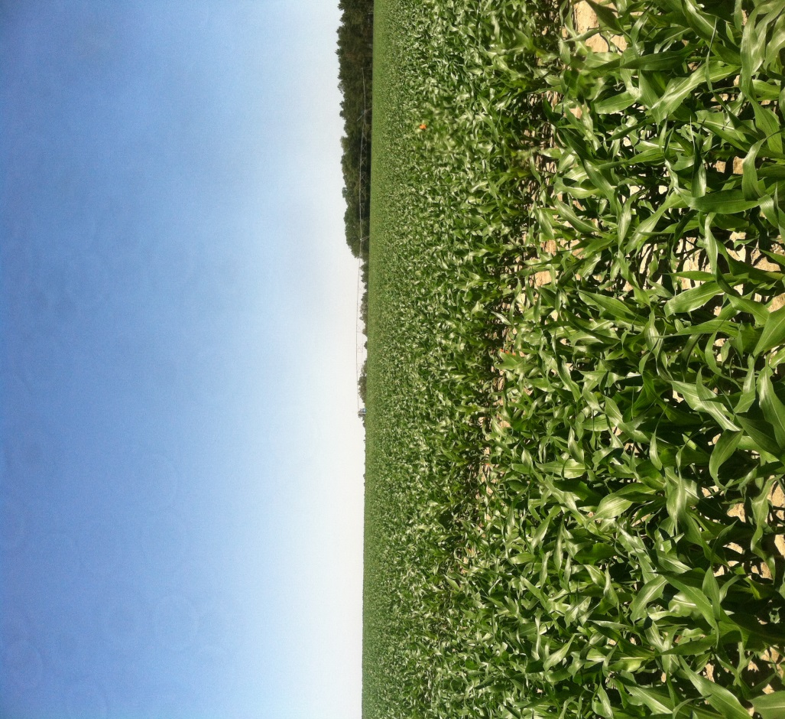
Questions/Comments?
eprostko@uga.edu
229-392-1034 (cell)
www.gaweed.com

