Slide 1
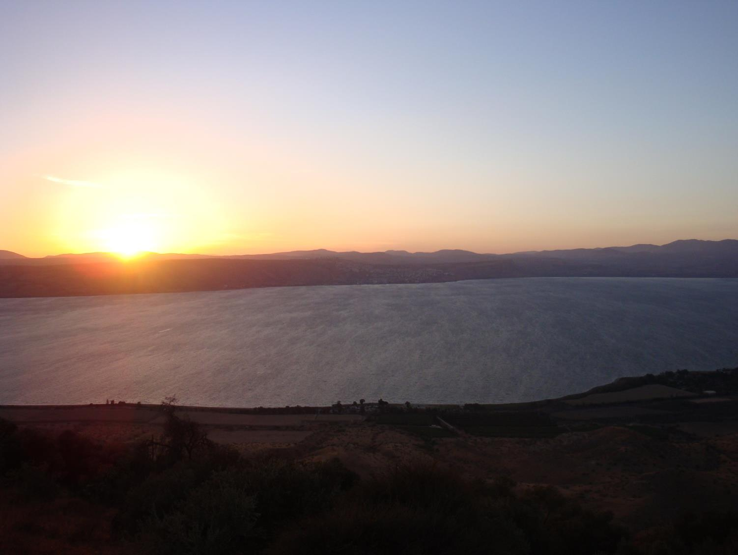
2014: Cotton Weed Update for Alabama Growers
Stanley Culpepper
UGA
Tifton Campus

Slide 2
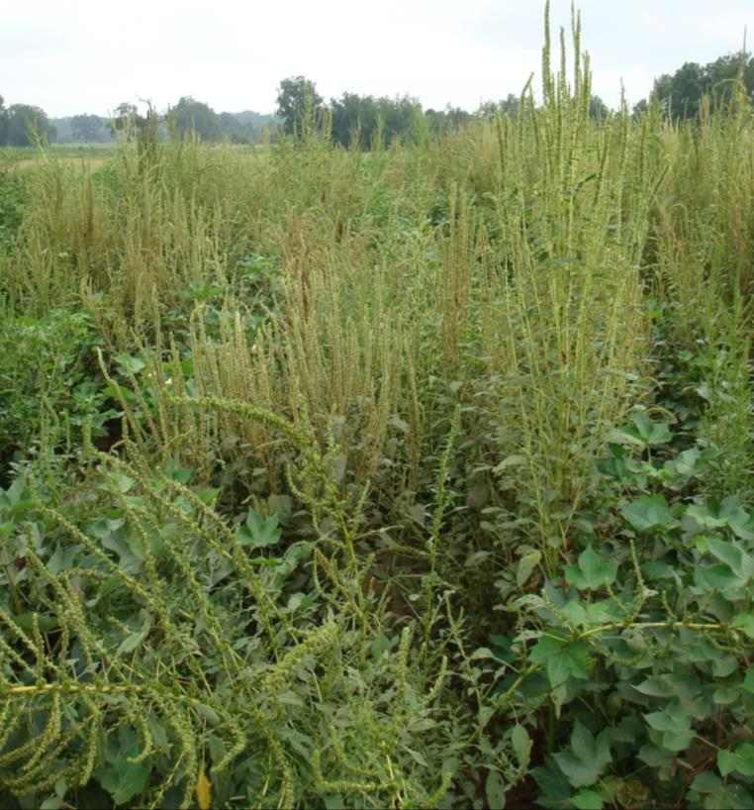
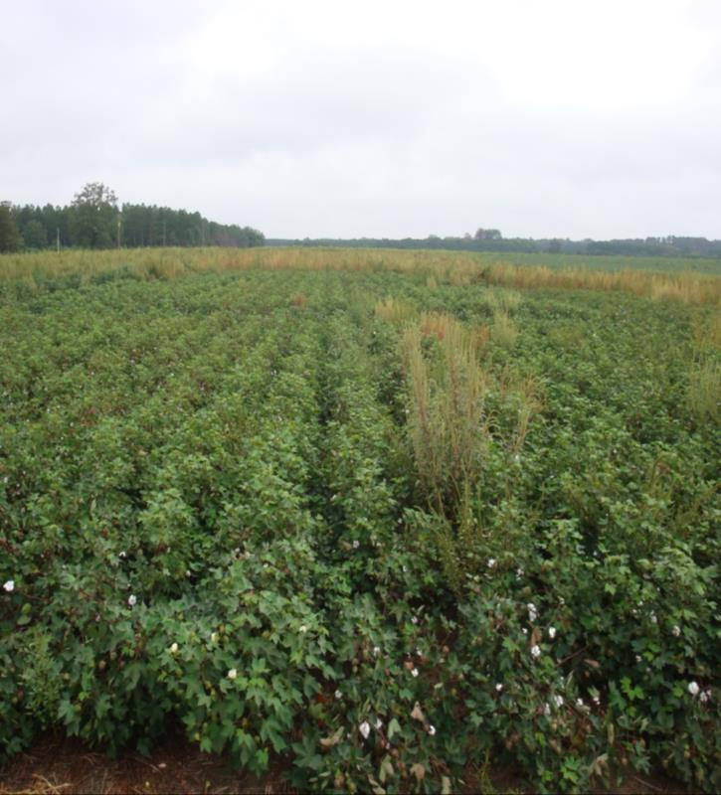
We Getting Better!!!
2010
2012
*Conditions first six wk after planting drier during 2012 than 2010.

Slide 3

Management Very Good But Very Costly!!!
Georgia cotton growers = $100 million per year since 2008

Slide 4
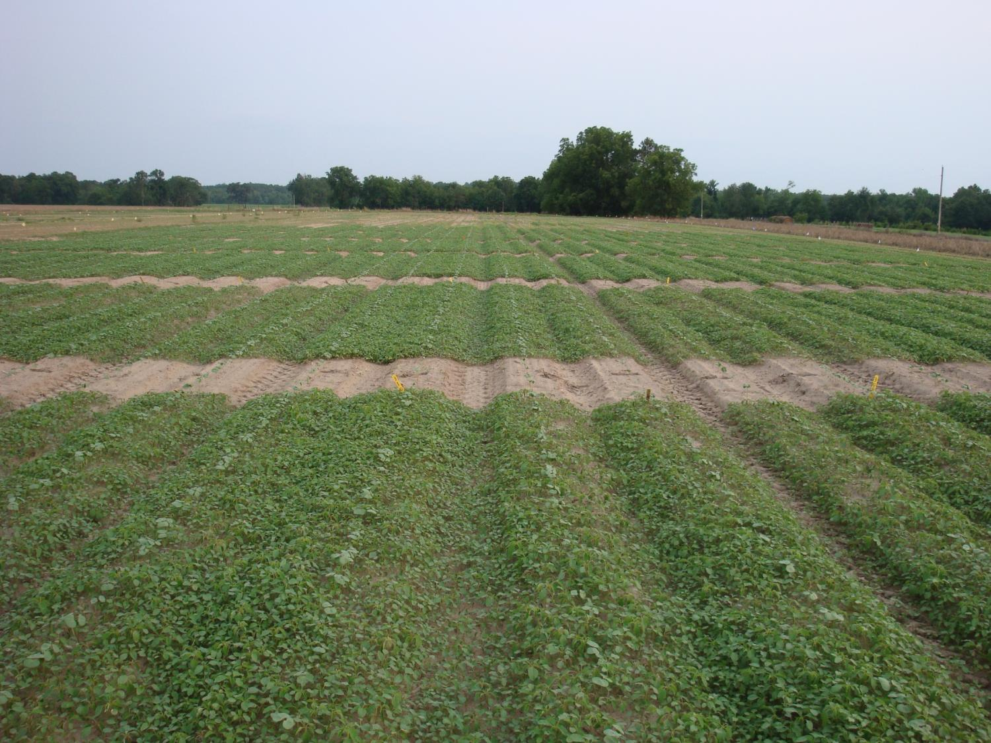
Tremendous Populations

Slide 5
Why More Effective….Growers Are
More knowledgeable
Diversified
Manage seedbank
Timely

Slide 6
Knowledgeable
1. BIOLOGY of pest in question
Notes:
6

Slide 7
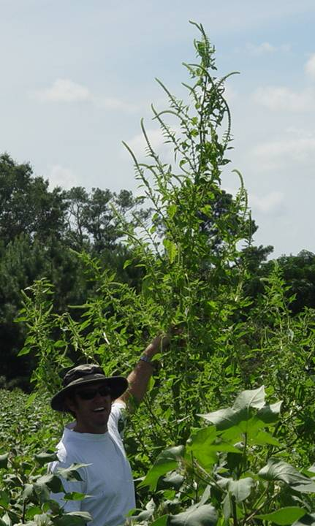
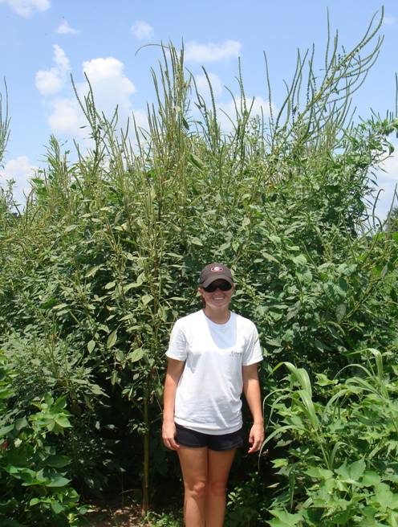
Rapid Growth Becoming Extremely Large

Slide 8
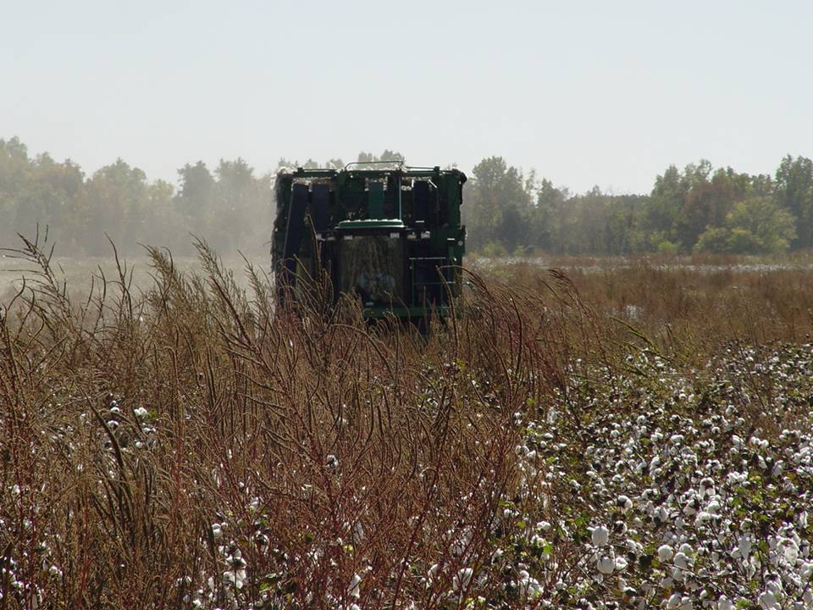
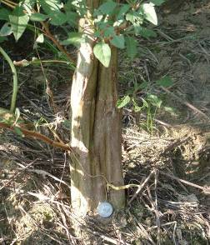
Impact on Harvest

Slide 9
Number of Seed Produced per Plant
450 K
309 K
230 K
28 K
250
Giant ragweed
Johnson-grass
Horseweed
Waterhemp
Palmer amaranth
Ragweed = Harrison et al. 2001; johnsongrass = Warwick and Black (1983); horseweed = Regehr and Bazzaz (1979); waterhemp = Nordby and Hartzler (2004); Palmer amaranth = Macrae et al (2009).

Slide 10
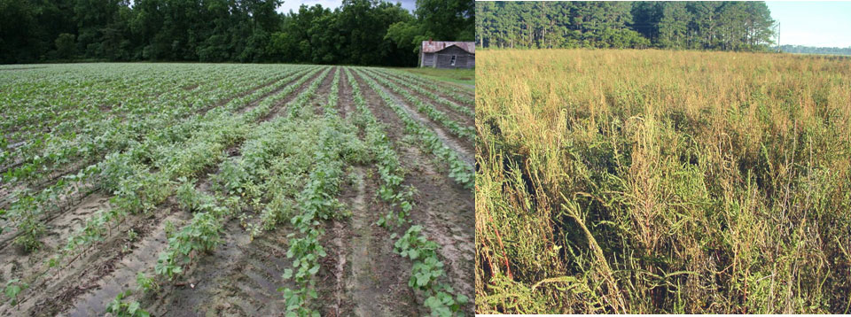
Palmer amaranth seed production allows for rapid field domination
Year 1
Year 3 to 4
Notes:
10

Slide 11
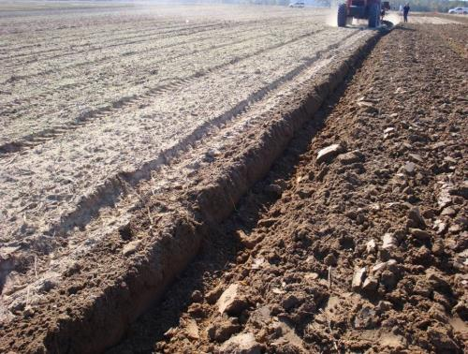
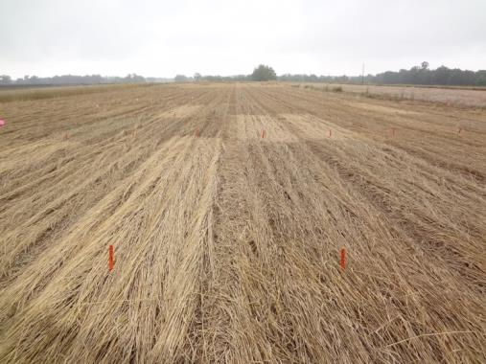
Weakness of Pigweeds
Emergence depth!
Seed life longevity?
Light requirement for emergence.
Notes:
11

Slide 12
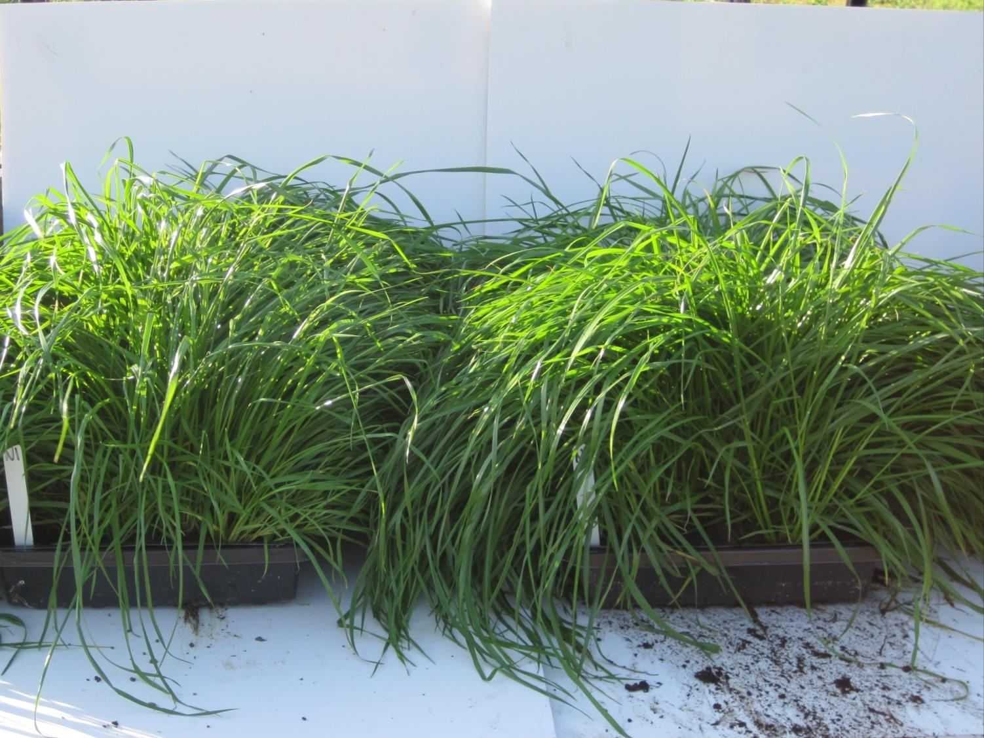
Non-treated control
Hoelon 2X rate

Slide 13
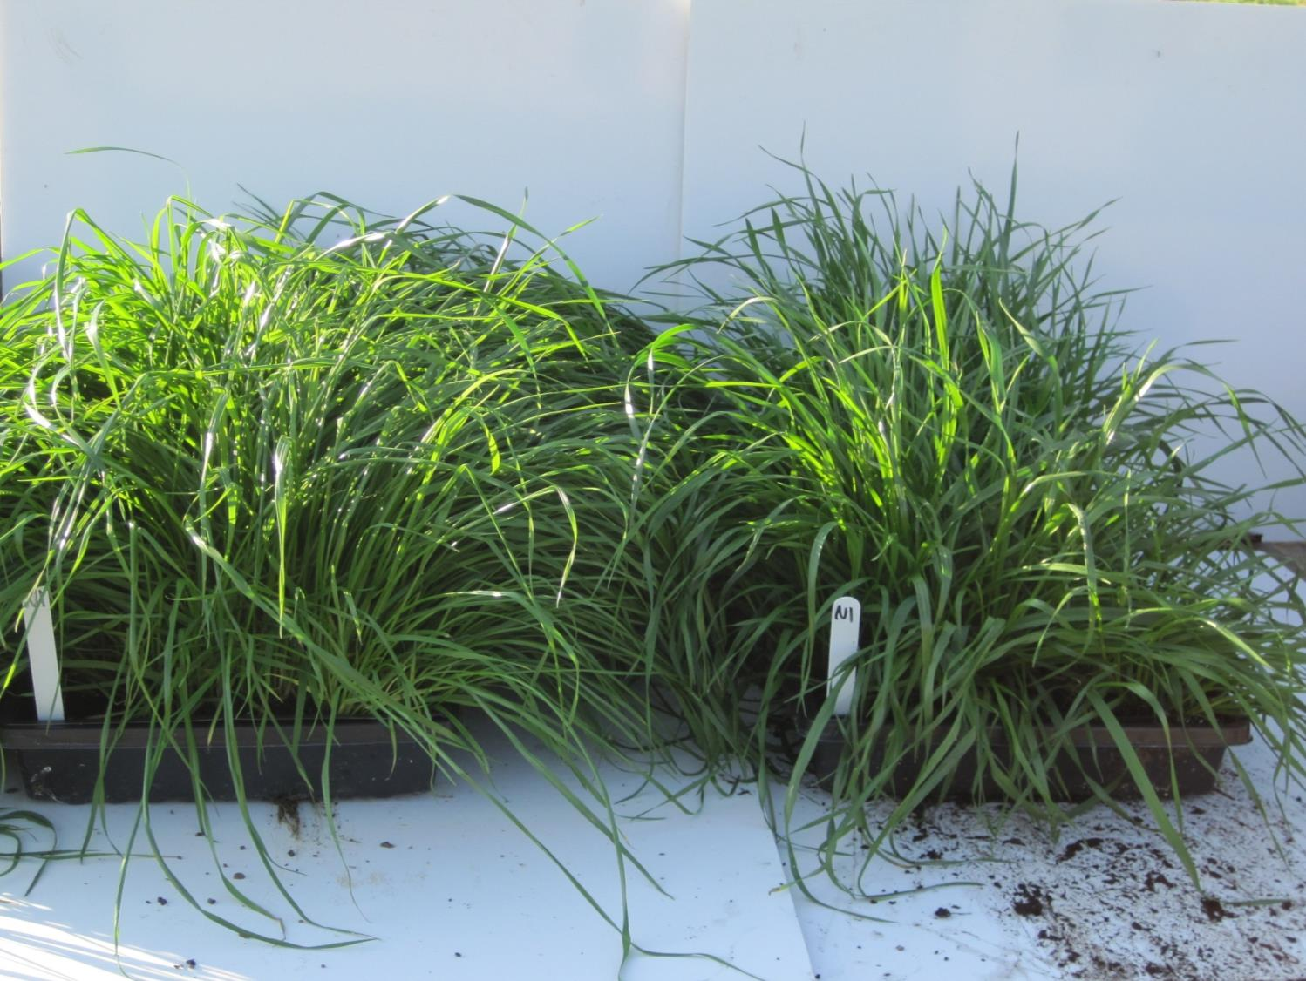
Non-treated control
PowerFlex 3X rate or Osprey at 3X rate

Slide 14
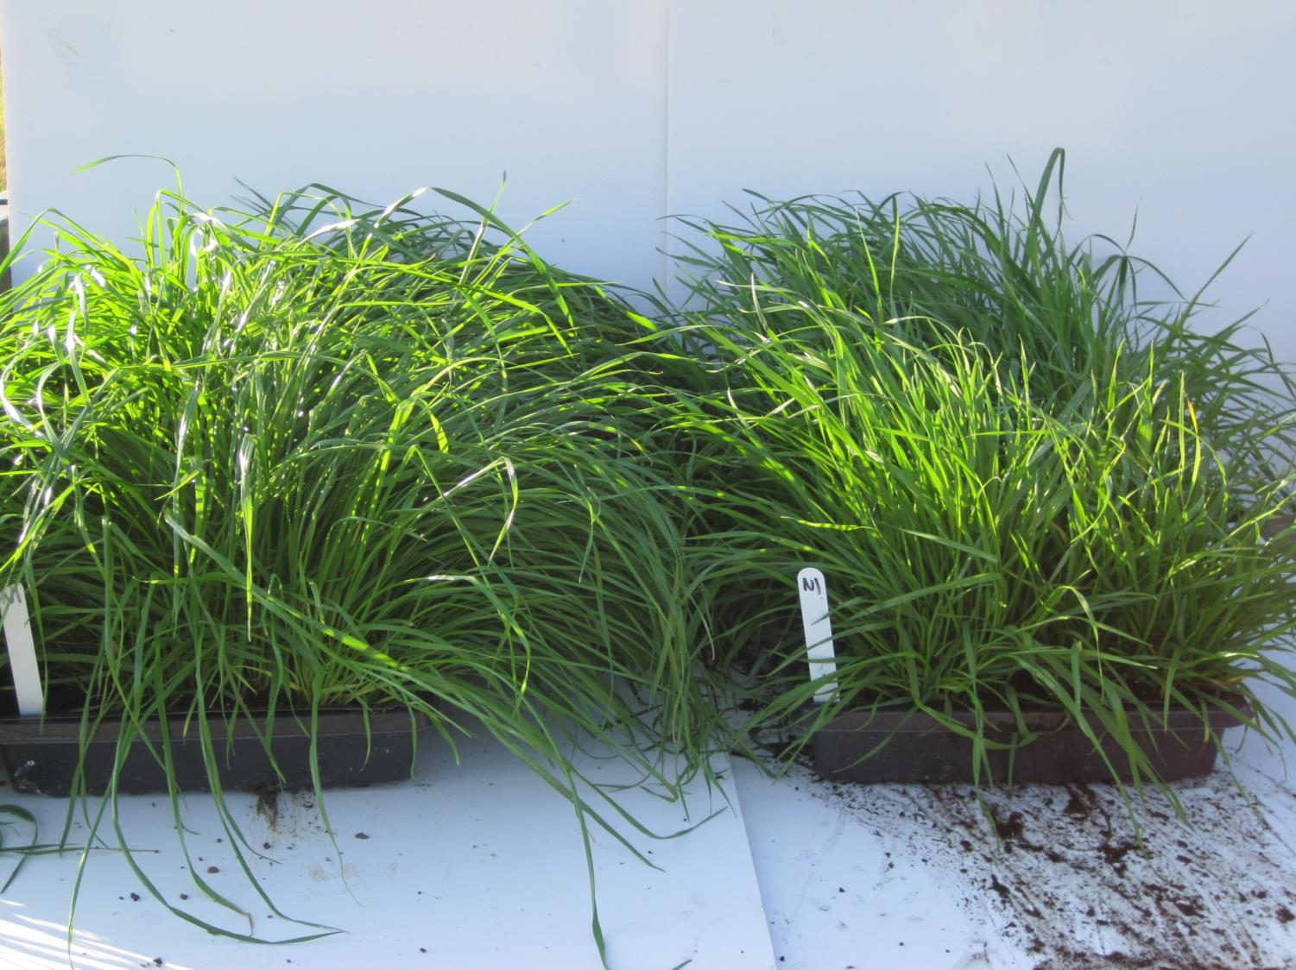
Non-treated control
Axial XL 2X rate

Slide 15
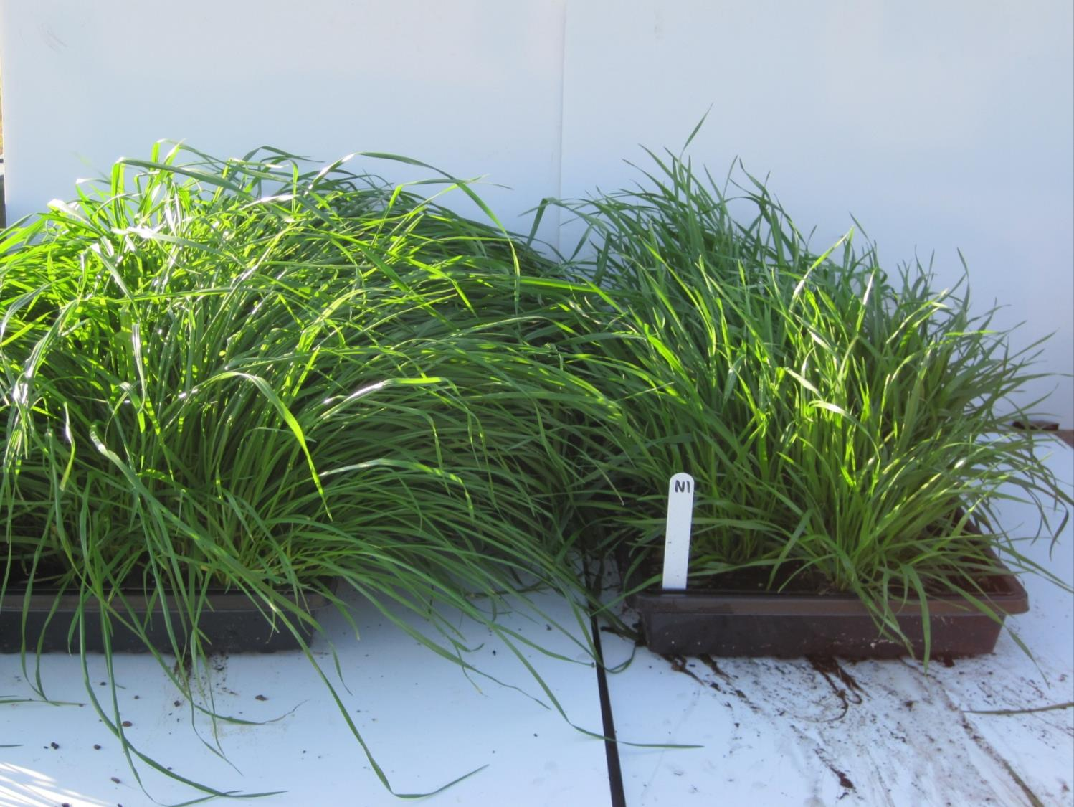
Non-treated control
Was A Future Product

Slide 16
Knowledgeable
BIOLOGY of pest in question
Herbicide effectiveness
Notes:
16

Slide 17
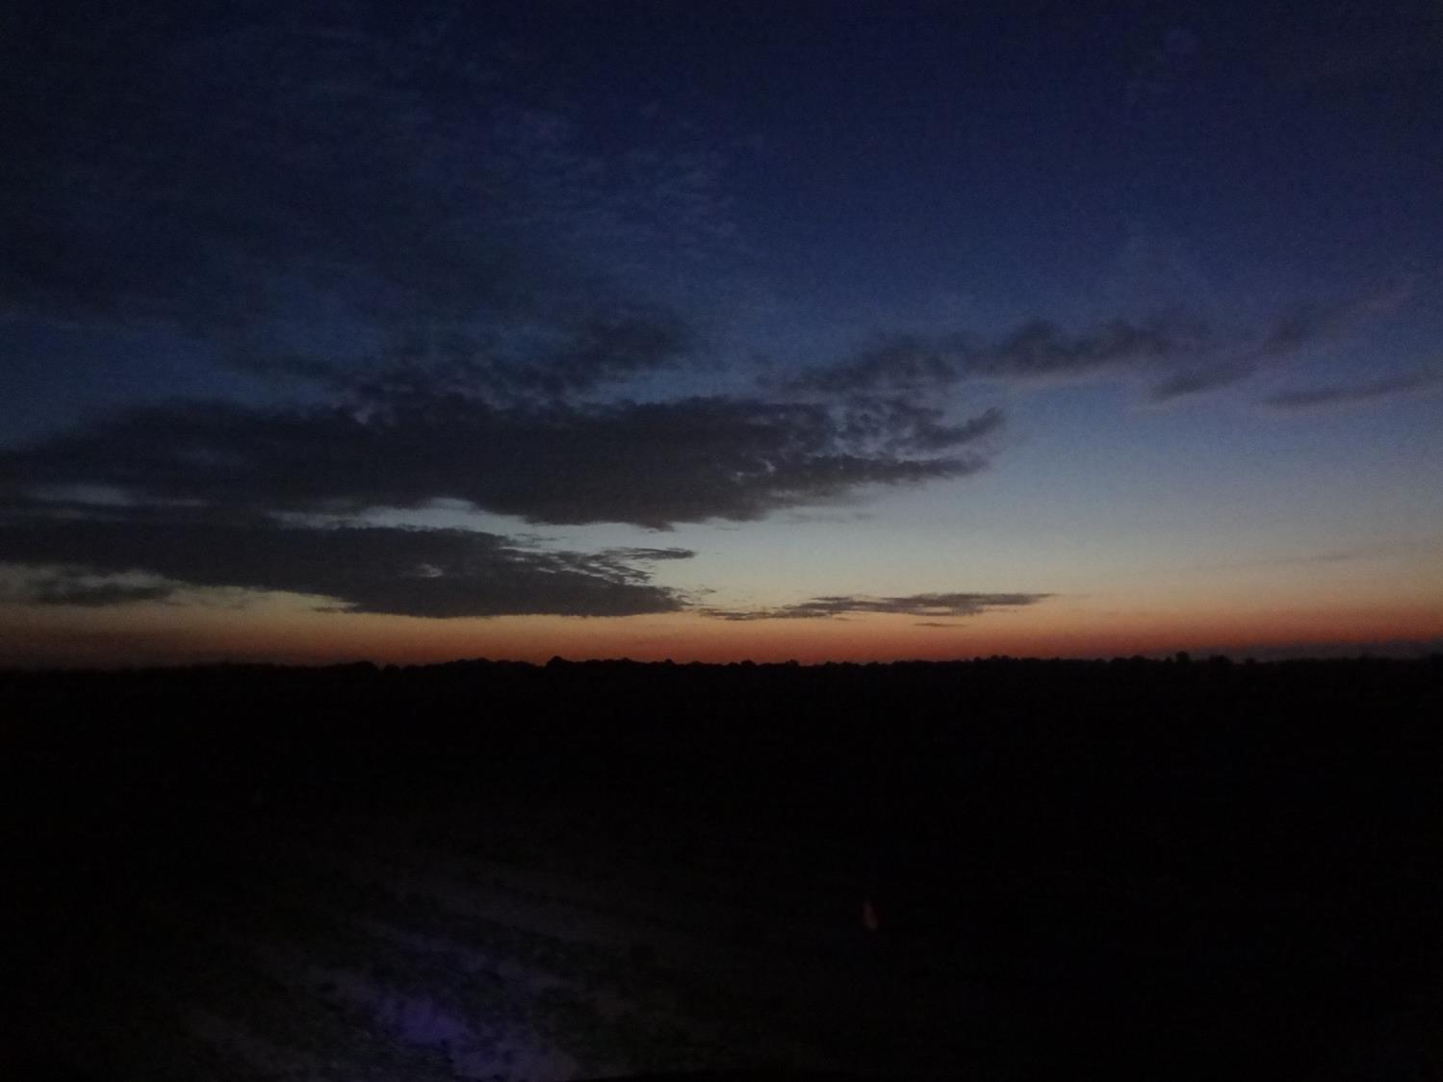

Slide 18
Palmer Control by Liberty System as Influenced by Time of Day. Late-Season in GA, LA, MS, NC, TN.
90 ab
93 a
93 a
82 b
66 c
%
48 d
39 de
34 e
1 hr before sunrise
1/2 hr before sunrise
sunrise
1/2 hr after sunrise
1 hr after sunrise
2 hr after sunrise
4 hr after sunrise
6 hr after sunrise
Time of Day Liberty was Applied
*Liberty POST 1 (5” Palmer), Liberty POST 2 (15 d later), Diuron + MSMA layby

Slide 19
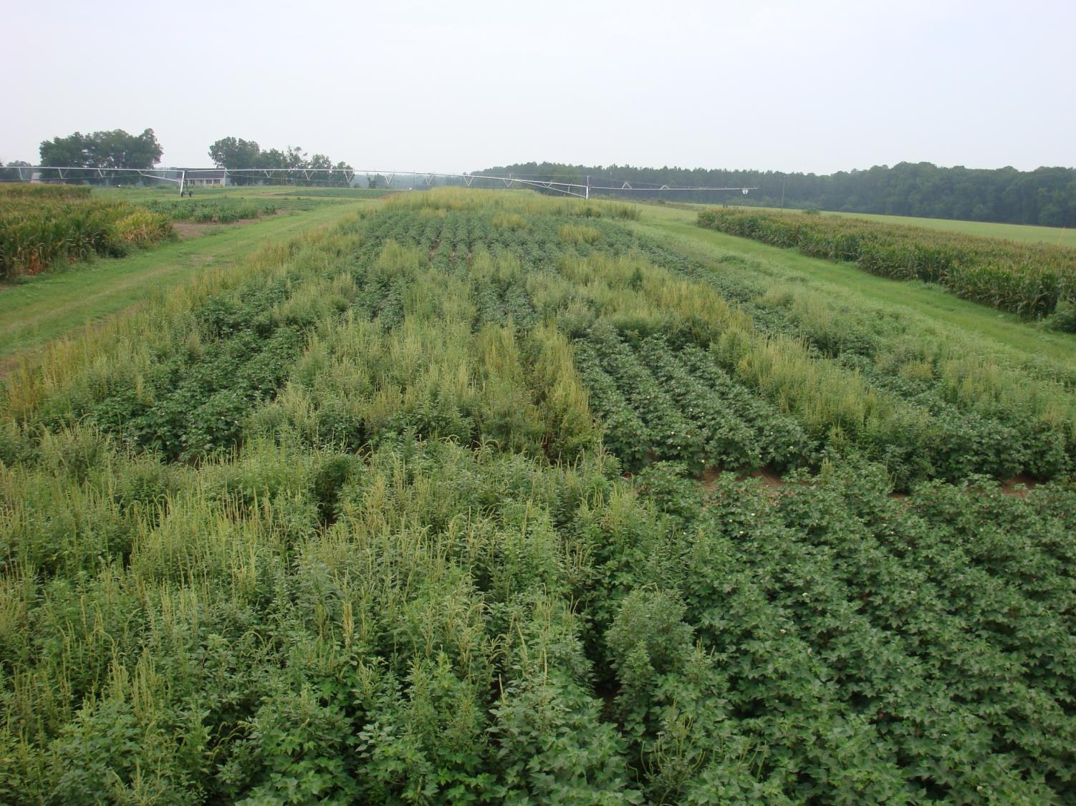
Liberty Application Time of Day; Morning Application; GA
2 hr or after

Slide 20
Palmer Control by Liberty as Influenced by Time of Day. Late-Season in GA and NC.
99 a
99 a
99 a
99 a
97 a
91 b
69 c
64 c
%
6 hr before sunset
4 hr before sunset
2 hr before sunset
1 hr before sunset
1/2 hr before sunset
sunset
1/2 hr after sunset
1 hr after sunset
Time of Day Liberty was Applied
*Liberty POST 1 (5” Palmer), Liberty POST 2 (18 d later), Diuron + MSMA layby
Notes:
Liberty is less sensitive in the evening, however we do start tailing off after sunset.
20

Slide 21
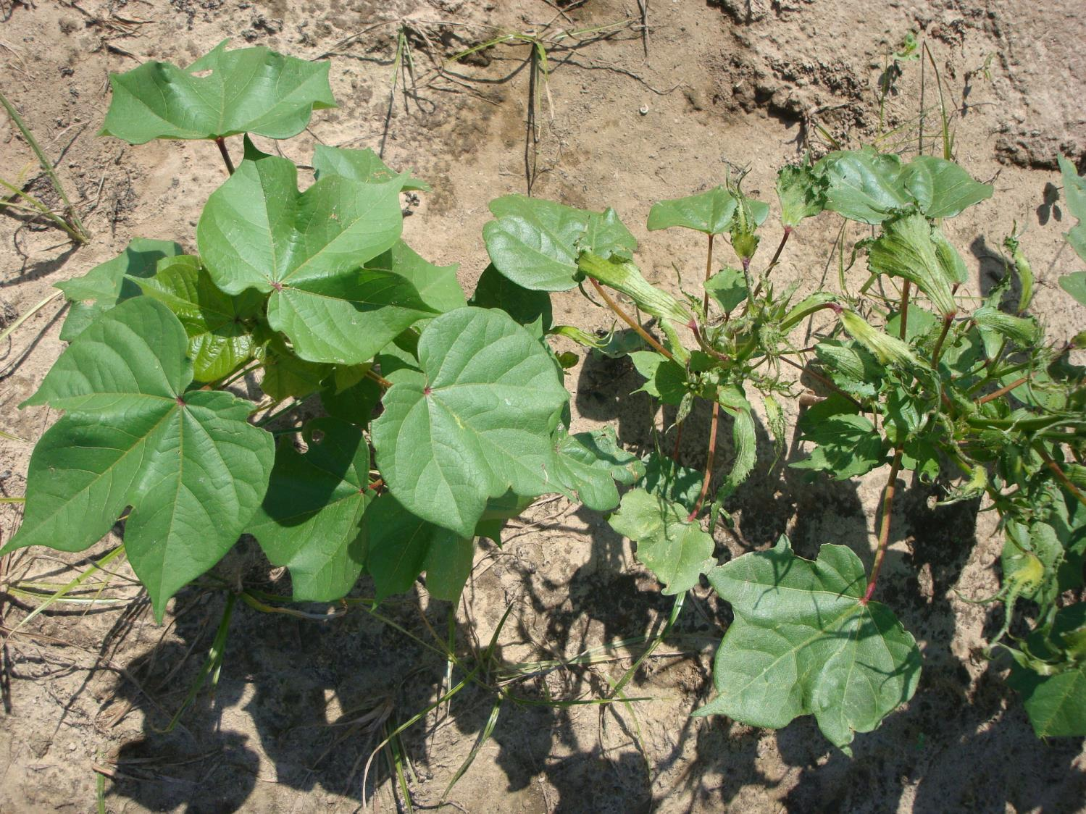
Time of Day Influence on 2,4-D

Slide 22
Palmer Control by RU + 2,4-D Systems. Macon County, 2011 and 2012.
93 a
89 a
%
39 b
32 b
1 AM
7 AM
1 PM
7 PM
Time of Day RU + 2,4-D Applied
POST 1 (5-8” Palmer), POST 2 (15 d later), Diuron + MSMA layby

Slide 23
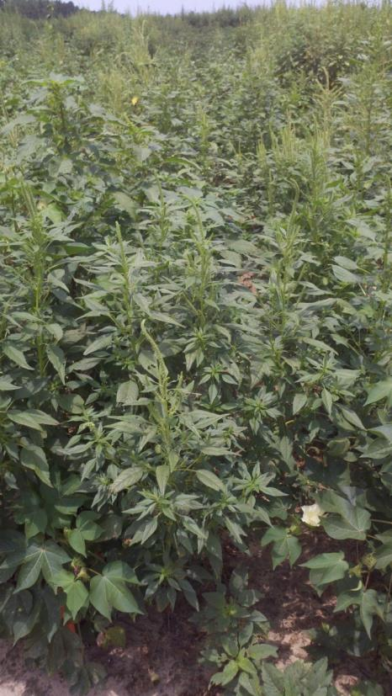
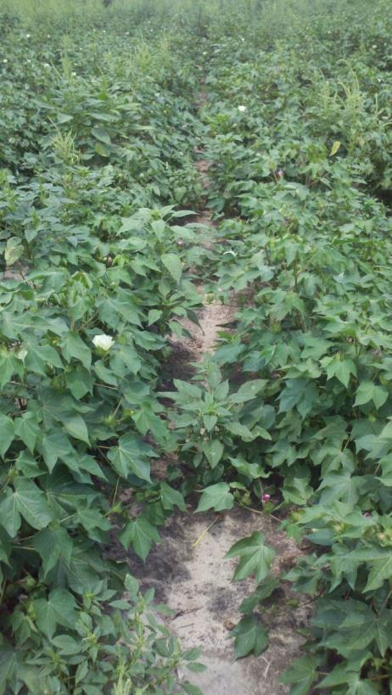
GR Palmer Control
2,4-D w/ glyphosate fb
2,4-D w/ glyphosate
7 AM
2,4-D w/ glyphosate fb
2,4-D w/ glyphosate
1 PM

Slide 24
Palmer Control by Dicamba Mixes as Influenced by Time of Day. Macon 2013. 20 DAT.
93 a
89 a
90 a
74 b
72 b
%
5 AM
6:30 AM
8 AM
9:30 AM
11 AM
Time of Day RU + Clarity Applied
Palmer: 4 to 7 inch

Slide 25
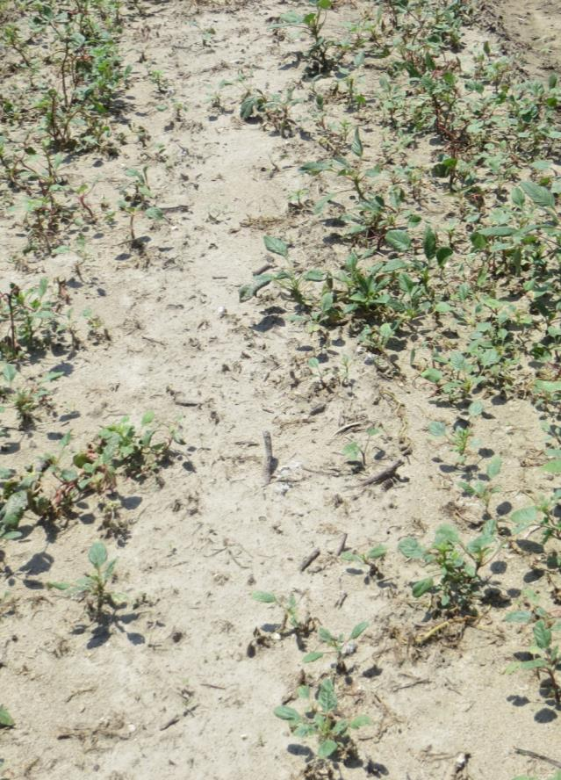
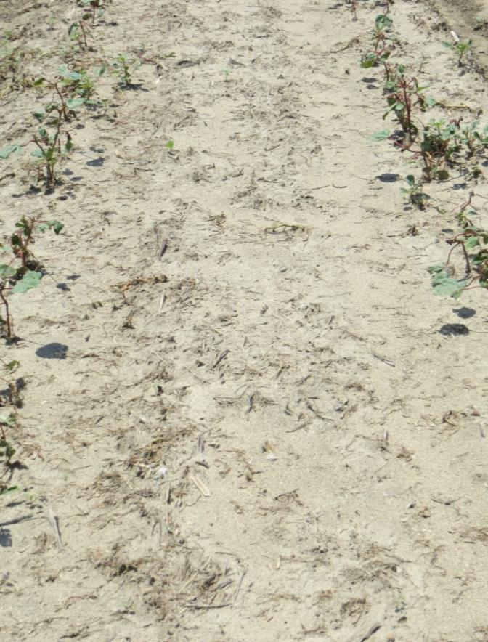
Roundup + Clarity
6:30 AM
8:00 AM

Slide 26
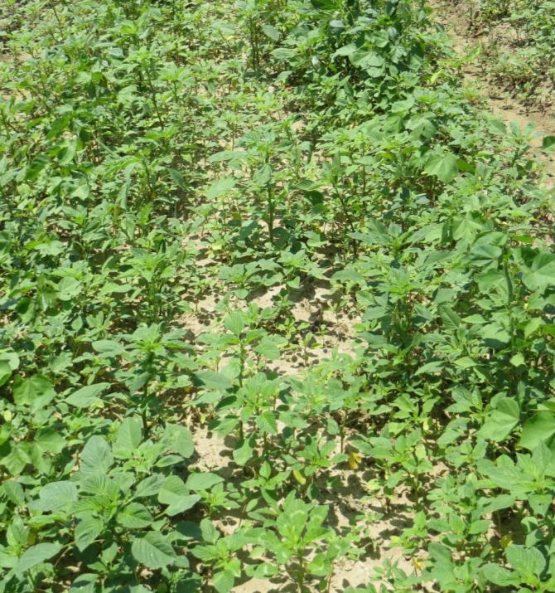
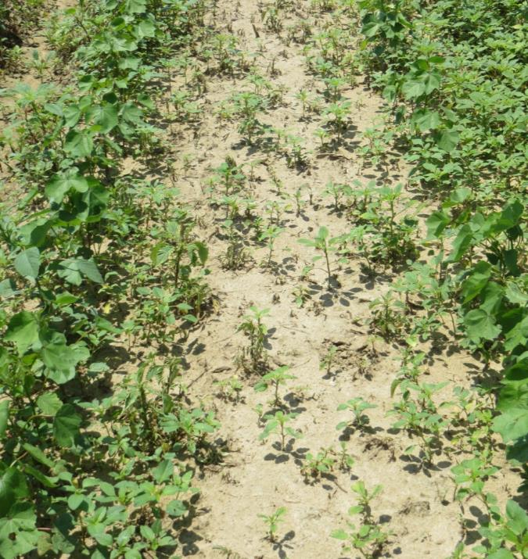
Roundup WeatherMax
8 AM
11 AM

Slide 27
Roundup WeatherMax
HIGHLY RESISTANT POPULATION
8 AM
11 AM

Slide 28
Warrant vs Dual Magnum
Warrant
1. PRE use on cotton
2. Better in dry conditions
3. Variable injury POST
Dual Magnum
1. No PRE use on cotton
2. Better with moisture
3. Consistent injury POST
Notes:
28
Many individuals think Warrant and Dual are similar but there are some distinct differences. “Read slide”.

Slide 29
Palmer control from Warrant and Dual Magnum as impacted by moisture. 2012.
Irrigated Immediately
First rain 11 DAT (Palmer emerged with rain)
99 a
95 a
83 b
50 c
55 b
Warrant
3 pt
Dual Mag
1 pt
Warrant
3 pt
Dual Mag
1 pt
No Palmer up at time of application. Control 23 to 33 DAT.
Notes:
Our data suggest that when irrigation or rain activates these herbicides in a timely fashion Dual Magnum will provide better Palmer control but in dry land conditions with untimely rains, Warrant is the better option.

Slide 30
Palmer control from acetochlor, S-metolachlor, and metolachlor. Macon Co., GA 2009.
80 a
77 a
50 c
Warrant
3 pt
S-metolachlor
(Dual Mag, 1 pt)
metolachlor
(Parrlay, 1 pt)
No Palmer up at time of application. Layby of RU + Direx applied 19 d after POST.

Slide 31
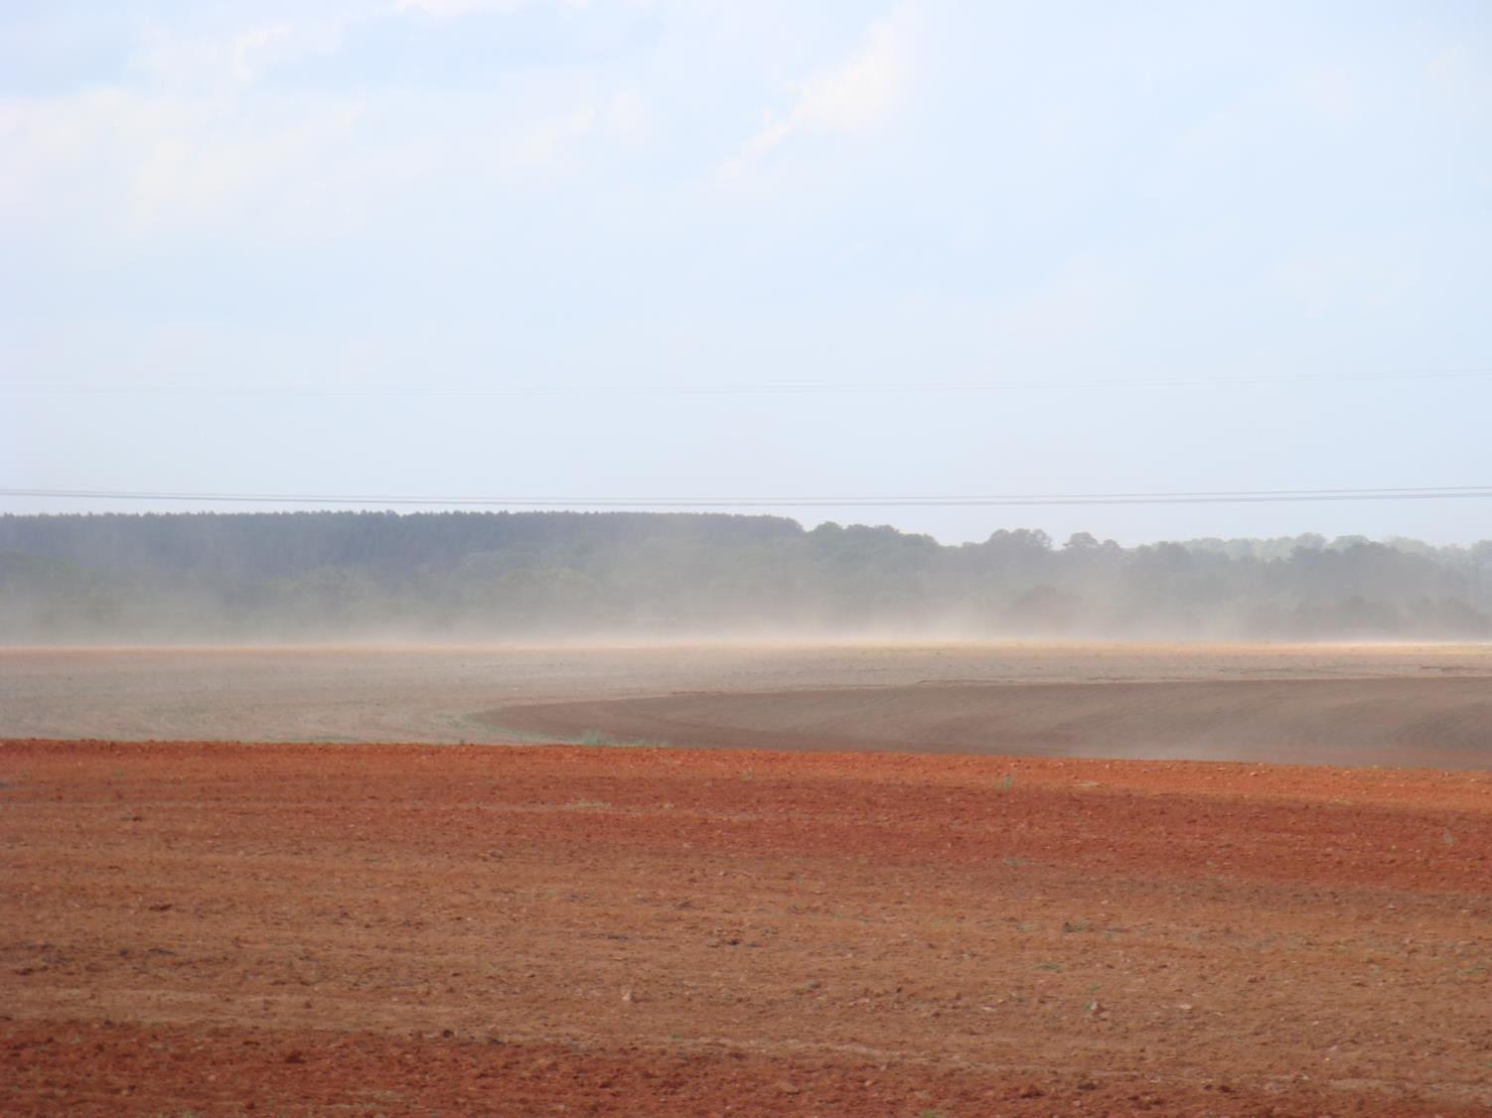
Some herbicides can wait on rain as long as they don’t blow away
Valor
Reflex
Staple

Slide 32
Why More Effective….Growers Are
More knowledgeable
Diversified
Manage seedbank
Timely

Slide 33
Evolution of Row Crop
Weed Management
Cultural + Chemical +
mechanical mechanical
Chemical
1900 1920 1940 1960 1980 2000 2010
Mike Owen

Slide 34
“Ideal” Integrated Weed Management
Mechanical
Cultural
Mechanical
Cultural
Herbicide
Herbicide
Current
Future
Mike Owen

Slide 35
Diversified Management Approach
herbicide diversity, use residuals

Slide 36
RR Reduced Tillage Cotton Systems. 2014.
Preplant | PRE | POST1 | POST2 | Layby
Valor Palmer < 1” Valor + Direx Palmer 1-5” Direx Palmer < 5”; less than 10 d to plant
APPLY VALOR AND/OR DIREX TO EVERY ACRE; ADD GRAMOXONE IF PIGWEED UP!!!
Notes:
36

Slide 37
RR Reduced Tillage Cotton Systems. 2014.
Preplant | PRE | POST1 | POST2 | Layby
Valor and/or Direx | 1. Reflex + Warrant 2. Reflex + Direx 3. Direx + Warrant
1. Reflex rate of 12 oz.
2. Warrant rate 3 pt/A.
3. Direx rate 10 to 24 oz/A
4. Include burndown herbicide.
Notes:
37

Slide 38
RR Reduced Tillage Cotton Systems. 2014.
Preplant | PRE | POST1 | POST2 | Layby
Valor and/or Direx | YOU GUYS MAYBE: Warrant + Direx Cotoran + Direx Cotoran + Prowl
Notes:
38

Slide 39
RR Reduced Tillage Cotton Systems. 2014.
Preplant | PRE | POST1 | POST2 | Layby
Valor and/or Direx | 1. Reflex + Warrant 2. Reflex + Direx 3. Direx + Warrant | RU + Staple or Pyrimax | RU + Dual Mag | Direx + MSMA
If using Liberty/Roundup system and planning on using Liberty; Liberty POST 1 is almost always correct timing
Notes:
39

Slide 40
RR Reduced Tillage Cotton Systems. 2014.
Preplant | PRE | POST1 | POST2 | Layby
Valor and/or Direx | 1. Reflex + Warrant 2. Reflex + Direx 3. Direx + Warrant | RU + Staple/ Pyrimax | RU + Dual Mag | Direx + MSMA
Add Envoke if morningglory is issue.
Suprend + MSMA just as effective.
Notes:
40

Slide 41
Diversified Management Approach
herbicide diversity; use residuals
appropriate herbicide rates
plant clean;

Slide 42
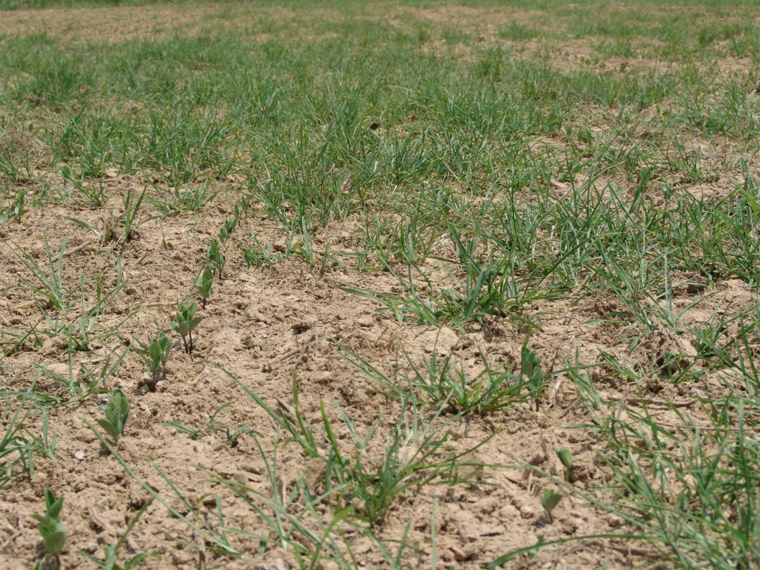

40 ozs of Gly 4 -20 DAA
Steckel 2012

Slide 43
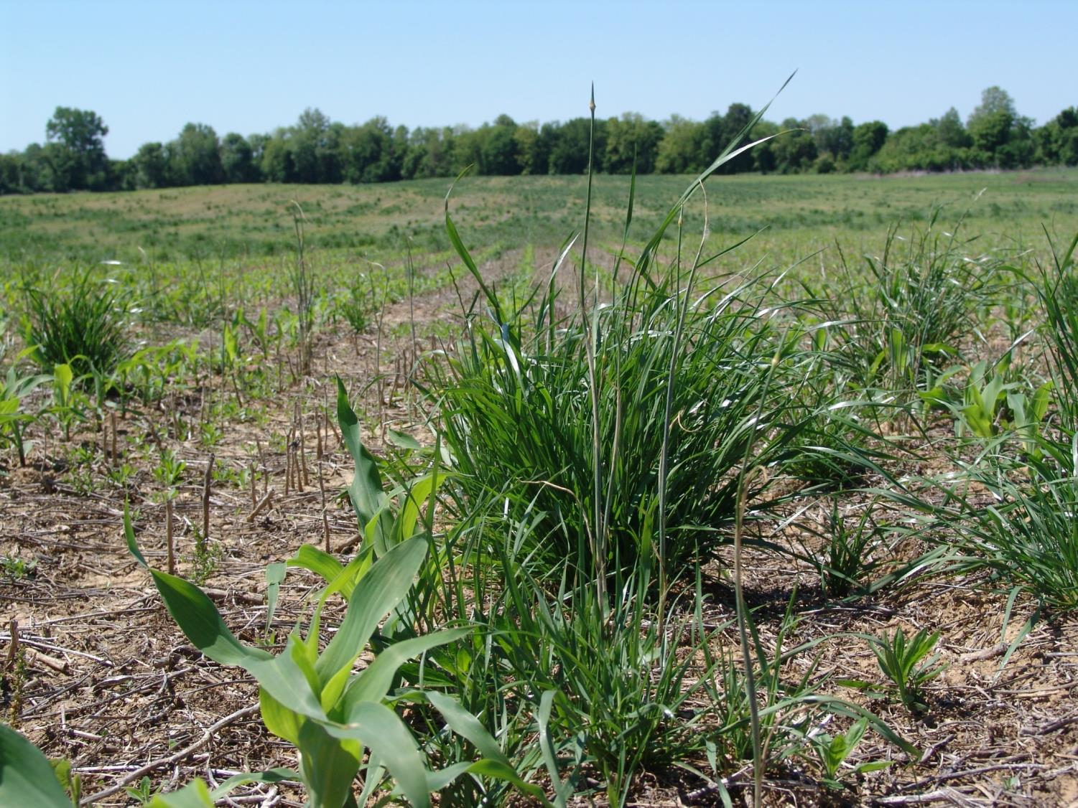
Glyphosate Resistant ryegrass
Steckel 2012

Slide 44
Diversified Management Approach
herbicide diversity; use residuals
appropriate herbicide rates
plant clean; be timely
crop rotation when economical

Slide 45
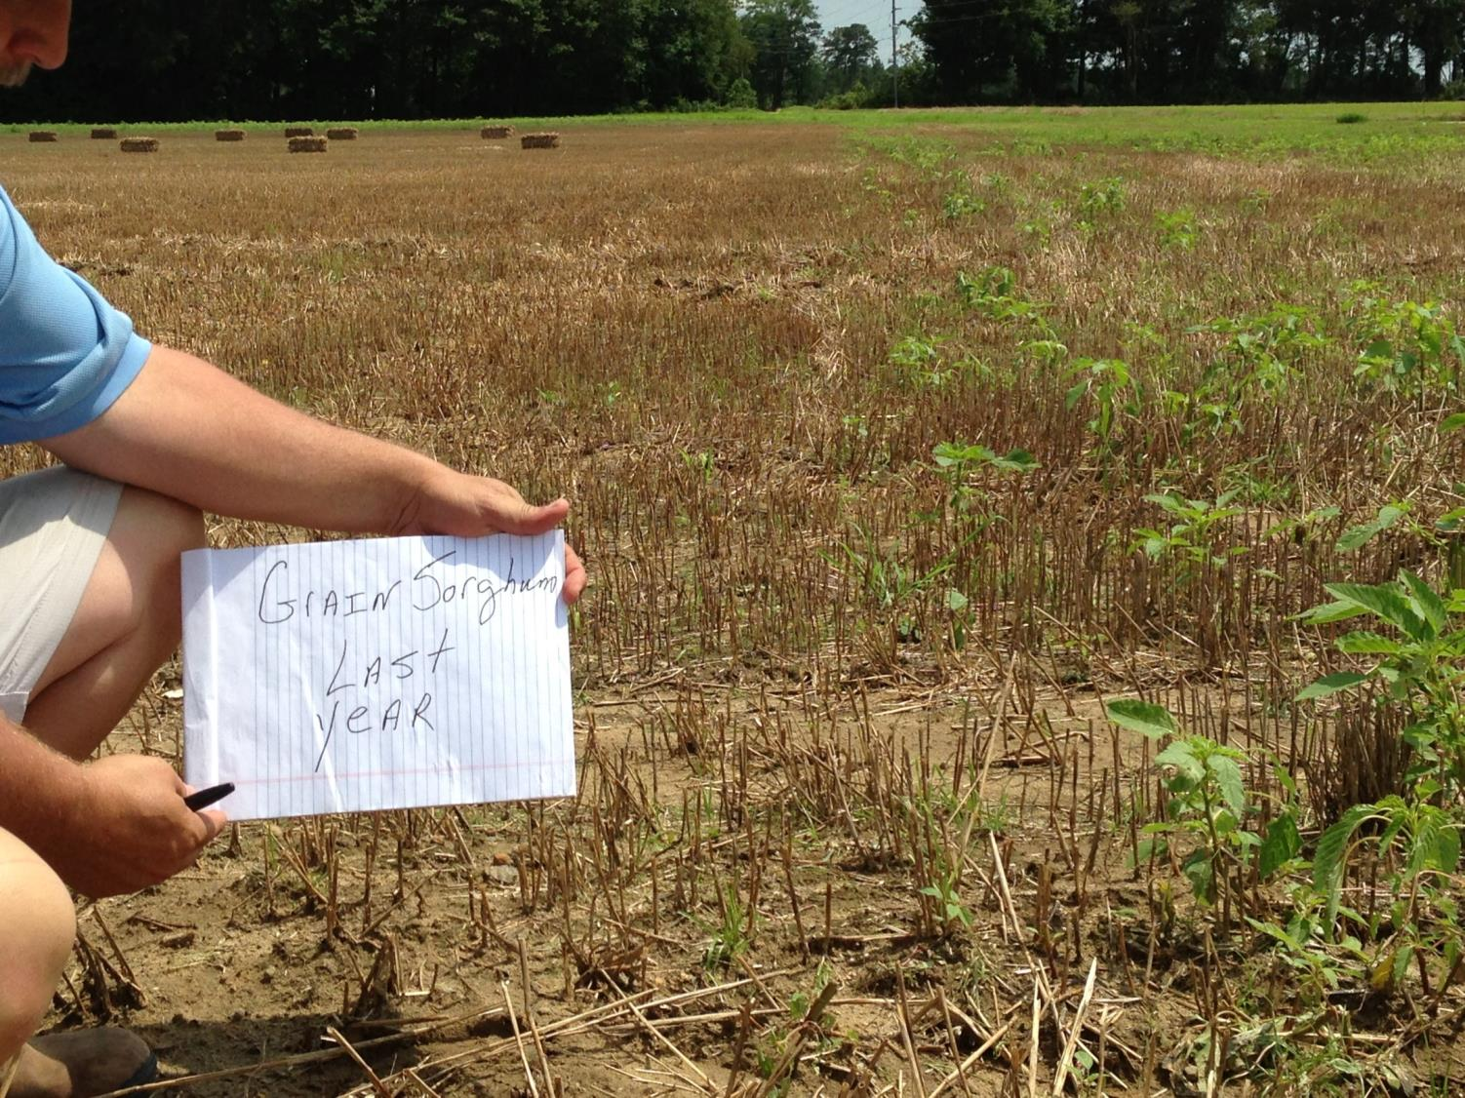

Slide 46
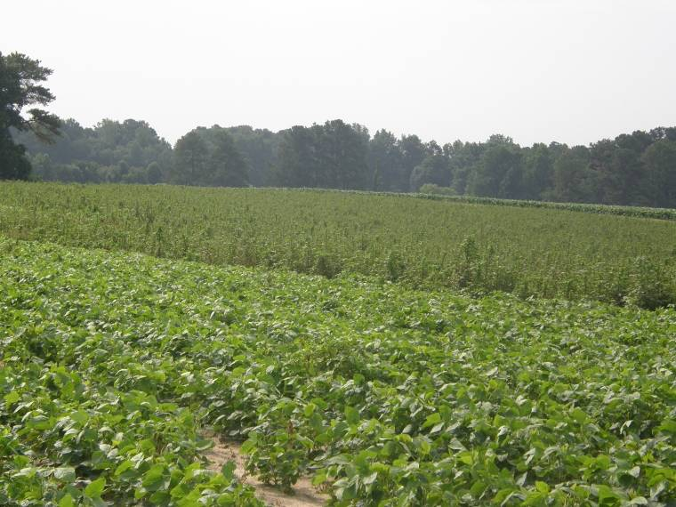
Impact of Crop Rotation and Good Control in Rotational Crop
(whole field in soybean in 2009; all treated alike in 2009)
Soybean
2008
Tobacco
2008
Carthage, NC 2009
Notes:
46
46

Slide 47
Diversified Management Approach
herbicide diversity; use residuals
appropriate herbicide rates
plant clean; be timely
crop rotation when economical
Integrated programs- tillage, cover crops

Slide 48
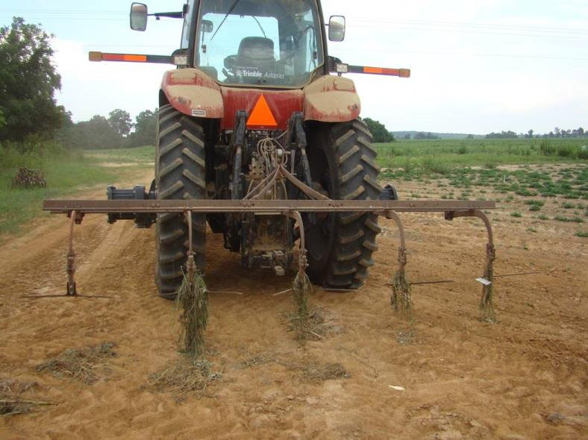
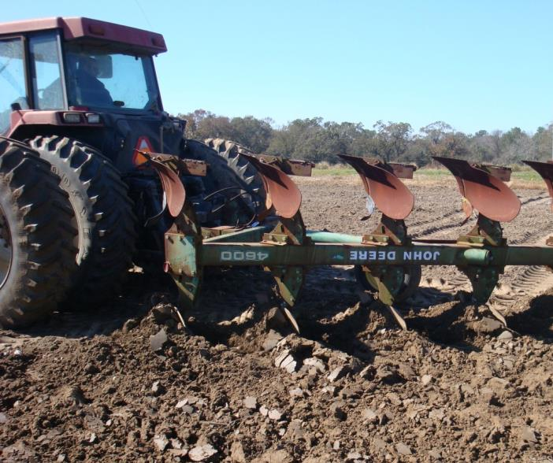
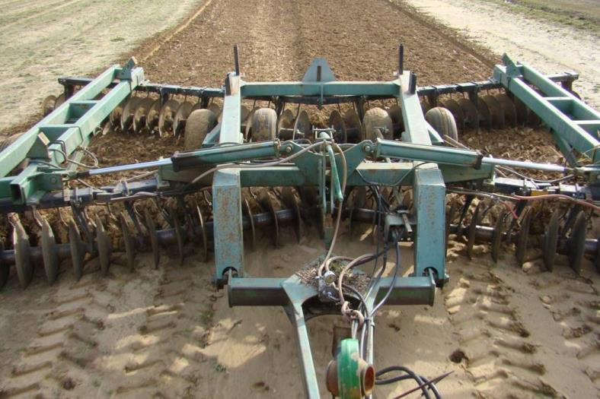
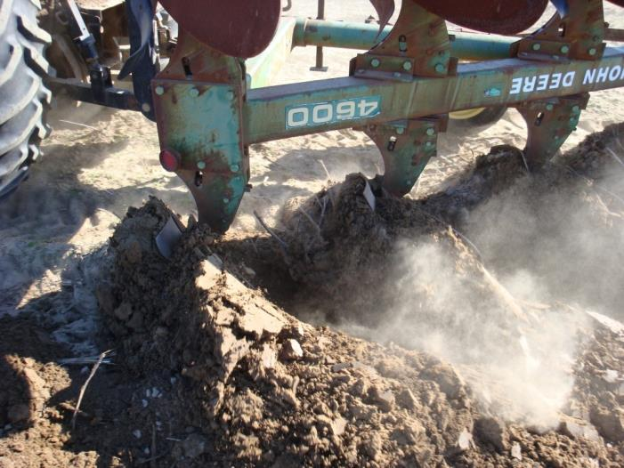
Tillage is now a common scene

Slide 49
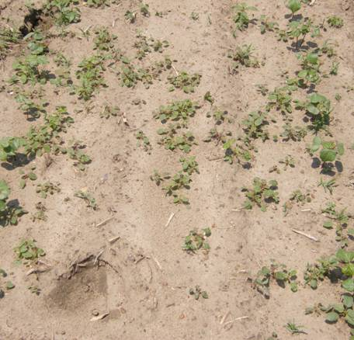
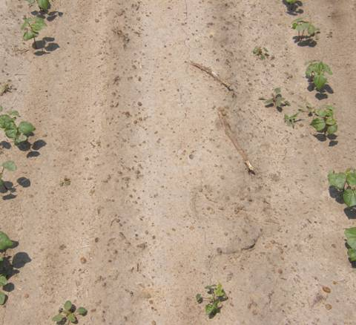
Number of Palmer Amaranth Plants During Early Season. Macon Co., Georgia 2008.*
No Deep Tillage
Deep Turn
No Herbicide Treatment

Slide 50
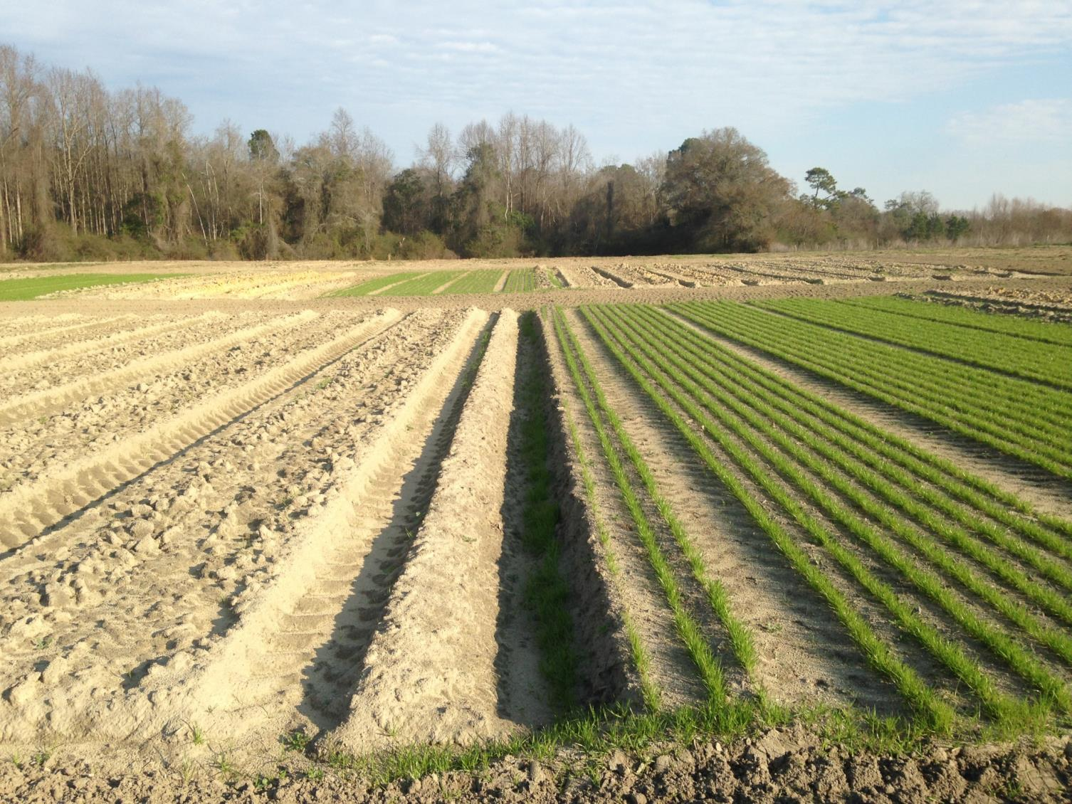
Deep Turn
Drilled

Slide 51
Numerous Concerns With Tillage

Slide 52
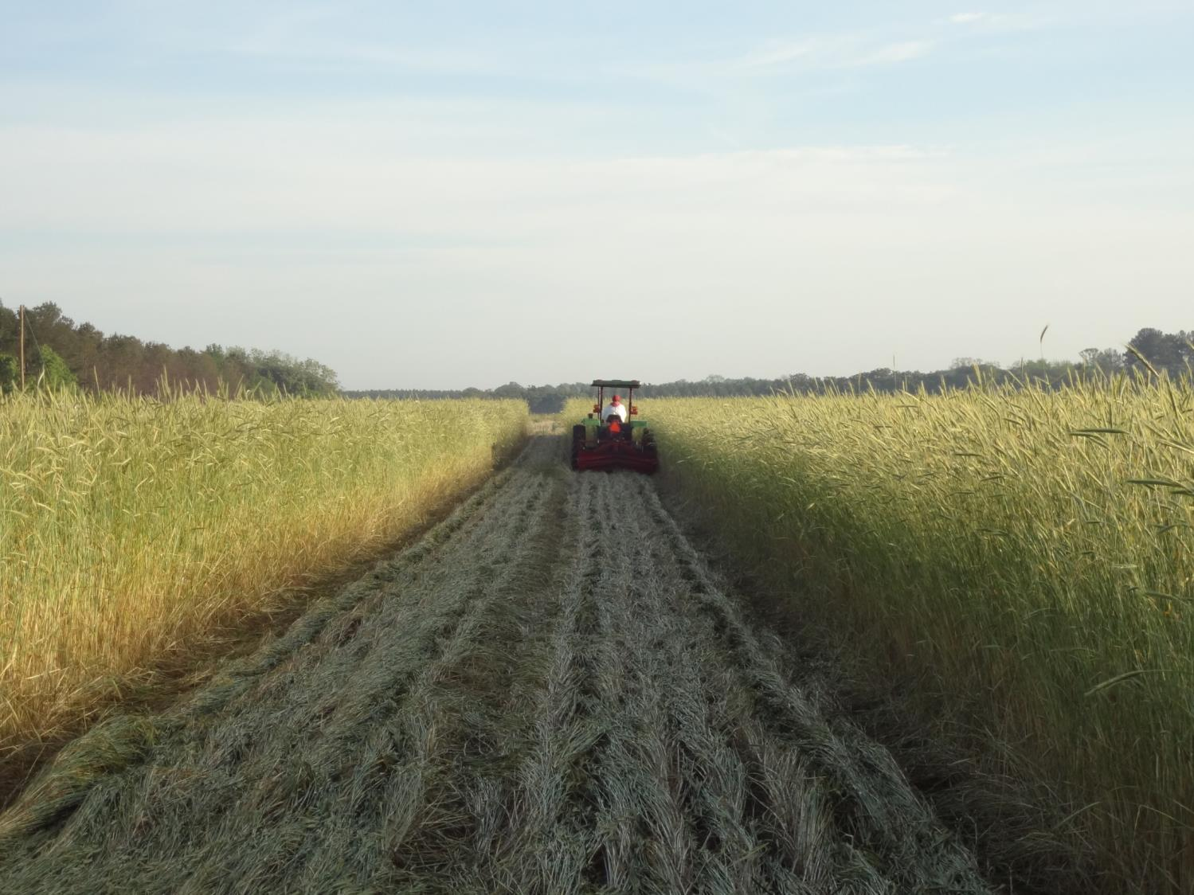
Rolling creates a mulch that is key to reducing Palmer amaranth emergence.

Slide 53
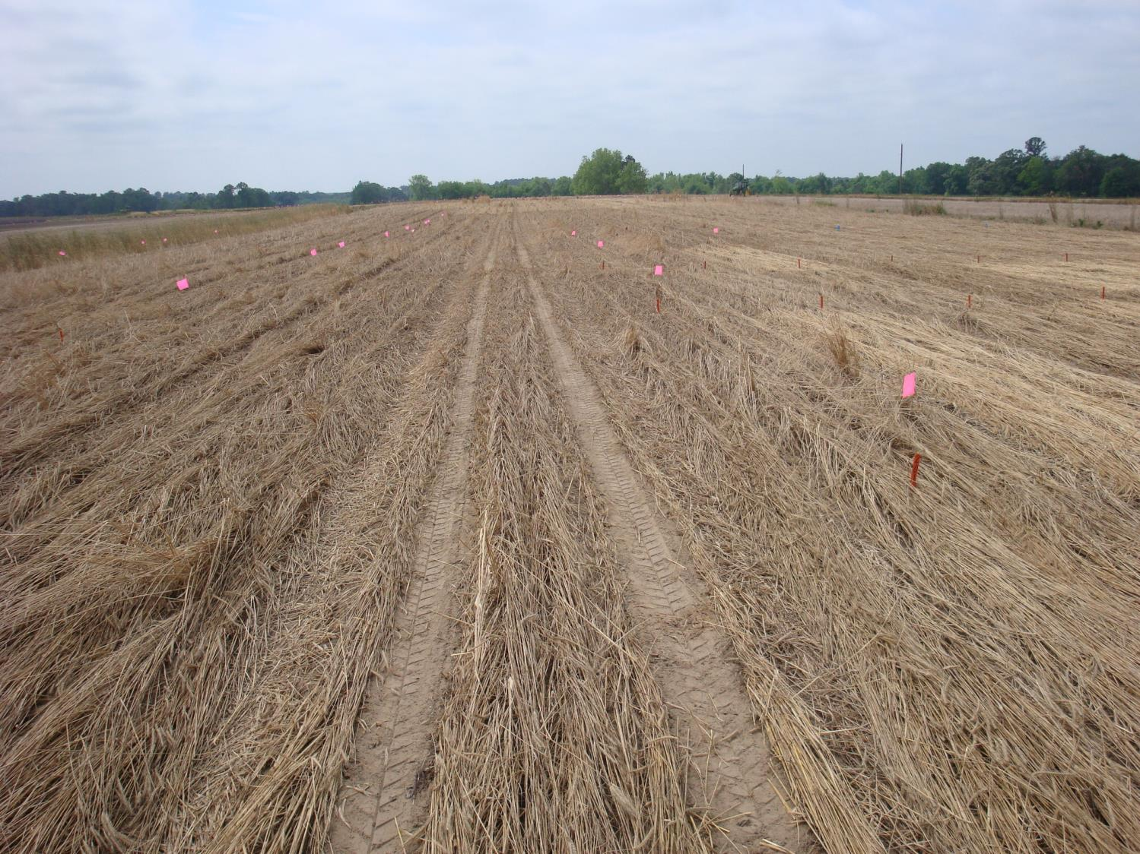

Slide 54
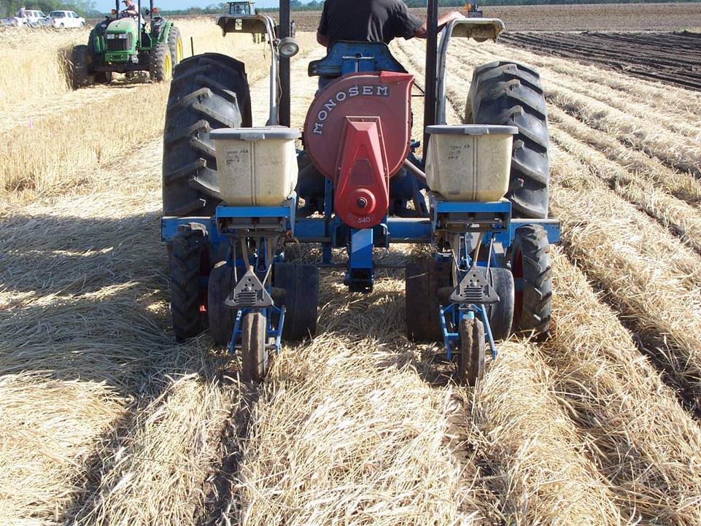
Rye Mulch Greatly Reduces Palmer Emergence
65 to 95% control in middle

Slide 55
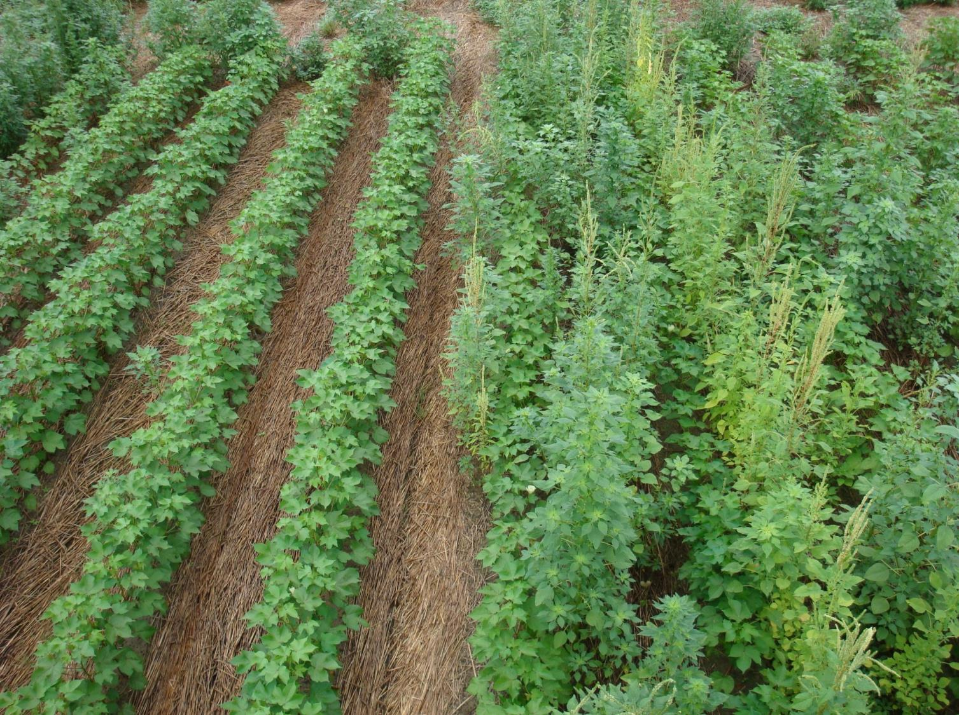
Using Heavy Rye Covers For Sustainability
Rye Cover
Weedy Cover

Slide 56
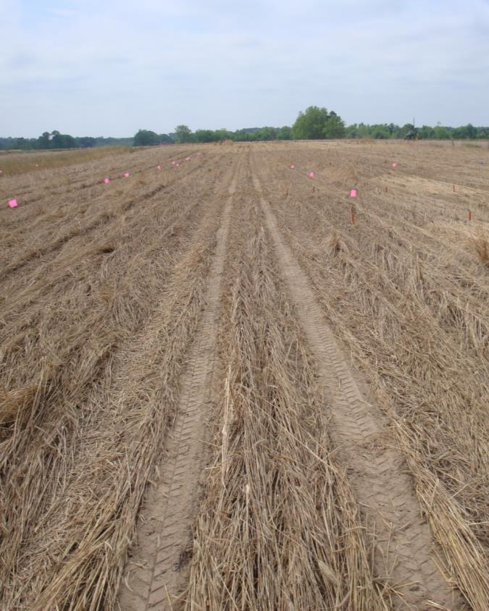
Potential Benefits for Georgia Growers
Improved Palmer control
Reduce herbicide input over time
Protect herbicide chemistry
Less labor (compared to tillage)
Mitigate wind and water erosion
Moisture conservation
Likely higher yields on dryland
Possibly reduce irrigation
Reduces thrips damage
Likely reduce impact from ryegrass and horseweed.
HELP ME WITH NRCS!!!!

Slide 57
Diversified Management Approach
herbicide diversity; use residuals
appropriate herbicide rates
plant clean; be timely
seed bank management
crop rotation when economical
Integrated programs- tillage, cover crops and/or
hand weeding

Slide 58
Why More Effective….Growers Are
More knowledgeable
Diversified
Manage seedbank
Timely

Slide 59
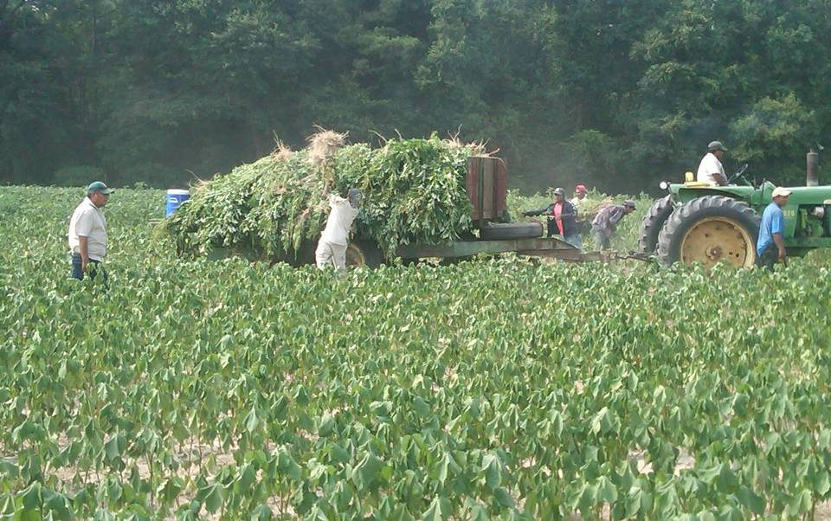
Hand Weeding
York 2010
2010: GA: Herbicide input: $90 million
Notes:
59

Slide 60
Biology of Palmer Amaranth
Prolific seed production
    450,000 seed/plant grown in competition with
    cotton (Sosnoskie and Culpepper, UGA)
    Equivalent to 10 seed/ft² if evenly distributed
    over an acre
Notes:
60

Slide 61
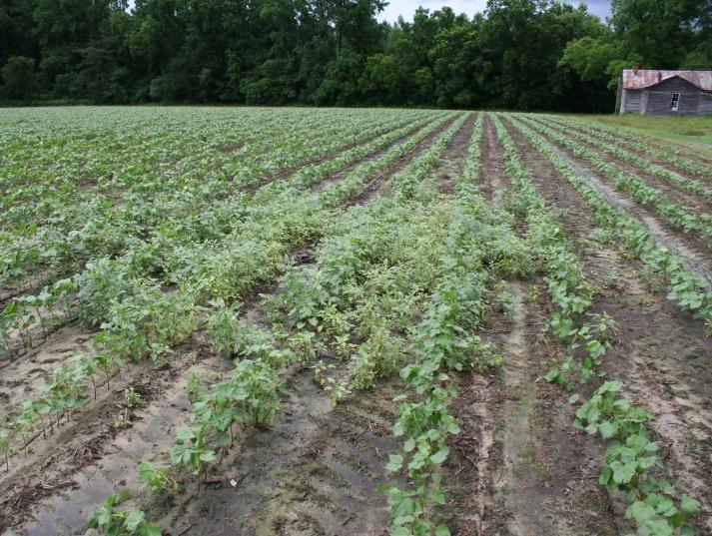
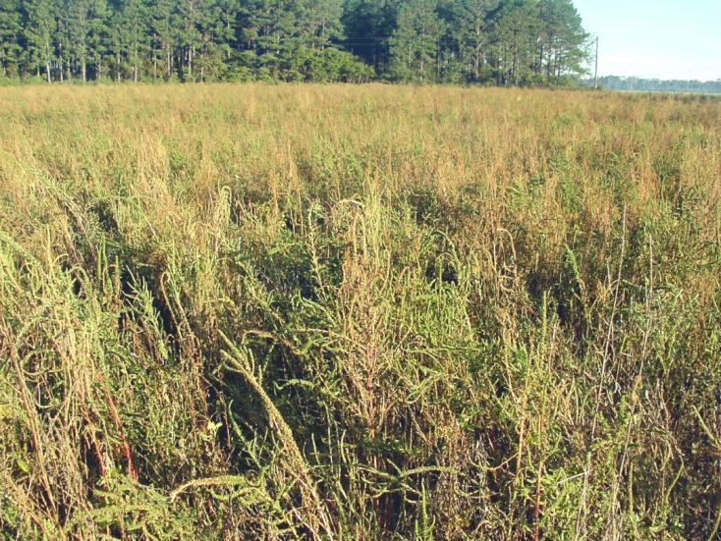
Resistant Populations Can Build Up Quickly;
Early Detection Critical
^{Photo: A. Bradley}
^{Photo: A. York}
^{Photo credit: A. Bradley}
Notes:
61
61

Slide 62


Slide 63
Why More Effective….Growers Are
More knowledgeable
Diversified
Manage seedbank
Timely

Slide 64
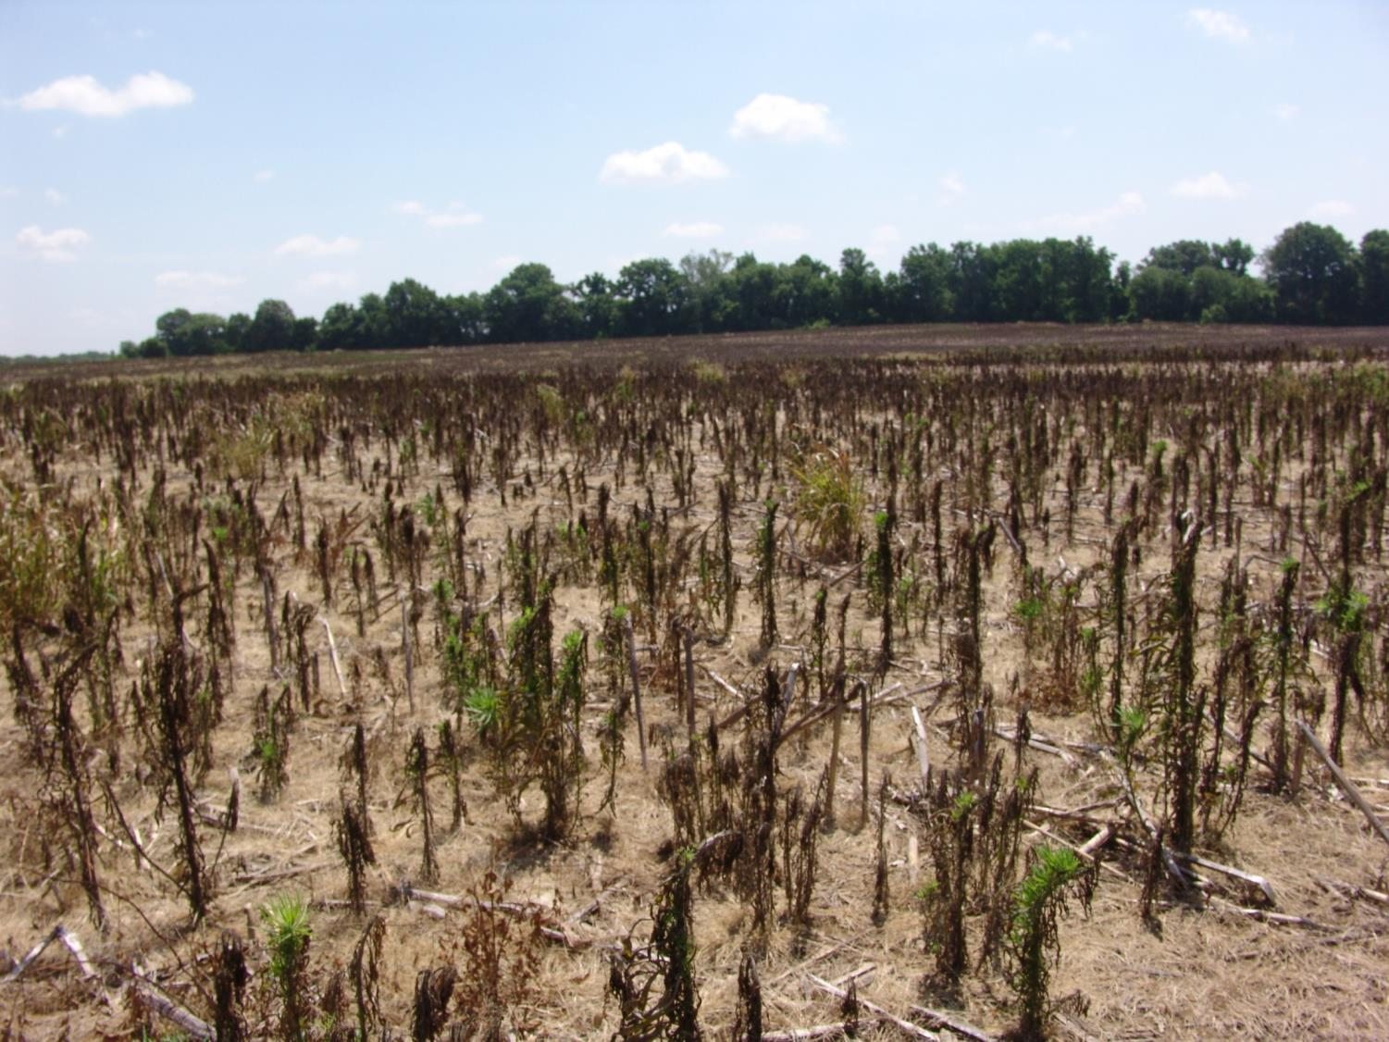
Resistant Horseweed Issues
Steckel 2013

Slide 65
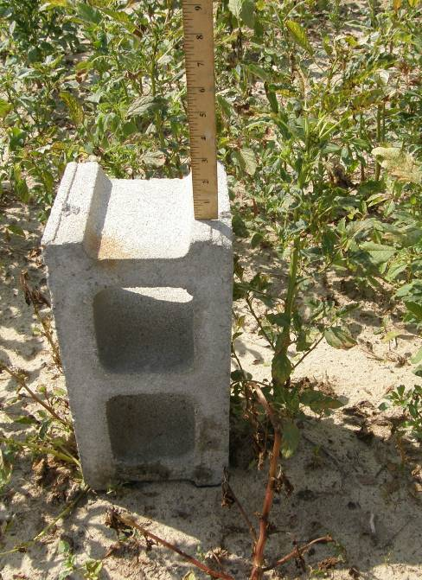
This is not a 4-inch pigweed!

Slide 66
RR Reduced Tillage Cotton Systems. 2014.
Preplant | PRE | POST1 | POST2 | Layby
Valor and/or Direx | 1. Reflex + Warrant 2. Reflex + Direx 3. Direx + Warrant | RU + Staple/ Pyrimax | RU + Dual Mag | Direx + MSMA
For Georgia Growers, tell us when you plant and we will tell you when to apply POST and layby.
Notes:
66

Slide 67
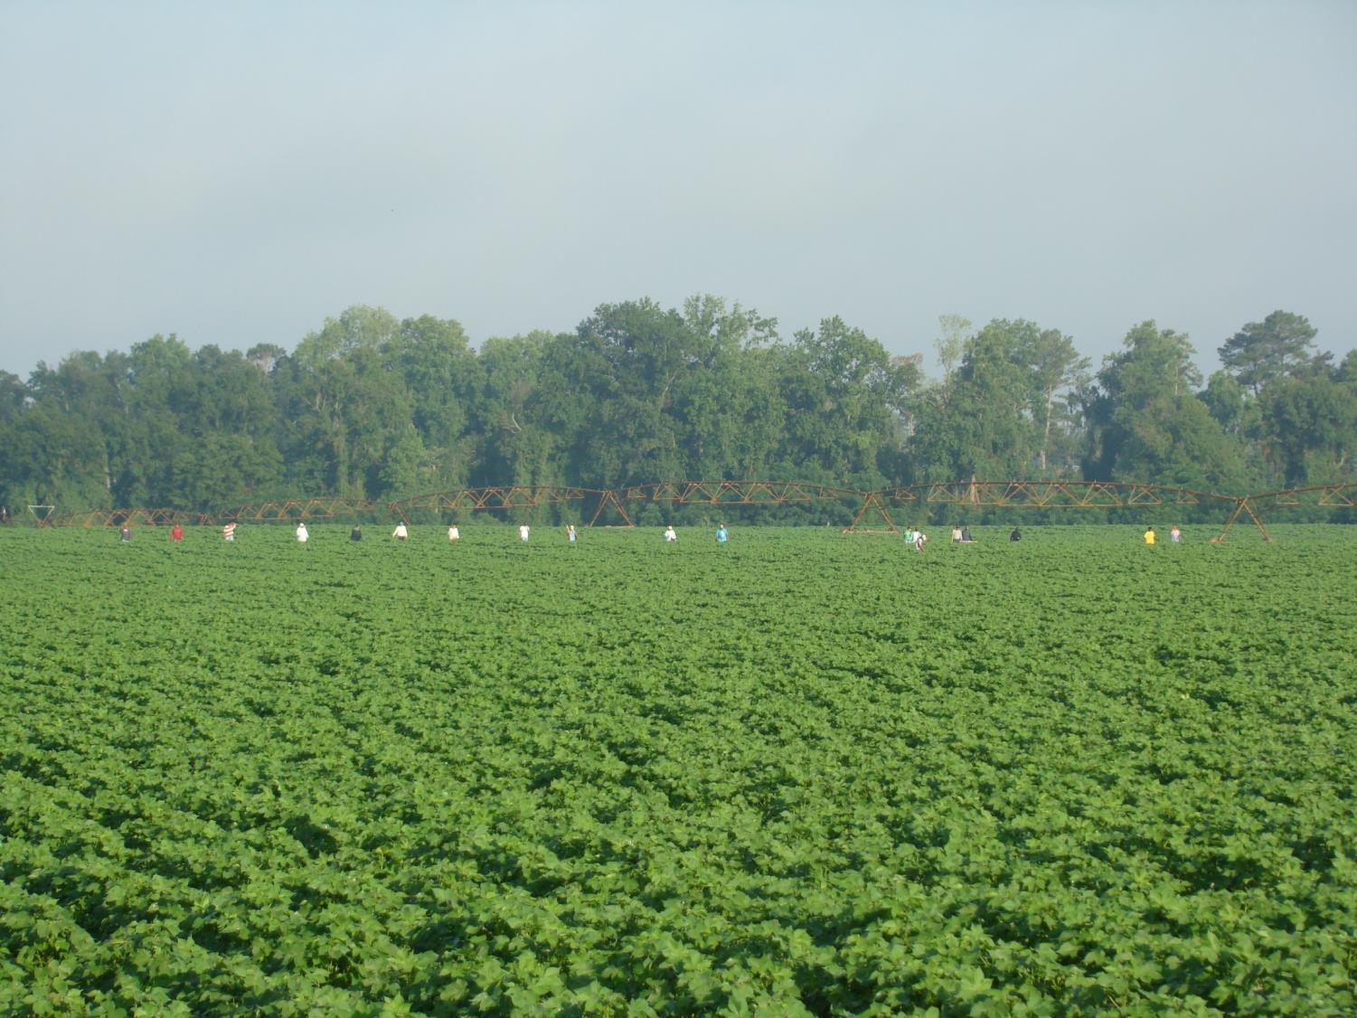
Benefits and Concerns with Future Herbicide Tolerant Traits
Stanley Culpepper
UGA Cooperative Extension
Tifton, GA

Slide 68
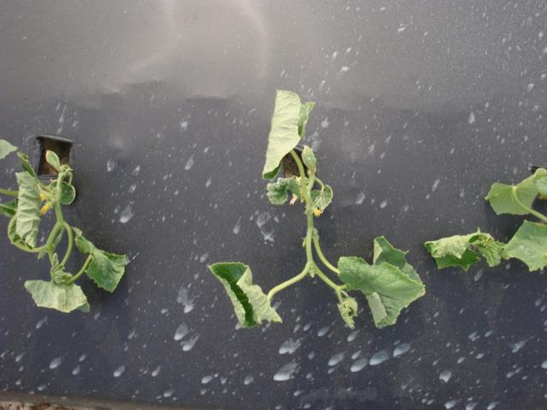
The Balancing Act
Risk
Reward

Slide 69
Problematic Weeds
Palmer amaranth
Waterhemp
Horseweed
Giant Ragweed
Common Ragweed
Ryegrass
Johnsongrass
Goosegrass
Morningglory

Slide 70
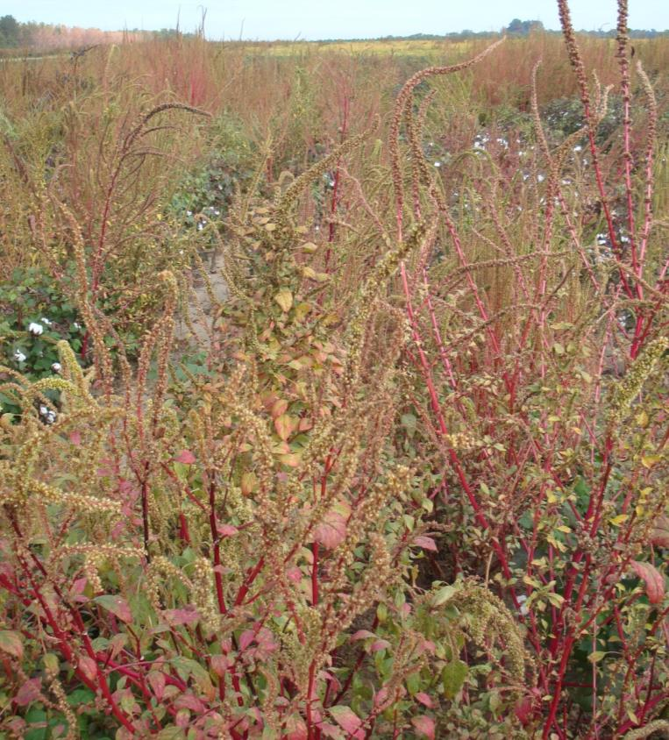
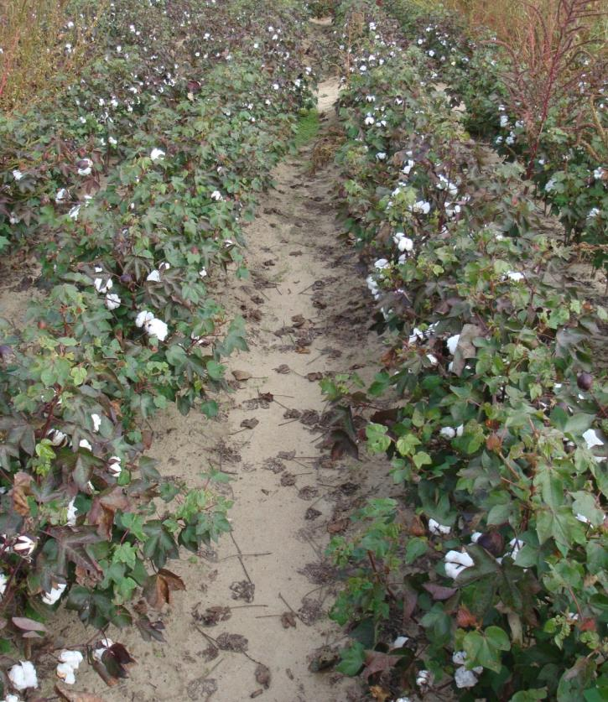
2015/2016: New Technology: 2,4-D & dicamba
flexibility
consistency
dryland or irrigated
less hand weeding
less carryover
Average RR Program
Future Technology
2010

Slide 71


12 DAT
24 DAT
dicamba 0.5 lb; 8 inch Palmer

Slide 72



2012 Georgia Fruit and Vegetables
Approximately 200,000 acres of veggies
45 different crops
3rd in U.S. vegetable production acres
Farm Gate Value: $1,200,000,000

Slide 73




Most Specialty Crops Are Very Sensitive to 2,4-D or Dicamba

Slide 74


The Balancing Act
Managing off-target movement
Potentially more economically effective sustainable programs?

Slide 75
Culpepper Future Cotton Programs (Seed Technology)
Monsanto = Roundup, Liberty, Residuals, dicamba
Dow = Roundup, Liberty, Residuals, 2,4-D choline
Bayer = Roundup, Liberty, Residuals

Slide 76

Percentage of Time Wind is < 10 MPH
May 1 – June 30, 2012*

Slide 77
Culpepper Future Cotton Programs (Seed Technology)
Monsanto = Roundup, Liberty, Residuals, dicamba
YIELD
Dow = Roundup, Liberty, Residuals, 2,4-D choline
Bayer = Roundup, Liberty, Residuals

Slide 78


Comments?

