Slide 1

2014 Soybean Weed Control Update
Eric P. Prostko
Professor and Extension Weed Specialist
Dept. Crop & Soil Sciences

Slide 2
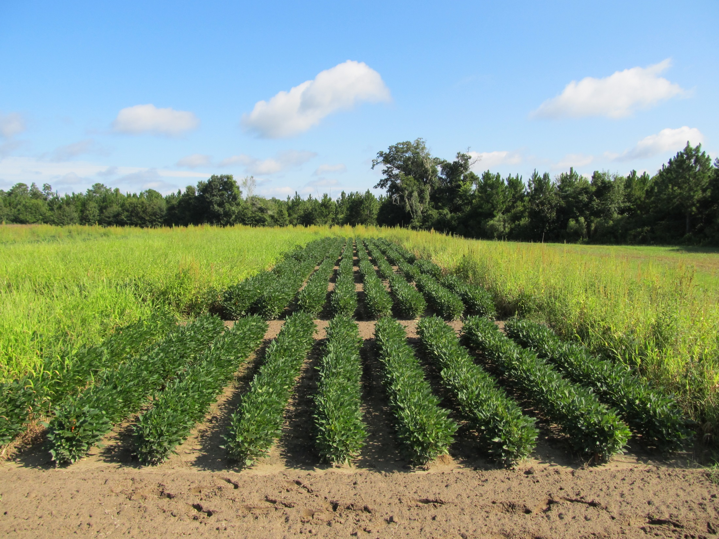
Soybean Weed Control Tips
Start clean!
2 residual herbicides
Timely POST applications (<3” weeds)
narrow row spacing (if you can)

Slide 3
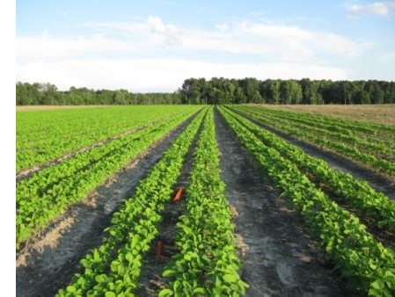
Narrow Rows and Weed Control - Soybeans
“A review of row spacing experiments in which an initial weed management practice had been accomplished revealed that in 64% of the cases (72 of 113 site-years), less late-season weed density and/or biomass, or greater late-season weed control, was achieved in narrow- compared to wide-row soybean production systems.”
Bradley, K. W. 2006. A review of the effects of row spacing on weed management in corn and soybean. Online. Crop Management doi:10.1094/CM-2006-0227-02-RV.

Slide 4
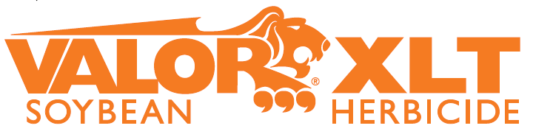

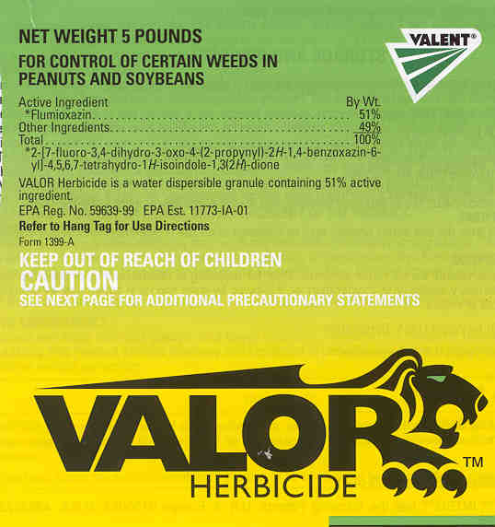

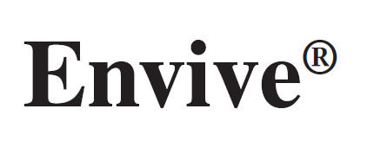
Just thinking???
Fierce or Valor or Envive or Valor XLT (PRE) followed by Reflex (POST) = great pigweed control but not great …….
Resistance Management
PPO followed by PPO
Not great in cotton and peanut rotations relying on Valor and Reflex
Might be OK in corn/soybean rotation when no PPO is used in corn

Slide 5
For Growers in Peanut/Cotton Rotations Who Want to Protect Valor and Reflex
RR Soybeans
Warrant or Dual Magnum fb Glyphosate + Reflex (Flexstar GT)
Tricor or Boundary or Canopy or Authority MTZ (metribuzin herbicides) fb Glyphosate + Reflex (Flexstar GT)
LL Soybeans
Warrant or Dual Magnum fb Liberty + Reflex
Reflex or Valor fb Liberty + Warrant or Dual Magnum
No metribuzin on LL varieties
Herbicide
Resistance?

Slide 6
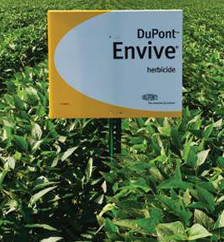
Envive Rates/Crop Injury
Dupont
41.3% WG
Classic – 9.2%
Valor – 29.2%
Harmony – 2.9%
Rate range of 2.5-4.0 oz/A
I prefer 2.5 oz/A
Similar injury situation occurs with Valor XLT
Most likely cause is Classic

Slide 7
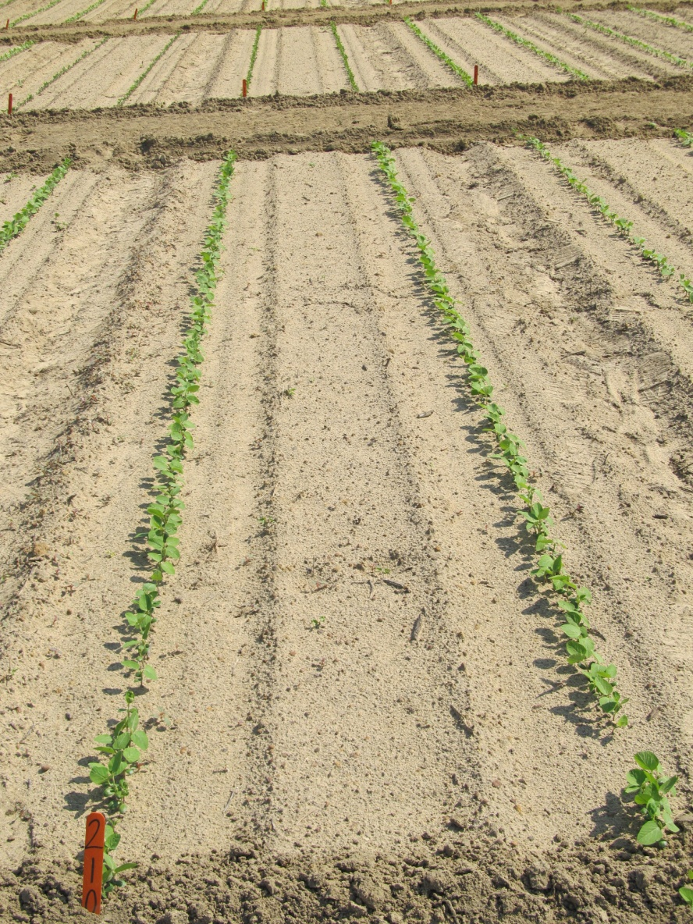
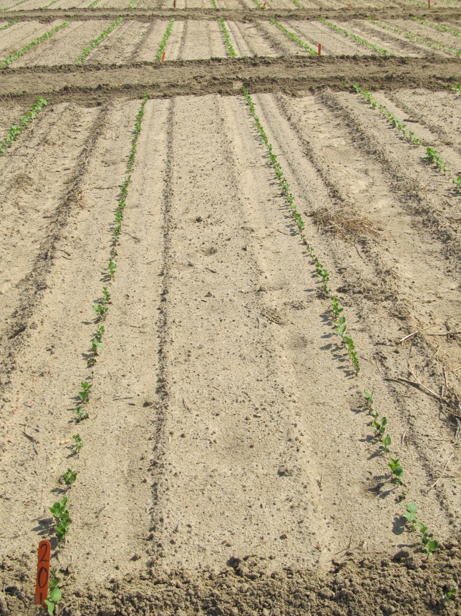
Soybean Injury Caused by Envive 41.3WG @ 3.5 oz/A 10 DAP
NTC
Envive
SB-21-11

Slide 8
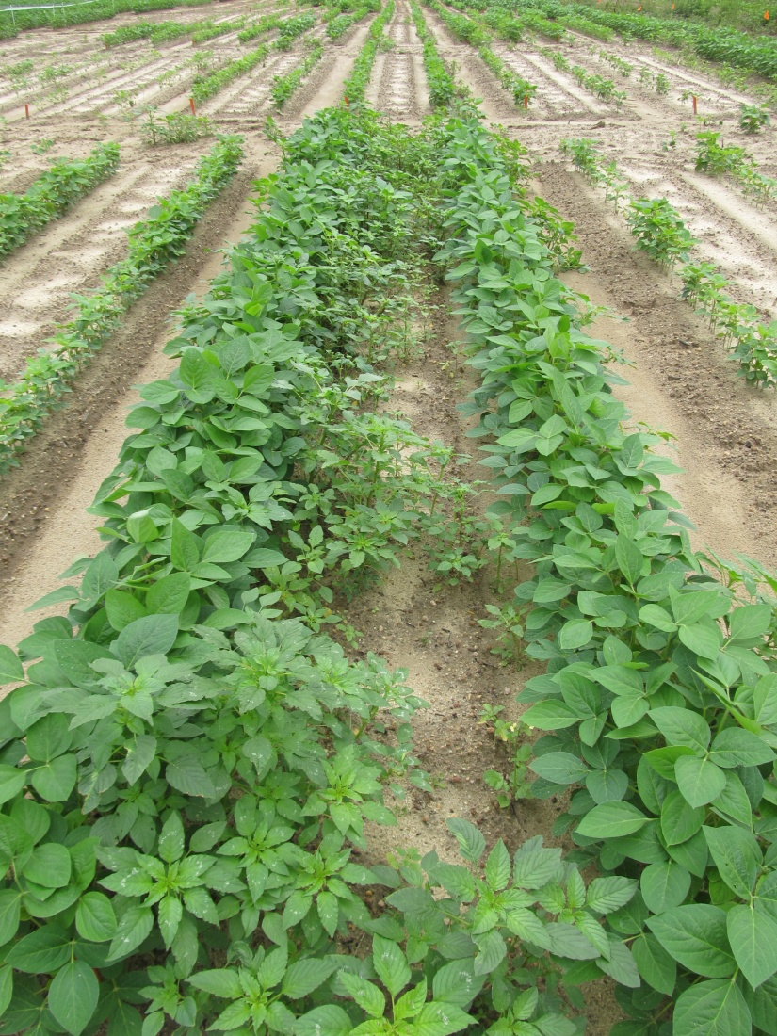
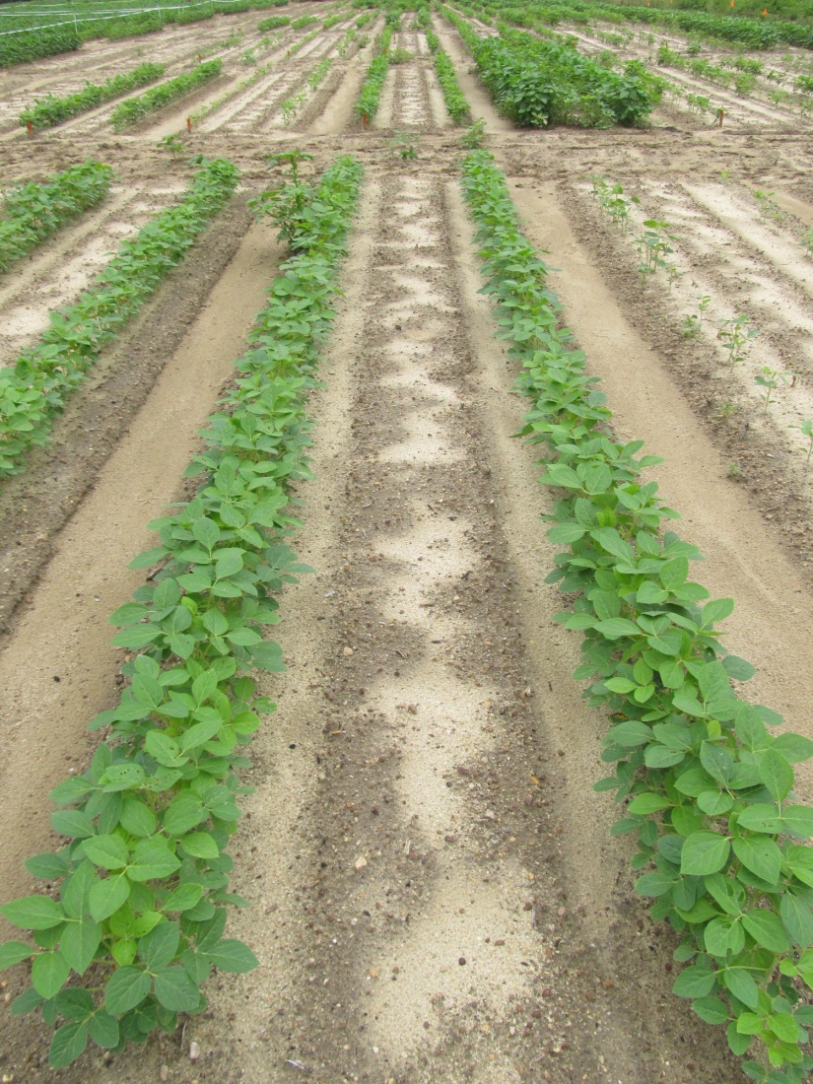
LL-Soybean and Weed Response to Envive SB-02-12 (June 12)
NTC
Envive 41.3DG @ 3.5 oz/A (PRE)
Liberty 2.34SL @ 22 oz/A (POST)

Slide 9
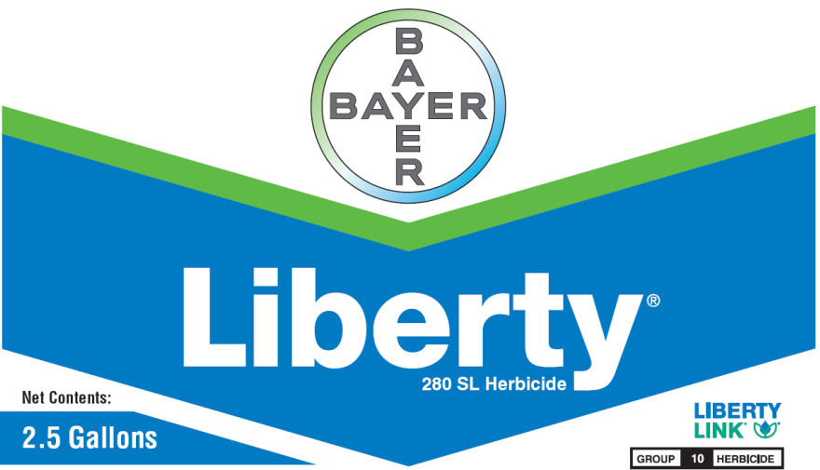
Liberty-Link® Soybeans
Liberty 2.34SL @ 22-36 oz/A
VE-R1
2 applications (65 oz/A/year total)
Tank-mixes with POST grass herbicides may reduce grass control
Assure (10-21%); Fusilade (8-12%); Poast (25-41%); Select (4-22%)
Residuals still needed
Variety performance?
Getting better
**Best Results
15 GPA, medium droplet size, small weeds, 9 am - 6 pm

Slide 10
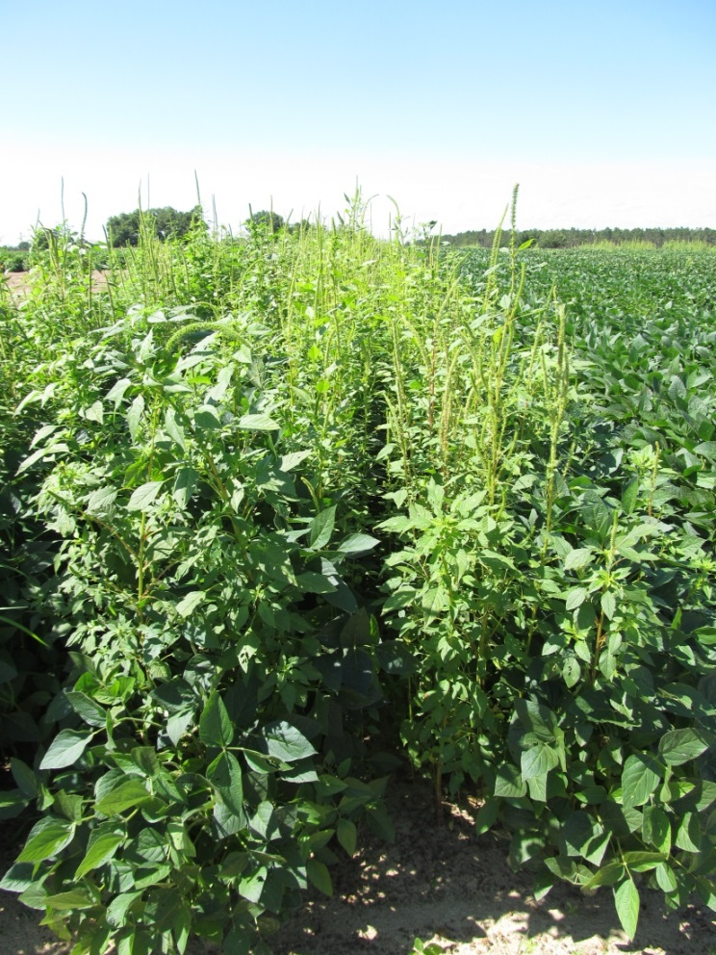
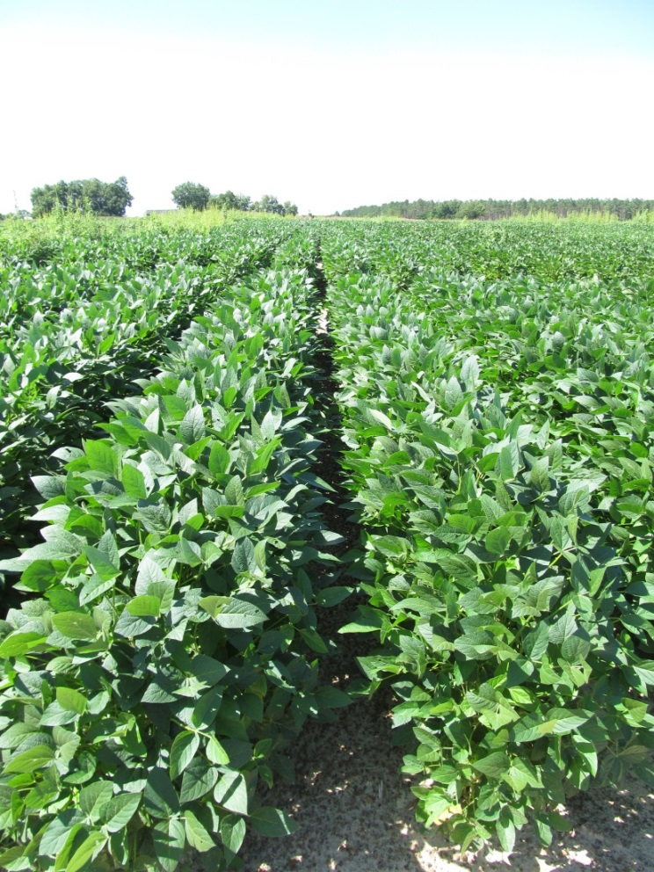
Weed Control in LL Soybeans 2013
NTC
Dual Magnum @ 16 oz/A (PRE)
Liberty @ 29 oz/A (MPOST)
Reflex @ 16 oz/A (MPOST)
SB-23-13
July 17

Slide 11
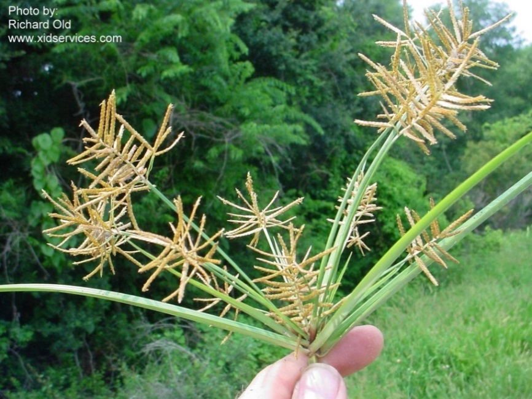
Yellow Nutsedge Control in Soybeans
How competitive?
2.2-13 plants/m² = 9-34% yield loss
Nelson and Smoot (2010) Weed Technol. 24:39-43
Herbicides
Dual Magnum – PRE +
Classic or Basagran – POST
Classic = 3-4” tall
Basagran = up to 8”, 2 applications

Slide 12
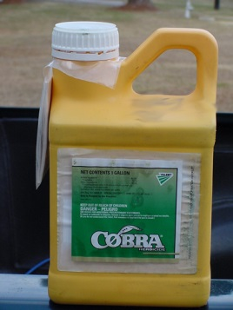
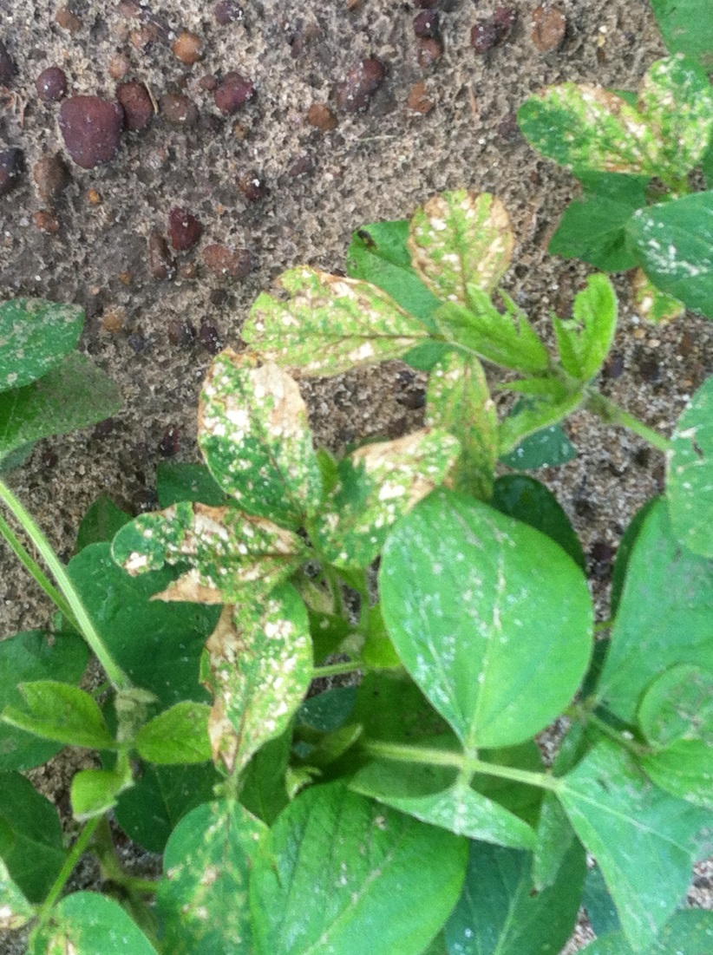
Do early applications of Cobra increase soybean yields?
Nebraska (2013)
Decreases in yield were observed by destroying apical meristem by both clipping at V2 and applications of Cobra
Arkansas
V3 stage
21% increase in yield (2011)
No difference in yield (2012)
Iowa (2011)
V2.5 stage
No positive effect
Multi-State (MN, WI, MI, IA, KS, IL, IN, AR, KY)
2012
V4 stage
No positive effect from Cobra alone
Increased yield with SOYA + Cobra (+8.9%) but not different from SOYA alone.

Slide 13

2014 Pest Control Handbook Additions
(pyroxasulfone)
(Valor + Zidua)

Slide 14

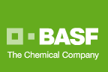
Zidua 85WG
Pyroxasulfone
Residual control of annual grasses and certain broadleaf weeds including pigweed (beggarweed?)
Same MOA as Dual or Warrant but used at lower rates
Use rate: 1-2 oz/A (~$6.50/oz)

Slide 15
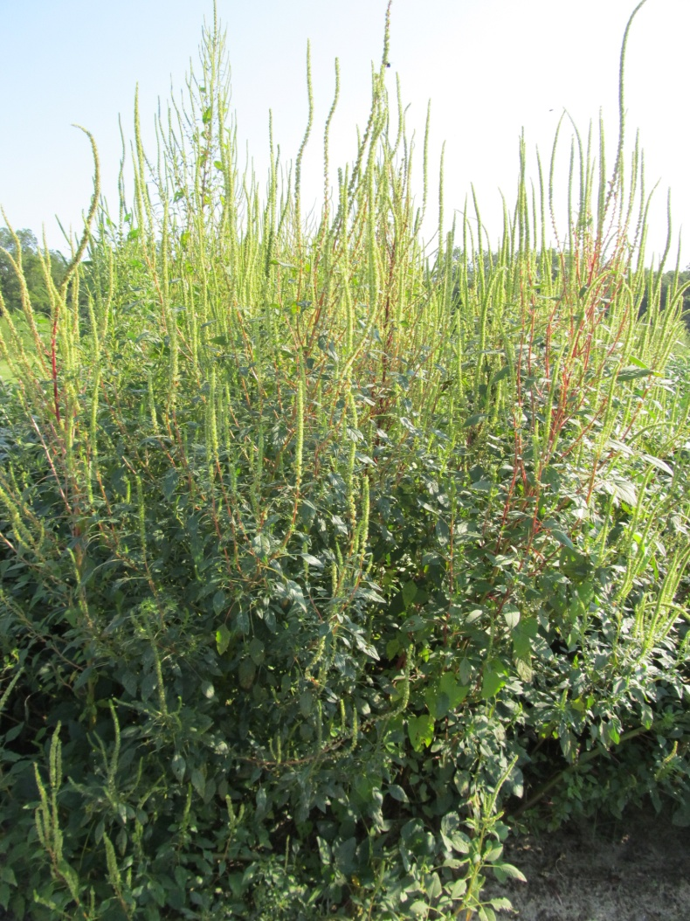
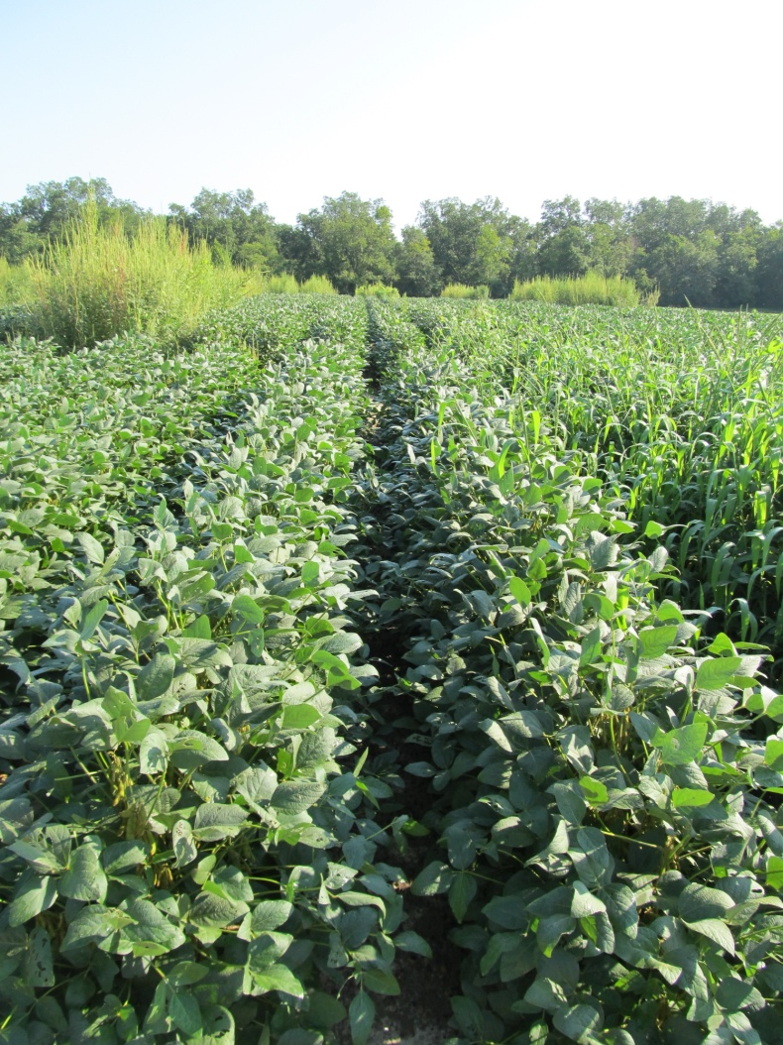

Weed Control in Soybeans with Zidua - 2012
NTC
Zidua 85WG @ 2 oz/A – PRE
Abundit 4SL @ 32 oz/A – POST
AMS Xtra @ 2.5% v/v - POST
SB-01-12
August 13
83 DAP

Slide 16

Fierce 76WDG
Valor (33.5%) + Pyroxasulfone (42.5%)
preplant or preemergence
3 oz/A on coarse soils (Valor @ 2 oz/A + Pyrox @ 1.5 oz/A)
March 2013

Slide 17
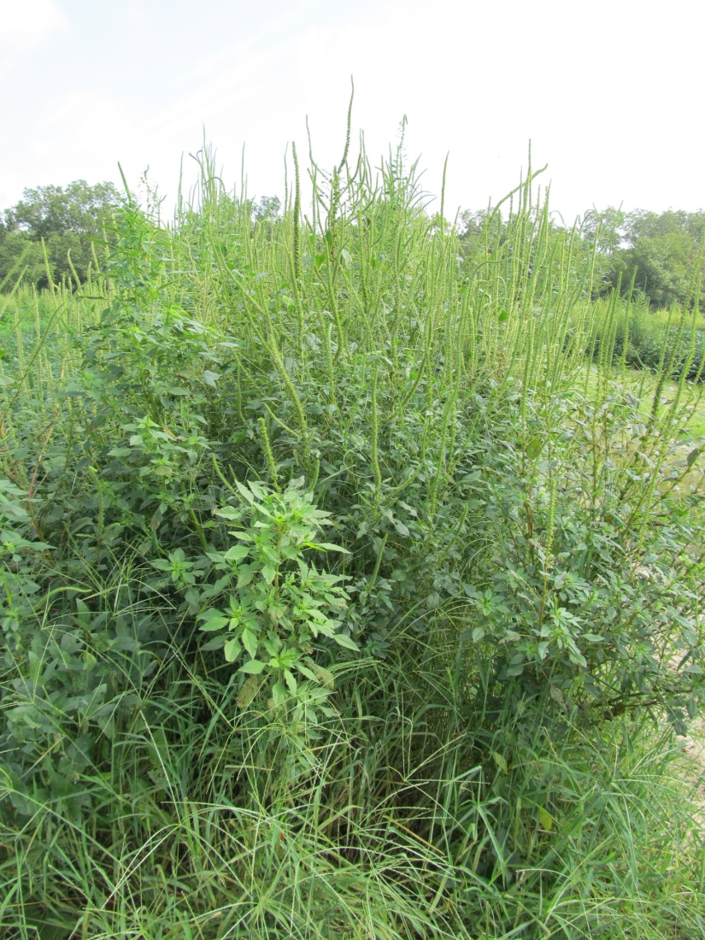
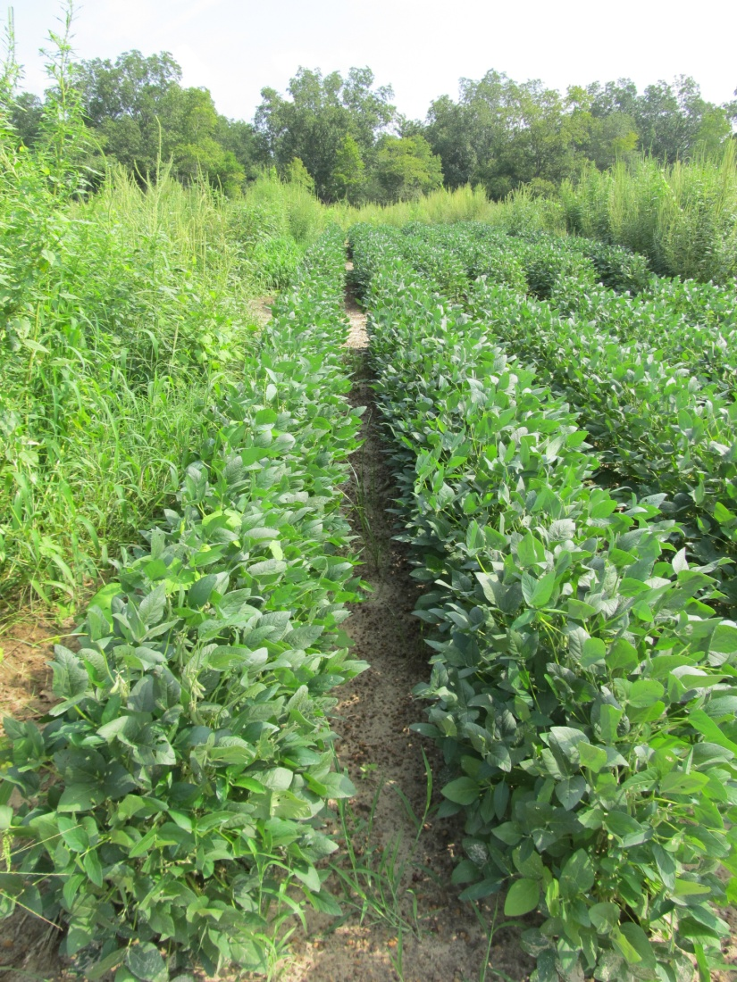
GR-Palmer Control in Soybeans with Fierce – 2012
NTC
Fierce 76WG @ 3 oz/A - PRE
Roundup WM 5.5SL @ 22 oz/A – POST (June 20)
SB-10-12
August 9
78 DAP

Slide 18

Future Technologies
2,4-D resistance
Dicamba resistance

Slide 19
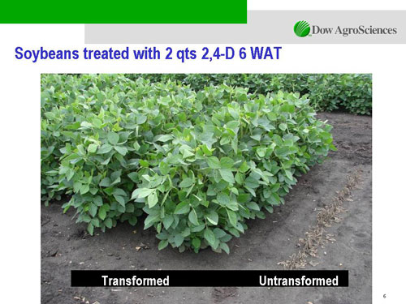

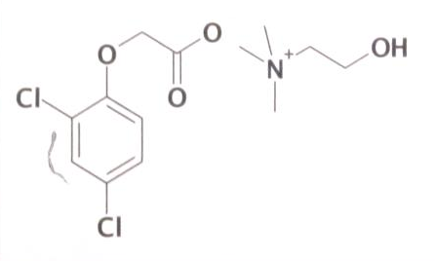
Enlist™ Herbicide Tolerant Soybean
tolerance to 2,4-D + glyphosate + glufosinate (Liberty)
Colex-D™ technology
2,4-D choline
lower volatility
lower drift potential
enhanced handling/mixing characteristics
reduced odor
1 Burndown/PRE application + 2 POST applications (R2 stage)
Enlist™ Duo
DMA-Glyphosate (1.71 lb ae/gal) + 2,4-D choline (1.63 lb ae/gal)
3.5 pt/A
2015 Product Launch (MG 3.8)
Pioneer License
2,4-D choline

Slide 20

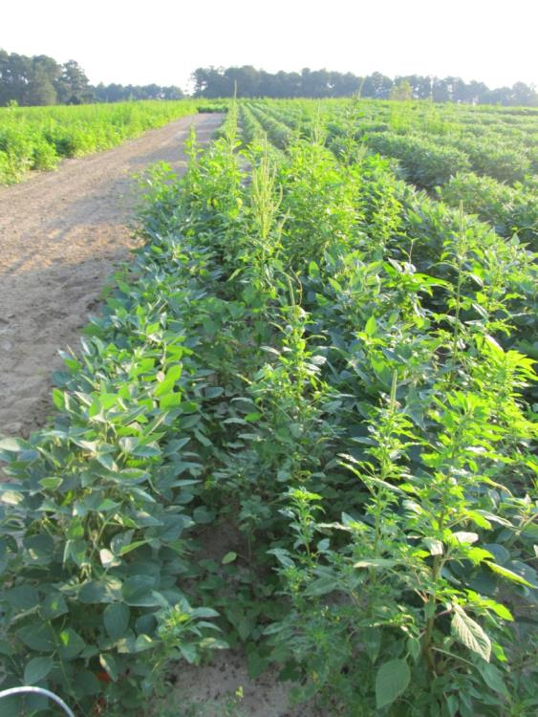
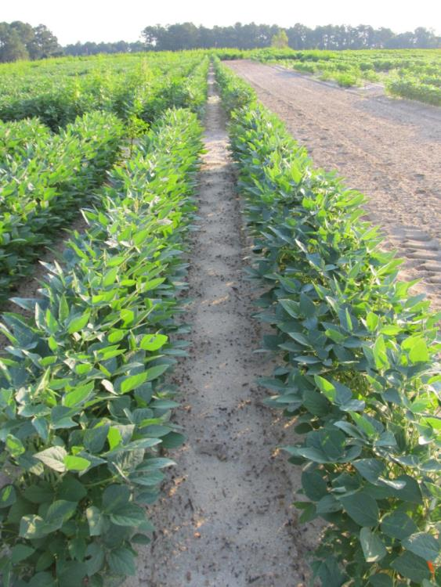
Enlist Soybeans - 2012
NTC
Valor SX 51WG @ 2 oz/A – PRE (May 4)
Enlist Duo (GF-2726) @ 56 oz/A – MPOST (June 1)
N-PAK AMS @ 2.5% v/v - MPOST (June 1)
SB-09-12
Planted May 3
Photo: June 29

Slide 21



Dicamba-Tolerant (DT) Soybeans
Monsanto/BASF
Roundup Ready 2 Xtend (Monsanto)
XtendiMax
Reduced volatility dicamba
Roundup Xtend
Reduced volatility dicamba + glyphosate
Engenia™ (BASF)
Reduced volatility formulation of dicamba
Banvel = dicamba-DMA
Clarity = dicamba-DGA
Engenia = dicamba–BAPMA
PRE or POST
RESIDUAL STILL NEEDED!!!!!!!!!!!!!!!!!!!!!!!
2015-2016?
Engenia™

Slide 22
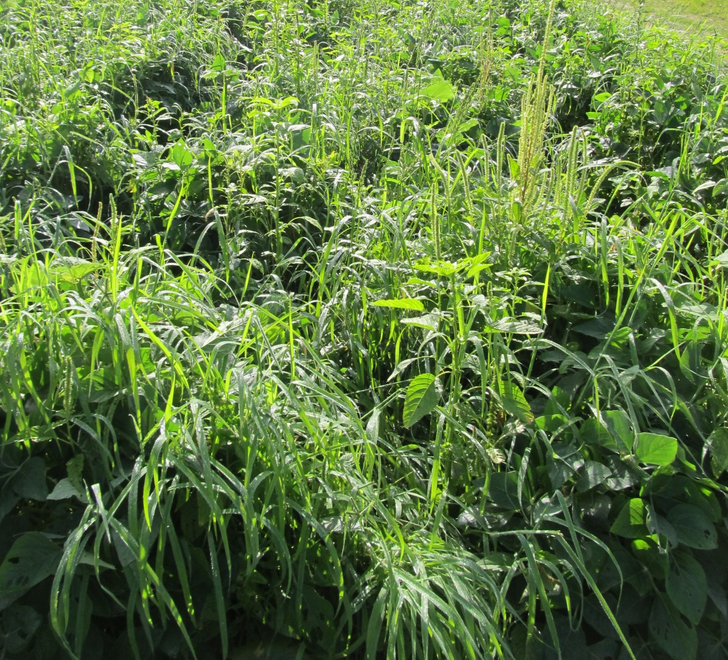
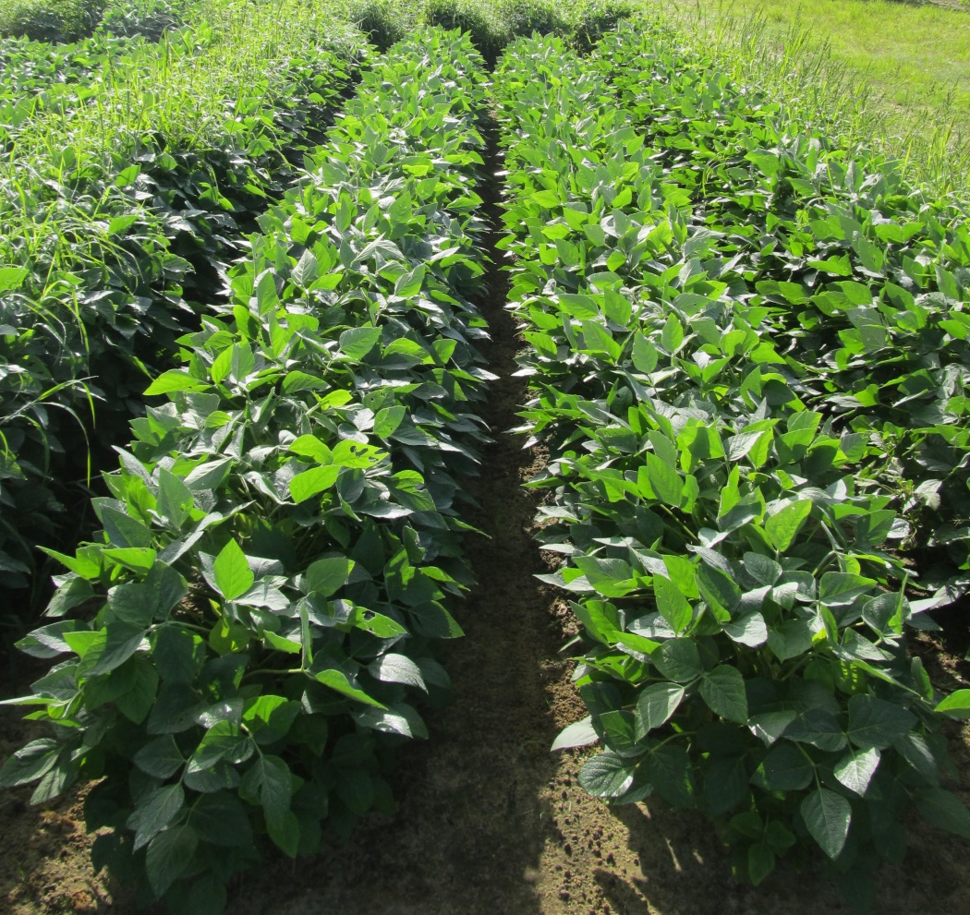
Weed Control in Soybeans with Engenia - 2013
NTC
Zidua @ 2 oz/A (PRE)
Engenia @ 12.8 oz/A (POST)
Roundup PowerMax @ 28 oz/A (POST)
Induce @ 0.25% v/v (POST)
Newsome
July 30, 2013
39 Days after POST

Slide 23
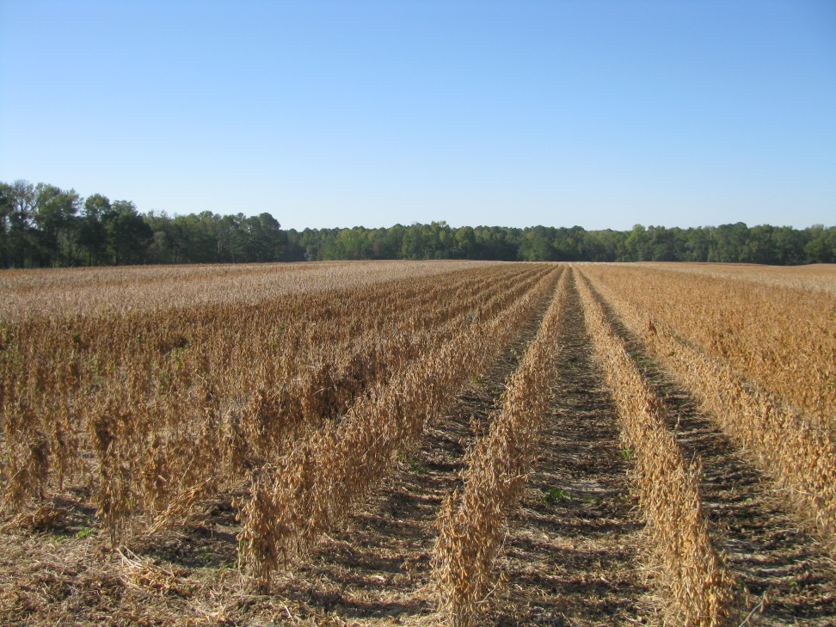
2,4-D and Dicamba Tolerant Soybeans
Still need a residual!
Still need to be timely (3-4” tall weeds)!
Will also need Ignite!
Not on Xtend beans though!
Must significantly improve in the areas of drift and sprayer contamination management

Slide 24
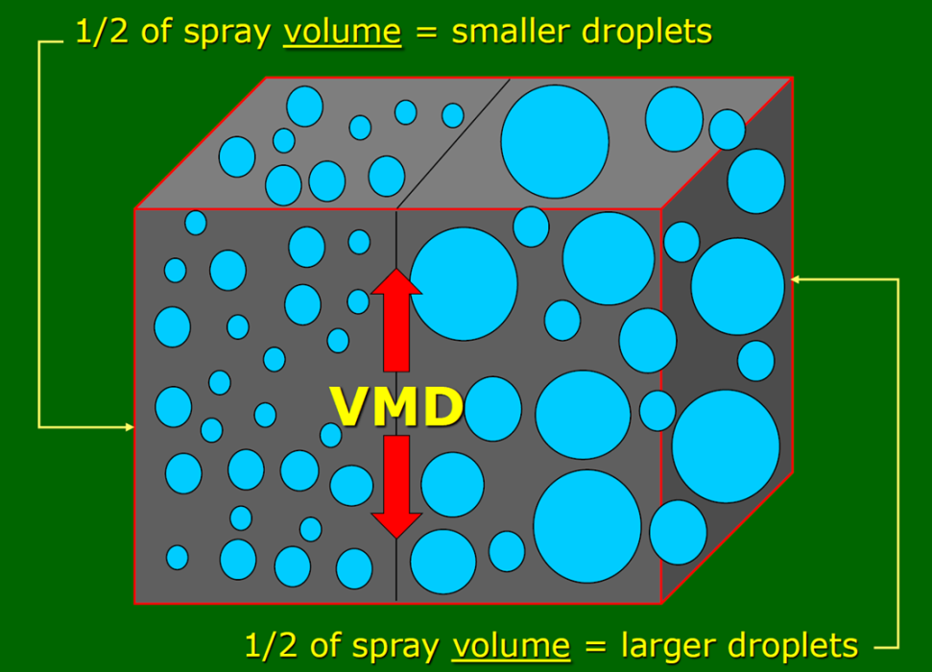
Volume Median Diameter (VMD)
value where 50% of the total volume or mass of liquid sprayed is made up of droplets larger than this value, and 50% is made up of droplets smaller than this value.
D_{v0.5}
Measured in microns

Slide 25
2,4-D/Dicamba Soybeans Understanding spray droplet size will be very important!
Category | Symbol | Color Code | Approximate VMD² (Microns)
Extremely Fine | XF | PURPLE | ~50
Very Fine | VF | RED | <136
Fine | F | ORANGE | 136-177
Medium | M | YELLOW | 177-218
Coarse | C | BLUE | 218-349
Very Coarse | VC | GREEN | 349-428
Extremely Coarse | XC | WHITE | 428-622
Ultra Coarse | UC | BLACK | >622

Slide 26
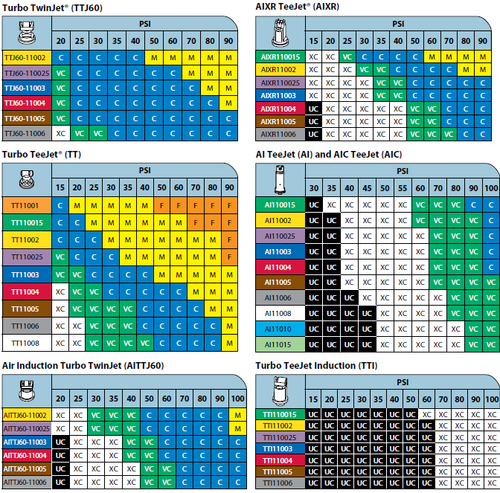

Slide 27



On the Next Horizon
HPPD resistant soybeans
Bayer/MS Technologies
“Balance” beans
Glyphosate + isoxaflutole
2015?????
Syngenta + Bayer
“MGI” beans
Mesotrione (Callisto)
Glufosinate (Liberty)
Isoxaflutole (Balance)
2015-2020????

Slide 28
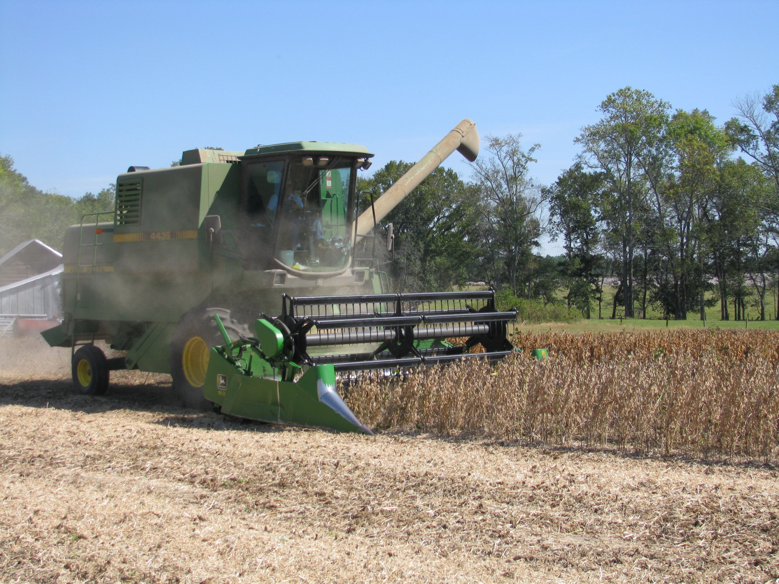
QUESTIONS?
www.gaweed.com

