Slide 1

Peanut Weed Control Update - 2014
Eric P. Prostko, Ph.D.
Professor and Extension Weed Specialist
Department of Crop & Soil Sciences

Slide 2
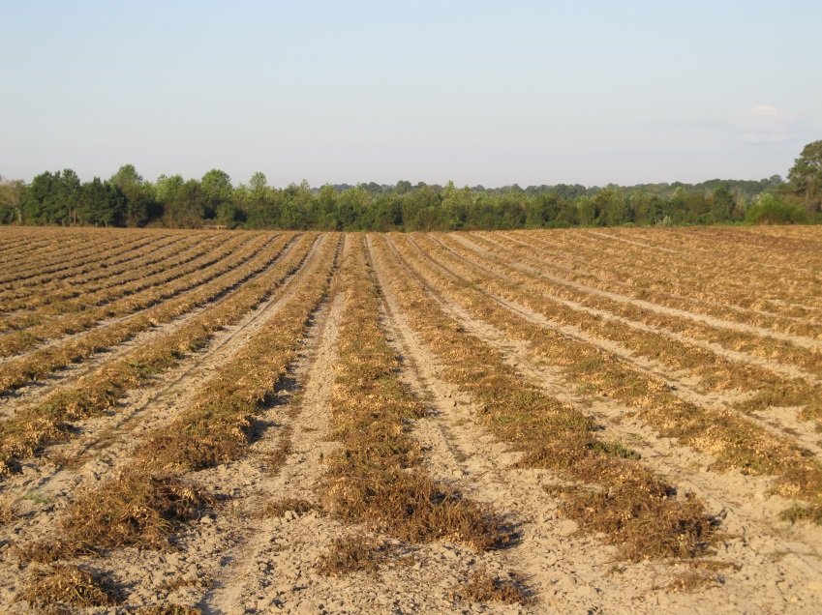
Topics
Valor
Paraquat
Classic
Palmer amaranth
Sicklepod
T. spiderwort
New herbicides
Pest Control Handbook Updates

Slide 3
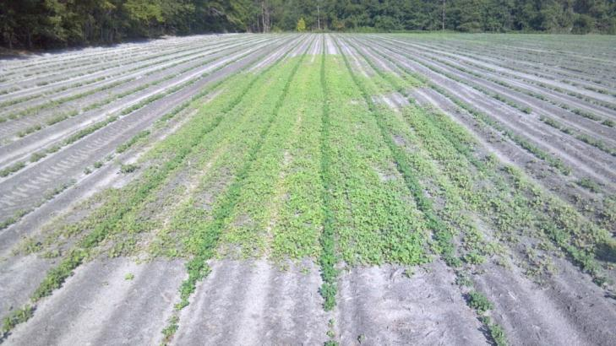
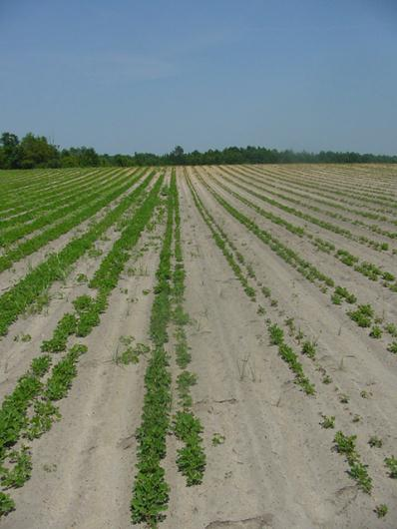
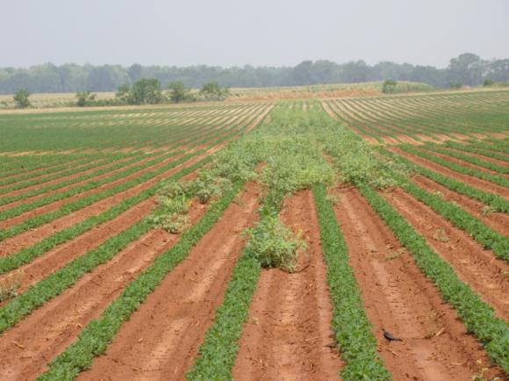

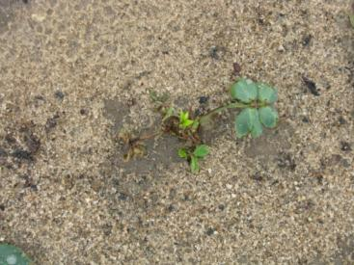
Valor Great Weed Control vs. Crop Injury

Slide 4
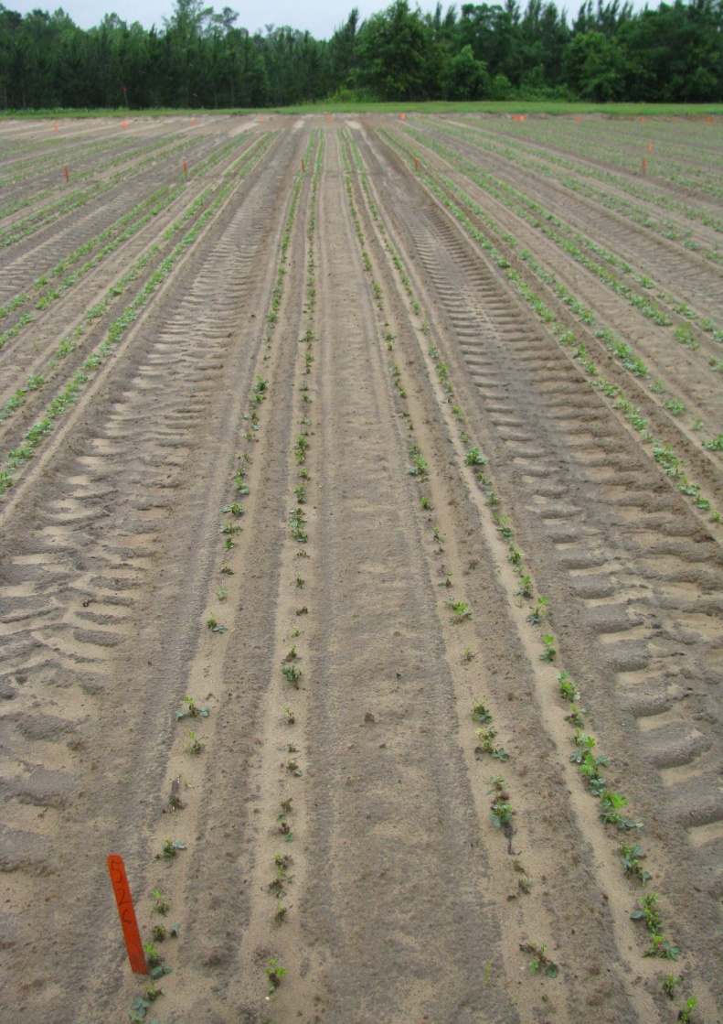
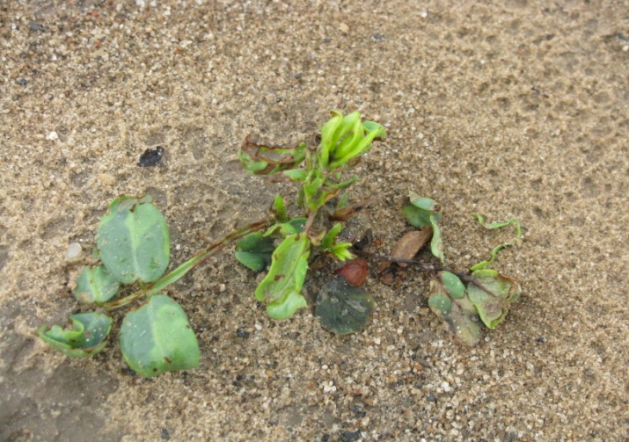
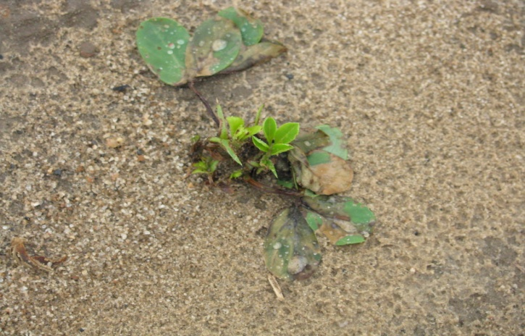
Valor Injury @ (6 oz/A) 16 DAT
PE-05-09
May 22, 2009

Slide 5
Figure 1. Peanut Yield Response to Valor - 2013
lbs/A
PE-14-13
Averaged over 3 planting dates (April 16, April 29, May 13)
GA-06G
P = 0.8162

Slide 6
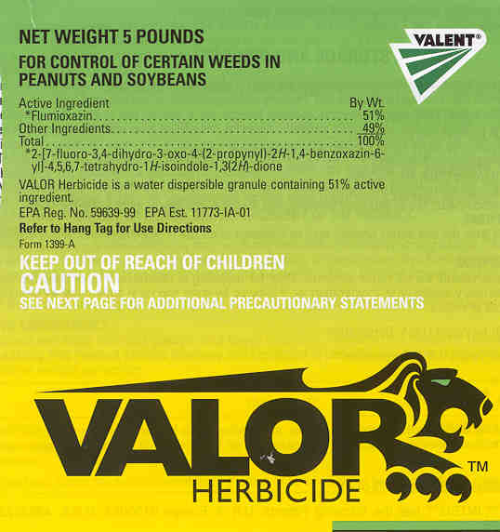
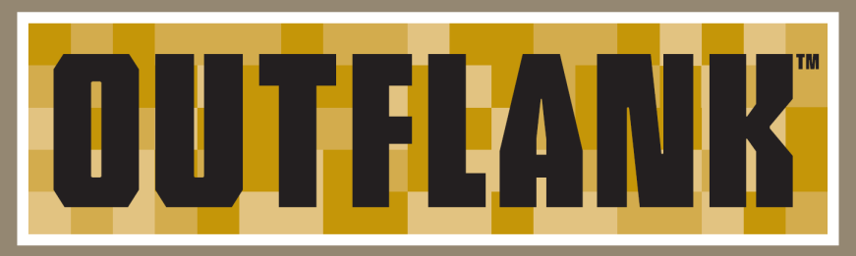
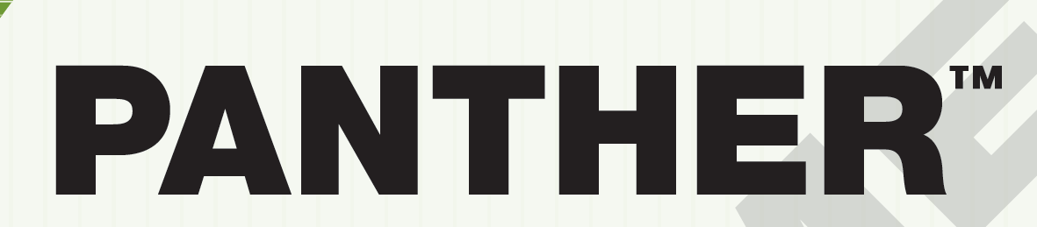
Generic Valors
Outflank (MANA)
Panther (NUFARM)
ai still provided by Valent
Minimal GA data at this point

Slide 7
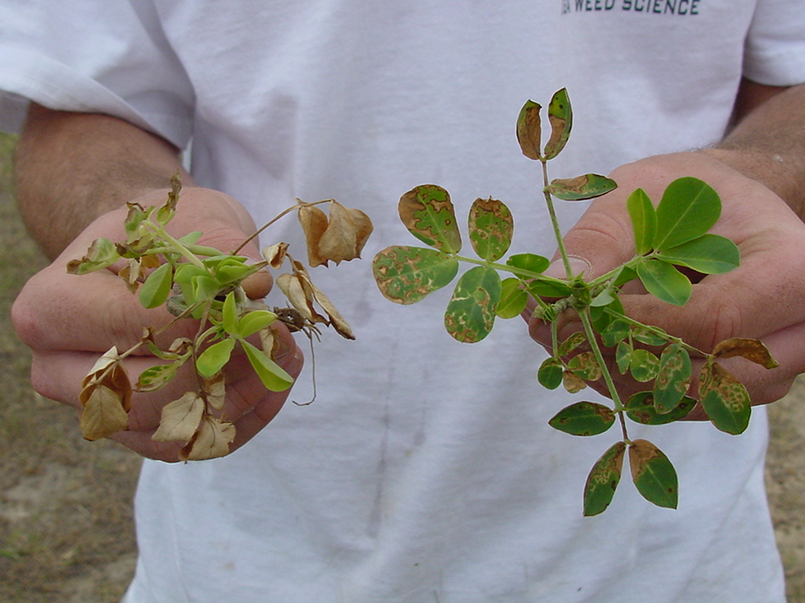
Treatments applied 6 DAC; Photo at 3 DAT
GA-02C
GI @ 8 oz/A +
NIS @ 0.25% v/v
GI @ 12 oz/A + Basagran @ 8 oz/A +
NIS @ 0.25% v/v

Slide 8
Peanut Variety Response to Gramoxone Treatments - 2013
Herbicide | Rate/A | Yield (lb/A)
 |  | GA-06G | GA-09B
None | -- | 6291 | 5701
Gramoxone 2SL Adept | 8 oz 0.25% v/v | 6218 | 5720
Gramoxone 2SL Storm 4SL Adept | 12 oz 16 oz 0.25% v/v | 6328 | 5813
Gramoxone 2SL Storm 4SL Dual Magnum 7.62EC Adept | 12 oz 16 oz 16 oz 0.25% v/v | 6284 | 5962
P = 0.10 |  | 0.9310 | 0.8837
Averaged over 3 application timings (15, 22, and 31 DAP).
UGA Ponder Farm
PE-02-13
PE-02B-13

Slide 9
A Comparison of Irrigated Weed-Free Peanut Yields Between NTC and Gramoxone (12 oz/A) + Storm (16 oz/A) + NIS (0.25% v/v) Treatments in Georgia, 2012-2013.
G + S
(lbs/A)
6000 = 5961 (99%)
PE-01-12 (GA-06G)
PE-02-13 (GA-06G)
PE-02B-13 (GA-09B)
NTC (lbs/A)
n = 32

Slide 10
A Comparison of Irrigated Weed-Free Peanut Yields Between NTC and Gramoxone (12 oz/A) + Storm (16 oz/A) + Dual Magnum (16-21 oz/A) Treatments in Georgia, 2011-2013.
G + S + DM
(lbs/A)
PEA01-11 (GA-06G)
PEA01-12 (GA-06G)
PE-20-11 (GA-06G)
PE-01-12 (GA-06G)
PE-17-12 (GA-06G)
PE-02-13 (GA-06G)
PE-02B-13 (GA-09B)
PE-12-13 (GA-06G)
PE-13-13 (GA-06G)
6000 = 5801 (97%)
NTC (lbs/A)
n = 50

Slide 11
A Comparison of Irrigated Weed-Free Peanut Yields Between NTC and Gramoxone (12 oz/A) + Storm (16 oz/A) + Dual Magnum (16 oz/A) fb Cadre (4 oz/A) + Dual Magnum (16 oz/A) Treatments in Georgia, 2012-2013.
G + S + DM fb C + DM
(lbs/A)
6000 = 5828 (97%)
PE-06-12
PEA03-12
PE-12-13
PE-13-13
NTC (lbs/A)
n = 13

Slide 12

Label Tank Mixing Guidelines – Current (new)
Order of Tank Mixing - In general, Gramoxone SL 2.0 tank mixes with other products and should be mixed as follows:
Fill spray tank 1/2 full with clean water or other approved carriers such as clear liquid fertilizer.
Begin tank agitation and continue throughout mixing and spraying.
Add nonionic surfactant to tank.
Add dry formulations (WP, DF, etc.) to tank.
Add liquid formulations (SC, EC, L, etc.) to tank.
Add Gramoxone SL 2.0 to tank.
Add crop oil concentrate or methylated seed oil where needed
Fill remainder of spray tank.
Always refer to labels of other pesticide products for mixing directions and precautions which may differ from those outlined here.
Since many of the herbicides listed on this label are available in several types of formulations, it is advisable to perform a jar test to check physical compatibility.

Slide 13
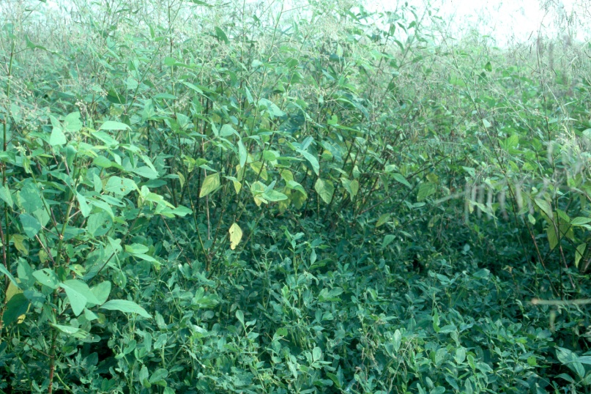

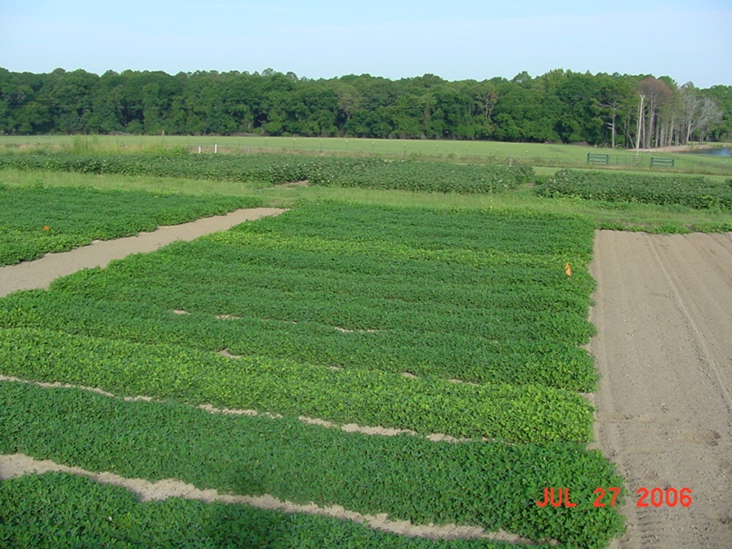
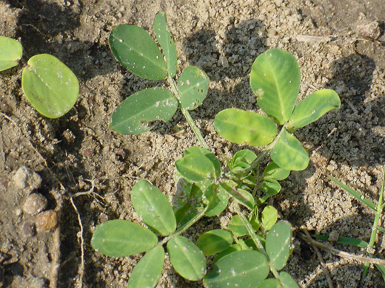
FL-07, GA Greener, GA-07W = No problems
GA-06G and Tifguard = 7-11% yield losses

Slide 14
Georgia-09B Yield Response to Classic (0.5 oz/A): 2013-2014
Time of Application (DAE) | 2013 | 2014
0 | 6987
60-69 | 6808
70-79 | 6616 (-5.3%)
90-99 | 7167
100+ | 6737
LSD 0.10 CV | 339 4
DAE = Days After Peanut Emergence

Slide 15
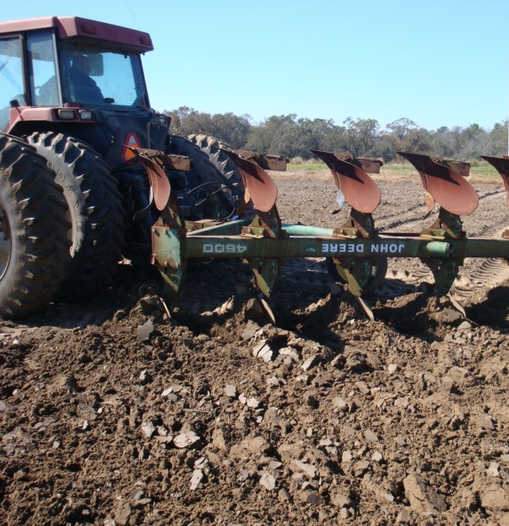
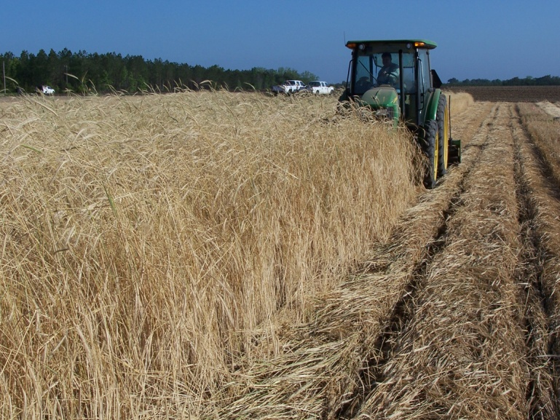
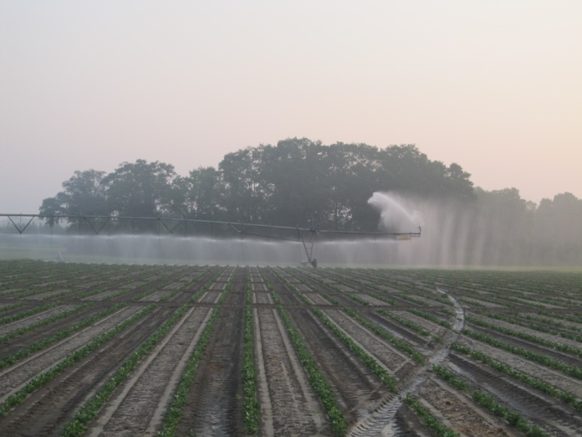
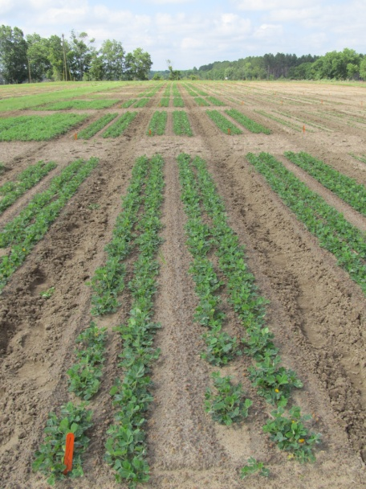
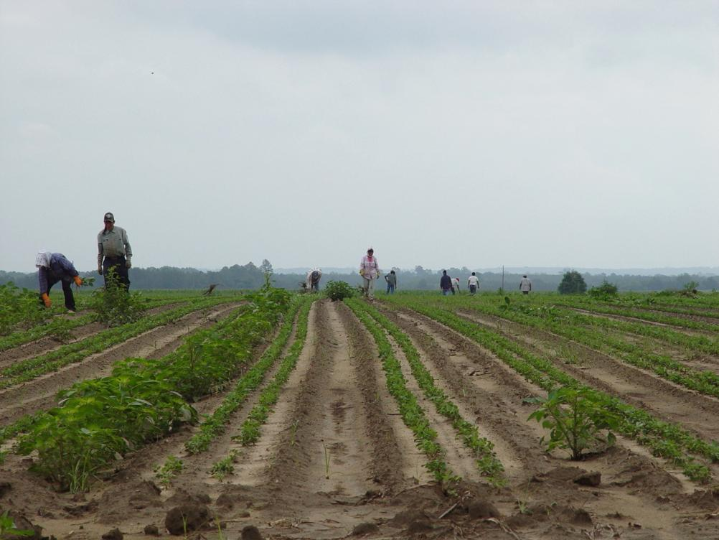
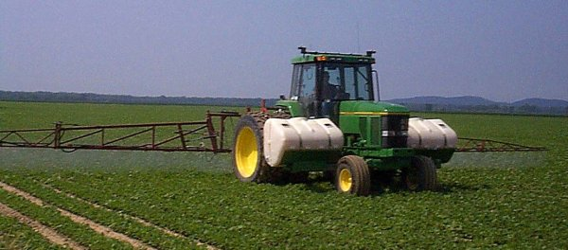
Palmer Amaranth Control Integrated Program Approach
Tillage
Irrigation
Rye Cover Crop
Hand-Weeding
Twin Rows
Herbicides

Slide 16
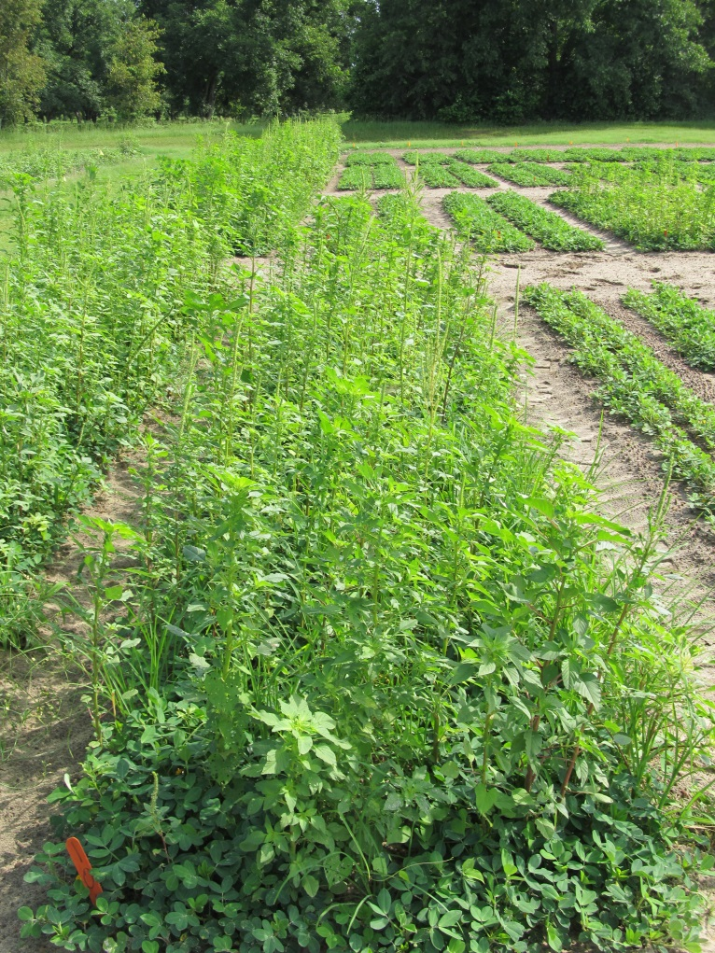
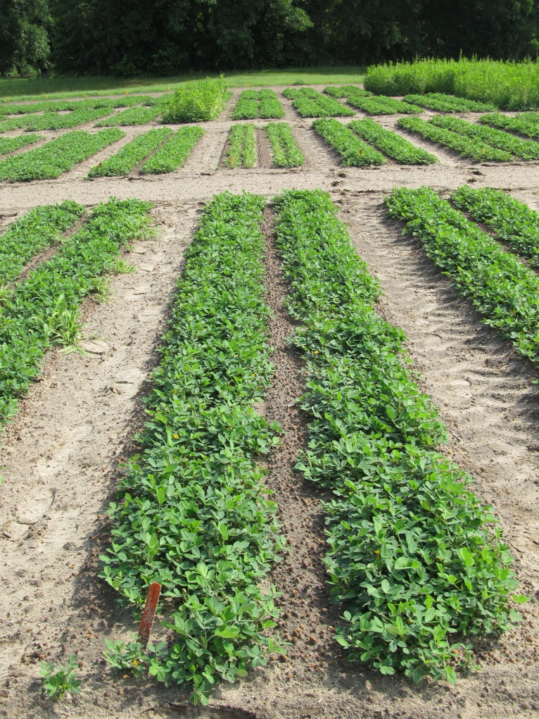
Peanut Weed Control - 2013 Prowl/Valor/Strongarm/Cadre/Dual Magnum
NTC
Prowl H₂0 @ 34 oz/A (PRE)
Valor @ 3 oz/A (PRE)
Strongarm @ 0.23 oz/A (PRE)
Cadre @ 4 oz/A (POST)
Dual Magnum @ 16 oz/A (POST)
PE-01-13
June 25
57 DAP

Slide 17
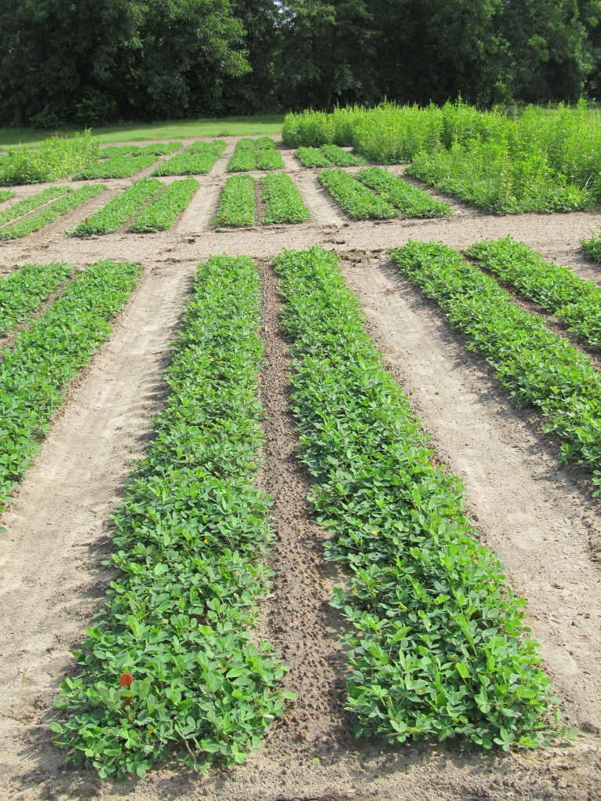
Peanut Weed Control - 2013 Prowl/Gramoxone/Storm/Cadre/Dual Magnum
NTC
Prowl H₂0 @ 34 oz/A (PRE)
Gramoxone @ 12 oz/A (EPOST)
Storm @ 16 oz/A (EPOST)
Dual Magnum @ 16 oz/A (EPOST)
Cadre @ 4 oz/A (POST)
Dual Magnum @ 16 oz/A (POST)
PE-01-13
June 25
57 DAP

Slide 18
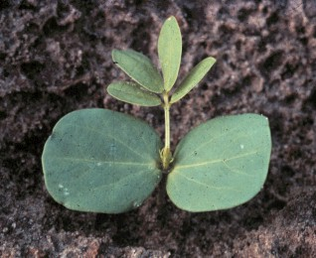
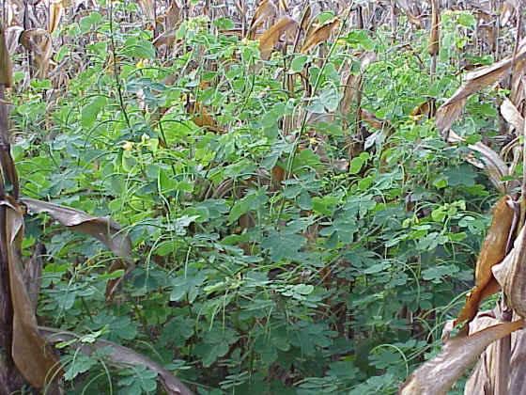
Sicklepod Control in Peanut
Why so difficult?
25,000 seed/plant
seed remain viable in soil for at least 5 years
no peanut herbicide provides adequate residual control
Cultural Practices
Twin rows (+8-9%)
Herbicide Options
Cadre (3” OR LESS)
2,4-DB (multiple apps, suppression only)
Paraquat in NSA
50% solution

Slide 19
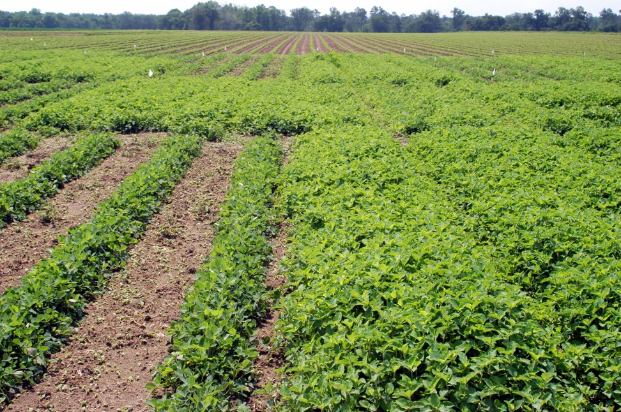
Tropical Spiderwort (a.k.a.Benghal Dayflower) Control in Peanut
Tillage (moldboard plow)
Twin Rows (+8%)
2 applications of Dual Magnum
Gramoxone, Cadre, Strongarm, Basagran - POST

Slide 20



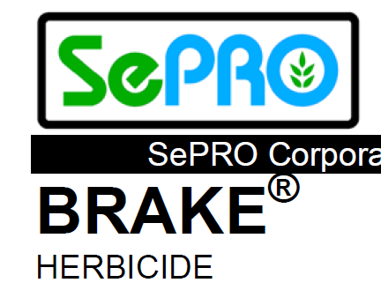
Herbicides on the Horizon Currently Evaluating Their Potential
Pyroxasulfone (KIH-485)
Zidua (pyroxasulfone)
Fierce (Valor + Zidua)
Acetochlor
Warrant
Fluridone
Brake

Slide 21
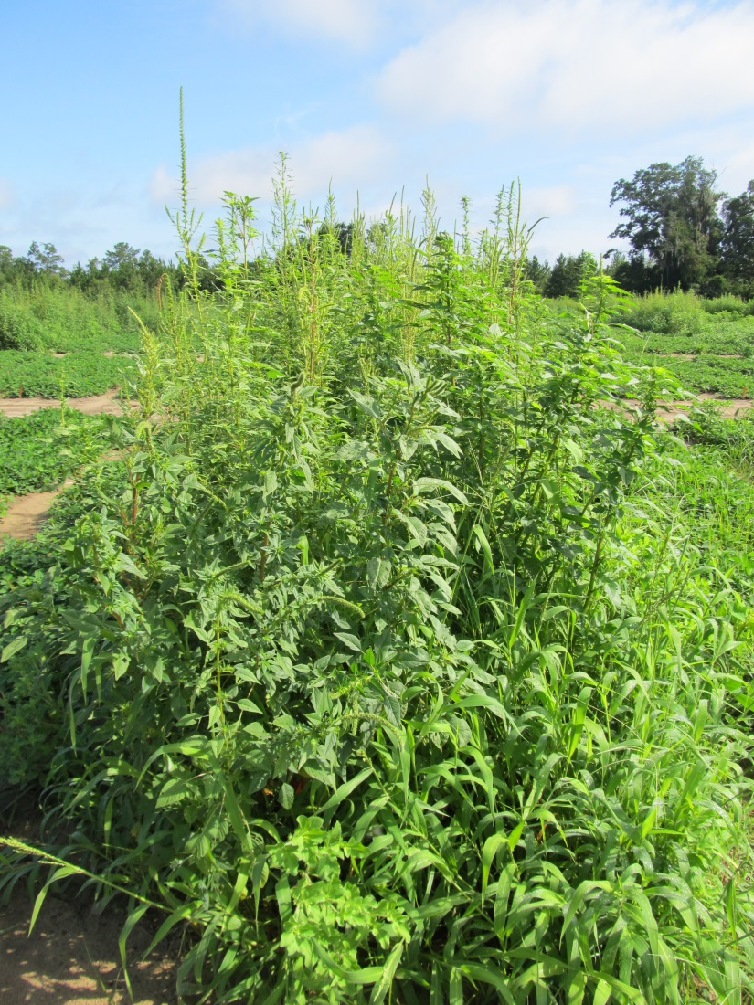
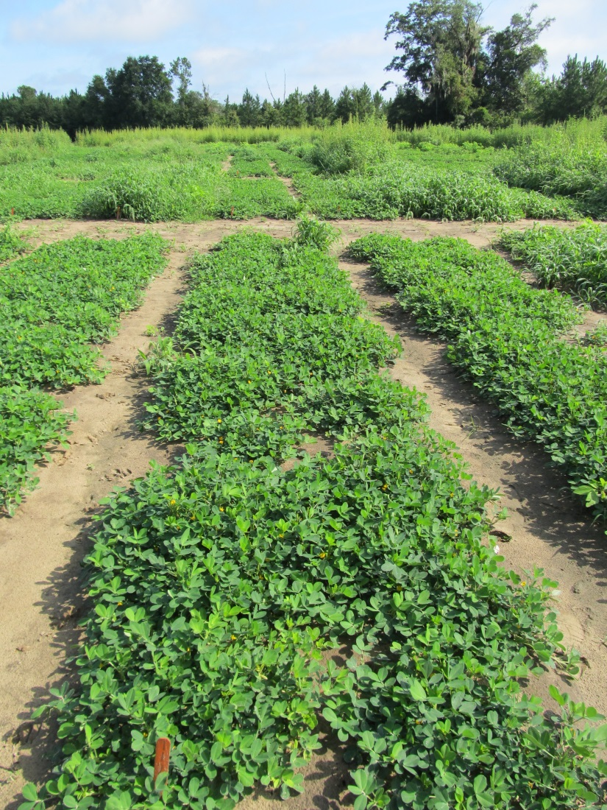
Weed Control in Peanut with Zidua
NTC
ZIDUA 85WG 1.51 OZ/A CRACK
GRAMOXONE SL 2SL 12.0 OZ/A CRACK
STORM 4SL 24.0 OZ/A CRACK
NIS 0.25 % V/V CRACK
CADRE 2AS 4.0 OZ/A EPOST
ZIDUA 85WG 1.01 OZ/A EPOST
NIS 0.25 % V/V EPOST
PE-15-12
July 18
69 DAP

Slide 22
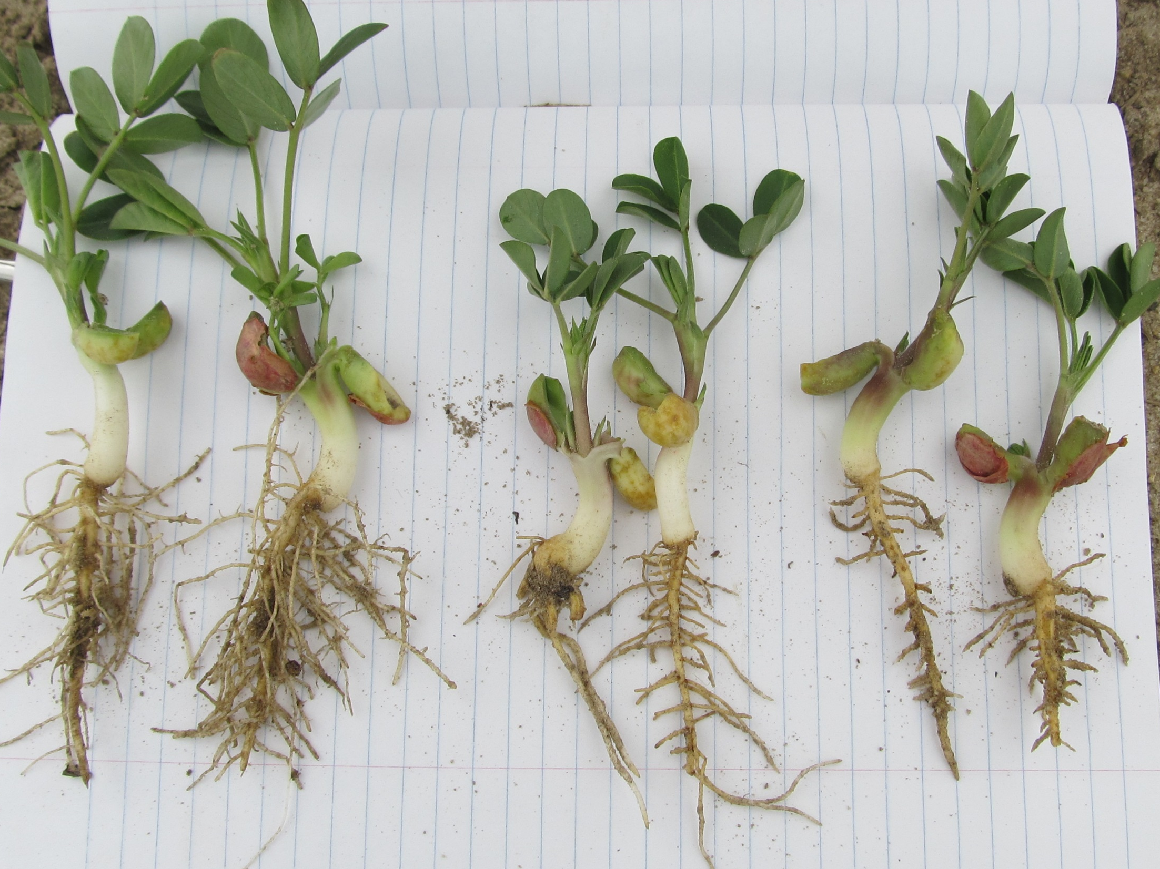
PE-14-13, May 1, 15 DAT
Georgia-06G
Fierce 76WG
3.0 oz/A
Fierce 76WG
6 oz/A
NTC

Slide 23
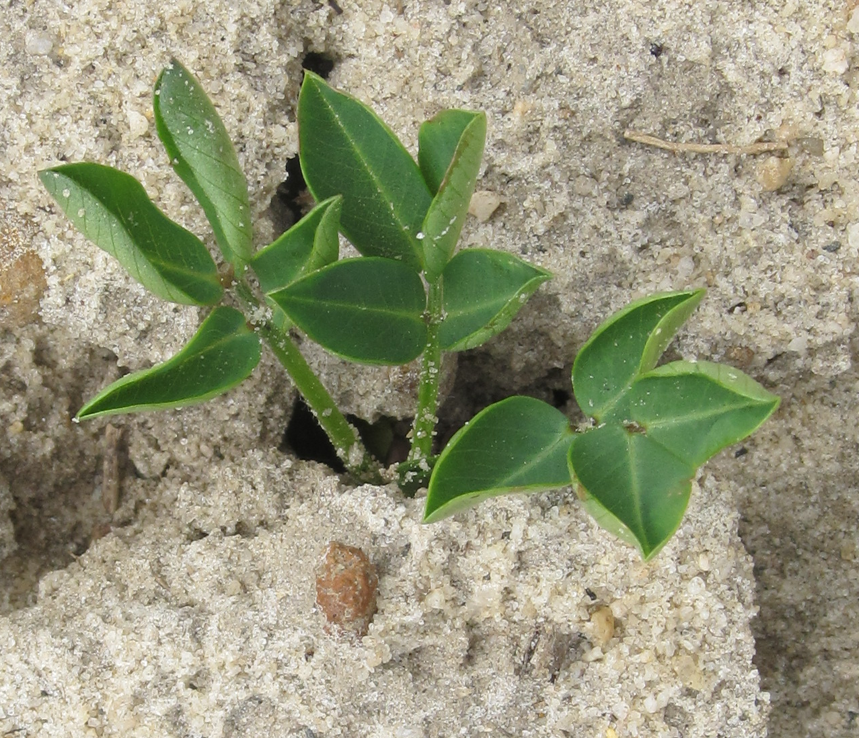
Peanut Leaf Cupping Caused by Pyroxasulfone Applied PRE

Slide 24
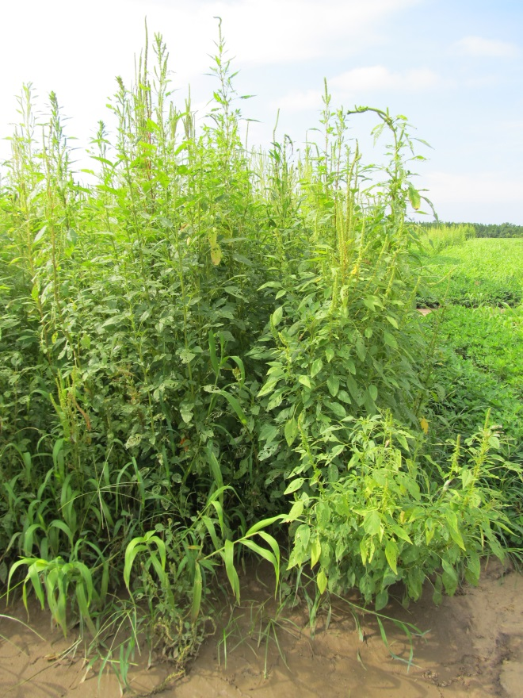
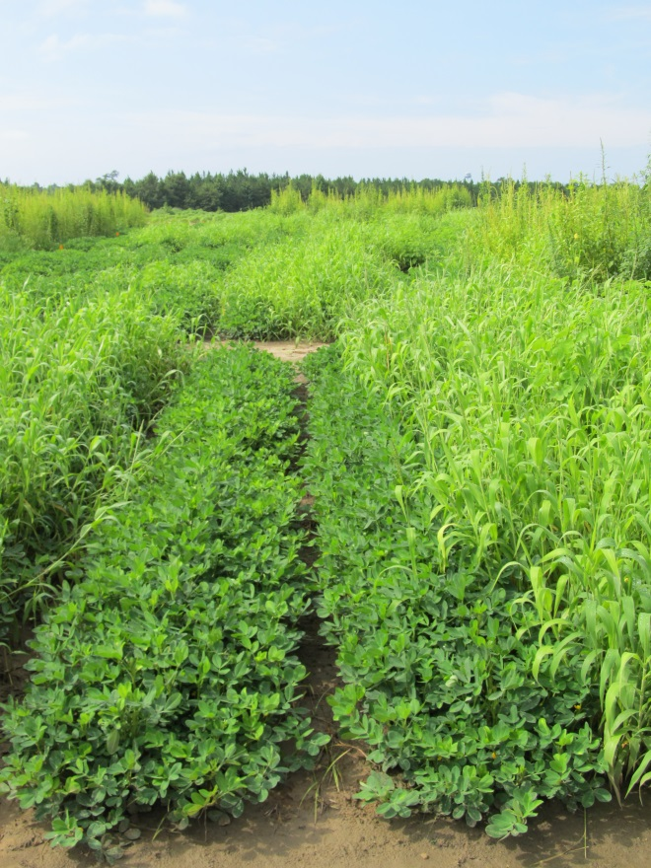
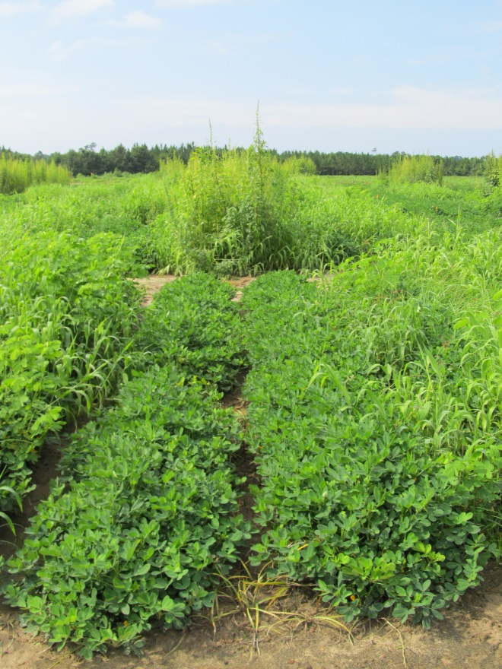

Weed Control in Peanut with
Valor, Dual, Warrant, Cadre - 2013
NTC
Dual Magnum 7.62EC @ 16 oz/A (PRE)
Valor SX 51WG @ 3 oz/A (PRE)
Cadre 2AS @ 4.0 oz/A (POST)
Dual Magnum 7.62EC @ 16 oz/A (POST)
Warrant 3ME @ 48 oz/A (PRE)
Valor SX 51WG @ 3 oz/A (PRE)
Cadre 2 AS @ 4.0 oz/A (POST)
Warrant 3ME @ 48 oz/A(POST)
COC @ 1% v/v (POST)
PE-01B-13
July 25
76 DAP

Slide 25
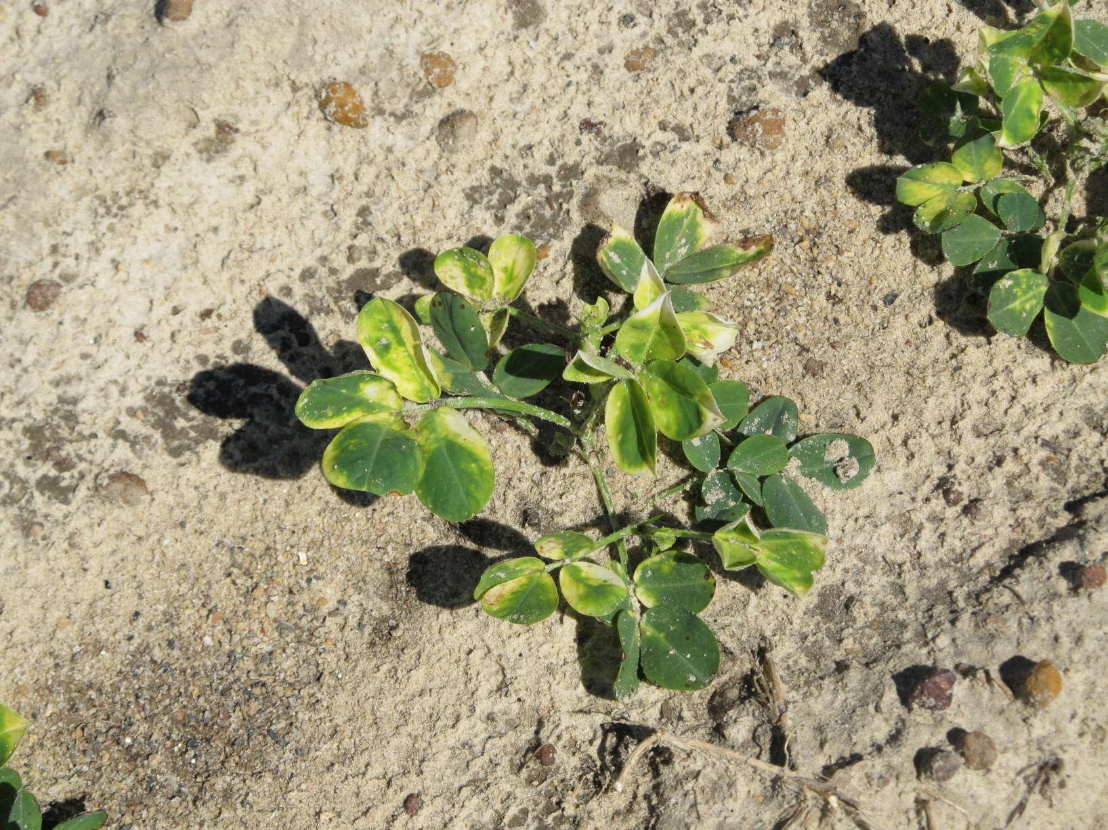
Brake Injury in peanut

Slide 26
Peanut Yield Response to Brake 2SC
Rate/A (ozs) | Peanut Yield (lbs/A)
 | 21 DBP | PRE
0 | 7273 | 6845
9.6 | 7356 | 6956
12.8 | 7531 | 6288
16.0 | 7347 | 7444
19.2 | 6698 | 7071
22.4 | 6560 | 6417
25.6 | 6712 | 6482
28.8 | 6408 | 6629
32.0 | 6293 | 6495
P CV | 0.3448 9.89
PE-10-13
GA-06G

Slide 27
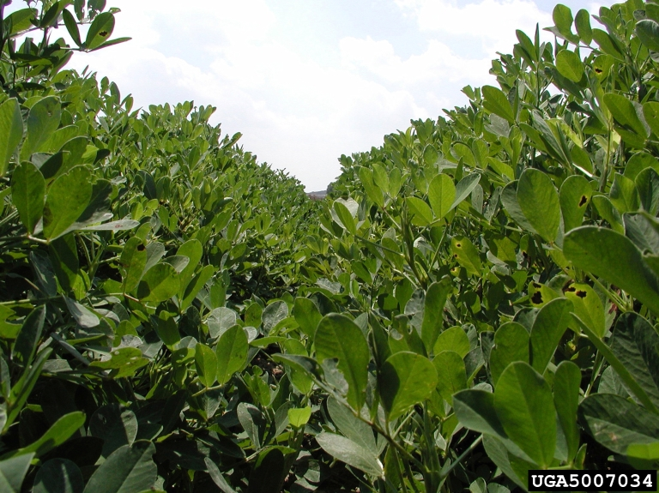

What do the top growers do? 2012 Georgia Peanut Achievement Club Winners
10 growers
6204 lbs/A average yield
10/10- irrigated
8/10 – bottom plow
10/10 – twin rows
Herbicides
9/10 – Sonalan
10/10 – Valor
3/10 – Dual
9/10 – Cadre
2/10 – 2,4-DB
1/10 – Prowl
2/10 - Strongarm

Slide 28
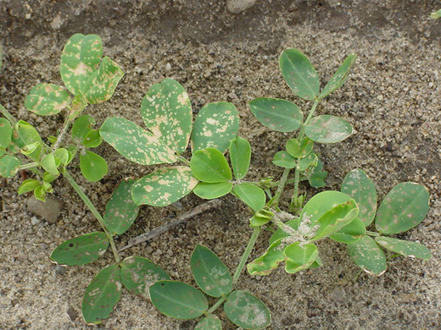

2014 UGA Pest Control Update Peanut
ET added as harvest aid for annual morningglory

Slide 29
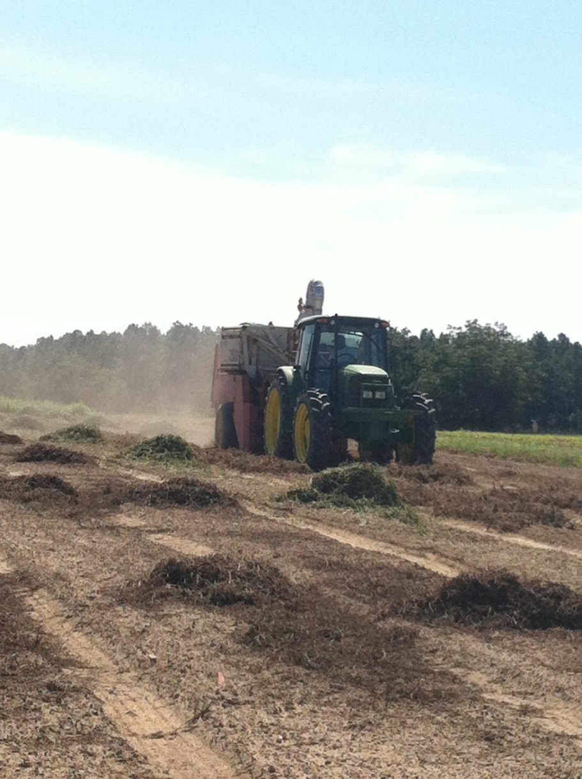
Questions/Comments?
eprostko@uga.edu
229-392-1034 (cell)
www.gaweed.com

