Slide 1
2013
Peanut Weed
Management Update
Eric P. Prostko, Ph.D.
Professor and Extension Weed Specialist
Department of Crop & Soil Sciences

Slide 2
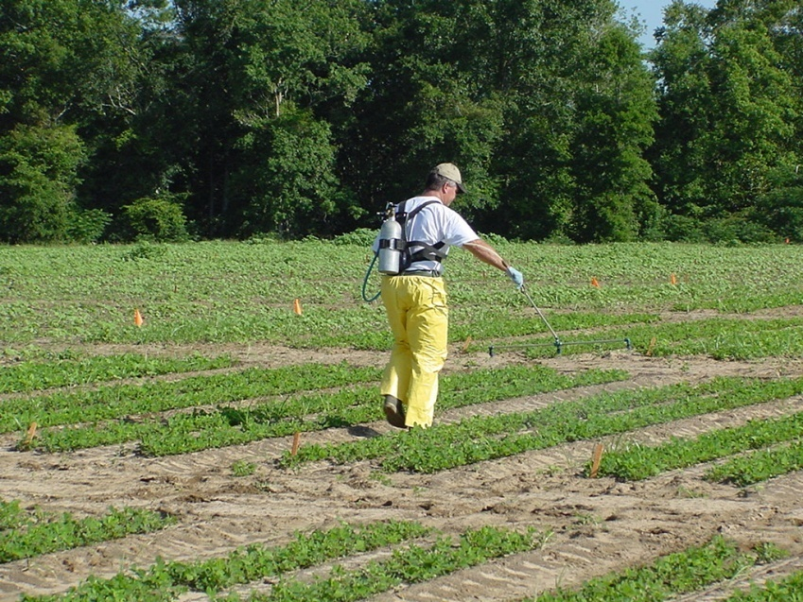
What are we working on?
Palmer Amaranth Control
Variety Tolerance
  Classic (chlorimuron)
  Gramoxone (paraquat)
  Dual Magnum (s-metolachlor)
New Labels????
  Warrant (acetochlor)
  Pyroxasulfone (KIH-485)
    Zidua (BASF),
    Fierce (Valor + Pyrox) (Valent)
Drift/Sprayer Contamination Issues
  glyphosate, dicamba, glufosinate, 2,4-D

Slide 3
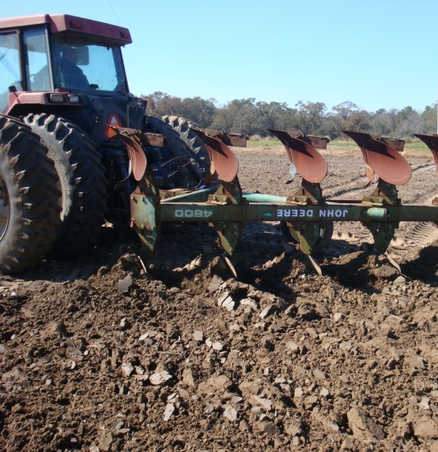
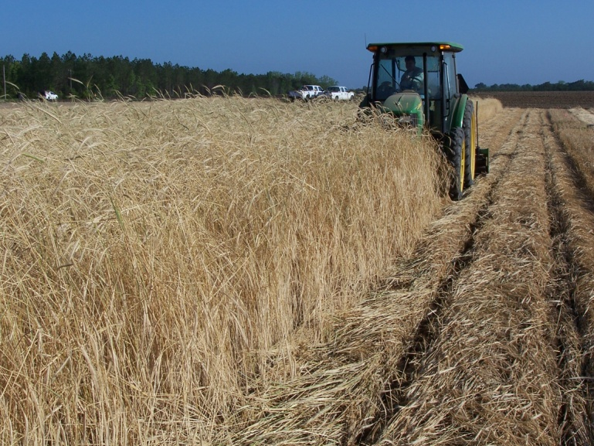
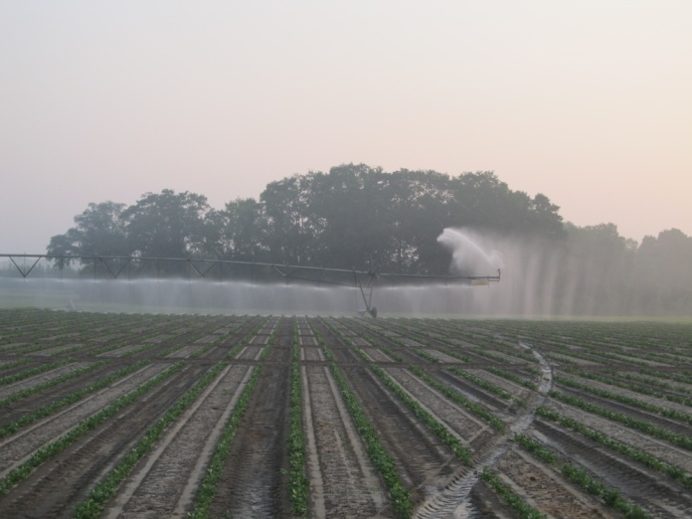
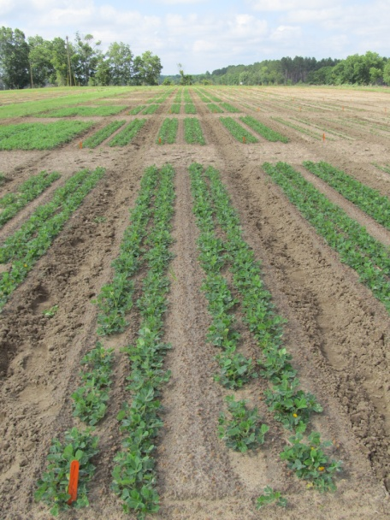
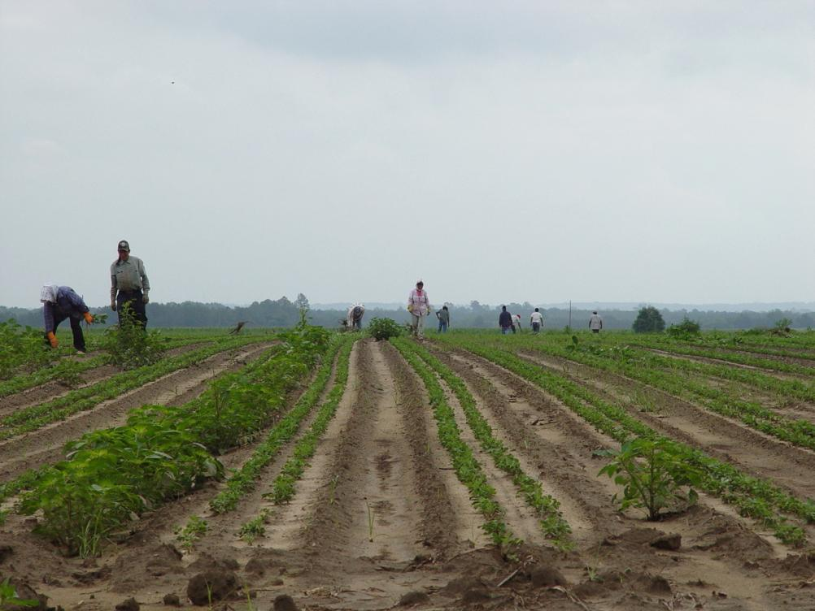
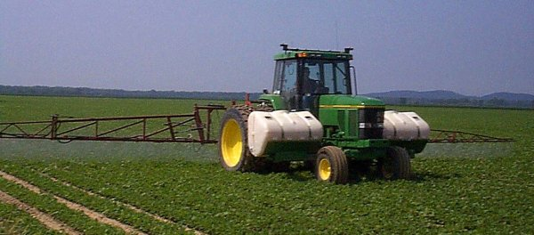
Palmer Amaranth Control
Integrated Program Approach
Tillage
Irrigation
Rye Cover Crop
Twin Rows
Hand-Weeding
Herbicides

Slide 4
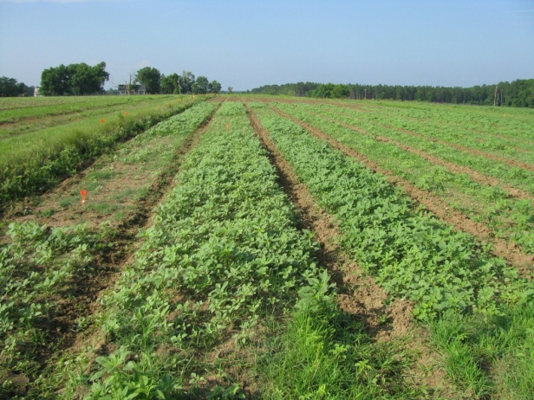
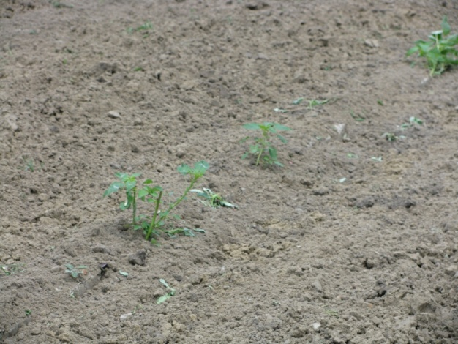
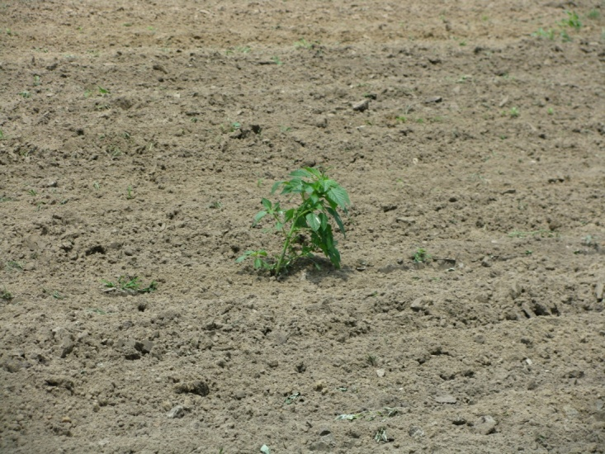
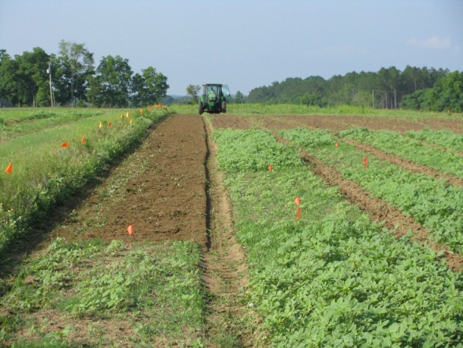
Absolutely, must start clean or you will lose!

Slide 5
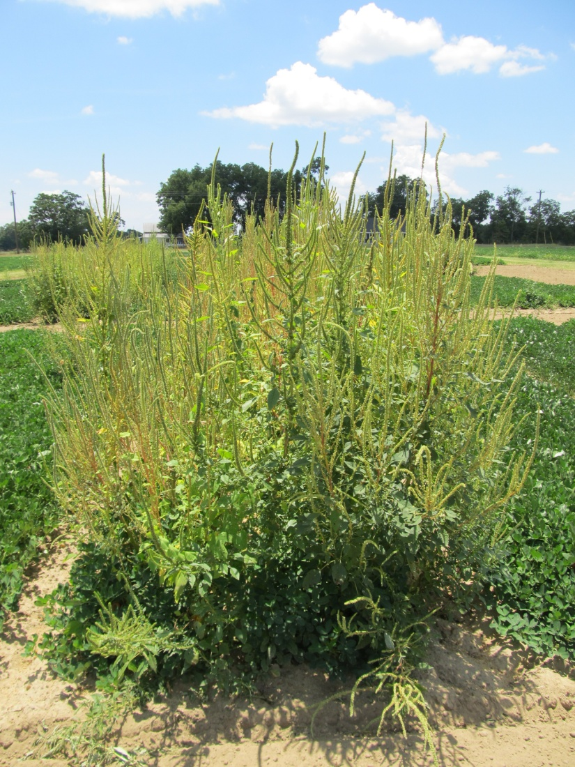
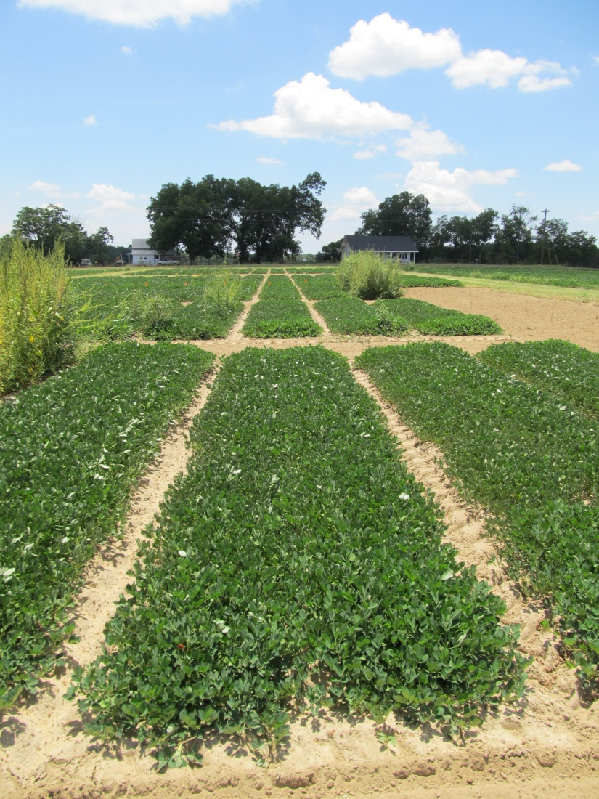
Palmer Amaranth Control in Peanut – 2012
(Valor/Strongarm Based Program)
NTC
Prowl H₂O @ 34 oz/A (PRE)
Valor @ 3 oz/A (PRE)
Strongarm @ 0.23 oz/A (PRE)
Cadre @ 4 oz/A (40 DAP)
COC @ 1% v/v (40 DAP)
PE-04-12
July 18
83 DAP

Slide 6
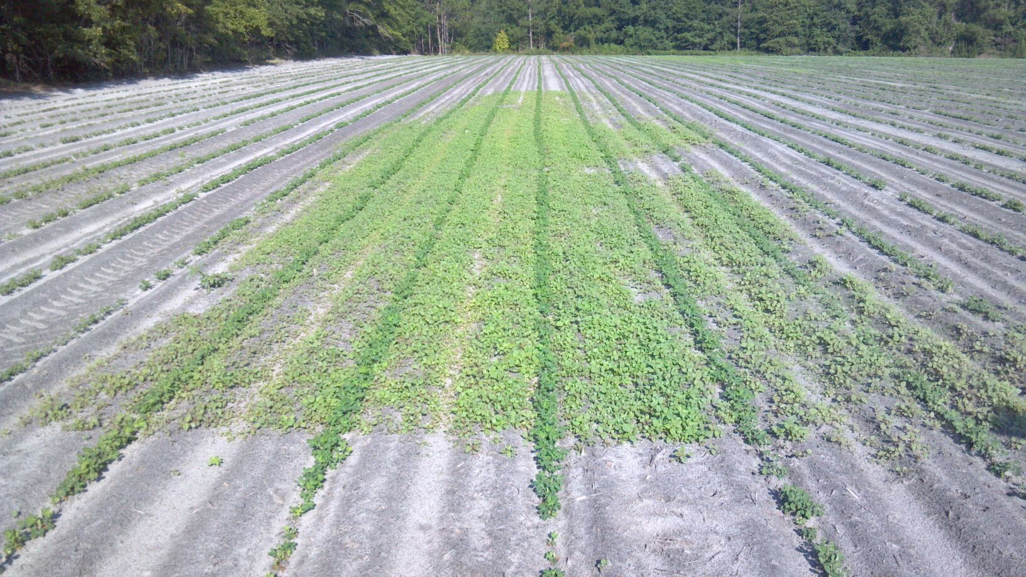
Benefits of Valor
James Jacobs
Pierce Co.
May 24, 2012

Slide 7
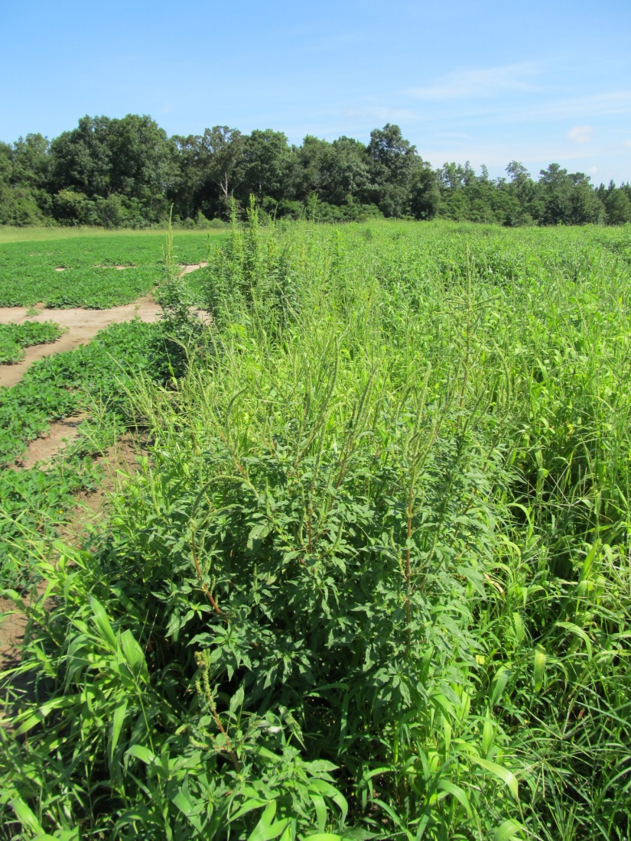
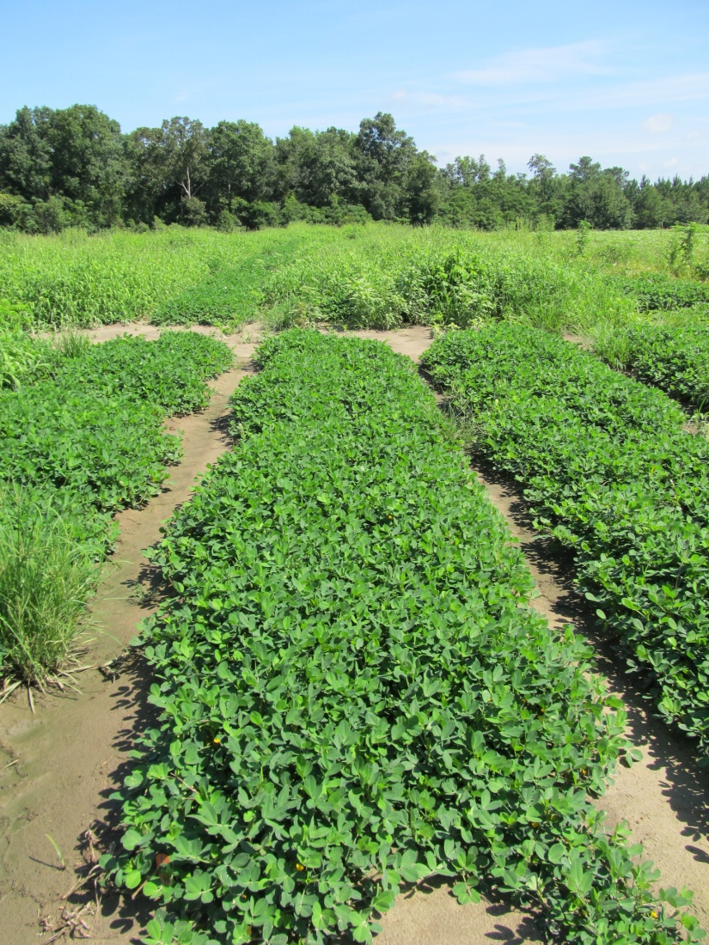
Palmer Amaranth Control in Peanut – 2012
(Dual Magnum Based Program)
NTC
Prowl H₂O @ 34 oz/A (PRE)
Gramoxone SL @ 12 oz/A (21 DAP)
Storm @ 16 oz/A (21 DAP)
Dual Magnum @ 16 oz/A (21 DAP)
Cadre @ 4 oz/A (39 DAP)
Dual Magnum @ 16 oz/A (39 DAP)
PE-18-12
July 18
75 DAP

Slide 8
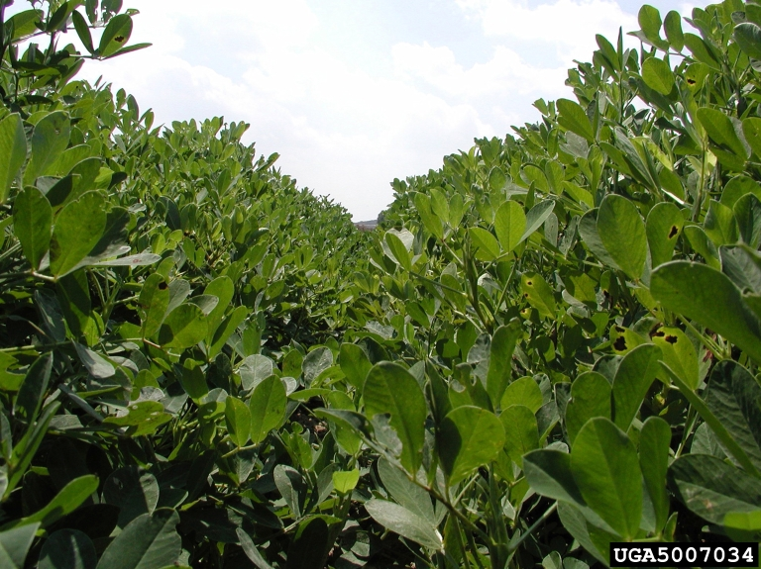

What do the top growers do?
2011 Georgia Peanut Achievement Club Winners
10 growers
6202 lbs/A average yield
10/10- irrigated
7/10 – bottom plow
9/10 – twin rows
Herbicides
  8/10 – Sonalan
  9/10 – Valor
  3/10 – Dual
  8/10 – Cadre
  6/10 – 2,4-DB
  3/10 – Gramoxone
  2/10 – Prowl
  2/10 - Strongarm

Slide 9
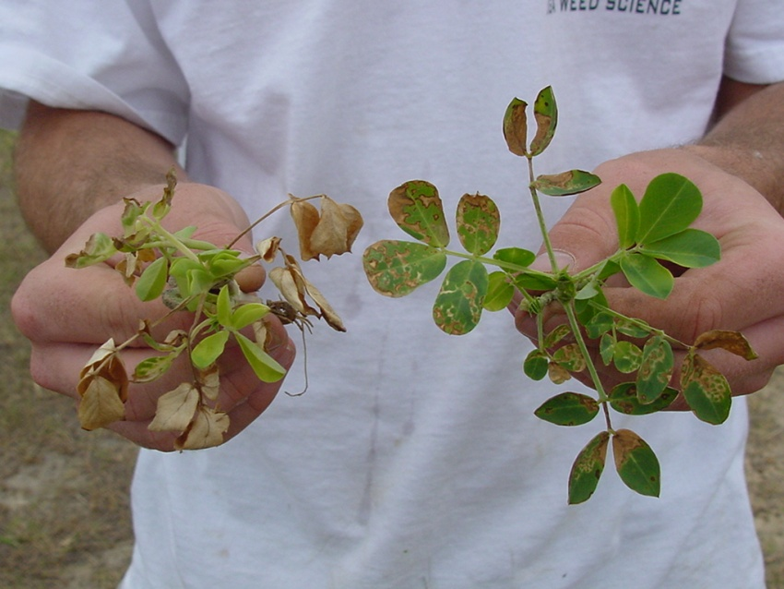


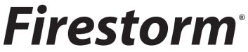
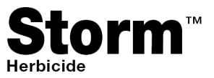
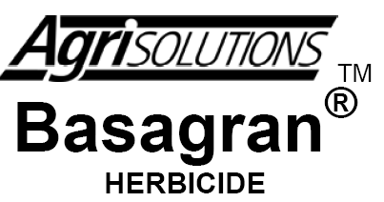
Paraquat Injury
Weed-free trials conducted in 2010-2012
10/10 comparisons (100%)
  no negative yield effects
  Gramoxone (+/-) Storm or Basagran
Gramoxone +
Basagran
Gramoxone

Slide 10


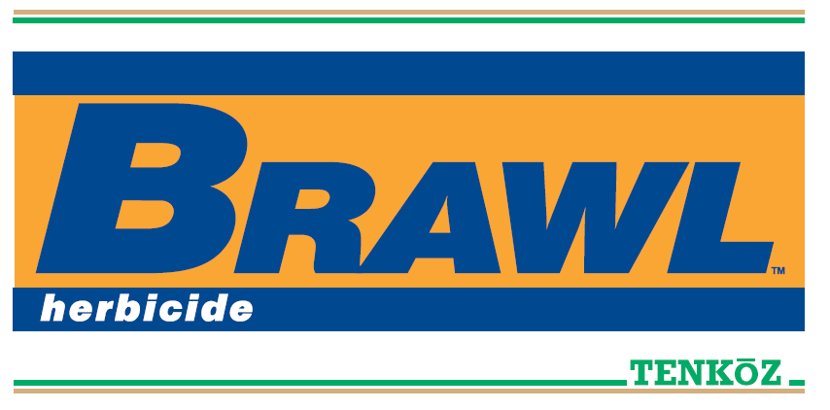
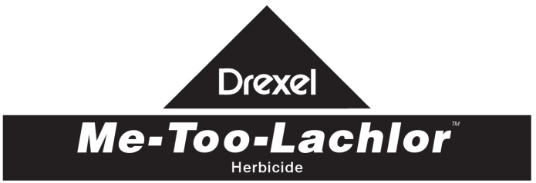
What about Dual Magnum?
Weed-free trials conducted in 2010-2012
32/33 comparisons (97%)
  no negative yield effects
  PPI, PRE, EPOST, POST, Cadre + Dual

Slide 11
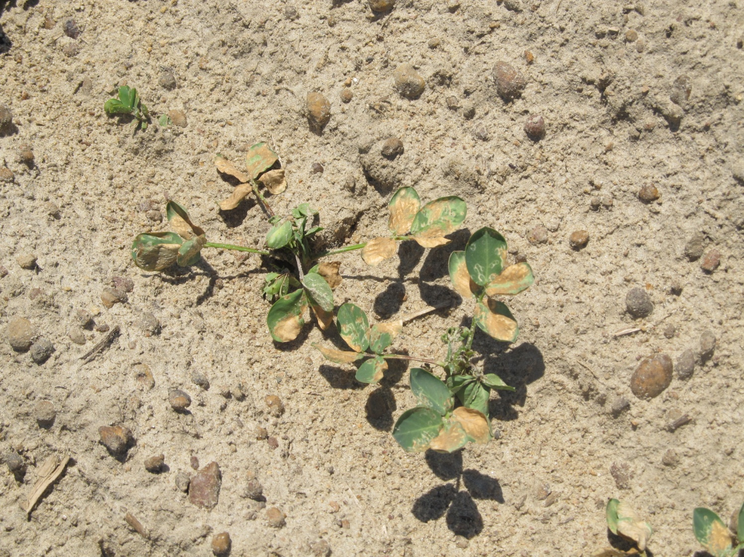
What about Gramoxone + Storm + Dual Magnum?
4-6% yield loss in weed-free conditions
2 DAT

Slide 12
A Comparison of Weed-Free Peanut Yields Between NTC and Gramoxone (12 oz/A) + Storm (16 oz/A) + Dual Magnum (16-21 oz/A) Treatments in Georgia, 2011-2012.
G + S + DM
(lbs/A)
PEA01-11
PEA01-12
PE-20-11
PE-01-12
PE-17-12
NTC (lbs/A)
n = 25

Slide 13
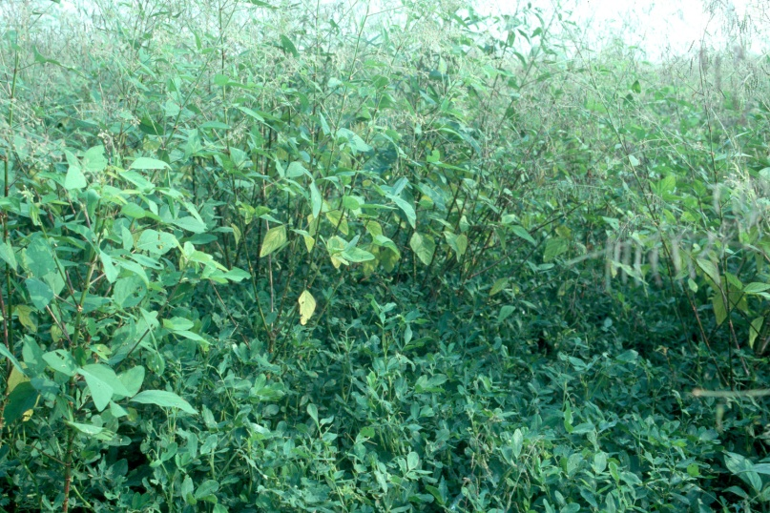

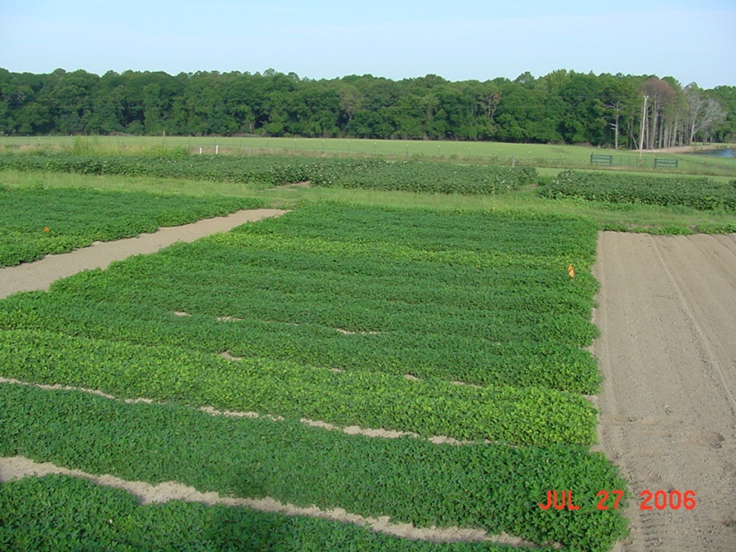
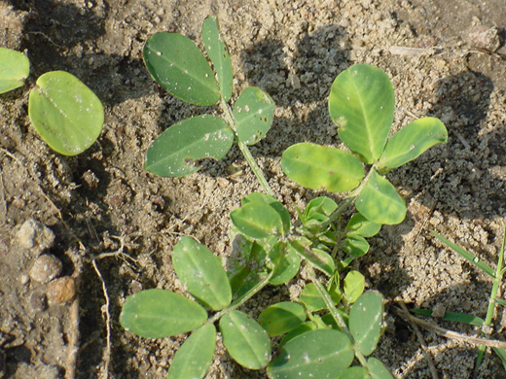
FL-07, GA Greener, GA-07W = No problems
GA-06G and Tifguard = 7-11% yield losses

Slide 14
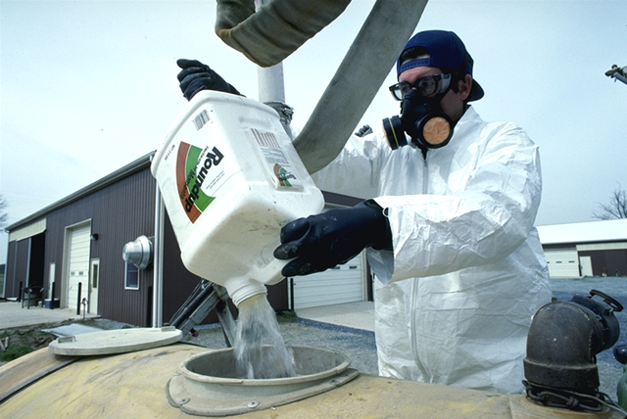
Tank-Mixes

Slide 15
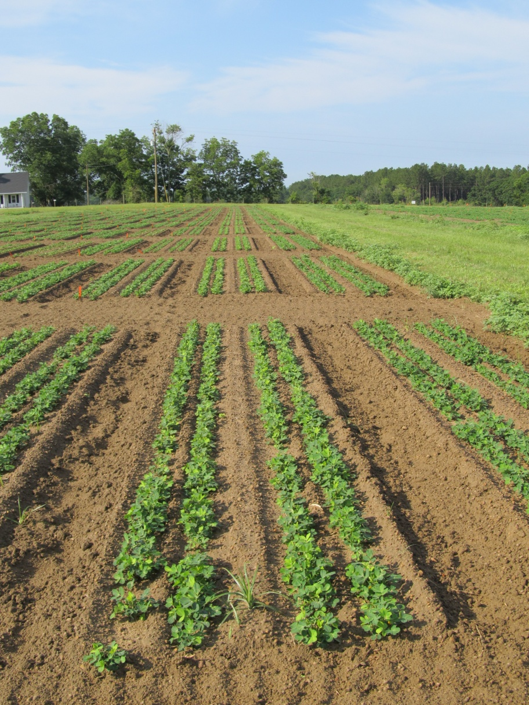
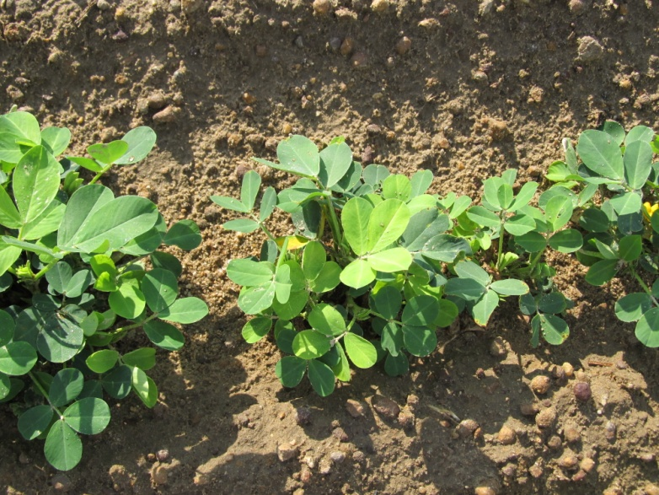
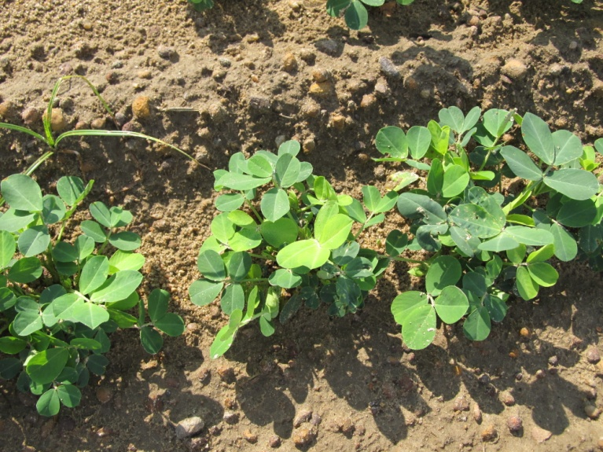
Cadre @ 4 oz/A + Dimilin @ 4 oz/A + Bravo WS @ 24 oz/A + NIS @ 0.25% v/v – 5 DAT

Slide 16
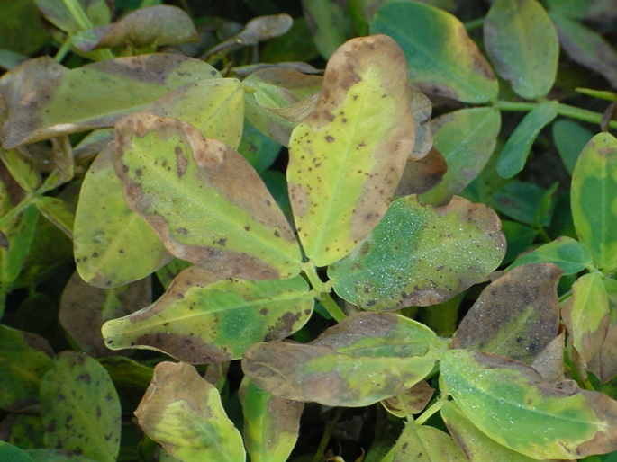
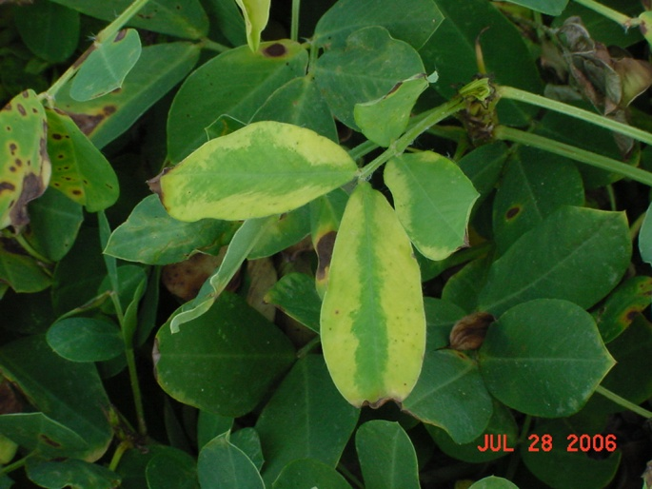
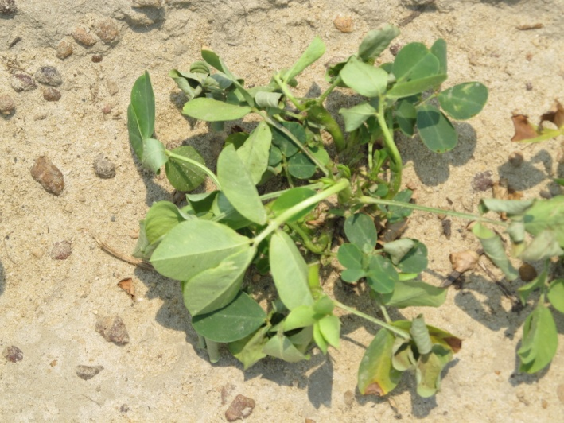
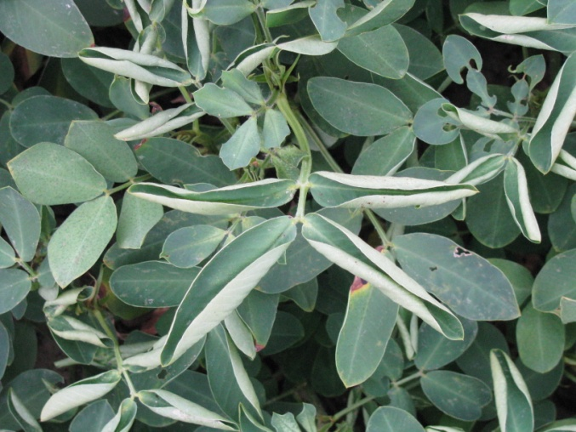
What happens to peanut yield when drift or sprayer contamination occurs?
glufosinate
glyphosate
2,4-D
dicamba

Slide 17
Estimated peanut yield loss (%) caused by glyphosate applied at 75-105 days after planting.
Glyphosate Rate (oz/A) (4.0 lb ai/gal) | Glyphosate Rate (oz/A) (5.5 lb ai/gal) | Peanut Yield Loss (%)
2.8 | 2.0 | 0
5.5 | 4.0 | 5
8.3 | 6.0 | 12
11.0 | 8.0 | 24
16.5 | 12.0 | 36
22.0 | 16.0 | 48
24.0 | 17.5 | 53
32.0 | 23.2 | 70

Slide 18
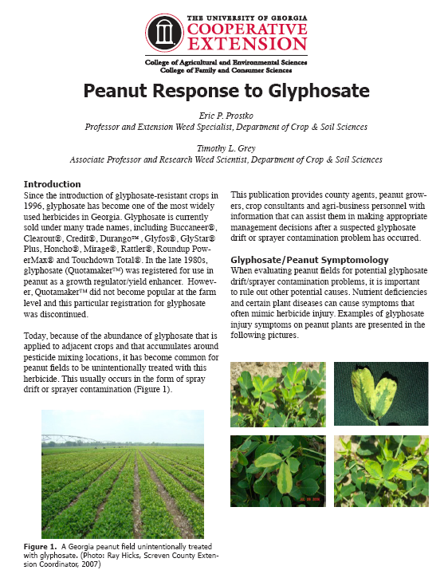
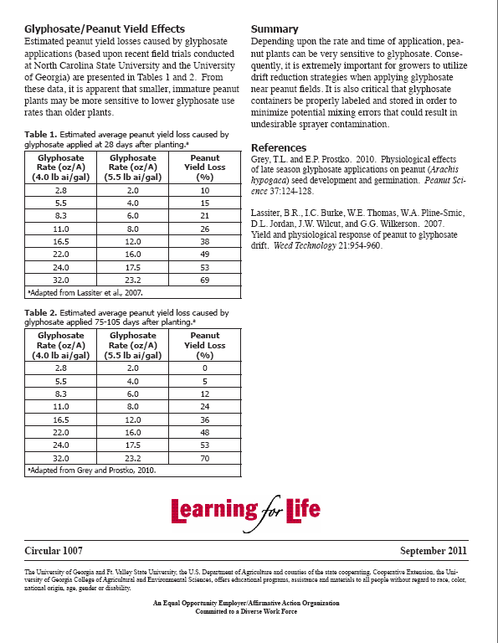
Publication
“Peanut Response to Glyphosate”
UGA Circular 1007
September 2011
http://www.caes.uga.edu/applications/publications/files/pdf/C%201007_1.PDF

Slide 19
Estimated Peanut Yield Losses (%) caused by dicamba (Clarity 4SL).**
Rate oz/A (4 lb ai/gal) | Time of Application
 | 30 DAP | 60 DAP | 90 DAP
1 | 12 | 16 | 4
2 | 16 | 20 | 8
4 | 24 | 30 | 14
8 | 39 | 49 | 27
16 | 70 | 86 | 54
32 | 100 | 100 | 100
**2 site-years in Georgia

Slide 20
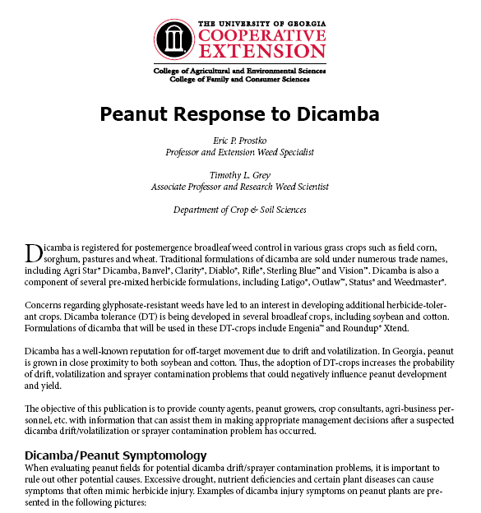
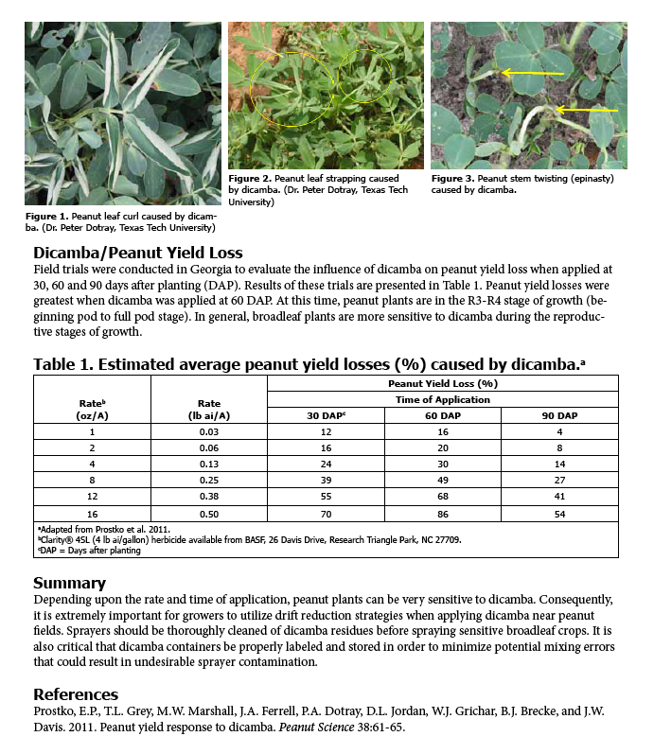
New Publication
“Peanut Response to Dicamba”
UGA Circular 1015, April 2012
http://www.caes.uga.edu/applications/publications/files/pdf/C%201015_1.PDF

Slide 21
Estimated Peanut Yields Losses (%) caused by glufosinate (Liberty 2.34SL)**
Rate/A (ozs) | Time (DAP)
 | 30 | 60 | 90
2 | 7 | 13 | 13
4 | 13 | 17 | 17
8 | 26 | 26 | 26
16 | 51 | 44 | 42
32 | 100 | 80 | 76
**GA-06G, 4 site years in Georgia (Ponder + Plains)

Slide 22
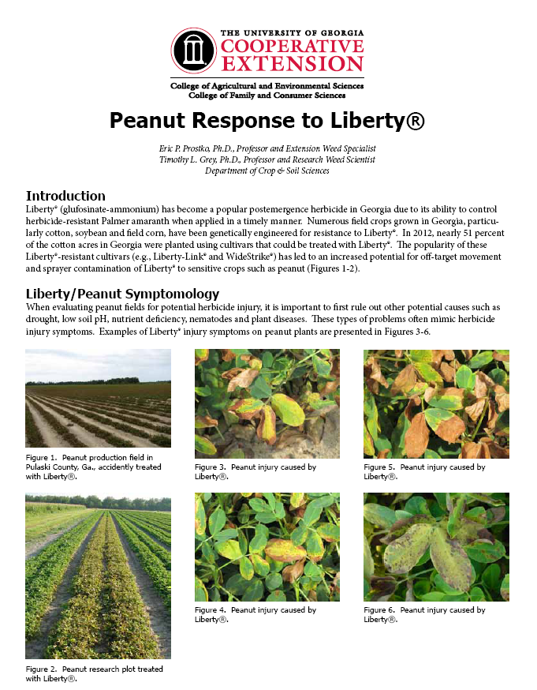
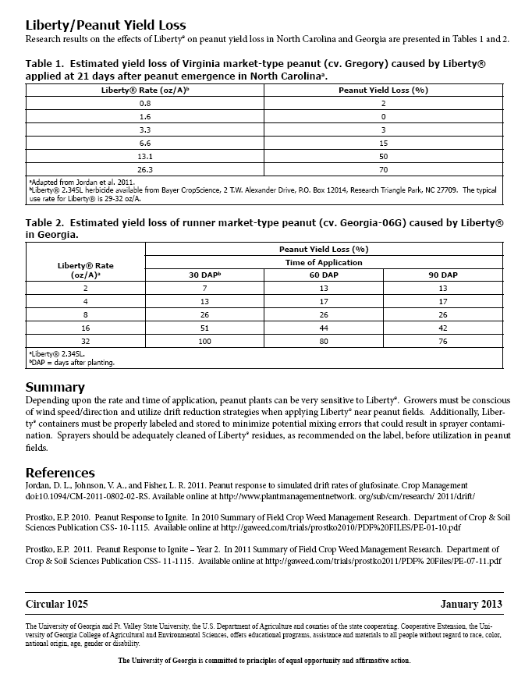
New Publication
“Peanut Response to Liberty”
UGA Circular 1025, January 2013
http://www.caes.uga.edu/Publications/pubDetail.cfm?pk_id=8022

Slide 23
Estimated Peanut Yield Loss (%) Caused by 2,4-D amine 3.8SL**
Rate/A (ozs/A) | Time of Application (DAP)
 | 30 | 60 | 90
2 | 3 | 6 | 5
4 | 5 | 8 | 5
8 | 8 | 11 | 7
16 | 15 | 18 | 10
32 | 27 | 31 | 15
**Pooled over 4 site-years in Georgia (Ty Ty, Attapulgus)

Slide 24



Potential New Peanut Labels?????
May or May Not Happen
(Valor + Zidua)
(pyroxasulfone)

Slide 25


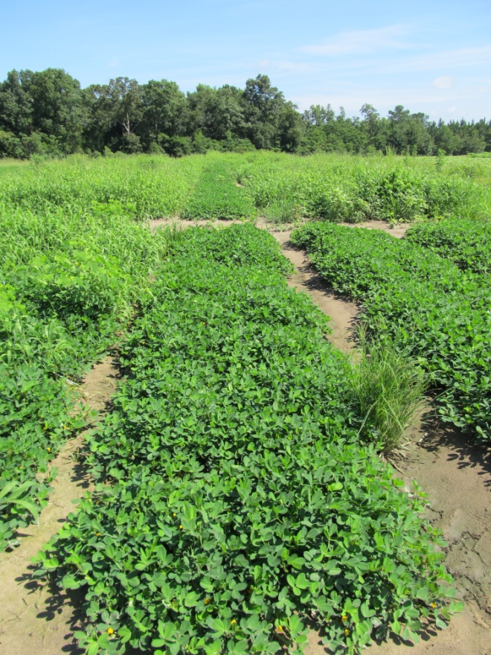
Dual Magnum vs. Warrant
Peanut Weed Control Programs– 2012
NTC
Prowl H₂O @ 34 oz/A (PRE)
Gramoxone SL @ 12 oz/A (21 DAP)
Storm @ 16 oz/A (21 DAP)
Dual Magnum @ 16 oz/A (21 DAP)
Cadre @ 4 oz/A (39 DAP)
Dual Magnum @ 16 oz/A (39 DAP)
Prowl H₂O @ 34 oz/A (PRE)
Gramoxone SL @ 12 oz/A (21 DAP)
Storm @ 16 oz/A (21 DAP)
Warrant @ 48 oz/A (21 DAP)
NIS @ 0.25% v/v (21 DAP)
Cadre @ 4 oz/A (39 DAP)
Warrant @ 48 oz/A (39 DAP)
NIS @ 0.25% v/v (39 DAP)
PE-18-12
July 18
75 DAP

Slide 26
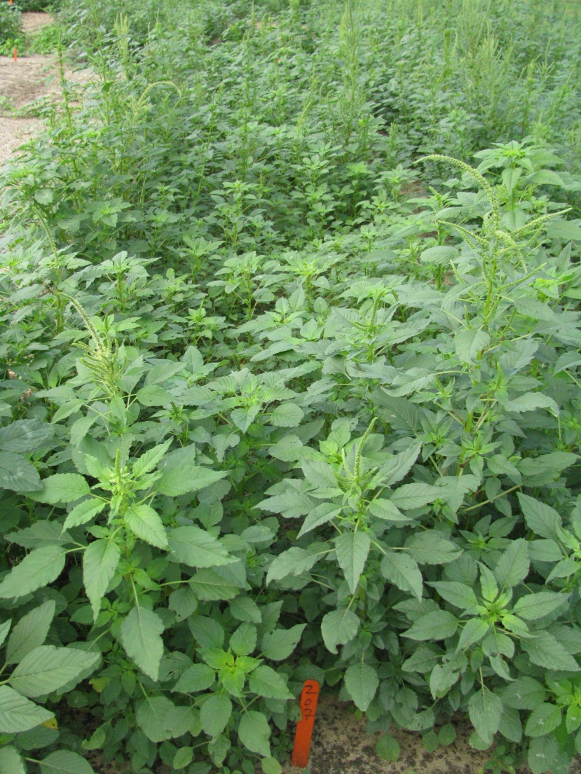
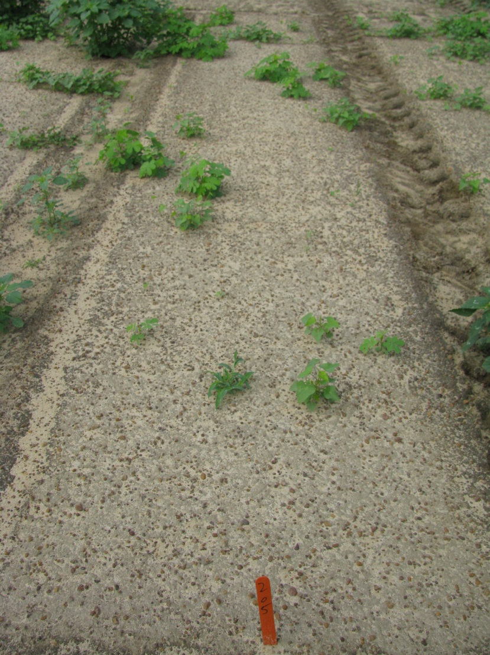

Weed Control with Zidua – 5 WAT
NTC
Zidua 85 WG
@ 1.5 oz/A*
NC-05-11
Notes:
Pyroxasulfone does exhibit excellent residual control of troublesome weeds such as Palmer amaranth, Texas panicum, and large crabgrass.
Texas panicum control is rate dependent.

Slide 27
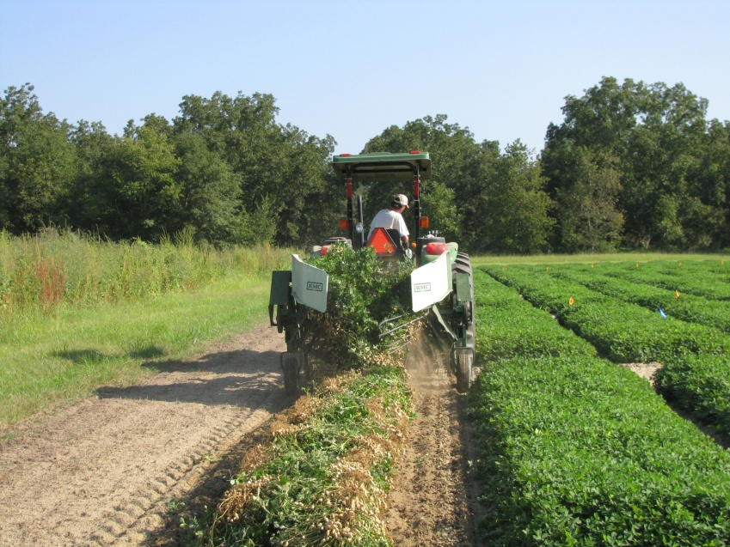
Final Thoughts
Next 2-5 years
  Warrant
  Maybe Zidua???
After that?????
Desperately need a new MOA!!!!!
  ↑Selection pressure
    Valor, Reflex
    Dual, Warrant
2,4-D and dicamba resistant cotton?

Slide 28

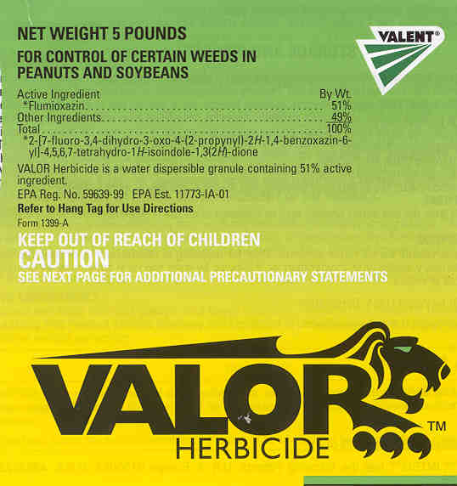

Popular Herbicides That We Must Protect From Resistance

Slide 29
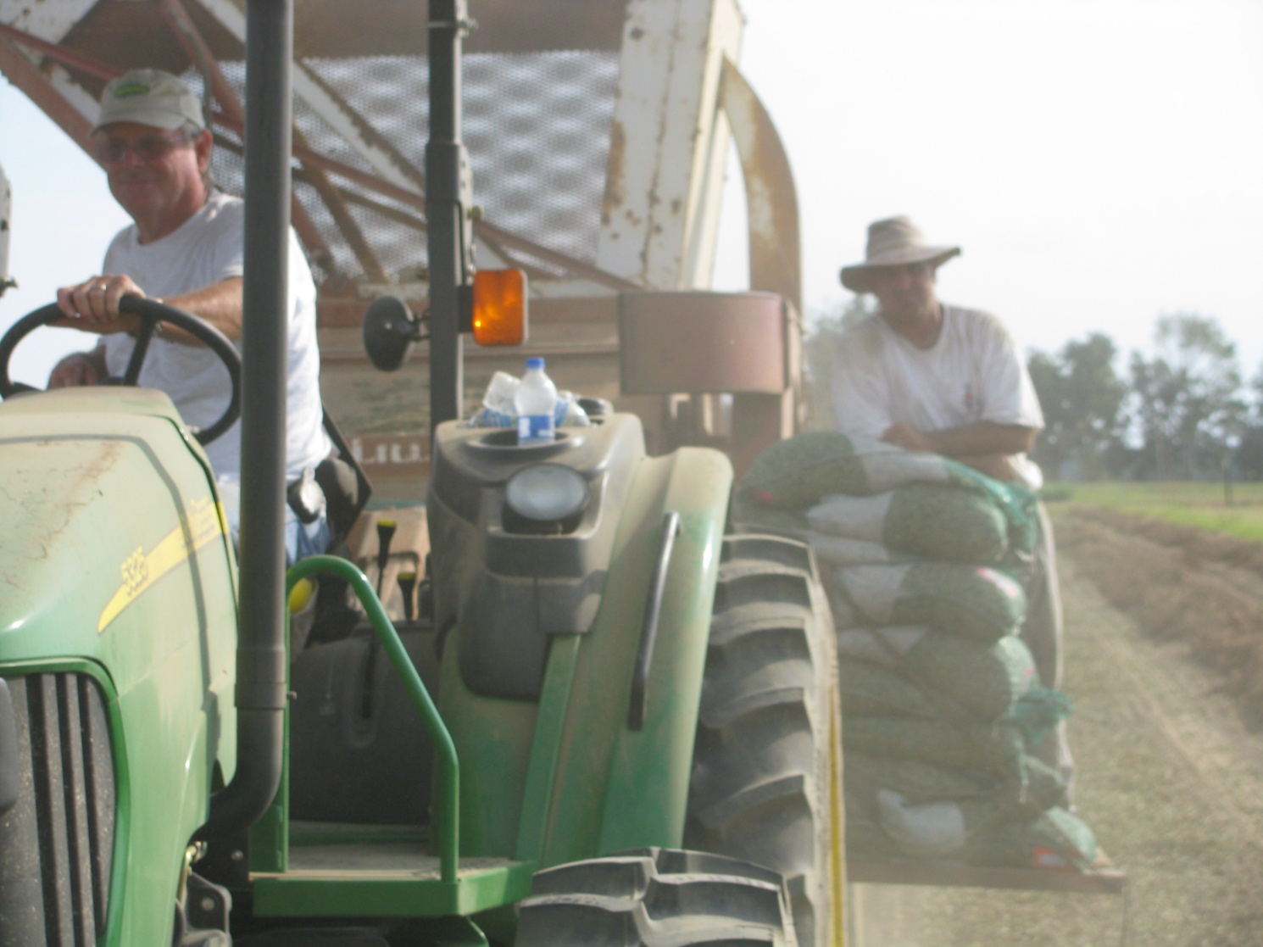
Questions?
www.gaweed.com

